Slide 1
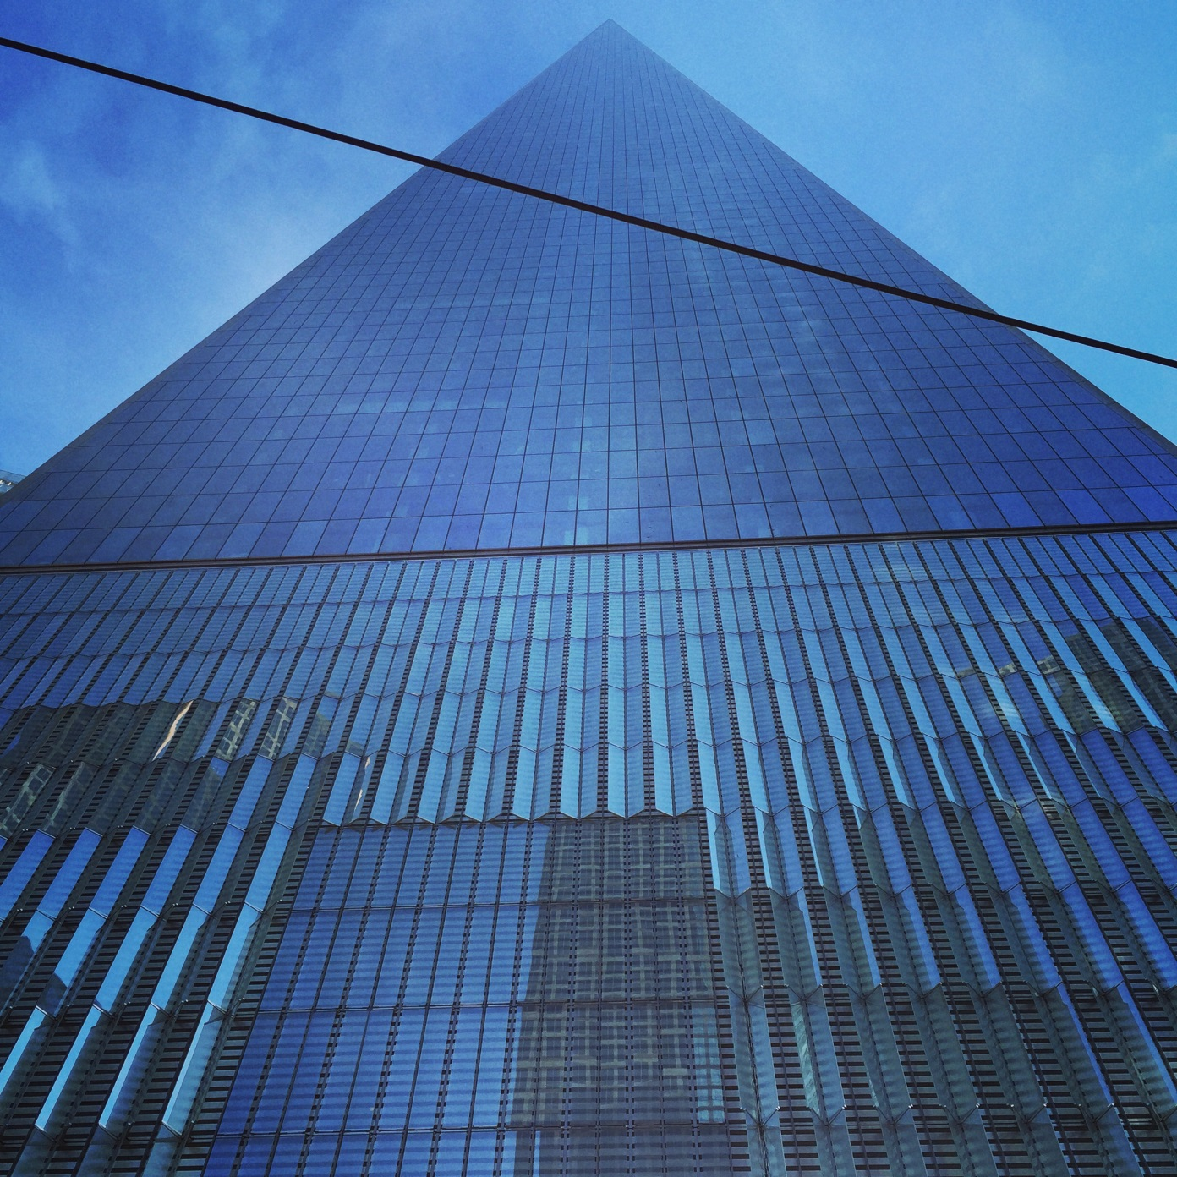
Chapter 6
A Resource-Rich Nation

Slide 6
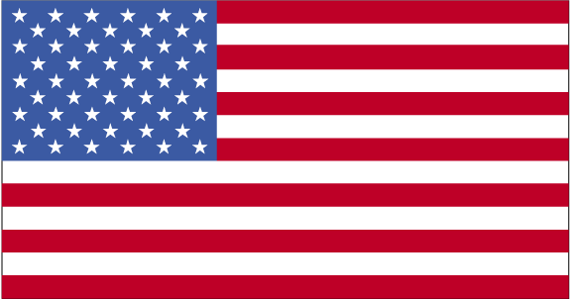
Introduction to United States
The United States is HUUUUUUUUGE.
4th largest country in area, 3rd most populous.
Wealthy nation.
Abundance of natural resources
Innovations in transportation
Innovations in communication
Respect for individual freedoms.
Gross National Product (GNP) highest in world.

Slide 7
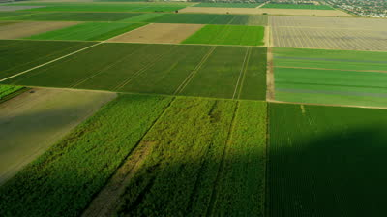
Abundance of Natural Resources
Land (one of the most abundant natural resources in the US).
After US was established, people could gain parcels of land from the government by promising to live on the land for at least five (5) years.
1790, 1st census established that 3/4^{ths} of the nation’s people lived on a farm.

Slide 8
Continued…
1862, Homestead Act encouraged inhabiting the Great Plains for agricultural purposes.
Act granted 160 acres of land to settlers who agreed to farm.
1862, Department of Agriculture developed to promote farming.

Slide 9
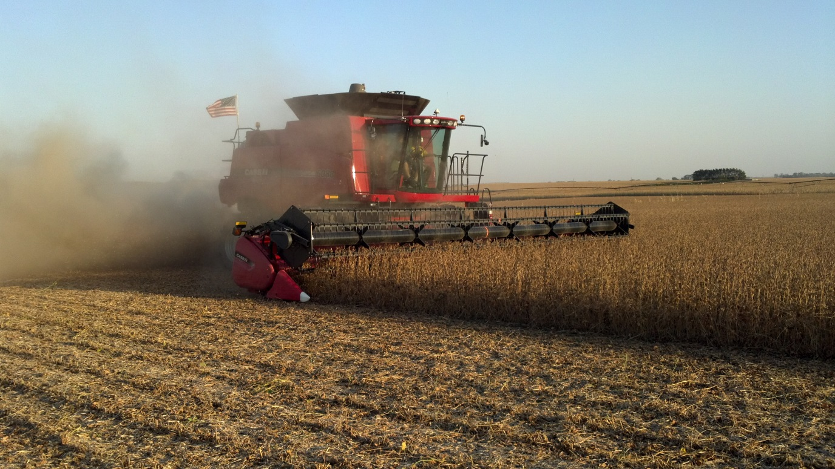
Continued…
Today, fewer than 1/4th of Americans live in rural areas.
Still, farming exports bring in about $50 billion annually.
Almost half the US is used for raising crops or animals.
90% of Nebraska is used for farming.

Slide 10
Continued…
Forests are another of the US’s rich resources.
Provide material for housing, furniture, paper, rayon, photographic film, artificial sponges, charcoal, methanol, medicinal chemicals, maple sugar and even plastics.
US lumber industry began in colonial New England.
Sawed timber for barrel staves and board lumber.
Harvested trees to make ships’ masts, etc.

Slide 11
Forests
Forests are a renewable resource.
Grazing laws
Harvesting regulations
Better logging practices
Reforestation programs
Thousands of acres have been set aside as national parks.
*** However, only 5% of the nation’s virgin forest remains.

Slide 12
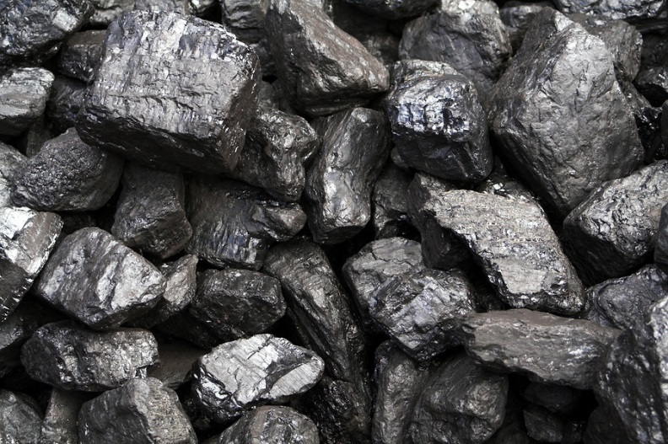
Finding Wealth Underground
Abundance of mineral resources.
Coal = one of the most abundant minerals in US.
Solid fossil fuel that is used as a source of energy for industry, transportation and homes.
USA produces 1/5 of world’s coal supply.
Oil and Natural Gas are also found in US.
Lie beneath central and western plains, and Alaska.
Americans concerned with management of oil, gas and coal.

Slide 13
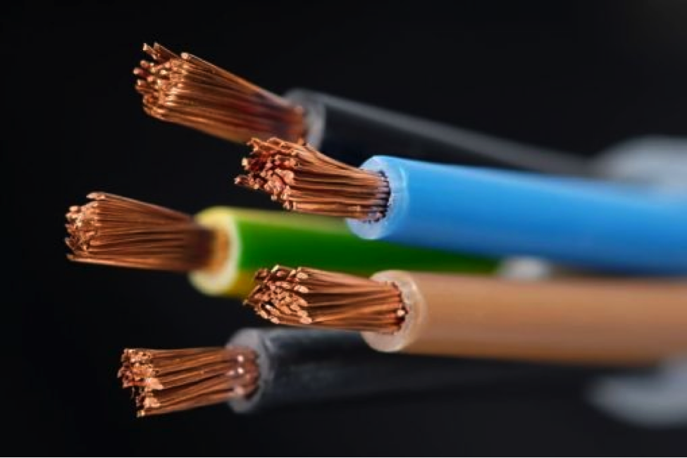
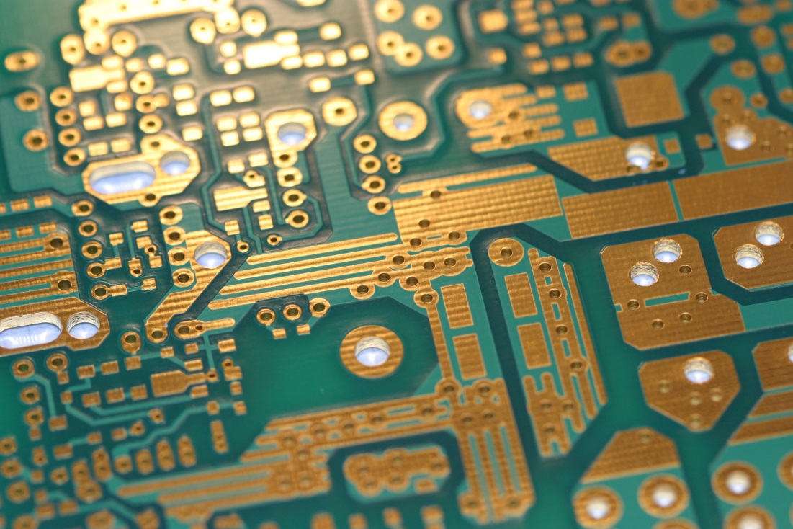
Continued…
U.S. also produces significant amounts of copper, gold, lead, titanium, uranium, zinc and other non-fuel minerals.
Important for trade but also development of industry.
Ex. Copper, used in building construction, electrical and electronic equipment, transportation, and consumer products.

Slide 14
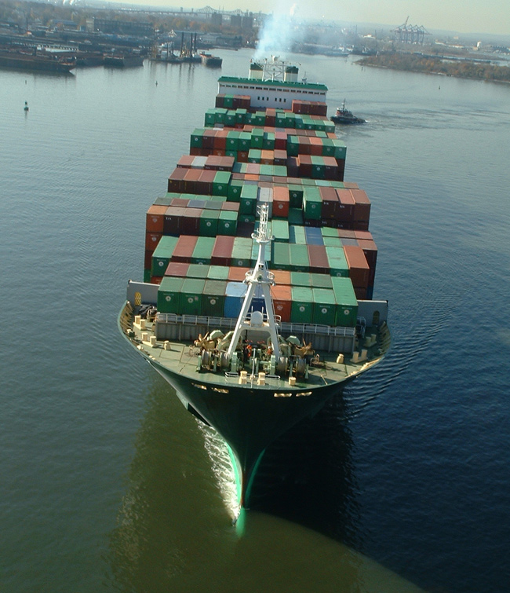
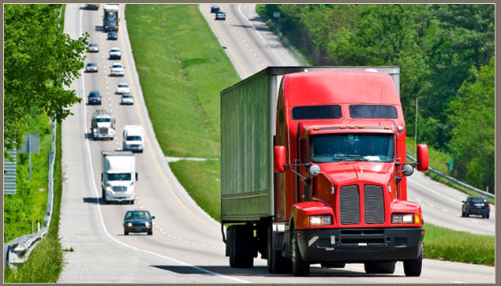
Moving Resources, Goods and People
US would not have turned its resources into wealth without the development of new technologies for transportation.
Travel by land and water.

Slide 15
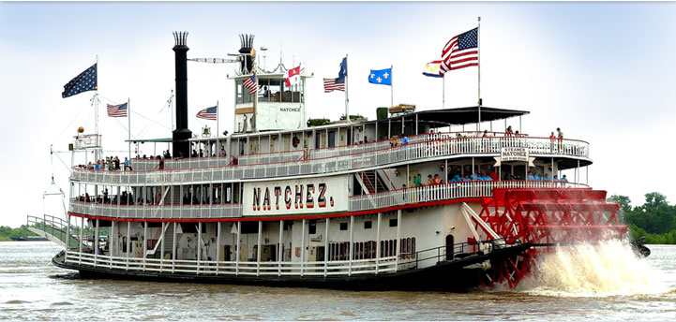
Travel Over Water
1800s, transportation was faster on water than land.
A boat could take 6 weeks to float down the Mississippi and 4 months to make a return trip.
Steam engines changed all of that.
Steam provided boats with power to travel against both wind and current.
Steamboats turned the Great Lakes into important transportation routes.

Slide 16
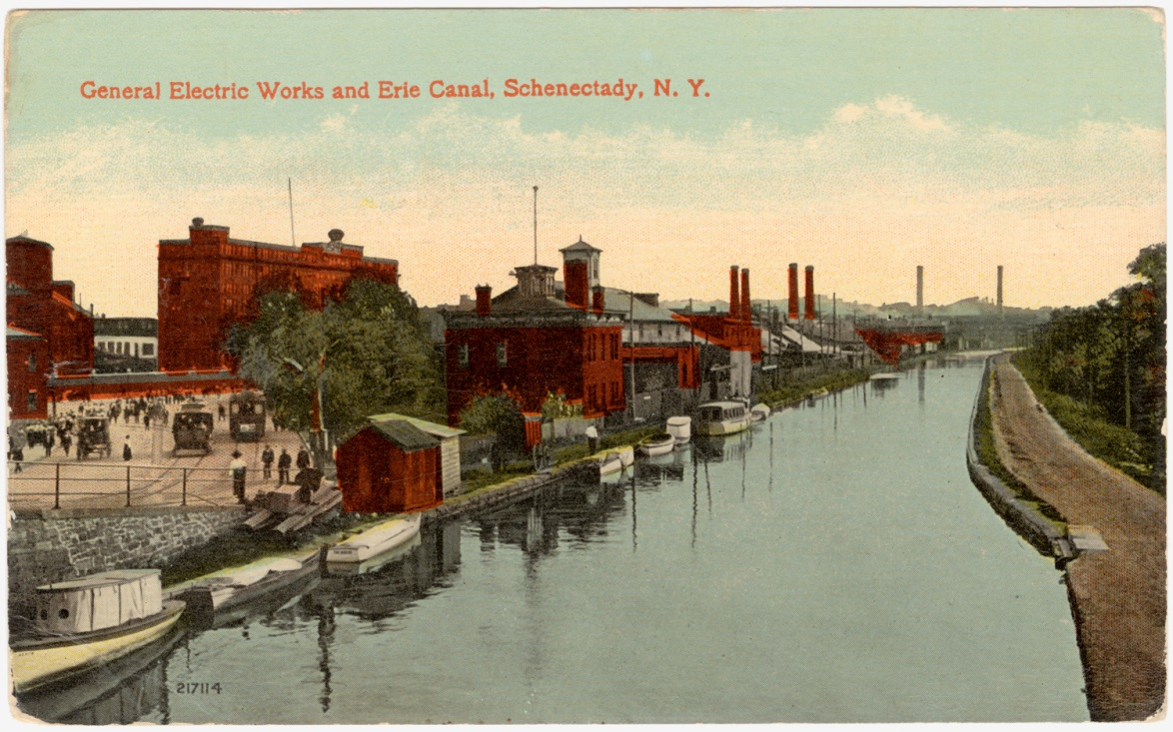
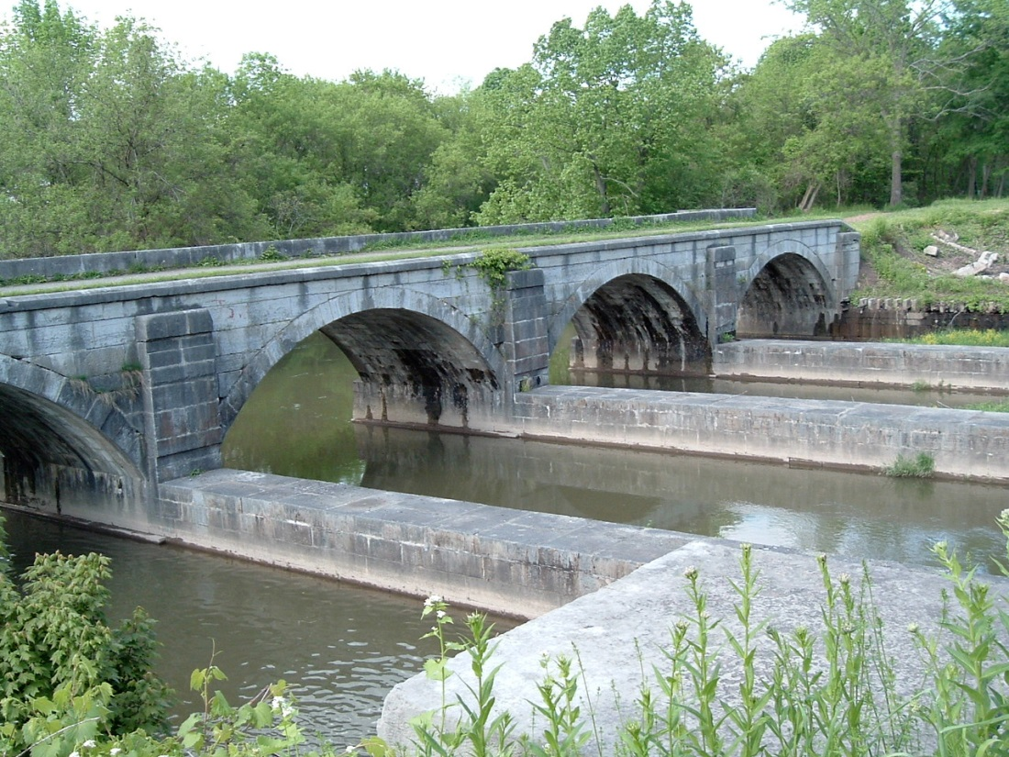
Continued…
1800s, US began building canals to make more places accessible by water.
Made process of steamboat travel cheap and fast.

Slide 17
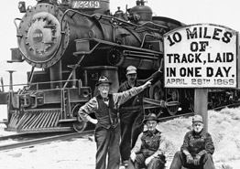
Movement over Land
Steam-powered railroads later replaced steamboats.
1869, transcontinental railroad linked the East and West coasts of the United States.
By 1900, people and goods in every settled part of the US were located near railroads.
Network of railroads spurred economic growth.

Slide 19
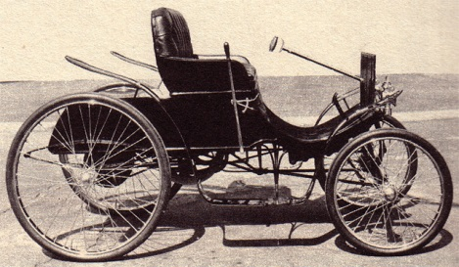
Movement over land continued…
Invention of automobile in 1890s heralded the next revolution in transportation.
Powerful diesel engines were used to power heavy-duty modes of transportation like…
Ships
Trains
Trucks
Tractors

Slide 20
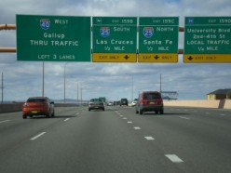
Continued…
Nation enjoyed benefits of greater freedom of movement by 1950s.
More and more people owned cars, the nation began building an interstate highway system.
Network of roads that link major cities across the nation.

Slide 21
Communication Technology
Industrial and economic growth of US tied to improved communications.
Early 1800s, communication required the transportation of people or paper.
Samuel F.B. Morse changed all of that.
Morse found a way to send messages by an electric current.
1837, first Morse Code telegraph sent using patterns of long and short sounds or printed dots and dashes that were converted to letters of the alphabet.

Slide 22
Continued…
Telegraph lines were strung along railroads in exchange for free service to railroad companies.
Trains were now able to coordinate train schedules, locate trains and establish standardized time.
By 1860, telegraph lines were in every important city.
Telegraphs allowed information to be transferred in minutes instead of days.

Slide 23
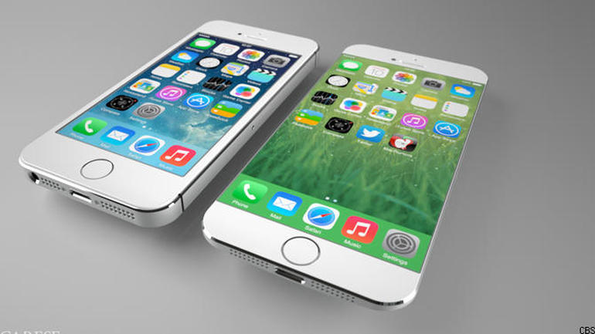
Continued…
American businesses could now communicate more efficiently with the people who supplied raw materials and parts for their machines, as well as customers.
1876, new forms of communication sprung.
Alexander Graham Bell invented the telephone.
By 1915, telephone wires connected people from coast to coast.
Today cell phones are continuously replacing wired phones.

Slide 24
Continued…
Many people and businesses today communicate and exchange info. via computer networks.
The internet, telephone, satellite and other forms of telecommunication are vital to business.

Slide 25
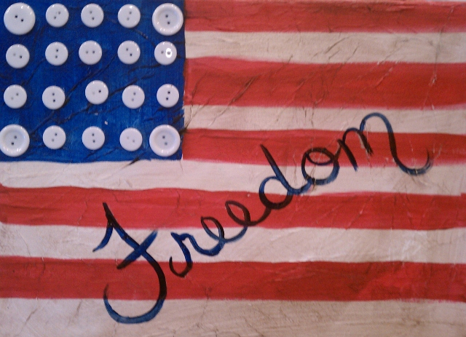
Respecting Individual Freedoms
Interaction between production, transportation and communication has been vital to the United State’s economic and political success.
Belief in individual equality, opportunity and freedom.

Slide 26
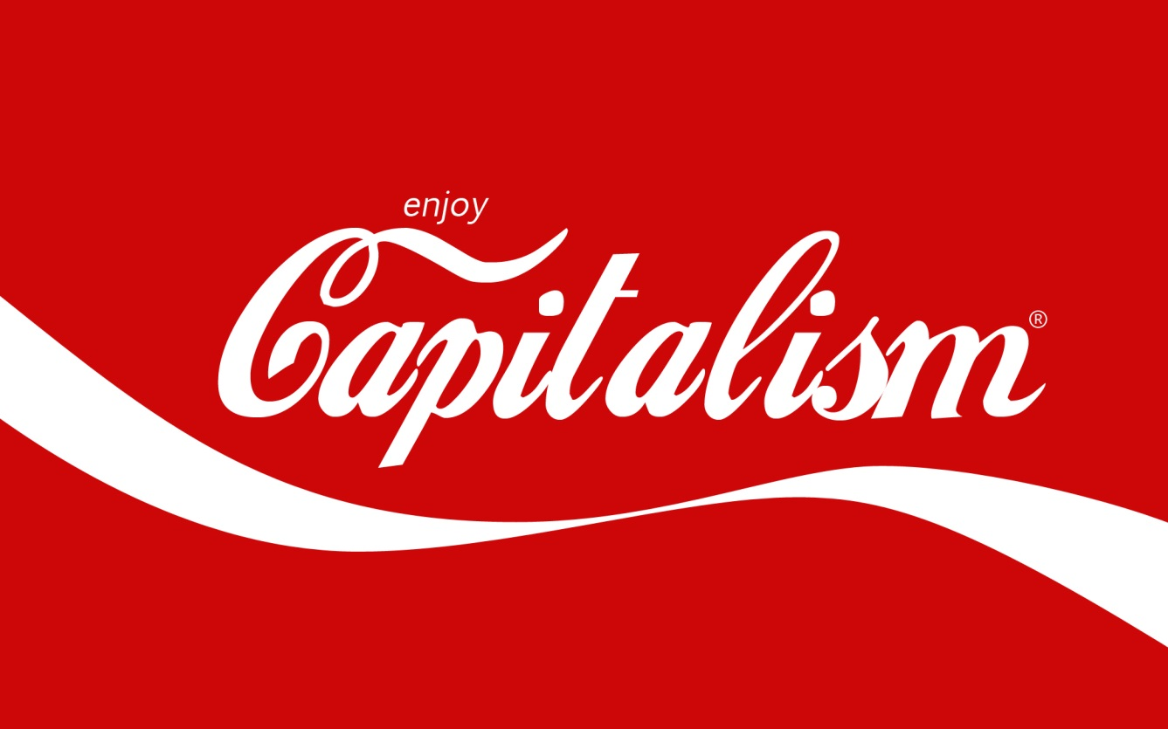
Continued…
Belief that individuals acting in their own interest may also serve interests of others.
Supported by Free enterprise.
Any hard working individual, regardless of wealth, cultural background, or religion, can find opportunity and success in the United States.

Slide 27
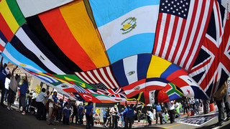

Slide 28
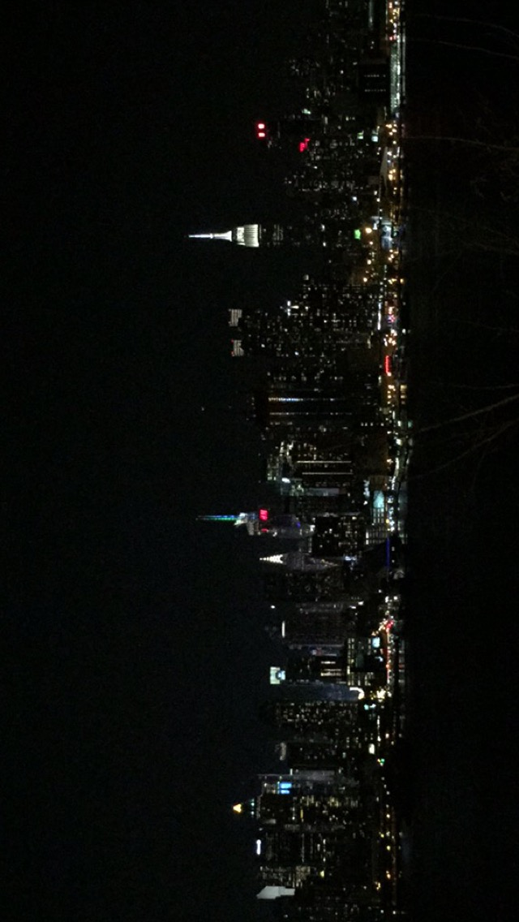
Chapter 6, Section 2 A Nation of Cities

Slide 29
Introduction
U.S.’s economy grew from a farming based economy to an industrial and manufacturer economy.
Service industries (Tertiary Activity) have begun to make up a larger share of the nation’s economy.
Ex. Healthcare, education, entertainment, banking, transportation and government are all service industries.
By 1890, cities became the centers of transportation and production in the new industry economy.

Slide 30
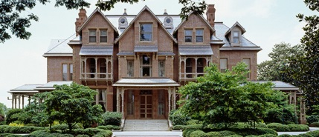
Metropolitan Areas and Location
United States has more than 250 metropolitan areas.
Ex. Boulder is now part of Denver, Colorado’s metropolitan area.
Why do some areas grow faster than others?
Value of a city’s location, is affected by changes in transportation, changes in economic activities, and changes in popular preferences.
Ex.
New York City 2 bedroom apartment rent = $4,000 per month.
Pa average for same thing is less than $1,000.
In Hazleton you could buy a $600,000 dollar house with no down payment and pay less than $4,000 a month.

Slide 31
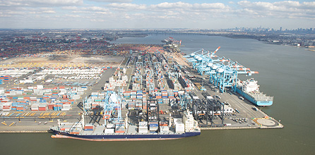
Transportation Affects Patterns of Settlement
Cities along the Atlantic Coast served as ports for trading between the United States and Europe.
Some of the largest were Baltimore, Boston, New York and Philadelphia.

Slide 32
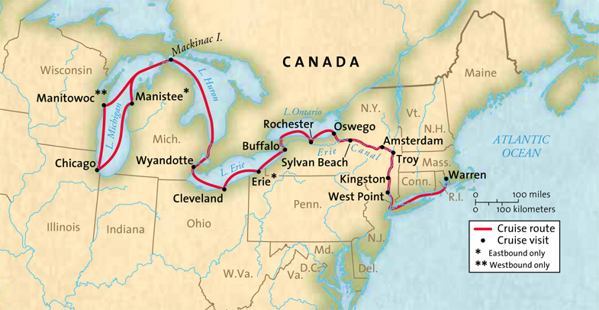
Canals
As the interior of the continent developed, settlers relied on rivers to transport crops.
Many of which were tributaries of Mississippi River.
At the mouth of the Mississippi, lies New Orleans, which flourished from steady trade of goods from the Midwest and rest of the world.
This influenced DeWitt Clinton (Governor of NY), to dig 363 mile canal from Lake Erie to the Hudson River.

Slide 34
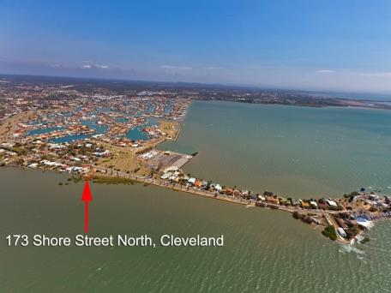
Canals Continued..
Western crops could be floated east through the Great Lakes into the canal to the Hudson River.
New cities were established on the shores of the Great Lakes and also along the Ohio, Mississippi, and Missouri Rivers.
Buffalo, Cleveland, Detroit and Chicago soon rivaled the older cities of the East,
Erie canal sparked a canal-
building boom.

Slide 35
Railroads
First successful railroad in the US was built in 1830.
Began in the East, in 1862, the US government decided to build a single rail line connecting the East and West.
Thousands of Chinese and European immigrants performed dangerous and difficult work of laying the tracks through the Rocky Mountains and Sierra Nevada.
Transcontinental railroad completed in 1869.

Slide 37
Railroads continued…
After the end of the Civil War in 1865, railroads became the country’s most important form of transportation.
Cities along the railroads grew rapidly.
Chicago, located centrally between the coasts, had the best location and therefore became the largest city in the Midwest.
New York City, acquired so many people, businesses, and activities it developed into the most important metropolitan area in the United States.

Slide 40
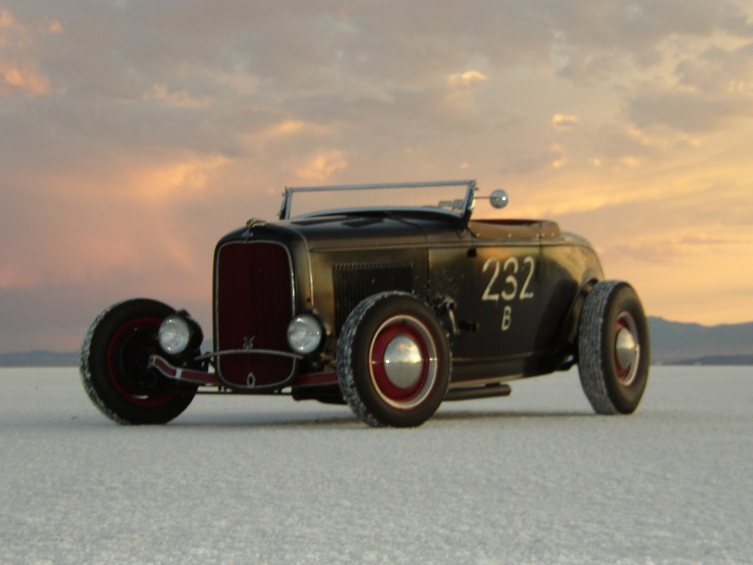
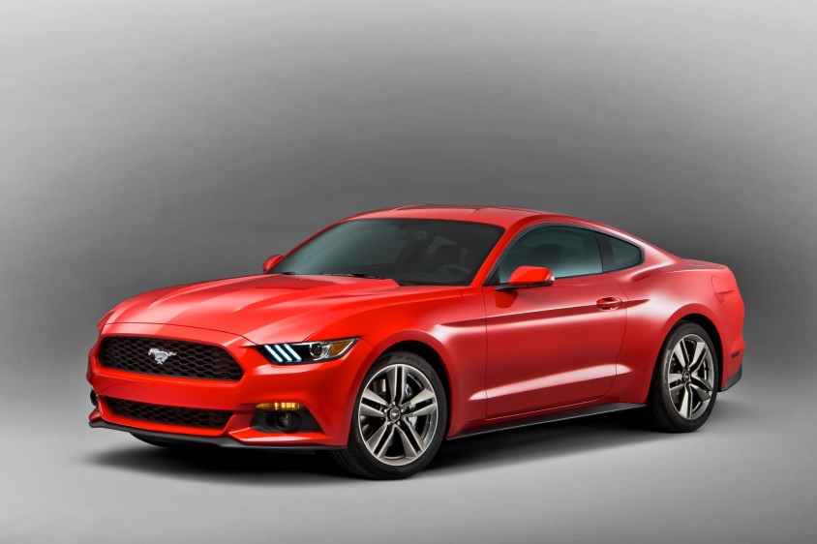
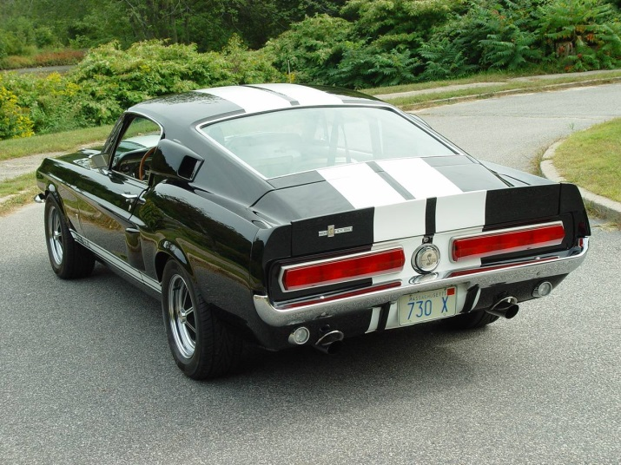
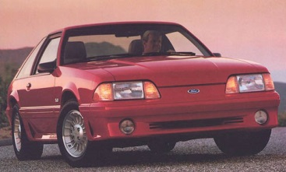
Automobiles

Slide 41
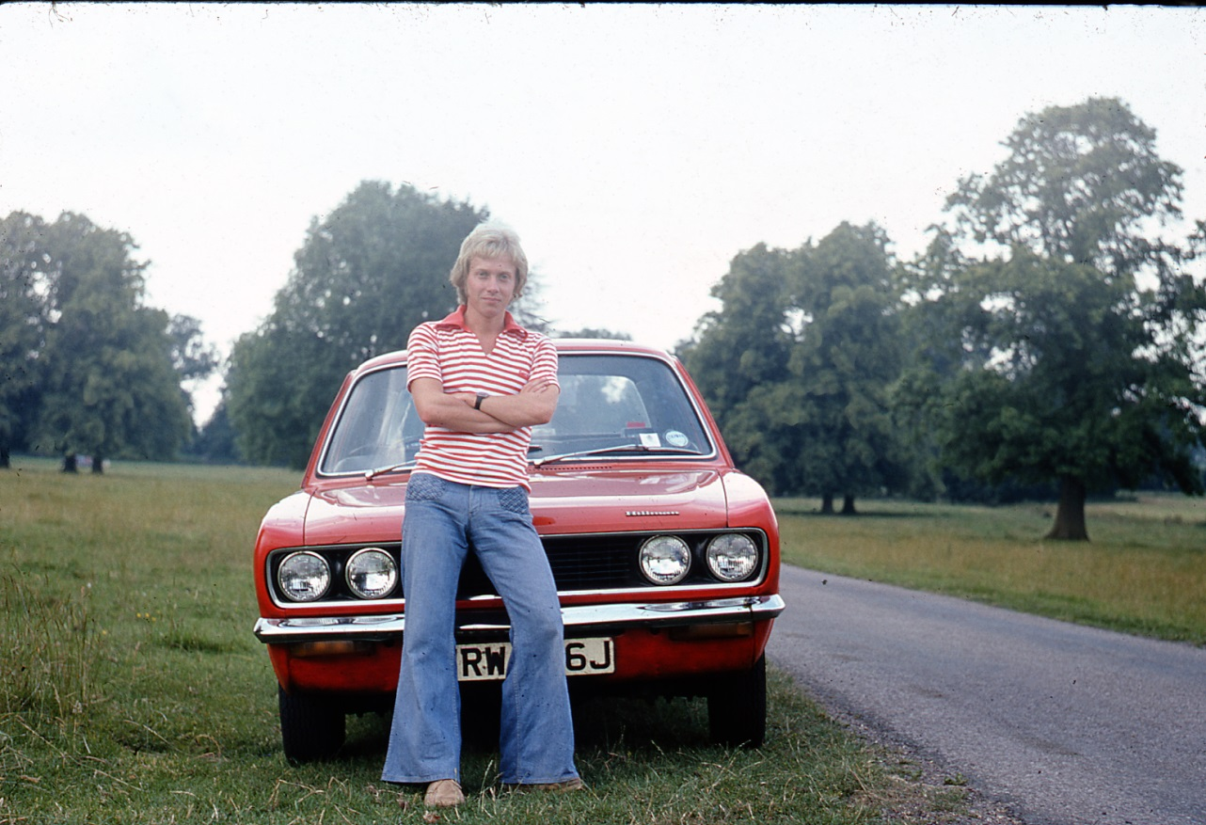
Automobiles
Until the invention of the automobile, efficient travel was limited to waterways and railroads.
The automobile gave Americans a new freedom.

Slide 42
Automobiles continued…
Americans now could go anywhere there were roads, at any time they wished.
1950s, manufacturers produced 8 million new cars each year.
Federal-Aid Highway Act of 1956 provided $26 billion to build an interstate highway system more than 4,000 miles long.
People were able to travel longer distances to work thanks to the increased availability of automobiles and public transportation.

Slide 43
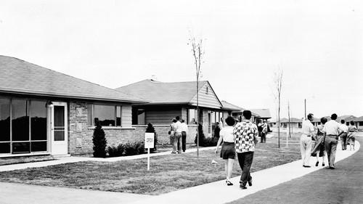
Automobiles continued…
After WWII, many businesses and people moved from the cities to the suburbs (residential areas on the outer edges of a city).

Slide 44
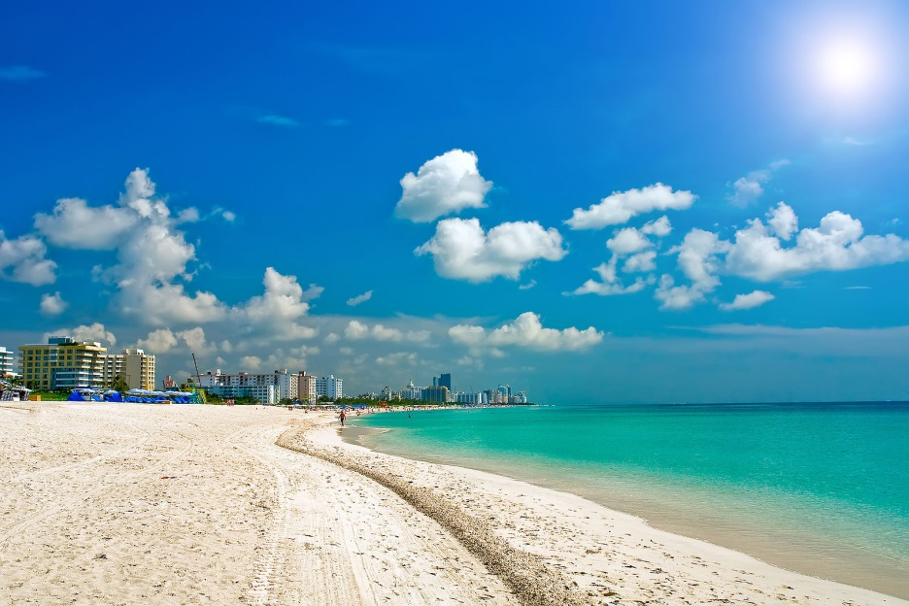
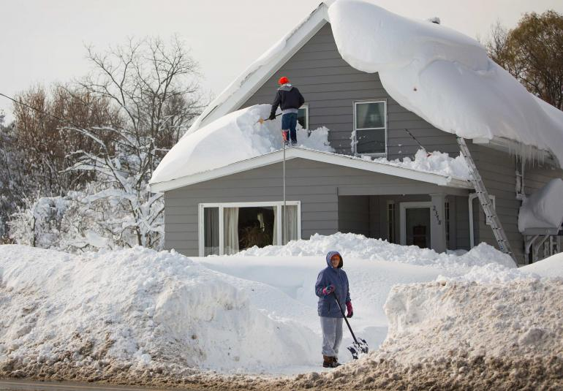
The Impact of Migration on the Nation
Advances in transportation allowed people freedom to select where their business would operate and where they would live.
People choose location that they feel offer the best possible surroundings.
As a result, cities in the South and West, where winters are less severe than in the Northeast, have flourished.

Slide 45
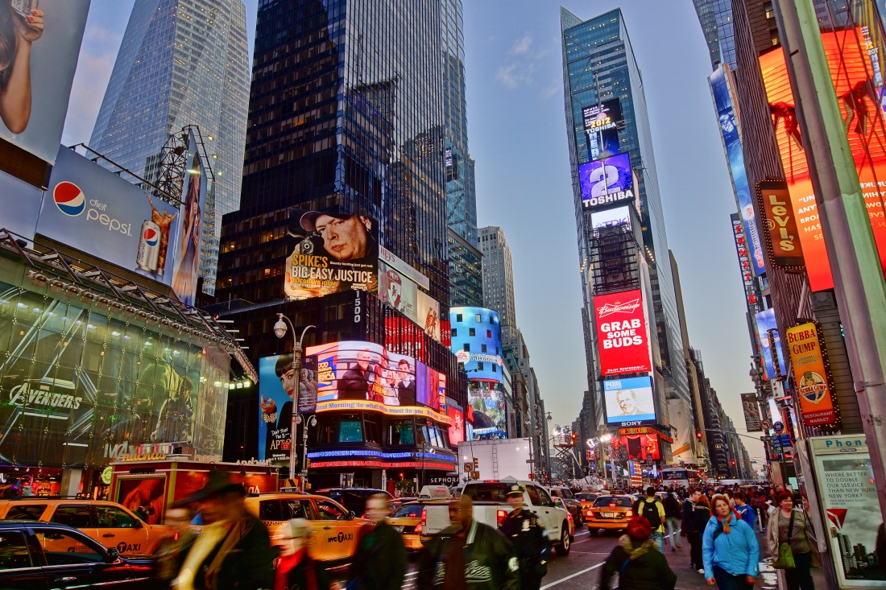
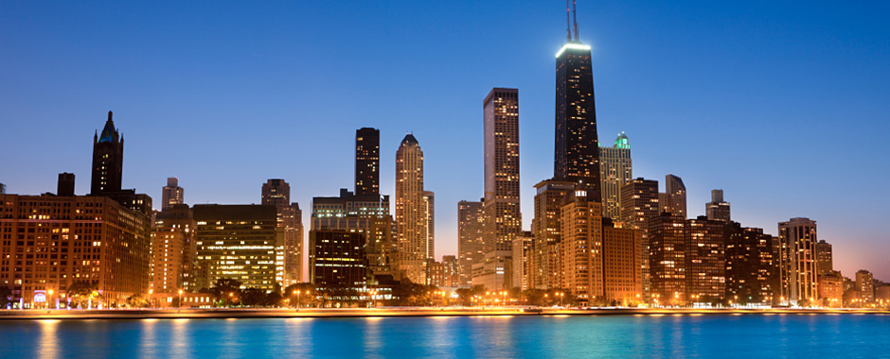
Comparison of Present to 1800s
Due to new industries and cultural attractions, New Orleans has regained the importance it lost when railroads replaced steamboats.
Places like New York and Chicago maintained their positions because they offer many jobs and varied activities.

Slide 46
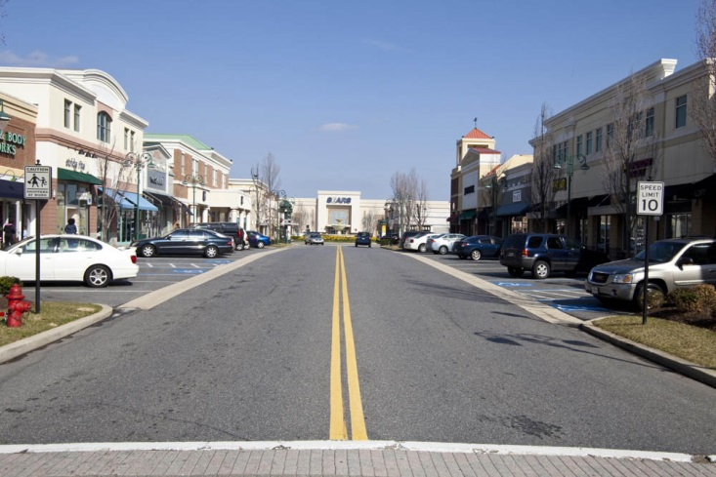
Cities and Towns
80% of all people in the USA live in metropolitan areas teeming with business and industry.
20% continue to live in small towns and villages.

Slide 47
Interconnections
100 years ago, vegetables probably would not have gone farther than the dinner table on the farm where they were grown.
Advances in technology have allowed consumers to find canned and fresh vegetables in cities many miles from the nearest field.

Slide 48
Functions and Size
Geographers talk about the nation’s urban places in terms of a hierarchy, or rank, according to their function.
Larger areas provide more functions.
Large cities are called metropolises.
Their large areas of influence are their hinterlands.
Ex. New York is the most important financial center in the western hemisphere.
LA – World’s leading film production center.

Slide 49
Continued…
Large metropolises have advanced medical facilities, art galleries, major league sport teams and stores that sell expensive clothing.
People often travel here to enjoy these things.

Slide 50
Continued…
Cities – limited range of activities and smaller hinterlands.
Towns – Car dealers, supermarkets, fast food restaurants.
Villages – general stores.

