Slide 1
Hitler’s Rise to Power
Created by:
The Birmingham Holocaust Education Committee
February 2008
Notes:
Title Slide
The rise of the Nazis defies any simple narrative. It came out of a myriad of interlacing events, ideologies and historical accidents.

Slide 2
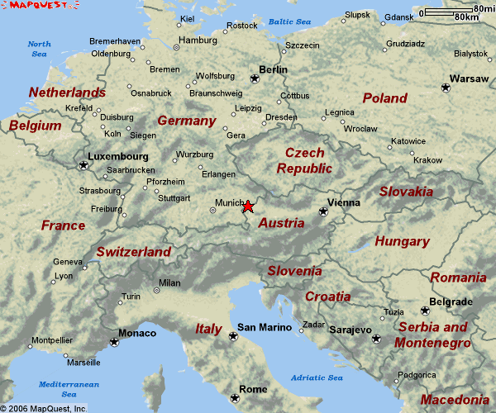
Born in Austria
Braunau-am-Inn
Notes:
Who Was Hitler? Born in Austria
Adolf Hitler was born April 20, 1889 in Braunau-am-Inn, Austria, a small town near Linz on the German border. The Austrians from this area spoke German and many considered themselves as Germans. At the age of 3, Adolf’s family moved to Passau, along the Inn River, on the German side of the border. The family moved once more in 1895 to the farm community of Hafeld, 30 miles southwest of Linz.
Hitler became a German citizen on February 25, 1932, just in time to run for President of Germany.

Slide 3
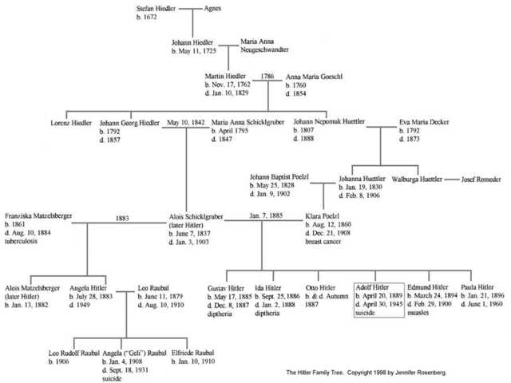
Insert Hitler Family tree
Notes:
Who was Hitler? Hitler’s Family Tree
Teacher Notes:
There are rumors hinting that Hitler’s grandfather was Jewish. Few reputable historians on the Holocaust believe that this is so. It is more likely that Hitler tried to keep the murky history of his family quite secret because there was a high incidence of insanity and feeble-mindedness among his ancestors.
This rumor arose during the Nuremberg Trials in 1945-46 when Hans Frank declared that Johann Hiedler was not the father of Alois Hitler. Anna Maria Schicklegruber was working in the town of Graz as a servant in the home of the Frankenberger family (Jewish) when she became pregnant with Alois. Frank claimed that Anna Maria was seduced by someone in the household and that Hitler’s grandfather was the result of this liaison.
Later investigation by Simon Wiesenthal disclosed no evidence of any Jewish family named Frankenberger ever living in Graz.
____________________________________________________________________________________
Klara Polzl, Adolf’s mother, was the daughter of Johann Polzl and Johanna Heidler. She was born next door to the house where her future husband, Alois Hitler, grew up under the care of her grandfather. Klara’s grandfather, Johann Nepomuk Hiedler, was her future husband’s step-uncle, and possibly his real father. She never got out of the habit of thinking of Alois as her uncle, not her husband. She was 23 years his junior. After they were married, she continued to call him “uncle.”
Alois Hitler, Adolf’s father, was a customs official for the Austro-Hungarian empire. He was the illegitimate son of Anna Maria Schicklgruber. His name at birth was Alois Schicklgruber. When Anna Maria married Johann Hiedler, Alois was adopted and his name was changed. The priest spelled the name Hitler.
Alois Hitler had been married twice before marrying Klara Polzl. He had 2 previous children from his second marriage: Alois Jr. and Angela. His second wife had died by the time he and Klara married so Alois Jr. and Angela grew up with Adolf as his step-brother & step-sister. Angela’s daughter, Geli, later came to have a very close (some say incestuous) relationship with her Uncle Adolf. Geli ultimately committed suicide.
Adolf was the 4th of 6 children born to Alois Hitler and Klara Polzl. Alois and Klara’s first two children, Gustav and Ida, died of diphtheria. A third child, Otto, died at birth. Adolf’s younger brother, Edmund, died at the age of 6 of the measles. Only Adolf and a younger sister, Paula, survived to adulthood.
In 1936, Adolf made Paula change her name from Paula Hitler to Paula Wolff and asked her to remain incognito (“Wolff” was Adolf Hitler’s nickname.). From 1929-1941 Paula saw her brother only once a year. Each year Adolf sent his sister a ticket to the impressive Nuremberg Rally. Until the last weeks of the war, Paula Hitler lived in Vienna where she was arrested by U.S. Intelligence officers in May 1945. Paula was released and returned to Vienna to work in an arts and crafts shop. On December 1, 1952, she moved to a two-room flat near Berchtesgaden, Hitler’s mountaintop retreat on the German-Austrian border, where she lived in seclusion under the last name of Wolff until her death on June 1, 1960.
While Alois was very strict and abusive towards his son Adolf, Klara was totally devoted – so much so that she was unwilling or unable to acknowledge his unstable emotional behavior. Even at a young age, Adolf exhibited asocial characteristics.
As a young child, Adolf’s family moved seven times, and Adolf attended five different schools. Even at a young age he exhibited anti-social characteristics. When he was 11, Adolf entered a private high school in Linz and discovered his talent for drawing. This did not please his father who wanted him to become a civil servant.
Adolf’s father died in January 1903 of a pleural hemorrhage. Adolf dropped out of school in 1905. The only subjects in which he excelled were freehand drawing and gymnastics. He failed to take the final examinations and never received a diploma.

Slide 4
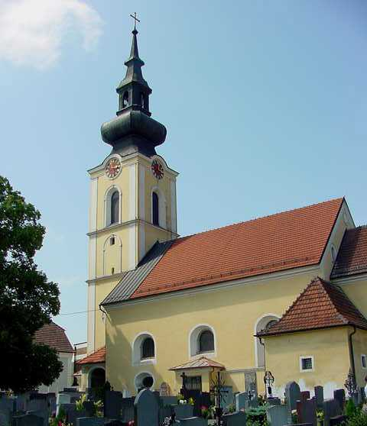
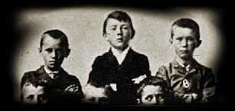
Reared Catholic
Adolf (center) with schoolmates, 1900.
St. Michael’s Catholic Church attended by Hitler as a child. Leonding, Austria
Notes:
Who Was Hitler? Reared Catholic
Adolf Hitler was reared Catholic.
Hitler’s parents are buried in the cemetery adjoining St. Michael’s Catholic Church.

Slide 5
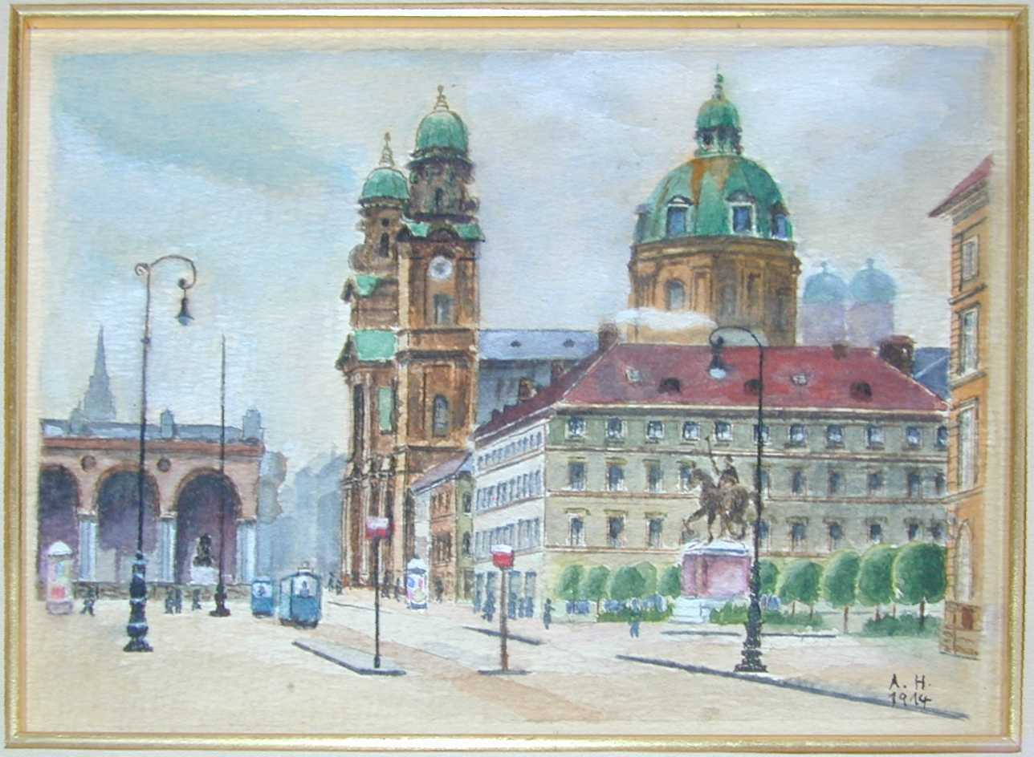
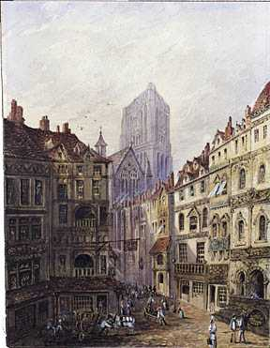
Aspired to be an Artist Rejected by Vienna Academy of Arts Never Attended College
Oedensplatz (Feldherrnhalle), Munich, 1914 Artist: Adolf Hitler
The Rotterdam Cathedral
Munich, 1930
Artist: Adolf Hitler
Notes:
Who Was Hitler? Aspired to be an Artist / Rejected by Vienna Academy of Arts / Never Attended College
In 1907, Hitler persuaded his mother to allow him to go to Vienna to apply for admission to the Vienna Academy of Fine Arts. He was rejected; his drawings were judged unsatisfactory. He stayed in Vienna, living on money sent by his mother, and applied again the following year. This time he was not even admitted to the test.
Meanwhile his mother had developed breast cancer. She was a patient of a devoted Jewish doctor, Dr. Eduard Bloch. On December 21, 1908, she died, and Hitler came home for the funeral.
A few weeks later, Adolf left home for good and returned to Vienna where he would live in anonymity for 4 cheerless years, relying on his orphan’s pension for support.

Slide 6
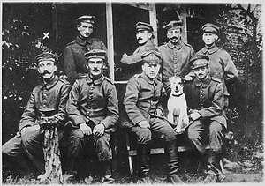
Moved to Germany to avoid Austrian draft. Fought for Germany in World War I.
Hitler served in the Bavarian contingent of the German Army.
Became a lance corporal and denied more promotions because he was not leader material
Fought side by side with Jewish soldiers
After he came to power had all Jewish names removed from war memorials.
Notes:
aWho Was Hitler? Moved to Germany to avoid Austrian draft. Fought for Germany in World War I
Teacher Notes:
Hitler is seated, far left.
It is important to point out that Jews served in World War I alongside their fellow countrymen. Once Hitler came to power, Jewish names were removed from all war memorials.
_________________________________________________________________________________
In 1913, after receiving the inheritance from his father as a result of reaching his 24th birthday, Hitler moved to Munich to avoid being drafted into the Austrian army. Although born in Austria, he had always considered himself German.
Hitler enlisted in the German army and rose to the rank of lance corporal but was denied further promotion because he was not considered a potential leader. He served at the front as a dispatch runner. Hitler narrowly escaped death several times during the war and received the Iron Cross, Second Class after being wounded and then the Iron Cross, First Class, for an unknown act of bravery. The latter decoration was proposed by his Jewish commander.
In 1918, he was temporarily blinded by mustard gas. He was in the hospital when Germany surrendered in November. Like other disillusioned ex-soldiers whose only profession had been to fight and kill, Hitler joined in the search for the lost security of a hierarchical, authoritarian system that had collapsed.

Slide 7
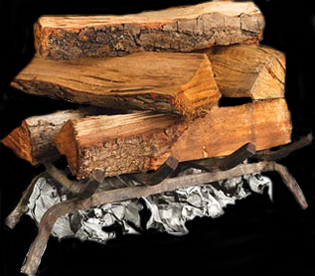
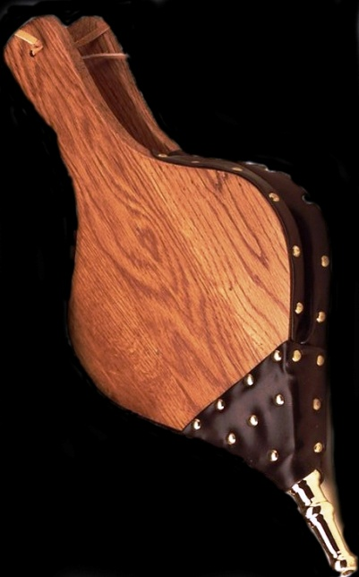
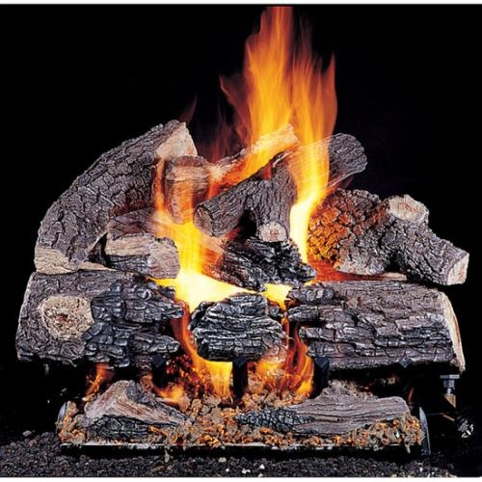
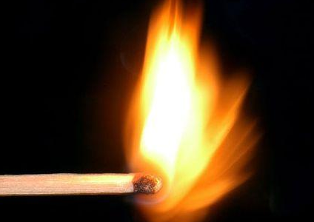
Economy
Nazi Propaganda
Antisemitism
German Nationalism
+
Adolf Hitler
The Holocaust
Notes:
Graphic of “Lighting the Match”
Some scholars believe that the Holocaust was masterminded by Adolf Hitler and was the result of long-term planning on his part. This opinion is often criticized for focusing too much on Hitler and letting everyone else off the hook.
Other scholars downplay the role of Adolf Hitler and describe the Holocaust as something that evolved over time in an improvised way. That Hitler was in fact a weak dictator, swept along by forces outside of his control.
A combination of these two viewpoints seems more in line. That Hitler was an essential factor in Nazism and the genocide it produced is without question. Without Hitler, Nazism, World War II and the Holocaust would have taken a very different form, if they had occurred at all. Yet Hitler did not have complete power – even dictators depend on popular support – and a program as massive as the crimes of Nazism required many accomplices.
If one were to think of the Holocaust as a raging fire, certain essential components or “kindling” were necessary to create that fire. Some of those were:
The existing antisemitism.
Hitler and the Nazis did not invent antisemitism. They simply reflected and built on prejudices that were familiar in many parts of Europe. A substantial part of the population had to be ready to consider it desirable, acceptable, or at least unavoidable, that certain other people would be isolated, persecuted, and killed.
2. The downturn in the German economy.
Although the Weimar Republic was not fully endorsed by the populace, without the downturn in the German economy the Nazis would have never gained power. The massive inflation and unemployment, exacerbated by the Great Depression, sent the public into a panic, searching for a quick fix.
3. The desire for a renewed German Nationalism.
After the humiliation of the Treaty of Versailles, Germany was searching for strong leadership to return them to the days of international dominance.
In order for that “kindling” to ignite, a “spark” was needed. That “spark or match” was Adolf Hitler.
Once the fire was going, it was “fueled” by the Nazi Propaganda machine.
War provided the killers with both a cover and an excuse for murder. Without the war, the Holocaust would not – and could not have happened.

Slide 8
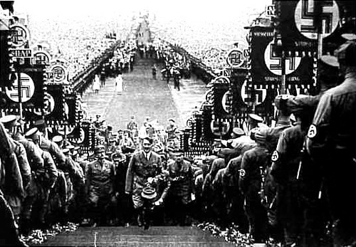
?
Adolf Hitler, Austrian Citizen, High school drop-out, Lance Corporal, German Army
Adolf Hitler, Dictator of Germany
Notes:
Graphic: How did Hitler become dictator of Germany?
How did a high school drop-out from Austria, who never rose above the rank of Lance Corporal in the German Army, become dictator of Germany and ultimately most of the European continent?

Slide 9
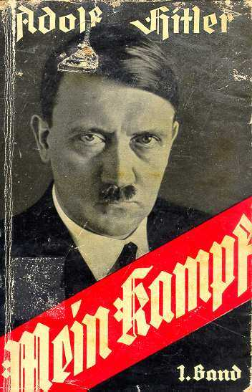
The personification of the devil as the symbol of all evil assumes the living shape of the Jew. Hitler’s Rise to Power: Mein Kampf
The text revolved around 4 basic themes:
1. Supreme importance of race.
2. Survival of the fittest.
3. Need for a militaristic state with a dictator.
4. Destiny of Germany to be the dominant world power.
Throughout the pages, Hitler heaps abuse on the Jews. He considered Jews an “inferior race” and blamed them for all of Germany’s troubles.
By 1945 the book had sold over 6 million copies and was Hitler’s sole source of income for the remainder of his life.
After Hitler’s death, royalties from the sale of Mein Kampf have gone to various charities such as the Red Cross. In some instances, these monies were refused on the basis of their origin.
Notes:
Hitler’s Rise to Power: Mein Kampf
During his short imprisonment, Hitler dictated Mein Kampf (My Struggle) to his secretary, Rudolf Hess, in his well-furnished prison cell. This was Hitler’s autobiography as well as his political philosophy. The text revolved around 4 basic themes:
1. Supreme importance of race.
2. Survival of the fittest.
3. Need for a militaristic state with a dictator.
4. Destiny of Germany to be the dominant world power.
Throughout the pages, Hitler heaps abuse on the Jews. He considered Jews an “inferior race” and blamed them for all of Germany’s troubles.
Mein Kampf became the ideological basis for the Nazi Party’s racist beliefs and murderous practices. By 1945 the book had sold over 6 million copies and was Hitler’s sole source of income for the remainder of his life.
After Hitler’s death, royalties from the sale of Mein Kampf have gone to various charities such as the Red Cross. In some instances, these monies were refused on the basis of their origin.

Slide 10
Hitler’s Rise to Power
The Germans, for centuries, lived in a monarchy.
This new democracy, known as the Weimar Republic, did not provide the strong leadership that the German people had once known.
This, coupled with the blows delivered by the Treaty of Versailles that stripped the German people of their national pride, provided a foundation for Hitler’s rise.
Hitler would offer the German people a new empire, one with a strong leader to guide them to glory once again. He prophesized that this Third Reich (empire) would last 1,000 years. In truth, it would only last 12.
Notes:
Hitler’s Rise to Power: Breaker Slide – Birth of Nazi Party

Slide 11
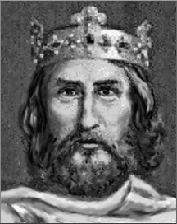
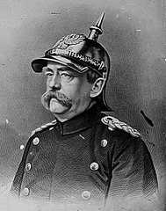
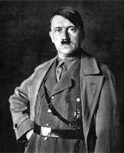
German Nationalism
1st Reich
800 - 1806
2nd Reich
1871 - 1918
3rd Reich
1933 - ?
Charlemagne
800-814
His vast realm encompassed what are now France, Switzerland, Belgium, Netherlands, half of present-day Italy and Germany, and parts of Austria and Spain.
Otto von Bismarck
1871-1890
Engineered the unification of the numerous states of Germany.
leAdolf Hitler
1933 – 1945
Hitler promised to return Germany to its previous glory with an empire that would last 1000 years. In reality, the 3rd Reich lasted only 12 years.
Notes:
Factors Contributing to the Rise of the Nazis: German Nationalism
Teacher Note:
Reich means realm or empire.
_____________________________________________________________________
The German people had never experienced a democracy having for centuries lived in a monarchy. They had lived for centuries under a monarchy and had thrived under its strong guidance. This new democracy, known as the Weimar Republic, did not provide the strong leadership that the German people had once known.
This, coupled with the blows delivered by the Treaty of Versailles that stripped the German people of their national pride, provided a foundation for Hitler’s rise.
Hitler would offer the German people a new empire, one with a strong leader to guide them to glory once again. He prophesized that this Third Reich (empire) would last 1,000 years. In truth, it would only last 12.
The First Reich, also known as The Holy Roman Empire (a continuation of the Roman Empire in Europe), started in the lands ruled by Charlemagne (Germany, Austria, Slovenia, Switzerland, Belgium, Netherlands, Belgium, Czech Republic, Eastern France, Northern Italy and Western Poland), beginning in 800 when Charlemagne was crowned by Pope Leo III in Rome and finishing in 1806 when Emperor Francis II gave up his throne. The Second Reich, also known as The German Empire, was ruled by the Hohenzollern Dynasty. It included the areas known as Prussia and Brandenburg, and lasted from 1871 to 1918, but fell at the end of World War I. During this Reich, the "Iron Chancellor" Otto Von Bismarck united Germany and set the roots for World War II. From 1919 to 1933 was the period of the Weimar Republic, a fragile democracy sometimes called the pre-3rd Reich. The Third Reich (1933 to 1945) or Nazi Germany, was under Adolf Hitler’s control. He called it the Third Reich because he thought that under his leadership Germany could reunite the old Holy Roman Empire, bringing Germany back to its glorious days. This Reich was terminated with the fall of Germany at the end of World War II.

Slide 12
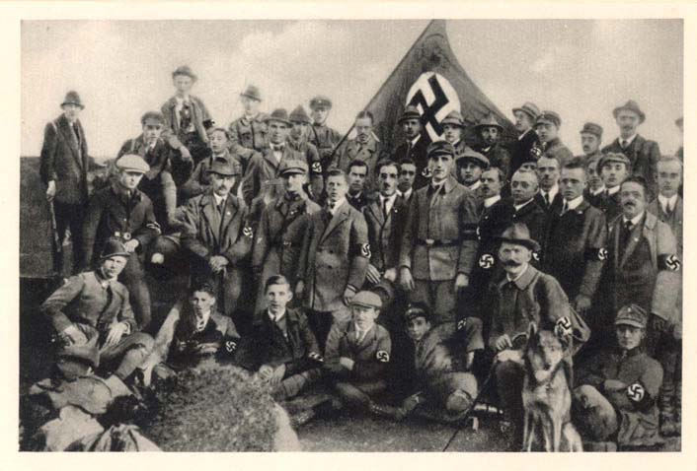
Birth of the Nazi Party
After World War I, Hitler stayed in the army. In September, 1919, Corporal Hitler was ordered to investigate a small, potentially dangerous group in Munich, the German Worker’s Party. In this disorganized party, Hitler saw opportunity. Its members expressed a right-wing doctrine consistent with his own.
It was here that Hitler discovered that he had two remarkable talents – public oratory and inspiring personal loyalty. His pounding fists, burning eyes, hoarse cries and hysterics aroused audiences to a fevered pitch.
In 1920 Hitler took control of the group and changed the name to the National Socialist German Worker’s Party, National Sozialistische Deutsche Arbeiter Partei, NSDAP, or Nazi for short.
German propaganda postcard showing an early Hitler preaching to the fledgling Nazi Party.
Assembly of the Nazi Party, 1922, Coburg, Germany
Notes:
Hitler’s Rise to Power: Birth of the Nazi Party
After World War I, Hitler stayed in the army, which was now mainly engaged in suppressing the various political uprisings that were breaking out across Germany.
In September, 1919, Corporal Hitler was ordered to investigate a small, potentially dangerous group in Munich, the German Worker’s Party. In this disorganized party, Hitler saw opportunity. Its members expressed a right-wing doctrine consistent with his own.
At the age of 30, Hitler joined as member #555 (the numbering system began at #500 to make the group appear larger). He would later become the 7th member of the Executive Committee of the party (#7 represents “completeness” in Judeo-Christian theology).
It was here that Hitler discovered that he had two remarkable talents – public oratory and inspiring personal loyalty. His pounding fists, burning eyes, hoarse cries and hysterics aroused audiences to a fevered pitch.
In 1920 Hitler took control of the group and changed the name to the National Socialist German Worker’s Party, National Sozialistische Deutsche Arbeiter Partei, NSDAP, or Nazi for short. He hoped the word “National” would attract nationalists who wanted to rebuild Germany and the word “Socialist” would attract socialists who wanted to improve the lives of working people in Germany. There were about 3,000 members.
In 1922, Major Joseph Hell, a German journalist, had the occasion to interview Adolf Hitler, and he wrote about the experience in his memoirs. Toward the end of his interview Major Hell asked Hitler, “What do you want to do to the Jews once you have full discretionary powers?” Hitler abruptly changed his demeanor, raising his voice and carrying on as if he were addressing an outdoor rally:
Once I really am in power, my first and foremost task will be the annihilation of the Jews. As soon as I have the power to do so, I will have gallows built in rows – at the Marienplatz in Munich, for example – as many as traffic allows. Then the Jews will be hanged discriminately, and they will remain hanging until they stink; they will hang there as long as the principles of hygiene permit. As soon as they have been untied, the next batch will be hung up, and so on down the line, until the last Jew in Munich has been exterminated. Other cities will follow suit, precisely in this fashion, until all Germany has been completely cleansed of Jews.
Eleven years later, on Monday, January 30, 1933, Adolf Hitler, the former Austrian corporal, was sworn in by President Paul von Hindenburg as Chancellor of Germany.

Slide 13
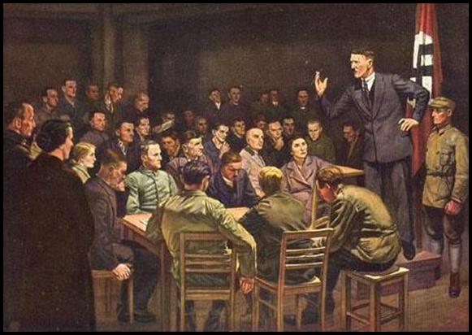
Once I really am in power, my first and foremost task will be the annihilation of the Jews. As soon as I have the power to do so, I will have gallows built in rows – at the Marienplatz in Munich, for example – as many as traffic allows. Then the Jews will be hanged discriminately, and they will remain hanging until they stink; they will hang there as long as the principles of hygiene permit. As soon as they have been untied, the next batch will be hung up, and so on down the line, until the last Jew in Munich has been exterminated. Other cities will follow suit, precisely in this fashion, until all Germany has been completely cleansed of Jews.

Slide 14
Inflation in Germany
DATE | GERMAN MARKS | U.S. DOLLARS
1919 | 4.2 | 1
1921 | 75 | 1
1922 | 400 | 1
Jan. 1923 | 7,000 | 1
July 1923 | 160,000 | 1
Aug. 1923 | 1,000,000 | 1
Nov. 1, 1923 | 1,300,000,000 | 1
Nov. 15, 1923 | 1,300,000,000,000 | 1
Nov. 16, 1923 | 4,200,000,000,000 | 1
Notes:
Chart: Inflation in Germany 1919-1923
By 1923, the German mark had become almost worthless:
A penny postage stamp was 5 million marks.
One egg was 80 million marks.
One pound of meat was 3.2 billion marks.
Germans lost their life savings. Hunger riots broke out.
Hitler felt the time was ripe for the Nazi party to make its move.

Slide 15
German children with stacks of inflated currency, virtually worthless in 1923.
Notes:
Photo: Children Stacking Reichmarks

Slide 16
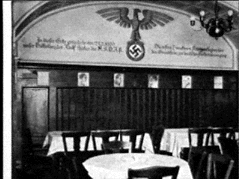
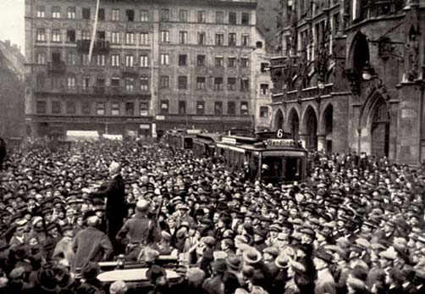
Beer Hall Putsch November 8-9, 1923
Part of a photo-card collection used by the Nazis to indoctrinate German children. The Bürgerbräukeller Beer Hall in Munich was the scene of the failed Nazi Putsch. It symbolized the birth pangs of Nazi power.
Munich, Germany, 1923, Masses in the streets during the Putsch.
Notes:
Beer Hall Putsch, November 8-9, 1923
Teacher Note:
Putsch – German word that means a secretly planned and suddenly executed attempt to overthrow a government
____________________________________________________________________________
In January 1923, French and Belgium troops occupied the Ruhr region of Germany in order to demand payment of reparations. In addition, hyperinflation created widespread discontent and criticism of the Weimar government. Right wing groups realized that the Weimar government was not doing enough to protect the German state. Hitler felt it was imperative to act before the government re-established order.
With a group of ex-soldiers, including war-time ace Hermann Goering and Field Marshall Erich von Ludendorff, the Nazis plotted to seize control of Munich, the capital of Bavaria, and then stage a march on Berlin.
On November 8, Adolf Hitler, Hermann Goering, and Erich von Ludendorff, backed by the SA, stormed into the Bügerbräukeller Beer Hall in the city of Munich in Bavaria (a German state) where Bavarian officials were meeting with 3,000 businessmen. They kidnapped the Prime Minister and dramatically announced that the National Revolution had begun.
The next day Hitler hoped to take over the Bavarian government buildings by force and ultimately move on to the remainder of the German states. Hitler and his comrades were confronted by the Bavarian police. During the ensuing battle, 16 Nazis and 4 policemen were killed. Ludendorff was arrested but later acquitted. Hitler was wounded and whisked away by comrades. He was arrested 2 days later and charged with treason. Ernst Roehm had tried to take over the Bavarian War Ministry across town, but also failed.
At first Hitler considered the Putsch a disaster; hysterically, he contemplated suicide. He soon recovered and used the ensuing trial as a vehicle for a propaganda attack on the hated democratic regime. Hitler was sentenced to 5 years in Landsberg Prison but served only 9 months.*
* The judge in the trial was a Nazi sympathizer and thus lessened the sentence.
Every November, Hitler and his cronies re-enacted the aborted putsch, pausing at a memorial that honored the “martyrs” that died.
Chancellor Gustav Stresemann (DVP, People’s Party) was severely criticized by members of the Social Democratic Party (SPD) and Communist Party over his unwillingness to deal firmly with Adolf Hitler and other Nazi Party leaders after the failure of the Beer Hall Putsch. Later that month the socialists withdrew from Stresemann's government and he was forced to resign as chancellor (November 1923).

Slide 17
Worldwide Depression, 1929
All seemed e road to recovery until
Germany had taken huge loans from U.S to pay their war reparations as well as finance German industrial expansion. Suddenly the banks called in their loans and the Germans were worse off than before.
The crisis of the Great Depression created the instability that Hitler needed.
Unskilled and/or unemployed were given promises of new and better jobs.
Soldiers and policemen improvements in equipment and benefits.
Doctors, lawyers and businessmen - benefiting from the confiscation of Jewish assets or the elimination of Jewish competition.
Students -more jobs and better careers.
Farmers -bolster agricultural prices.
Notes:
Worldwide Depression, 1929
All seemed on the road to recovery until October 1929 when Wall Street crashed and U.S. banks closed. The Great Depression hit.
Germany had taken huge loans from U.S. banks in order to pay their war reparations as well as finance German industrial expansion. Suddenly the banks called in their loans and the Germans were worse off than before.
The crisis of the Great Depression created the instability that Hitler needed. He would provide the stability that Germany longed for. Unlike the Beer Hall Putsch where the Nazis tried to take power by force, power would be achieved by legal means this time.
The crisis of The Depression brought disunity to the political parties of the Reichstag. As economic conditions in Germany worsened, Hitler and the Nazi party attracted a wider following from many different sectors of society. Unskilled and/or unemployed manual laborers and office workers were lured by promises of new and better jobs. Soldiers and policemen responded to promises of increased personnel and improvements in equipment and benefits. Doctors, lawyers and businessmen were attracted by the prospect of benefiting from the confiscation of Jewish assets or the elimination of Jewish competition. Students were lured by the promise of more jobs and better careers. Farmers looked to the Nazis to bolster agricultural prices. Unlike the existing political parties, the NSDAP had no proven track record of failure and therefore offered hope.
The NSDAP stands for the opposite of what exists today. - Gregor Strasser

Slide 18
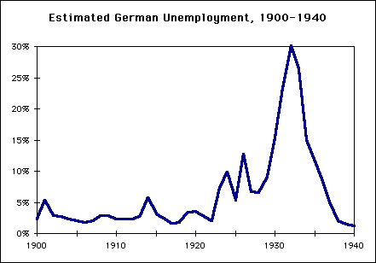
Unemployment in Germany 1928-1933
September 1928 | 650,000
September 1929 | 1,320,000
September 1930 | 3,000,000
September 1931 | 4,350,000
September 1932 | 5,102,000
January 1933 | 6,100,000
Notes:
Unemployment in Germany 1928-1933
Note the steady rise in unemployment after World War I (1919) and then the massive jump after the “Crash of 1929.” This provided the open door that Hitler needed.
After Hitler came to power (1933) he came through with his promise of jobs. Notice the decline in unemployment.

Slide 19
Nazi propaganda poster illustrating the Nazi’s desire to break the shackles of the Treaty of Versailles.
Notes:
Nazi Election Poster – Aryan in Shackles
The NSDAP also capitalized on German resentment of the Treaty of Versailles. In this poster, note the Aryan male image, the fire as a symbol of force/destruction, the “Versailles shackles” that the NSDAP (Nazis) wanted to burn apart.

Slide 20
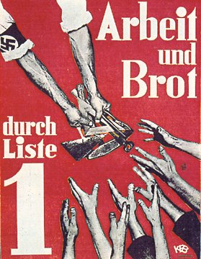
The Nazi Party, promised the German people a solution to their hunger and poverty: Work & Bread.
Created, public works programs similar FDR’s “New Deal” to stimulated the German economy.
1934-became Dictator
“Der Fuhrer”
Rearms Germany-created jobs
“Work and Bread!” Nazi Party election poster from the early 1930’s.
Notes:
Nazi Election Poster - Work & Bread
In preparation for the parliamentary elections of 1930, the NSDAP waged a whirlwind campaign. They shifted their strategy to rural areas and fueled antisemitism by calling for the expropriation of Jewish agricultural property and by condemning large Jewish department stores.

Slide 21
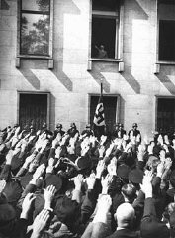
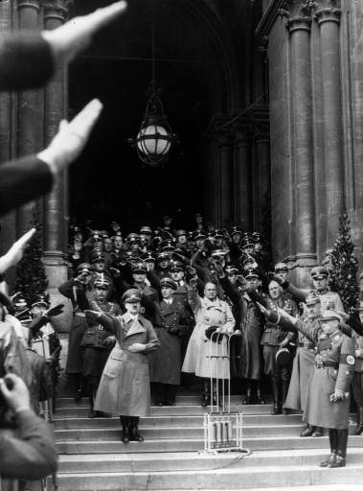
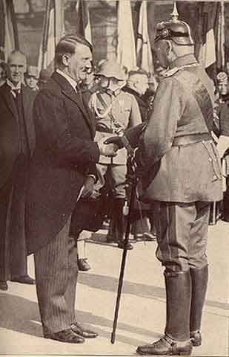
Hitler Appointed Chancellor January 30, 1933
Adolf Hitler greets a crowd of enthusiastic Germans from a window in the Chancellery building on the day of his appointment.
Hitler in Berlin as new Chancellor of Germany, January, 1933
Newly appointed Chancellor Adolf Hitler shakes hands with German President Paul von Hindenburg.
Notes:
Hitler Appointed Chancellor
Hitler was appointed Chancellor under Article 48 of the Weimar Constitution which granted the President the authority to invoke dictatorial power to protect the democratic order from overthrow (in this case Schleicher’s supposed overthrow), a clause originally inserted to ensure against a feared Communist revolution.
Even with Hitler’s appointment, most high-ranking officers of the army maintained their loyalty to Hindenburg, the revered General Field Marshal of World War I and President of Germany. Looking down on Hitler, they considered him, an ex-lance corporal, a mere enlisted man, to be an ignorant, uneducated, and dangerous adventurer. Still, they recognized that Hitler’s loyal SA militia, the nearly one million jackbooted storm troopers, were dangerous adversaries to their small army, which was restricted to 100,000 by the Treaty of Versailles.
The prevailing wisdom was that the Nazis had been tricked. It was actually thought that the best way to deal with the NSDAP was to let them into power. They would then actually have to make policy. They could no longer be everything to everybody.
Hitler’s deal did not even give him a majority in the Reichstag. His coalition of Nazis and Nationalists (DNVP) had only 248 out of 584 seats in the Reichstag. Still not a majority.
But Hitler wasted no time using his newfound powers to start eliminating the competition.
On his first day as Chancellor, Hitler manipulated Hindenburg into dissolving the Reichstag and calling for new elections on March 5, 1933. He hoped this would bring the Nazis closer to the majority they needed in the Reichstag to pass legislation. His goal was to pass the Enabling Act, a constitutional revision that required a 2/3 majority vote. This would allow him to abolish democracy in a legal fashion.
The Nazis began a campaign to ensure they would win the requisite seats.
Washington, Jan. 20. (AP)—Adolf Hitler's elevation to the Chancellorship in Germany, while something of a surprise to official Washington, apparently created little apprehension as to its effect on international relations.
He is regarded by Washington observers as being surrounded by a conservative cabinet which insures that his threats of past years to scrap treaties will not be carried out. Furthermore, it has now been arranged in Germany so that the Chief Justice of the Supreme Court and not the Chancellor is in line to succeed the President.
Paris, Jan. 30. (AP)—Official quarters, unalarmed by Adolf Hitler's accession to power in Germany, consider that the Nazis likely will be more moderate than speeches have indicated. The French are carefully watching developments and are especially interested in Hitler's attitude concerning disarmament and the League of Nations.
London, Jan. 30. (AP)—Great Britain turned anxious eyes toward the continent today as Adolf Hitler swung into power in Germany.
Whether France would counter the German Nationalist victory with the setting up of a similar Nationalist regime became a question of great interest in political circles.
Rome, Jan. 30. (AP)—Italy enthusiastically acclaimed the accession to power of the Fascist party in Germany, today's newspapers announcing Adolf Hitler's appointment as Chancellor under big headlines on the front pages.
The new development in German politics the newspapers described as a vindication of the Fascist system and an indication that Fascism is spreading through the world.
Papen’s Position
At the formation of Hitler's cabinet on January 30, the Nazis had three cabinet posts to the conservatives' eight. Counting on this majority and on the closeness of Hindenburg and Papen, the vice-chancellor had anticipated "boxing Hitler in." Papen boasted to intimates that "Within two months we will have pushed Hitler so far in the corner that he'll squeak.“
However, Hitler and his allies instead quickly marginalized Papen and the rest of the cabinet. Neither Papen nor his conservative allies waged a fight against the Reichstag Fire Emergency Decree in late February or the Enabling Act in March.
February 22, 1933
Goering declared that Germany was on the brink of civil war. That the Communist party was intending a coup. The police needed help and this was to come from the SA. The SA was sworn in as an auxiliary to the police.

Slide 22
I prophesy to you this … by the appointing Hitler Chancellor of the Reich, you have handed over our Sacred German Fatherland to one of the greatest demagogues of all time. This evil man will cast our Reich into the abyss and bring our nation to inconceivable misery. Future generations will damn you in your grave for what you have done.
General Erich Ludendorff, in a telegram to President Hindenburg
Notes:
Quote: Ludendorff’s Prophecy
Only one right wing politician, a man who knew Hitler better than anyone else, saw what was to come. In a telegram to his former wartime colleague, von Hindenburg, the de facto dictator of Germany from 1916-1918 and the figure head of Hitler’s 1923 Putsch predicted this.

Slide 23
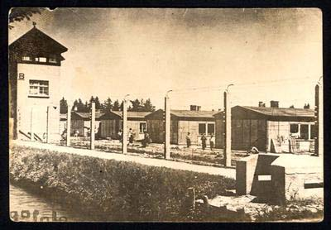
1st Concentration Camp Opens Dachau: March 22, 1933
Notes:
1st Concentration Camp Opens / Dachau – March 22, 1933
The first concentration camp, Dachau, opened on March 22, 1933, primarily to house political opponents of the regime. Theodor Eicke of the SS was Commandant.
Hermann Goering, Minister of the Interior for the State of Prussia, came up with the idea for concentration camps to relieve over-crowding in the jails. He turned to Heinrich Himmler to build the first camp to house some 15,000 political prisoners arrested in Prussia. It was built in an old gunpowder factory in a town 10 miles outside of Munich.
In the first few years of the regime, the concentration camps were instruments of terror, control and punishment, used for the incarceration of political dissidents; later, people defined by the Nazis as “asocial elements” – including the homeless, beggars, gypsies and hardened criminals – were also taken there.

Slide 24
Nazi Intentions Revealed
Since when do you have to agree with people to defend them from injustice?
- Lillian Hellman
Anti-Jewish Policies, 1933
Boycott of Jewish Shops: April 1, 1933
Nazi Book Burnings: May 10, 1933
Notes:
Nazi Intentions Revealed
Teacher Note:
One should note how quickly anti-Jewish actions began after Hitler assumed power. This included the implementation of anti-Jewish policies as well as the Boycott of Jewish Shops and Book Burnings which all occurred within Hitler’s first 4 months in power.
This should have been the time for protest from the German constituency as well as foreign governments. All of these acts were documented in U.S. as well as other foreign newspapers. Protests did occur in the U.S., initiated by the Jewish community, but fell on deaf ears.

Slide 25
Lebensraum
Hitler sought lebensraum =“living room” for its population.
Occupied Austria-Anschluss
Hitler preached German superiority over Slavs in Eastern Europe.

Slide 26
What the Nazis Believed
The Nazis valued authority and order.
The Nazis valued emotion more than reason.
The Nazis valued the community rather than the individual.
The Nazis had a strong belief in the traditional family.
The Nazis were strong nationalists.
The Nazis saw politics as a religion.
The Nazis valued the concept of a select race.
Notes:
What the Nazis Believed: Listing of Beliefs
The Nazis valued authority and order.
Democracy as a workable system was dead. The people needed a mystical savior to lead them. Hitler was their charismatic salvation. He was “Der Führer.”
The Führer was infallible. He gave the laws to Germany.
Referring to the Führer: “In thy service is perfect freedom.”
The Nazis quoted the German writer Goethe, “I would rather commit an injustice than endure disorder.” Thus, the emphasis was placed on order, control, discipline, duty, and sacrifice. “Through the door of death we enter the door of true life … He who does not risk his life to gain it ever anew is already dead, though he still breathes, eats, and drinks. Death is only a departure for the sake of a higher life … We are born to die for Germany.”
To justify Hitler’s decision making, the Nazis quoted Gerhart Hauptmann. “If only life would demand no more solutions from us.” Since people did not want to make decisions, Hitler would do it for them.
The Nazis valued emotion more than reason.
Thinking was criticized. A person should act spontaneously and without question.
The Nazis referred to the educated middle class as “acrobats of the intellect,” and “intelligent beasts with paralysis of the spine.” Hitler called them “rejects of nature.” An SS paper stated that I.Q. was inversely proportional to male fertility. “Intellectuals validate their claim to existence within the community by a paucity of children.”
The Nazis emphasized physical force and strength. Sports were important for developing the body to better serve the state. As one Nazi stated, “A young man who works with a spade for six months on the western fortifications has done more for Germany than an intellectual has done during his whole life.”
War was the ultimate expression of man’s capacity for sacrifice, courage and greatness. “The measure of the strength of a people is always and exclusively its readiness for military conflict.”
The Nazis valued the community rather than the individual.
The overall goal was unity; as Hitler stated: “the preservation and fostering of living beings who are physically and mentally alike.”
As befits the term “totalitarian,” the state would largely control the life of the citizen. As Robert Ley put it, “Our state never releases the human being from the cradle to the grave.” Individuals were to be measured by their usefulness to the state.
The Nazis had a strong belief in the traditional family.
The family was “the germ cell of the state.”
Women were not equal to men. Their purpose, Kindersagen, to be blessed with children. Women were encouraged not to wear make-up (which was considered a conspiracy of the Jews) or pants.
Women were encouraged to have many children. Abortions were called “acts of sabotage against Germany’s racial future,” and strict penalties would be given to doctors performing them. Men were encouraged to be adulterous if their wives were barren.
The Nazis, like many in the early 20th century, were interested in eugenics. To prevent the spread of “bad genes,” the Nazis would recommend the sterilization of those suffering from physical malformation, mental retardation, epilepsy, deafness and blindness.
The Nazis were strong nationalists.
The Nazis used incited appeals to German patriotism. Germany was a nation wronged by history.
To return to its rightful place, Germany should disregard any sense of “morality” in international life. They opposed German participation in any peace organizations such as the League of Nations.
The Nazis were critical of all people except those of the “Volk.” The Poles were “racial anti-types”; the British were worshippers of Mammon. Of the U.S., Hitler stated, “One Beethoven symphony contains more culture than America has produced in her whole history.” To Hitler, America was a Philistine, mongrelized community descended from convicts and the unwanted dregs of society. The Soviets were just above the Jews.
The Nazis saw politics as a religion.
Hitler was looked upon as someone greater than Jesus.
Acts against the state would be immoral in almost a religious sense.
Nazism became a mission: “The Reich must direct the life of nations, individuals and states. The Reich signifies a mission.”
Heinrich Himmler, Hitler’s right-hand-man and overseer of the concentration camps, once wrote to a friend:
I am to prepare a new Nazi religion. I am to draft the new Bible, the bible of the faith…The Führer has decided that, after the victory of the Third Reich, he will abolish Christianity throughout Germany and establish the faith on its ruins.
The latter will preserve the idea of God, but it will be very vague and indistinct. The Führer will replace Christ as the savior of humanity.
Thus, millions and millions of people will say only Hitler’s name in their prayers, and a hundred years from now nothing will be known but the new religion, which will endure for centuries.
The Nazis valued the concept of a select race.
The Germans were a superior race, a group they called the Aryan race.
Germany was destined to lead the world. Nature and fate would produce events to make this happen. The Aryan people would need more territory in which to grow. This desire to expand German boundaries was called lebensraum.
A lower race needs less room, less clothing, less food … than a higher race. The German cannot live in the same fashion as the Pole and the Jew … More bread, more clothing, more living room … these our race must have or it dies.
- Robert Ley, Minister of Labor
Only those of true German blood could be citizens. The Nazis called them the Volk. Concern for the Volk led to a glorification of German “ancestry.” Great Germans of the past, from Beethoven to Wagner, were honored. The Nazis studied Teutonic mythology and took pride in the heroic exploits of their ancestors. Praising the past led to an admiration for the medieval peasant. The peasant virtues of simplicity, honesty and physical labor were glorified.
As a result, Nazi education emphasized German history, biology and physical education.
One of the favorite images of the Nazis was the German painter Albrecht Durer’s “The Knight, Death, and the Devil.” The Nazis saw themselves as heroic, loyal and racially pure knights of the Round Table searching for the Holy Grail.
The Aryans would produce a Golden Age, a millennium which they called the “Third Reich.” The First Reich was the holy Roman Empire of Charlemagne, the Second Reich was under Otto von Bismarck. The Third Reich would last a thousand years.
Source: Furman, Harry, Editor-in-Chief, The Holocaust and Genocide: A Search for Conscience – a Student Anthology. New York: Anti-Defamation League, 1983.

Slide 27
“Second Creation”
Theodor Seuss Geisel, April 3, 1942
Notes:
What the Nazis Believed: Dr. Seuss Editorial Cartoon - “Second Creation”
This editorial cartoon by Dr. Seuss, a.k.a. Theodor Seuss Geisel, appeared in a New York daily newspaper, PM. This short-lived tabloid took no paid advertising. Not until the late 1950’s did Dr. Seuss receive recognition as a children’s writer.
Depicted here is the Nazi desire to have “good” Nazis created from the same mold, i.e. appreciation of human differences was not consistent with Nazi philosophy. Of primary importance was the quality of blind obedience to the Reich. Those that don’t fit the mold must be destroyed.

Slide 28
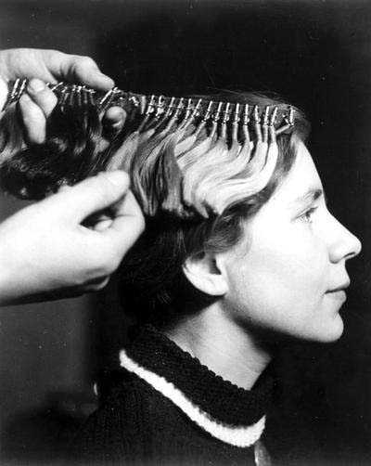
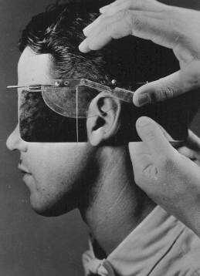
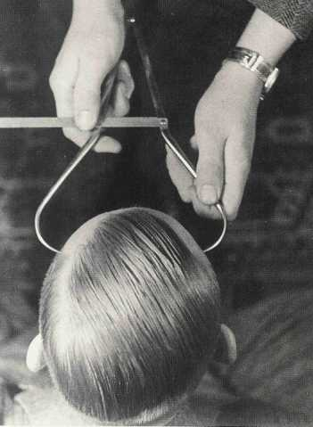
Racial Science
The law of existence requires uninterrupted killing, so that the better may live. – Adolf Hitler
Nazi physicians conducted “bogus” medical research in an effort to identify physical evidence of Aryan superiority & non-Aryan inferiority. The Nazis could not find evidence for their theories of biological racial differences among human beings.
This kit contains 29 hair samples used by doctors, anthropologists, and geneticists to determine racial makeup of individuals.
Establishing racial descent by measuring an ear at the Kaiser Wilhelm Institute for Anthropology.
Caliper to measure skull width.
Notes:
What the Nazis Believed: Racial Science
Teacher Notes:
When studying the stereotypes and justifications used by the Nazis for their ideology of racial hygiene and mass murder, students need to be frequently reminded that just because these hateful policies and beliefs are being discussed in the classroom does not mean that they have any basis in scientific fact.
Jews are not a race. Judaism is a religion that is practiced by Jews. In addition, Judaism has a distinct culture resulting from it’s unique practices that sets it apart from the Christian world.
The Nazis were the first to classify the Jews as a race; Jewishness became an issue of blood rather than religion.
The Nazis viewed Jews as a poisonous “race” which “lived off” other races and weakened them. All Jews, including children, had to be destroyed so as not to reproduce and infect the Aryan race.
Theories of race were central to Nazi ideology which professed a hierarchy of races. At the top were the Aryan, or Master Race. This “supposed” race included person with Nordic characteristics such as blonde hair, blue eyes, fair skin, tall and physically fit. Only Aryans were capable of true civilization, creativity and culture. At the bottom of the hierarchy were those the Nazis considered of mixed blood: the Slavs, Gypsies and the Jews. Life was a constant struggle between the inferior and superior races.
_______________________________________________________________________________
What the Nazis Believed – The Struggle for Existence
History is about the struggle of nations for living space and living space is about the continued existence of a race.
A healthy, vigorous people expands its population base of racially healthy individuals and expands its territorial base at the expense of its neighbors.
A dying people has a declining population, marred by race-mixing and territorial losses to its neighbors.
What the Nazis Believed – The Jews
Jews are special enemies of the German people.
Unlike other races, Jews have no living space of their own.
Jews seek to dominate host peoples by destroying the nation-state and establishing Jewish world domination.
The goals of Jews, by definition, is the genetic bastardization of all peoples and the elimination of all states.
We have the duty to ‘depopulate,’ much as we have the duty of caring for the German population. We shall have to develop a technique for ‘depopulation.’ You will ask what is ‘depopulation’ ? Do I propose to exterminate whole ethnic groups? Yes, it will add up to that. Nature is cruel; therefore we may be cruel too.
- Adolf Hitler in The Burden of Guilt by H. Vogt, p.146
History of Eugenics
The Eugenics Movement was founded in the 19th century by British naturalists. Taking Darwin’s concept of natural selection one step further, the movement promoted the concept that “artificial selection” should aid the process of “natural selection” in order to prevent the degeneration of the human race.
In the early 20th century this concept migrated to the U.S. and attempts were made to wipe out human beings who were considered imperfect. The U.S. legal system supported this concept with laws forcing sterilization, segregation and marriage restrictions. Later this concept traveled to Europe and came to Hitler’s attention.
Now more than ever, Germany needed every citizen to be 100% productive and eugenics was determined to be the way to accomplish this. It was the Nazis who later substituted the term “racial hygiene” for eugenics.
Originally the U.S. applauded Nazi efforts, but as things got out of control, the U.S. reconsidered their stance. While the American Eugenics Movement died by 1939, the Nazis pressed ahead, expanding the concept to include euthanasia.
Early Nazi Racial Hygiene
Shortly after Hitler came to power, a law was passed permitting the government to sterilize anyone suffering from diseases considered hereditary: schizophrenia, depression, retardation, physical deformity, epilepsy, congenital blindness or deafness, even severe alcoholism. This was the beginning of Nazi racial “breeding”, creation of a “perfect race.”
Following this, habitual criminals were sterilized and laws were passed prohibiting marriage or sexual relations between Jews and Germans.
It was also at this time that the “Rhineland Bastards” were sterilized. These were children of black, African soldiers who had been brought to Germany by the French to serve as occupation forces after World War I. These men had married German women and fathered children that Hitler considered an “insult” to the German nation.
Nazi Euthanasia
The loss of the right to reproduce life ultimately progressed to the notion of selectively eliminating those lives “unworthy of life.” Unlike the widely accepted sterilization program, the Nazis never openly declared a formal euthanasia program. The Nazi T-4 Program (referring to the address of the program headquarters at Tiergartenstrasse 4) operated in secrecy, targeting adult patients in government sanitariums and nursing homes who were physically and mentally handicapped. These people were considered “useless consumers” and burdens to the taxpayer.
Victims were murdered by a variety of means and their bodies burned. The T-4 program was responsible for approximately 70,000 deaths, including 5,000 children and a few thousand Jews. Although the program was officially halted in 1941 because of the intervention of Protestant and Catholic clergy, the killings continued until the end of the war.
The gassing technology developed in the T-4 Program proved to be useful later in the elimination of “inferior races” in the extermination camps.

Slide 29
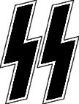
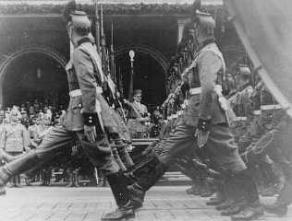
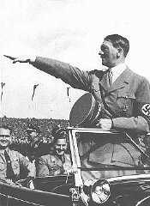
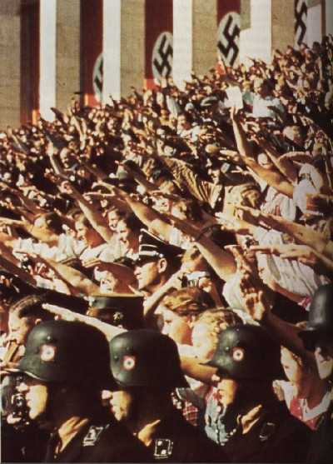
Symbols
Notes:
What the Nazis Believed: Nazi Symbols
Adolf Hitler
Hitler was a powerful and spellbinding orator. He was able to exert a magnetism that persuaded even sophisticated Germans that he was not to be underestimated. At public rallies, Hitler worked himself up to a pitch of near hysteria, and carried his audience with him. Hitler knew how to touch his audience, how to gain their sympathy and play on their fears.
Swastika (Hakenkreuz or Hooked Cross)
The symbol has appeared in religious art from the Byzantine Era (5th & 6th centuries) as well as from Indian tribes in the Americas. Today in India, it is a symbol for the Hindus and Buddhists.
At one point in Hitler’s childhood, he lived across from a large Benedictine monastery. As a youngster, Adolf’s dream was to enter the priesthood. The monastery’s coat of arms’ most prominent feature was a swastika.
Adopted as a Nazi symbol in 1920 and incorporated into the Nazi flag in 1935.
Today, it is illegal to display this symbol in Germany.
Runic Slashes
Thunderbolt symbol used by the SS.
The design was created in 1931 when Walter Heck, an SS leader, drew 2 Sig Runes side by side and noticed the similarity to the initials of the SS. For 2.5 Reichsmark, Heck sold the right of the Sig Runes to the SS.
Salute
Arm outstretched.
This salute was adopted from Mussolini and the Fascists.
“Heil” –Hail
“Sieg Heil” – Hail to Victory
“Heil Hitler” – Hail to Hitler (1st used by Rudolph Hess)
Rallies
Carefully planned mass gatherings to convey strength and power.
Flag
Red background for the social ideas of the movement.
White circle for nationalism.
Twisted cross for the Aryan struggle.
Slogans
“Ein Reich, Ein Volk, Ein Führer” – One State, One People, One Leader
“Die Juden Sind Unser Ungluck” – The Jews Are Our Misfortune.
“Deutschland ist Hitler! Hitler ist Deutschland” – Germany is Hitler! Hitler is Germany!

Slide 30
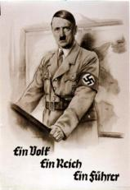
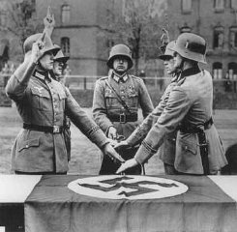
Hitler Becomes Führer
August 2, 1934
With President Paul von Hindenburg's death, Hitler consolidated power by joining the offices of Chancellor and President. He assumed the title of Führer (leader) and Reich Chancellor of the German nation.
Placing one hand upon the Nazi flag and raising the other in obedience, these German soldiers swear their allegiance to the Führer.
"One People, One Empire, One Führer."
Notes:
Hitler Becomes Führer: August 2, 1934
Upon Hindenburg’s death on August 2, 1934, Hitler combined the offices of President (the head of state) and Chancellor (the head of the government) and assumed the title of Führer and Reich Chancellor (Leader and Chancellor).
The day of the President’s death, the cabinet ordered a plebiscite (direct vote) for August 19, 1934 in order for the German people to approve the combination of the two offices. About 95 percent of registered voters in Germany went to the polls and gave Hitler 38 million votes (90%). Hitler could now claim he was Führer of the German nation with the overwhelming approval of the people.
The following day, August 20, 1934, the cabinet decreed the "Law on the Allegiance of Civil Servants and Soldiers of the Armed Forces." All public employees – the military, the civil service, police, teachers, and the judiciary – now had to take a loyalty oath not to the constitution, not to their country, but to Hitler, the Führer. The Nazis’ top jurist proclaimed, “In the old days we used to ask, ‘What is the law?’ Now we ask only, ‘What does the Führer want?’” Thus Hitler became the State and Germans transferred their customary deference and loyalty from the German nation to Hitler personally.
Hitler came to power legally, but not as a result of an election victory or any wave of popular enthusiasm. The Nazis had never won over 37% of the popular vote in a free election. Hitler assumed the reins of government only with the assistance of the old conservative elites, who naively continued to believe that Hitler would pay them deference. What gave Hitler his break was the colossal miscalculation that Hitler could, as a junior politician, be tamed and used by the Establishment. Once in office, Hitler proved to be uncontrollable. He astounded and overwhelmed those who felt they had trapped him. Hitler made legal what others considered to be illegal. Sensible people were sure that Hitler could not last long, that decency, rationality, and political order would reassert themselves. What followed was a terrifying indictment of the power of human indifference and passivity.

Slide 31
Germany Rearms and Expands
Better the German economy and prepare for territorial expansion, the Nazi Party began spending money on rearming Germany.
On March 7, 1936, German troops entered the Rhineland, ignoring the Versailles Treaty. However, neither Britain nor France took any action. Didn’t want a war!
1936, Hitler and Mussolini begin an alliance. Germany, Italy, and later Japan, became known as the Axis Powers.
In March 1938, Germany took over Austria. Then, Hitler demanded the Sudetenland (Czechoslovakia). Following the policy of appeasement, British PM Chamberlain agreed to allow Hitler to occupy the Sudetenland.

Slide 32
Neville Chamberlain (GB Prime Minister)-practiced a policy of appeasement
Didn’t want a war!

Slide 33
Democracy is a process, not a static condition. It is becoming rather than being. It can easily be lost, but never is fully won. It’s essence is eternal struggle.
William H. Hastie, 1st black Federal Judge
What followed was a terrifying indictment of the power of human indifference and passivity.
Notes:
Quote: William H. Hastie, 1st black Federal judge
Democracy is a process, not a static condition. It is becoming rather than being. It can easily be lost, but never is fully won. It’s essence is eternal struggle.
- William H. Hastie, 1st black Federal judge

