Slide 1
Types of Persuasion

Slide 2
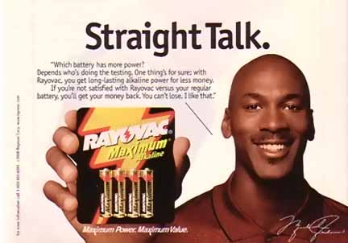

Slide 7
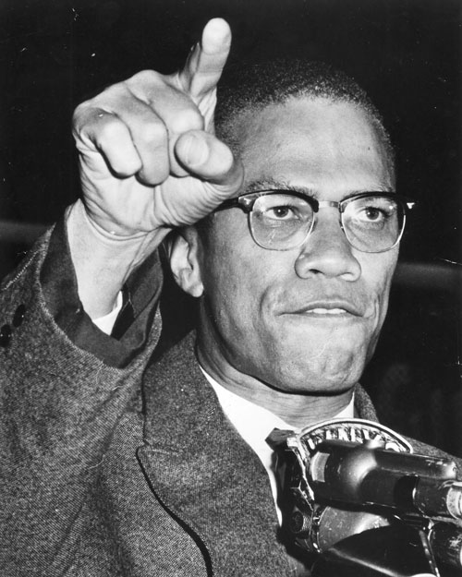
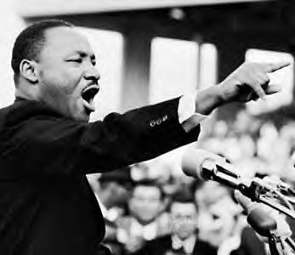
MAY APPEAL TO FUNDAMENTAL RIGHTS

Slide 8
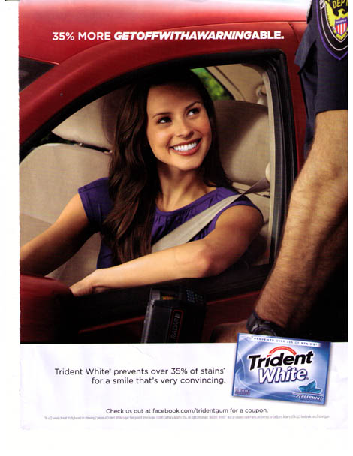

Slide 12
