Slide 1
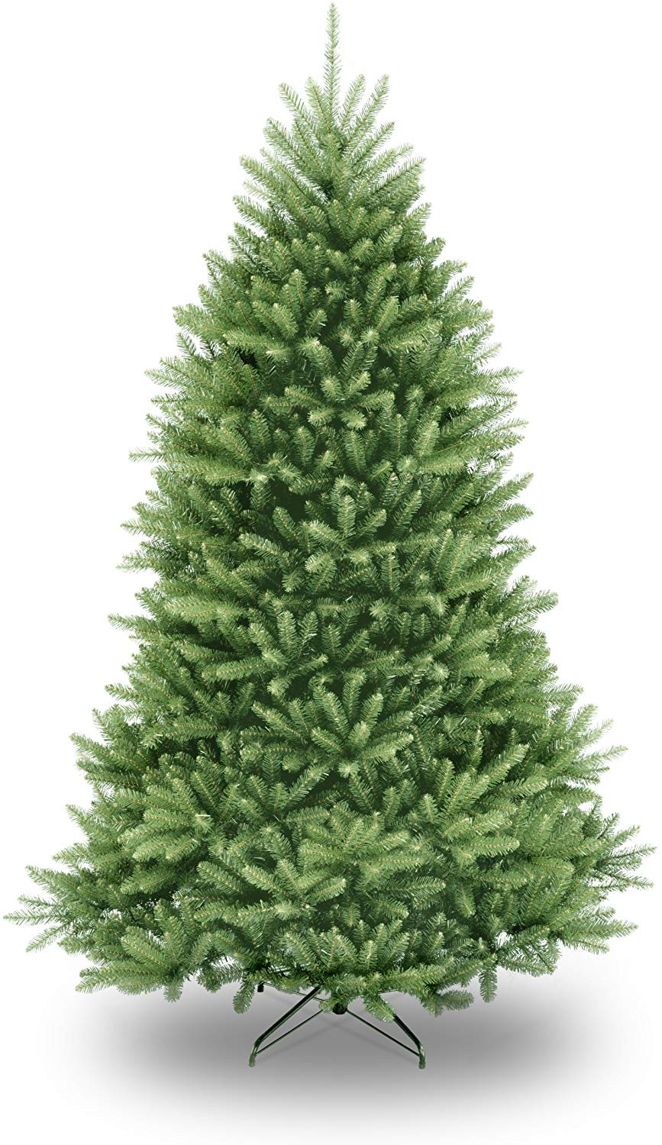
Click here to
Decorate the Tree
Notes:
We are going to:
Program the presents to open
Program the tree to get decorated
3. Change Background

