Slide 1
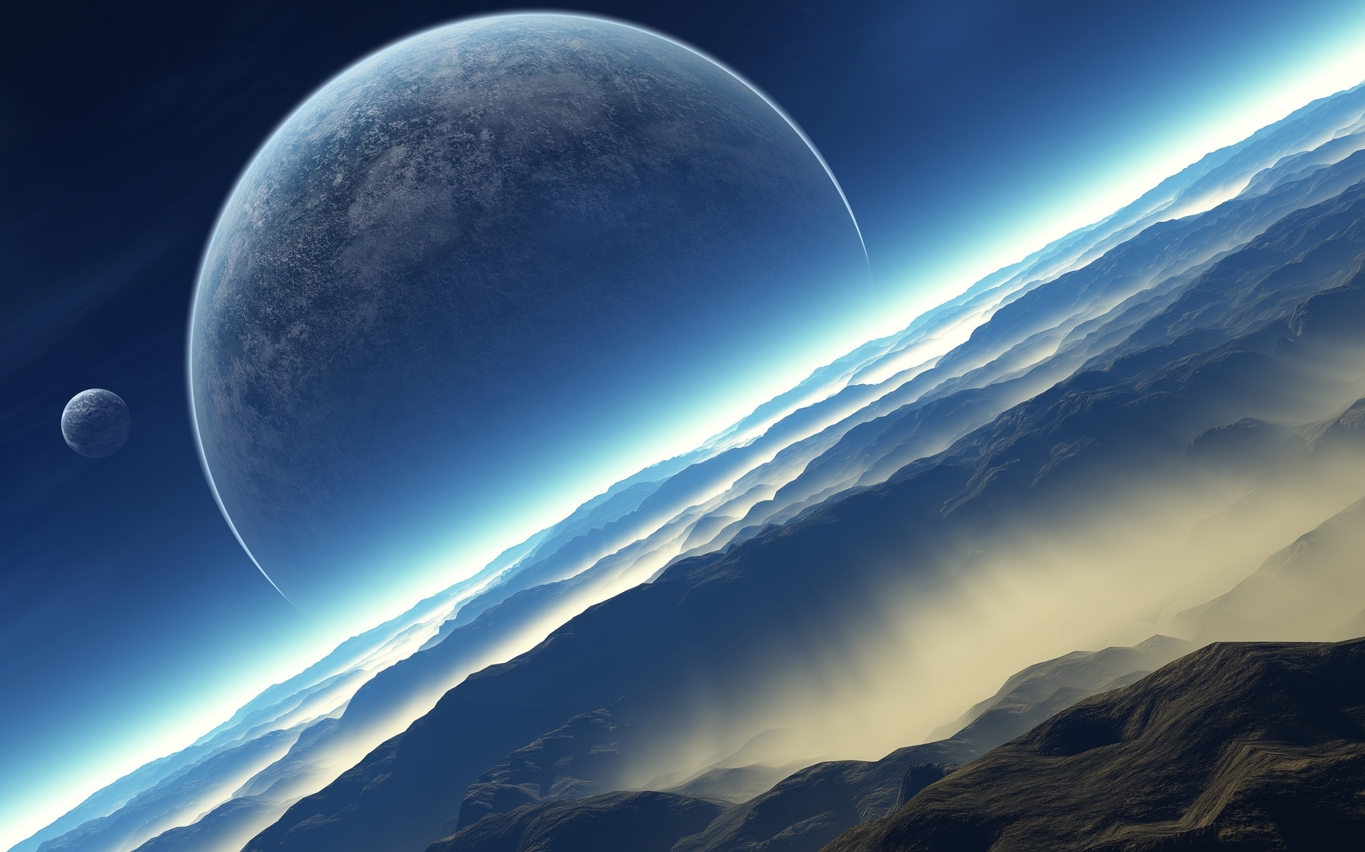
`
Mission Universe
An Adventure Into
Space
START

Slide 2
This is your mission!
You have to answer the questions to make your way to Pluto without crashing
start

Slide 3
Mars Rover Question: How many Rovers has NASA deployed to Mars?
A: six
Not too much, and not too little
B: two.
C:.Seventy-two
Hint

Slide 4
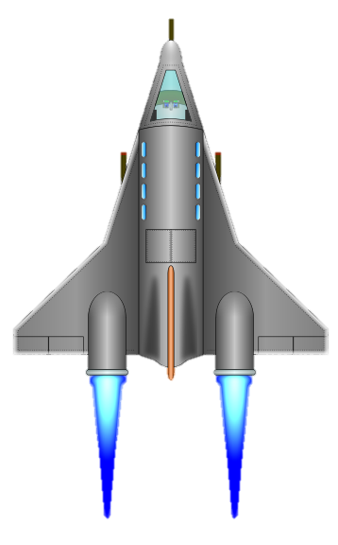
You zoom past Mars

Slide 5
Jupiter largest moon, Ganymede, has a diameter lager than…
A: The Death Star
It didn’t explode.
B: Saturn
C: Mercury.
Hint

Slide 6
You zoom past Jupiter

Slide 7
What is Saturn’s nickname?
A: The jewel of the solar system
If you like it should have put a ring on it.
B: Ring A Ding Ding ☺
C: The Big Giant
Hint

Slide 8
You zoom past Saturn

Slide 9
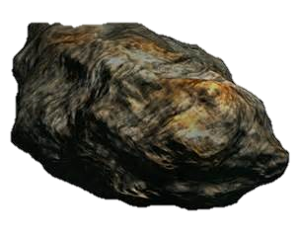
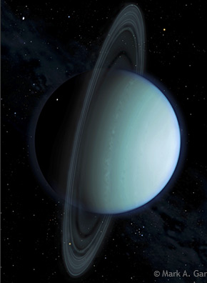
How many known rings does Uranus
have?
it’s high, but not that high
A: 7
B: 14
C: 13
Hint

Slide 10
You zoom past Uranus

Slide 11
How fast has the winds in Neptune’s great dark spot reached?
A: 35 miles per hour
B: 1200 miles per hour
C: 550 miles per hour
It’s fast (The strongest winds in the
Solar system).
Hint

Slide 12
You zoom past Neptune

Slide 13
What god was Pluto named after?
A. Zeus
Not the God married to Hera
B. Hermes
Hint
C. Hades

Slide 14
You zoom past Pluto…
The Final Question!

Slide 15
Final Question
How many craters are on the moon?!?!
A: 500,000
B: 120,000
C: 600,000
1,492.5 x 335
Good luck!!!
Hint

Slide 16
You Won!
Want to play again?
Bibliography
Credits

Slide 17
CREDITS,BRO
Mike, Big Papa, lead developer
Jenson/Yoda/Darth Vader/Darth Maul
/Pokemon Trainer/the dr./ anything I
want that ends in a slash /
Daniel\Boba Fett\Kanan Jarrus\ Luke Skywalker\ Kurt Takera\ Ezra Bridger\Darth maul\Emmet\
Avaleah/ Ashoka Tono/Kati \Carla\Leenda\ Jabril Albane /Jacob and James
PS: Some are alias names(we wanted to be funny)
Special Thanks to Mr. Ward, Our Parents, and Coach Andrew!!
Click here to start game

Slide 18
Bibliography
Space Images provided from
Wonderful Engineering . “Free Space Wallpaper”.
<http://wonderfulengineering.com/download-largest-collection-of-hd-space-wallpapers-for-free/>
January 15, 2015.
Credits

Slide 19
BONUS GAME

Slide 20
How long does its take Saturn to rotate on it’s axis?
A: 10 and a half hrs.
More than 9hrs
but less than 24
B: A day.
C: 14 hours.
Hint

Slide 21
Which of these is not a storm on Neptune?
A: The Small Dark Spot.
Two answers are correct but one is not
B: Great Dark Spot
C: Dark Giant.
Hint

Slide 22
Who discovered Neptune?
A: Jean Joseph Leverrier
He Is not famous
B: Albert Einstien
C: Sean Couturier
Hint

Slide 23
What did Neil Arm storing say when
he was on the moon?
A: that’s one small step for man
One giant leap for mankind
B: that’s one big step for man
C: O my gosh we’re on the MOON!!!

Slide 24
How long does it take Saturn to orbit the sun?
You’re not too old, but you’re not too young.
A: 7 Earth years
B: 29.5 Earth years
C: 72.7 Earth Years
Hint

Slide 25
You won the bonus Game!

Slide 26
Houston… We have a problem!
Your mission has failed.
Please Start Again!:(
Start over!!!!!!!

