Slide 1
Section 10.2
Real Number Exponents
Algebra II

Slide 2
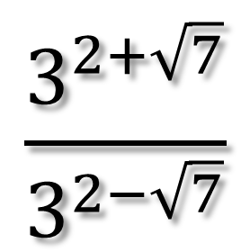
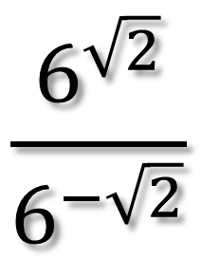
Simplify
$$\frac{6^{\sqrt{2}}}{6^{−\sqrt{2}}}$$
$$\frac{3^{2+\sqrt{7}}}{3^{2−\sqrt{7}}}$$

Slide 3
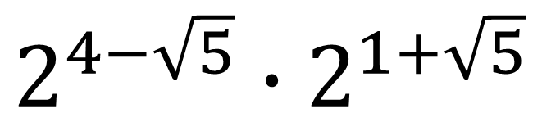
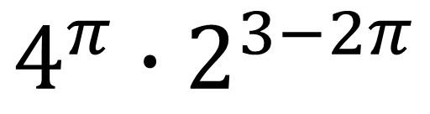
Simplify
$$4^{π}∙2^{3−2π}$$
$$2^{4−\sqrt{5}}∙2^{1+\sqrt{5}}$$

Slide 4
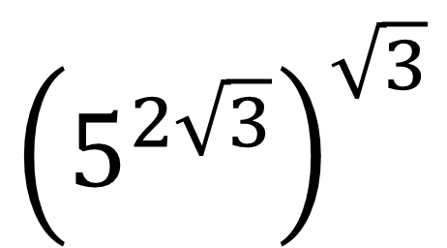
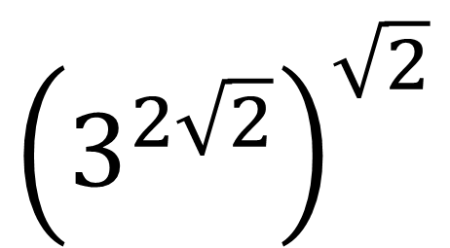
Simplify
$${\left(3^{2\sqrt{2}}\right)}^{\sqrt{2}}$$
$${\left(5^{2\sqrt{3}}\right)}^{\sqrt{3}}$$

Slide 5
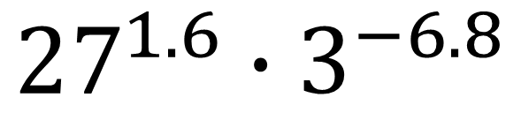
Simplify
$${27}^{1.6}∙3^{−6.8}$$

Slide 6
Solving Exponential Equations
Express each side of the equation as a power of the same base.
Set the exponents equal an then solve.

Slide 7
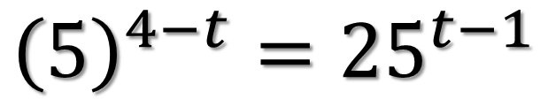
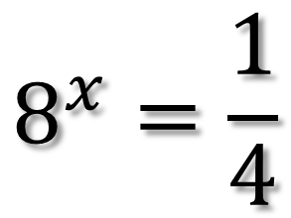
Solve
$$8^{x}=\frac{1}{4}$$
$${\left(5\right)}^{4−t}={25}^{t−1}$$

Slide 8
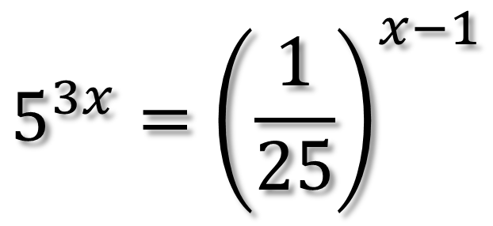
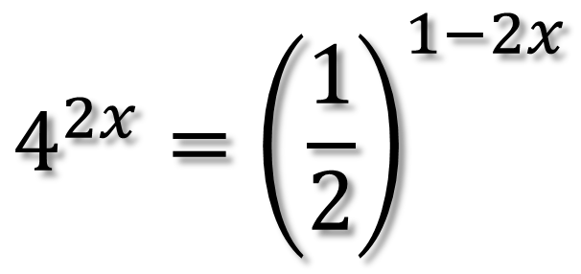
Solve
$$4^{2x}={\left(\frac{1}{2}\right)}^{1−2x}$$
$$5^{3x}={\left(\frac{1}{25}\right)}^{x−1}$$

