Slide 1
Section 10.3 Composition and Inverses of Functions
Algebra II

Slide 2
Composite Functions
The function whose value at $x$ is $f(g\left(x\right))$ is called the COMPOSITE of the function $f$ and $g$. The operation that combines $f$ and $g$ to produce their composite is called a COMPOSITION.
$$If f\left(x\right)=x+1 and g\left(x\right)=5x,$$
$$find f(g\left(5\right))$$
$$find g(f\left(2\right))$$

Slide 3
$$If f\left(x\right)=x+5 and g\left(x\right)=\sqrt{2x},$$
$$f(g\left(3\right))$$
$$g(f\left(3\right))$$

Slide 4
$$If f\left(x\right)=x+5 and g\left(x\right)=\sqrt{2x},$$
$$f(g\left(x\right))$$
$$g(f\left(x\right))$$

Slide 5
$$If f\left(x\right)=\frac{x+4}{2} and g\left(x\right)=2x−4,$$
$$f(g\left(1\right))$$
$$g(f\left(x\right))$$

Slide 6
Inverse Functions
$$The function f and g are Inverse Functions if$$
$$f\left(g\left(x\right)\right)=x for all x in the domain of g$$
$g\left(f\left(x\right)\right)=x for all x in the domain of f.$
$f^{−1}(x)$ is the INVERSE FUNCTION of $f(x)$

Slide 7
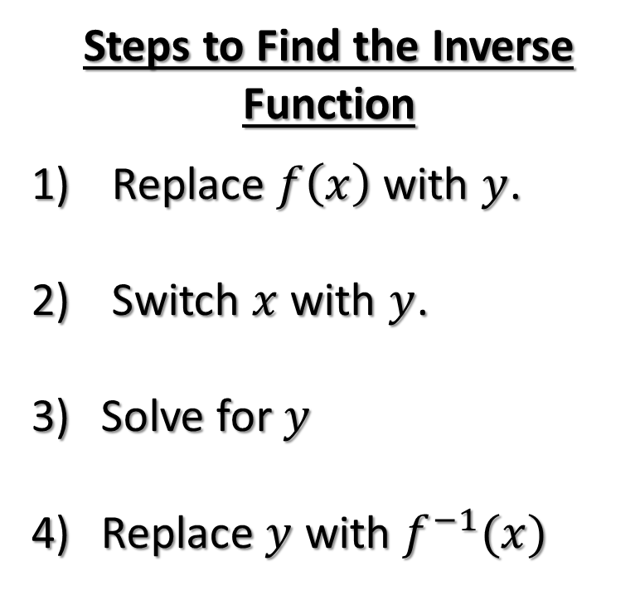
Inverse Functions
$$f\left(x\right)=2x+1$$
Steps to Find the Inverse Function
Replace $f\left(x\right)$ with $y$.
Switch $x$ with $y$.
Solve for $y$
Replace $y$ with $f^{−1}(x)$
$$g\left(x\right)=x^{2}+1$$

Slide 8
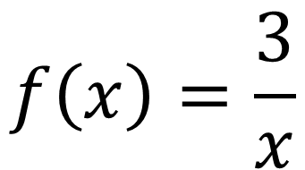
Inverse Functions
$$f\left(x\right)=\frac{3}{x}$$
Steps to Find the Inverse Function
Replace $f\left(x\right)$ with $y$.
Switch $x$ with $y$.
Solve for $y$
Replace $y$ with $f^{−1}(x)$
$$g\left(x\right)=x^{3}−3$$

