Slide 1
Section 10.4
Definition of Logarithms
Algebra II

Slide 2
Logarithms
$$\log_{b}{N}=k$$
Exponent
Base
Argument
$$\log_{b}{N}=k$$
$$b^{k}=N$$

Slide 3




Write Each Equation in Exponential Form
$$\log_{2}{16}=4$$
$$\log_{5}{625}=4$$

Slide 4







Write Each Equation in Logarithmic Form
$$5^{3}=125$$
$$3^{5}=243$$

Slide 5
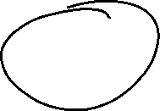






Simplify Each Logarithm
$$\log_{4}{\frac{1}{64}}$$
$$\log_{5}{25}$$

Slide 6



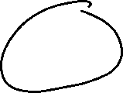



Simplify Each Logarithm
$$\log_{4}{2}$$
$$\log_{2}{8\sqrt{2}}$$

Slide 7
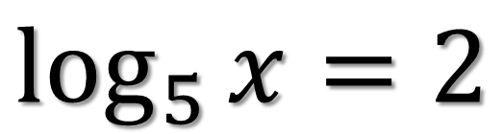


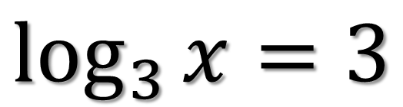



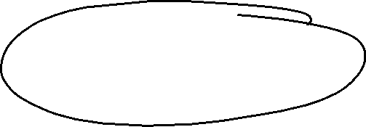

Simplify Each Logarithm
$$\log_{3}{x}=3$$
$$\log_{5}{x}=2$$

Slide 8


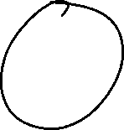
Simplify Each Logarithm
$$\log_{4}{x}=4$$
$$\log_{\frac{1}{2}}{x}=−2$$

Slide 9
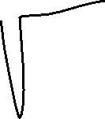






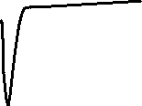


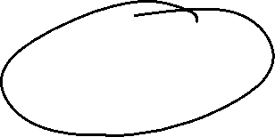

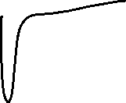
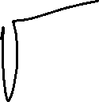

Simplify Each Logarithm
$$\log_{x}{64}=3$$
$$\log_{x}{25}=2$$

Slide 10

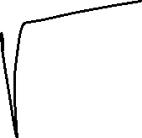
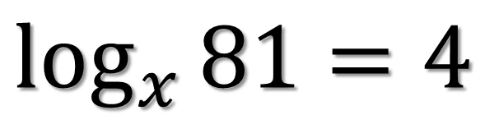

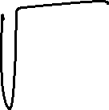












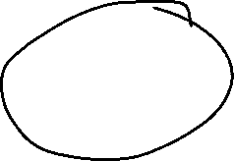
Simplify Each Logarithm
$$\log_{x}{81}=4$$
$$\log_{x}{5}=−1$$

