Slide 1
Section 10.4
Definition of Logarithms
Algebra II

Slide 2
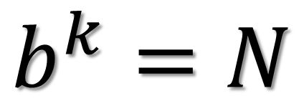
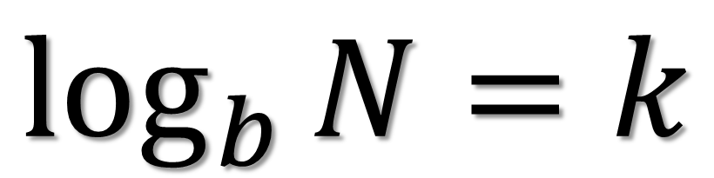
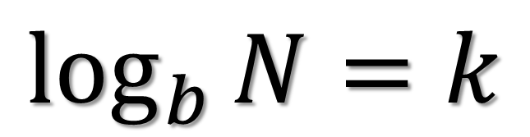
Logarithms
$$\log_{b}{N}=k$$
Exponent
Base
Argument
$$\log_{b}{N}=k$$
$$b^{k}=N$$

Slide 3
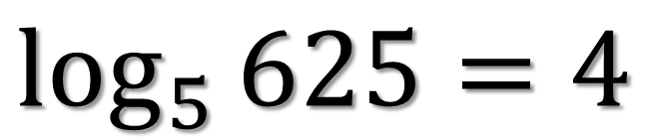
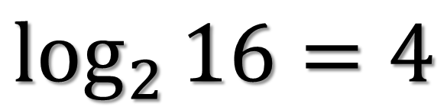
Write Each Equation in Exponential Form
$$\log_{2}{16}=4$$
$$\log_{5}{625}=4$$

Slide 4
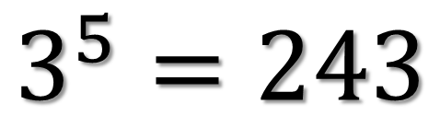
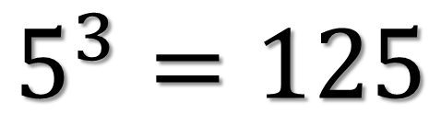
Write Each Equation in Logarithmic Form
$$5^{3}=125$$
$$3^{5}=243$$

Slide 5
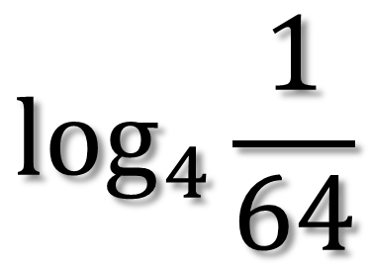
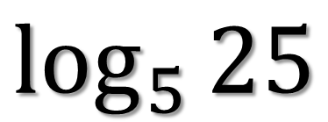
Simplify Each Logarithm
$$\log_{4}{\frac{1}{64}}$$
$$\log_{5}{25}$$

Slide 6
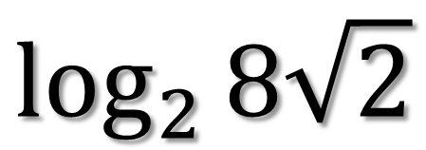
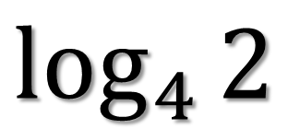
Simplify Each Logarithm
$$\log_{4}{2}$$
$$\log_{2}{8\sqrt{2}}$$

Slide 7
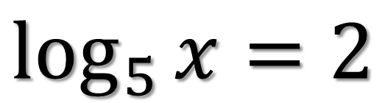
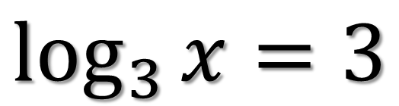
Simplify Each Logarithm
$$\log_{3}{x}=3$$
$$\log_{5}{x}=2$$

Slide 8
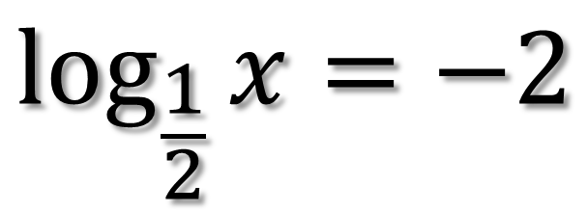
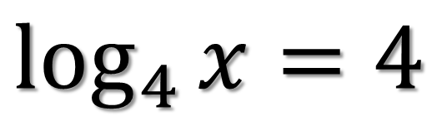
Simplify Each Logarithm
$$\log_{4}{x}=4$$
$$\log_{\frac{1}{2}}{x}=−2$$

Slide 9
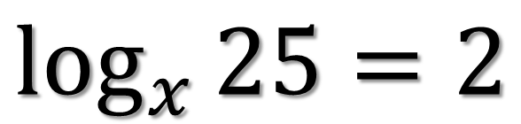
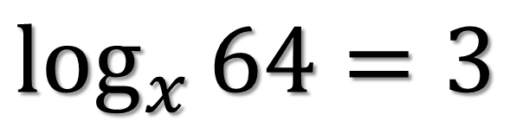
Simplify Each Logarithm
$$\log_{x}{64}=3$$
$$\log_{x}{25}=2$$

Slide 10
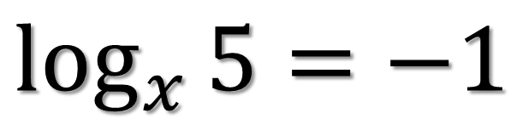
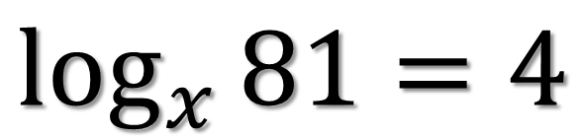
Simplify Each Logarithm
$$\log_{x}{81}=4$$
$$\log_{x}{5}=−1$$

