Slide 1
Section 10.5
Laws of Logarithms
Algebra II

Slide 2
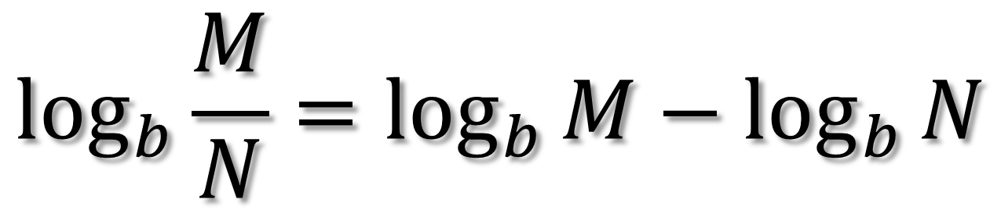



Laws of Logarithms
Let b be the base of a logarithmic function $(b>0,b≠1)$. Let M and N be positive numbers.
$$\log_{b}{MN}=\log_{b}{M}+\log_{b}{N}$$
$$\log_{b}{\frac{M}{N}}=\log_{b}{M}−\log_{b}{N}$$
$$\log_{b}{M^{k}}=k\log_{b}{M}$$

Slide 3

Express $\log_{6}{M^{2}N^{3}}$in terms of $\log_{6}{M}and\log_{6}{N}$.

Slide 4
Express $\log_{10}{a^{2}\sqrt{b}}$in terms of $\log_{10}{a}and\log_{10}{b}$.

Slide 5

Express $\log_{10}{\frac{a^{6}}{\sqrt{b^{3}}}}$ in terms of $\log_{10}{a}and\log_{10}{b}$.

Slide 6
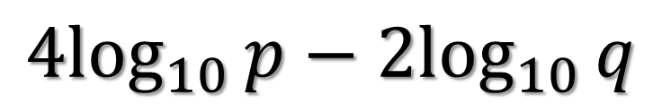
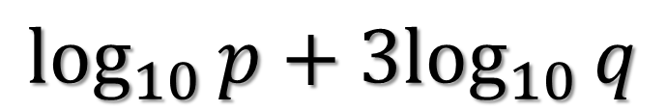
Express as a single logarithm.
$$\log_{10}{p}+3\log_{10}{q}$$
$${4log}_{10}{p}−2\log_{10}{q}$$

Slide 7
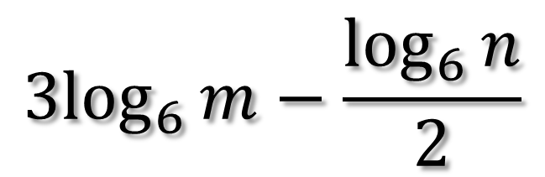
Express as a single logarithm.
$${3log}_{6}{m}−\frac{\log_{6}{n}}{2}$$

Slide 8
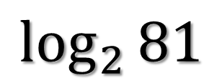
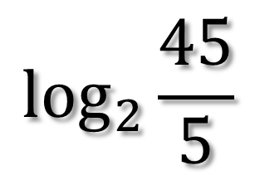
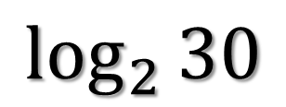
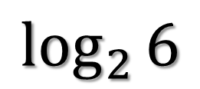
If $\log_{2}{3}=1.585 and\log_{2}{5}=2.322,$ find the following.
$$\log_{2}{81}$$
$$\log_{2}{6}$$
$$\log_{2}{30}$$
$$\log_{2}{\frac{45}{5}}$$

Slide 9
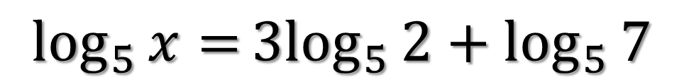
Solve.
$$\log_{5}{x=}3\log_{5}{2+\log_{5}{7}}$$

Slide 10
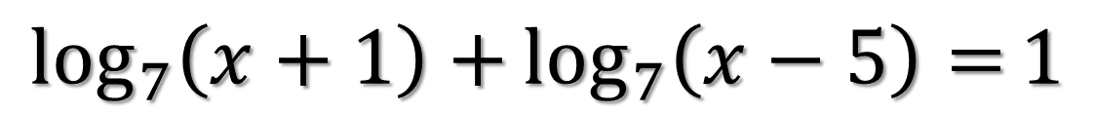
Solve.
$$\log_{7}\left(x+1\right)+\log_{7}\left(x−5\right)=1$$

