Slide 1
Section 1.7 Solving Equations with One Variable
Algebra II

Slide 2
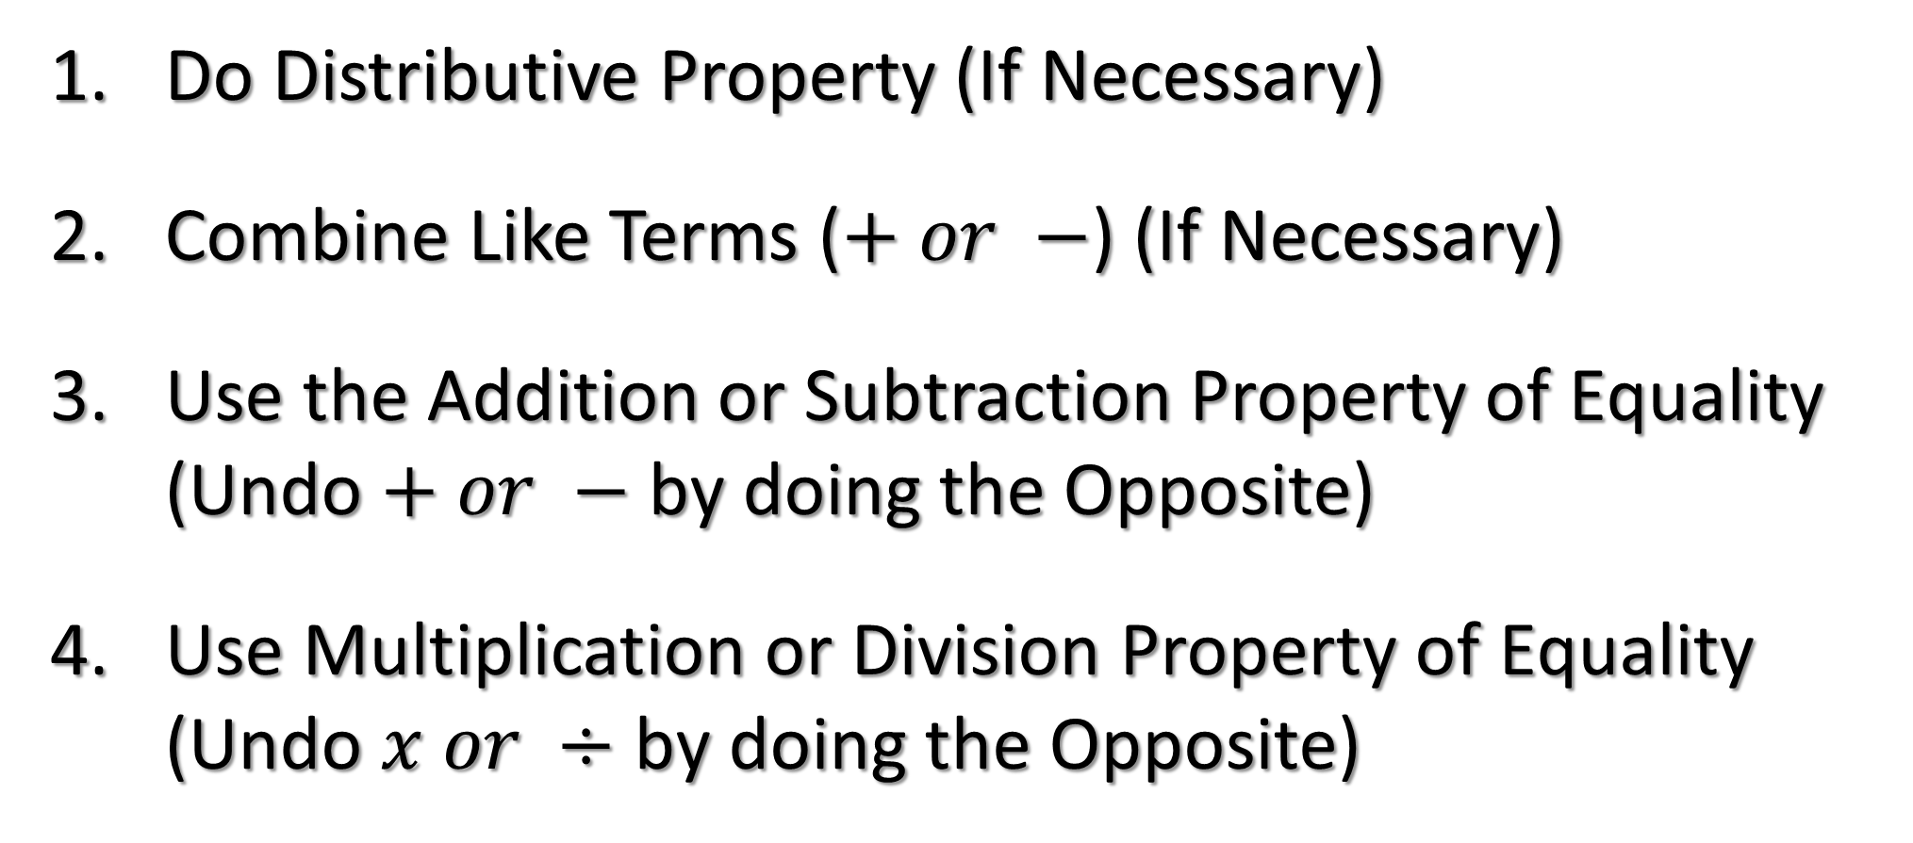
Steps for Solving an Equation
Do Distributive Property (If Necessary)
Combine Like Terms ($+ or −$) (If Necessary)
Use the Addition or Subtraction Property of Equality (Undo $+ or −$ by doing the Opposite)
Use Multiplication or Division Property of Equality (Undo $x or ÷$ by doing the Opposite)

Slide 3
Solve the Equation
$$7=2x+5x$$
$$y+3+4y=13$$

Slide 4
Solve the Equation
$$−7\left(3−4r\right)+8r=6+3(r−9)$$
$$−4r+2\left(1+5r\right)=10+5r$$

Slide 5
Solve the Equation
$$4m+20=4(m+5)$$
$$3\left(v+2\right)=3v−35$$

Slide 6
Solve the Formula for the Given Variable
$$x=y+z, solve for z$$
$$a=bc, solve for b$$

Slide 7
Solve the Formula for the Given Variable
$$A=4(c+r) solve for r$$
$$v=\frac{1}{2}tw, solve for t$$

Slide 8
Solve the Formula for the Given Variable
$$x=\frac{w−r}{t}, solve for w$$
$$3a+4k=−6, solve for k$$

Slide 9
Solve the Formula for the Given Variable
$$t=\frac{x+y}{8}, solve for y$$
$$z=ma−8b^{2}, solve for m$$

