Slide 1
Section 3.10 Relations
Algebra II

Slide 2
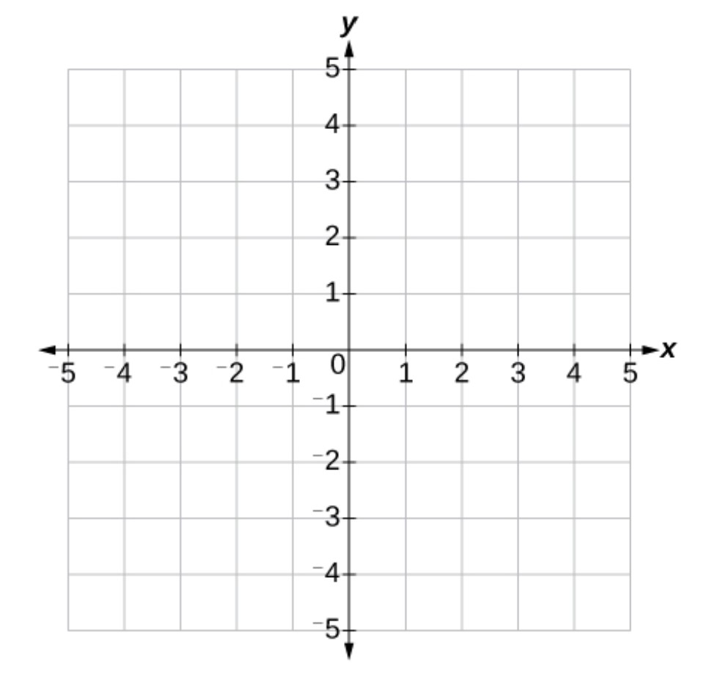
Relations
A Relation is any set of ordered pairs.
$$(x,y)$$
Domain (D): The input of the function (x – value in the Ordered Pair)
Range (R): The output of the function (y – value in the Ordered Pair)
Examples
D | R
$$1$$ | $$1$$
$$−2$$ | $$3$$
$$0$$ | $$1$$
$$1$$
$$−2$$
$$0$$
$$1$$
$$3$$

Slide 3
Functions
A Function is a relation with all unique x-values.
x-values Cannot Repeat
Examples
$$\{\left(4,2\right); \left(2,1\right); \left(−5,2\right)\}$$
D | R
$$4$$ | $$2$$
$$2$$ | $$1$$
$$−5$$ | $$2$$
$$4$$
$$2$$
$$−5$$
$$2$$
$$1$$

Slide 4
Give the Domain & Range for each Relation. Is the Relation a Function?
$$\{\left(2,4\right); \left(8,3\right); \left(6,4\right);(9,9)\}$$
$$\{\left(6,3\right); \left(1,5\right); \left(6,8\right);(2,11)\}$$

Slide 5
List the Ordered Pairs in the given relation. Is the relation a function?
$$1$$
$$6$$
$$3$$
-2
4
6
7
1
3
-2
$$4$$

Slide 6
Vertical Line Test
A relation is a function if and only if no vertical line intersects the graph more than once.

Slide 7
Vertical Line Test
Give the domain and range of each relation graphed below. Is the relation a function?

Slide 8
Graph each relation. State if it is a function. If it is not a function, draw a vertical line that intersects the graph more than once.
$$\{\left(1,2\right); \left(2,0\right); \left(−1,1\right)\}$$
$$\{(−2,1); \left(0,3\right); \left(4,2\right);(0,0)\}$$

