Slide 1
Section 4.3
Multiplying Polynomials
Algebra II

Slide 2


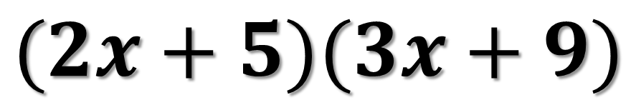



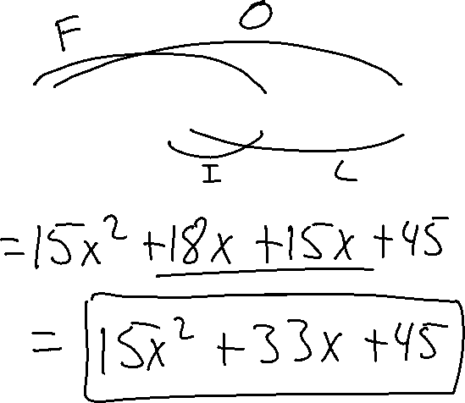
FOIL
$(A+B)(C+D$ $)$
$$(2x+5)(3x+9)$$
$(A+B)(C+D$ $)$
F: FIRST
O: OUTSIDE
I: INSIDE
L: LAST
$(A+B)(C+D$ $)$
$(A+B)(C+D$ $)$
$(A+B)(C+D$ $)$

Slide 3
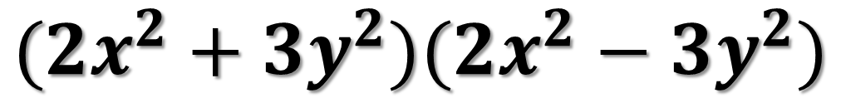
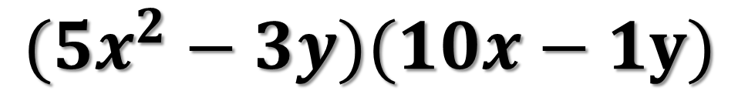
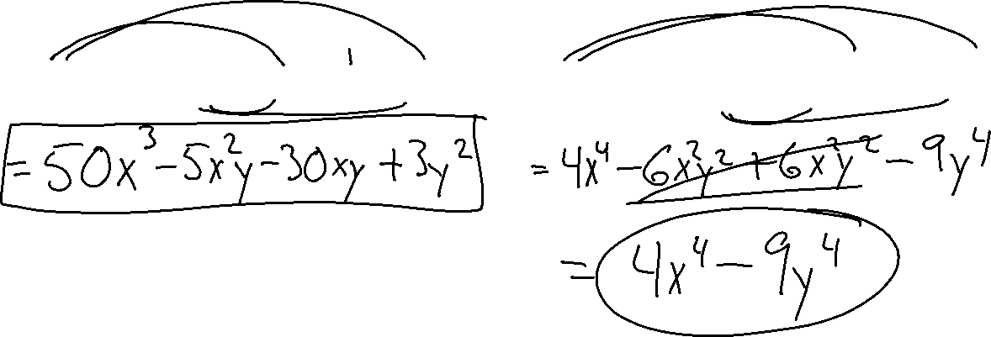
FOIL
$$(5x^{2}−3y)(10x−1y)$$
$$(2x^{2}+3y^{2})(2x^{2}−3y^{2})$$

Slide 4
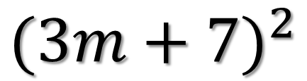
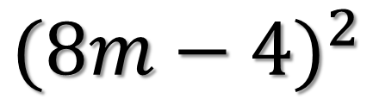
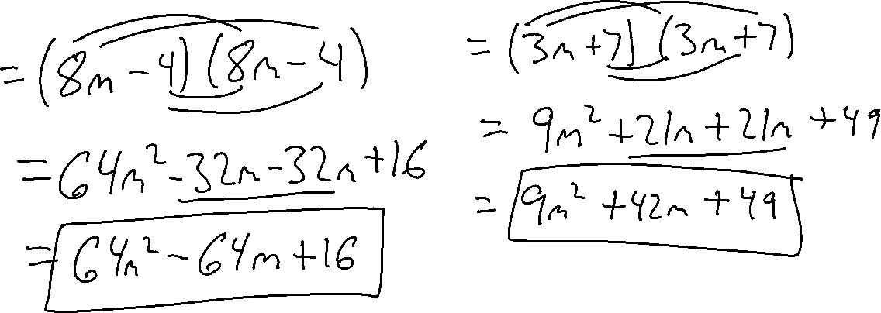
FIND THE SQUARE
$${(8m−4)}^{2}$$
$${(3m+7)}^{2}$$

Slide 5
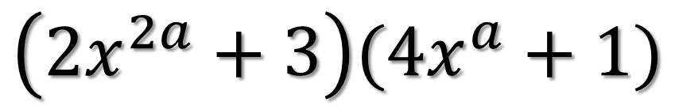
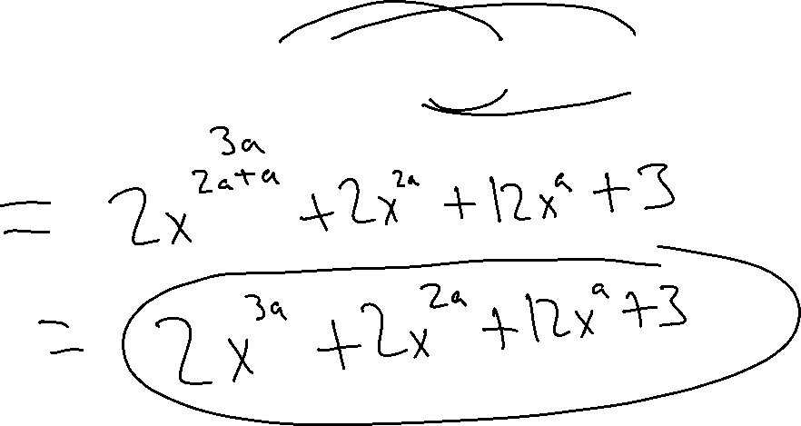
MULTIPLY THE POLYNOMIALS
$$\left(2x^{2a}+3\right)(4x^{a}+1)$$

Slide 6
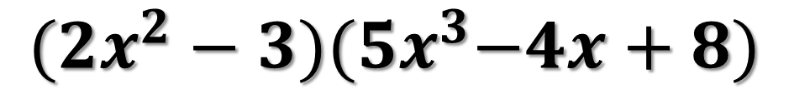
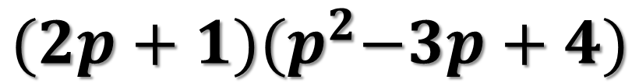
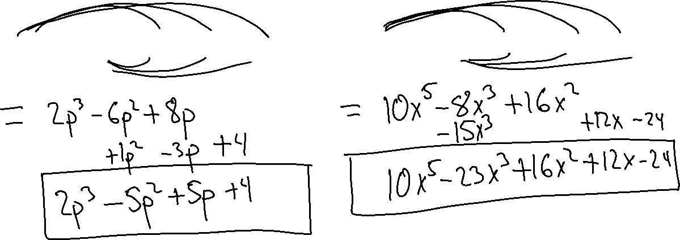
BINOMIAL TIMES A TRINOMIAL
$${(2p+1)(p}^{2}−3p+4)$$
$${(2x^{2}−3)(5x}^{3}−4x+8)$$

Slide 7
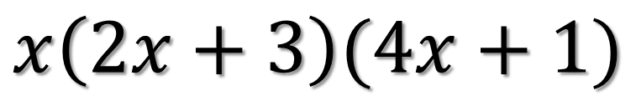
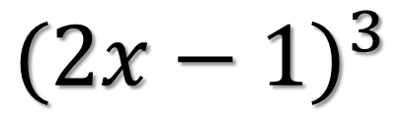
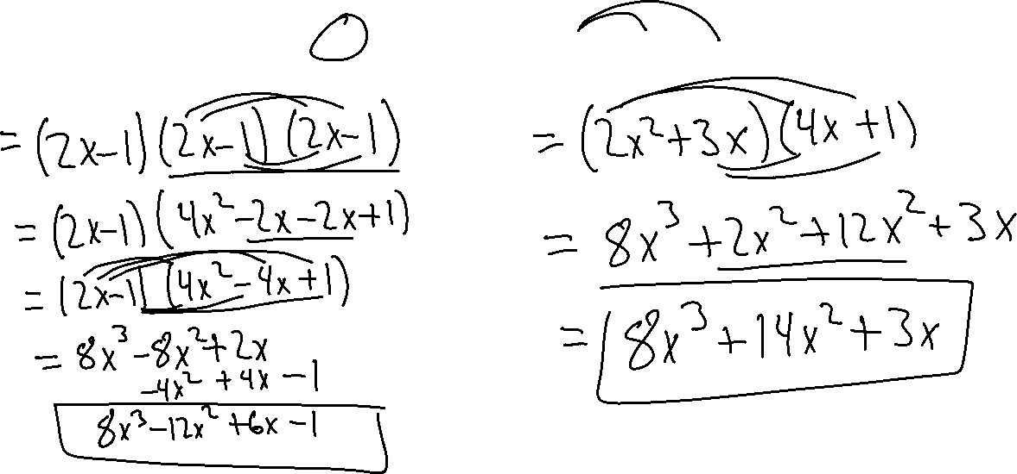
MULTIPLY THE POLYNOMIALS
$${(2x−1)}^{3}$$
$$x\left(2x+3\right)(4x+1)$$

Slide 8
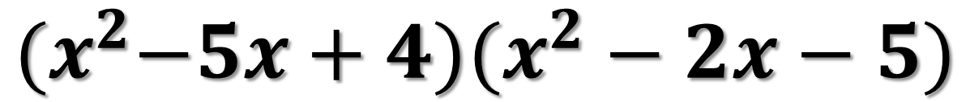
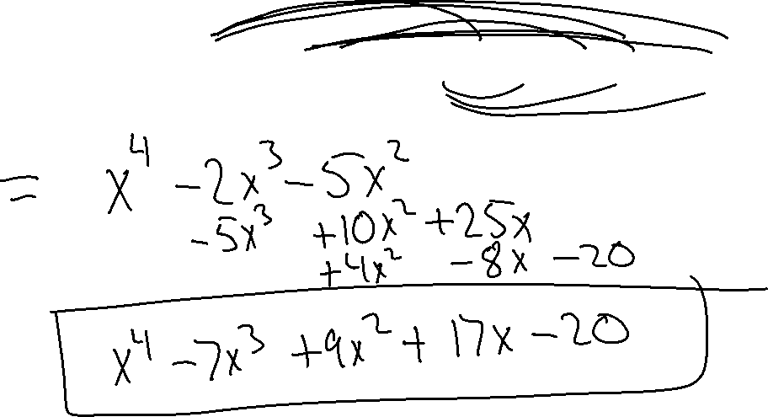
TRINOMIAL TIMES A TRINOMIAL
$${(x}^{2}−5x+4)(x^{2}−2x−5)$$

