Slide 1
Section 4.5 Factoring Polynomials
Algebra II

Slide 2
FACTORING OUT THE GCF
$${8xy}^{2}−14x$$

Slide 3
FACTORING OUT THE GCF
$$−15y^{2}x^{2}+25y^{2}+5y$$
$$16q^{3}p^{2}−36q^{4}+12q^{3}r^{3}$$

Slide 4
Difference of Two Squares
$$25x^{2}−16$$
Factor Out a GCF. (If Possible)
Find the Squares of the First Term
Find the Squares of the Last Term
Put the 1st Term in the 1st Place of Each (), Put the Last Term in the 2nd Place of Each ()
$${9n}^{6}−16$$
$$a^{2}−b^{2}=(a+b)(a−b)$$

Slide 5
Difference of Two Squares
$${45x}^{2}−20$$
Factor Out a GCF. (If Possible)
Find the Squares of the First Term
Find the Squares of the Last Term
Put the 1st Term in the 1st Place of Each (), Put the Last Term in the 2nd Place of Each ()
$${4k}^{2}−36$$
$$a^{2}−b^{2}=(a+b)(a−b)$$

Slide 6
FACTOR BY GROUPING
$$8n^{3}+10n^{2}+20n+25$$

Slide 7
FACTOR BY GROUPING
$$35xy−28x−30y+24$$

Slide 8
FACTOR BY GROUPING
$$15m^{2}h+21nf−35m^{2}f−9nh$$

Slide 9
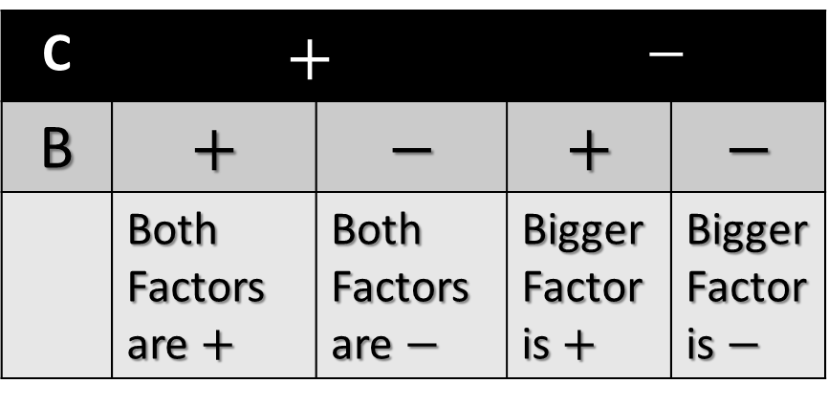
TRINOMIALS (A = 1)
$$a^{2}+15a+56$$
Check for GCF
Write two sets of parenthesis,
( )( ). These will be the factors of the trinomial.
Think of factors of c that add up to b. (Use Chart for Signs)
C | $$+$$ |  | $$−$$
B | $$+$$ | $$−$$ | $$+$$ | $$−$$
 | Both Factors are $+$ | Both Factors are $−$ | Bigger Factor is $+$ | Bigger Factor is $−$

Slide 10
TRINOMIALS (A = 1)
$$d^{2}−10d+24$$
Check for GCF
Write two sets of parenthesis,
( )( ). These will be the factors of the trinomial.
Think of factors of c that add up to b. (Use Chart for Signs)
C | $$+$$ |  | $$−$$
B | $$+$$ | $$−$$ | $$+$$ | $$−$$
 | Both Factors are $+$ | Both Factors are $−$ | Bigger Factor is $+$ | Bigger Factor is $−$

Slide 11
TRINOMIALS (A = 1)
$$x^{2}+x−56$$
Check for GCF
Write two sets of parenthesis,
( )( ). These will be the factors of the trinomial.
Think of factors of c that add up to b. (Use Chart for Signs)
C | $$+$$ |  | $$−$$
B | $$+$$ | $$−$$ | $$+$$ | $$−$$
 | Both Factors are $+$ | Both Factors are $−$ | Bigger Factor is $+$ | Bigger Factor is $−$

Slide 12
TRINOMIALS (A = 1)
$$n^{2}−2n−48$$
Check for GCF
Write two sets of parenthesis,
( )( ). These will be the factors of the trinomial.
Think of factors of c that add up to b. (Use Chart for Signs)
C | $$+$$ |  | $$−$$
B | $$+$$ | $$−$$ | $$+$$ | $$−$$
 | Both Factors are $+$ | Both Factors are $−$ | Bigger Factor is $+$ | Bigger Factor is $−$

Slide 13
TRINOMIALS (A = 1)
$${6d}^{2}−36d+30$$
Check for GCF
Write two sets of parenthesis,
( )( ). These will be the factors of the trinomial.
Think of factors of c that add up to b. (Use Chart for Signs)
C | $$+$$ |  | $$−$$
B | $$+$$ | $$−$$ | $$+$$ | $$−$$
 | Both Factors are $+$ | Both Factors are $−$ | Bigger Factor is $+$ | Bigger Factor is $−$

Slide 14
TRINOMIALS (A = 1)
$${2a}^{2}−4a−48$$
Check for GCF
Write two sets of parenthesis,
( )( ). These will be the factors of the trinomial.
Think of factors of c that add up to b. (Use Chart for Signs)
C | $$+$$ |  | $$−$$
B | $$+$$ | $$−$$ | $$+$$ | $$−$$
 | Both Factors are $+$ | Both Factors are $−$ | Bigger Factor is $+$ | Bigger Factor is $−$

Slide 15
TRINOMIALS (A = 1)
$${3x}^{2}−45x+150$$
Check for GCF
Write two sets of parenthesis,
( )( ). These will be the factors of the trinomial.
Think of factors of c that add up to b. (Use Chart for Signs)
C | $$+$$ |  | $$−$$
B | $$+$$ | $$−$$ | $$+$$ | $$−$$
 | Both Factors are $+$ | Both Factors are $−$ | Bigger Factor is $+$ | Bigger Factor is $−$

Slide 16
Sum & Difference of Cubes
FORMULAS
$${64a}^{3}+1$$
$$a^{3}+b^{3}={(a+b)(a}^{2}−ab+b^{2})$$
$$a^{3}−b^{3}={(a−b)(a}^{2}+ab+b^{2})$$
Remember SOAP
S = Same
O = Opposite
AP = Always Positive

Slide 17
Sum & Difference of Cubes
FORMULAS
$$m^{3}−216$$
$$a^{3}+b^{3}={(a+b)(a}^{2}−ab+b^{2})$$
$$a^{3}−b^{3}={(a−b)(a}^{2}+ab+b^{2})$$
Remember SOAP
S = Same
O = Opposite
AP = Always Positive

Slide 18
Sum & Difference of Cubes
FORMULAS
$${27x}^{6}−8$$
$$a^{3}+b^{3}={(a+b)(a}^{2}−ab+b^{2})$$
$$a^{3}−b^{3}={(a−b)(a}^{2}+ab+b^{2})$$
Remember SOAP
S = Same
O = Opposite
AP = Always Positive

Slide 19
Sum & Difference of Cubes
FORMULAS
$${32a}^{3}+{108b}^{3}$$
$$a^{3}+b^{3}={(a+b)(a}^{2}−ab+b^{2})$$
$$a^{3}−b^{3}={(a−b)(a}^{2}+ab+b^{2})$$
Remember SOAP
S = Same
O = Opposite
AP = Always Positive

