Slide 1
Section 4.6
Factoring Quadratic Polynomials
Algebra II

Slide 2

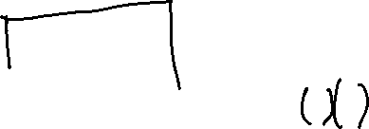

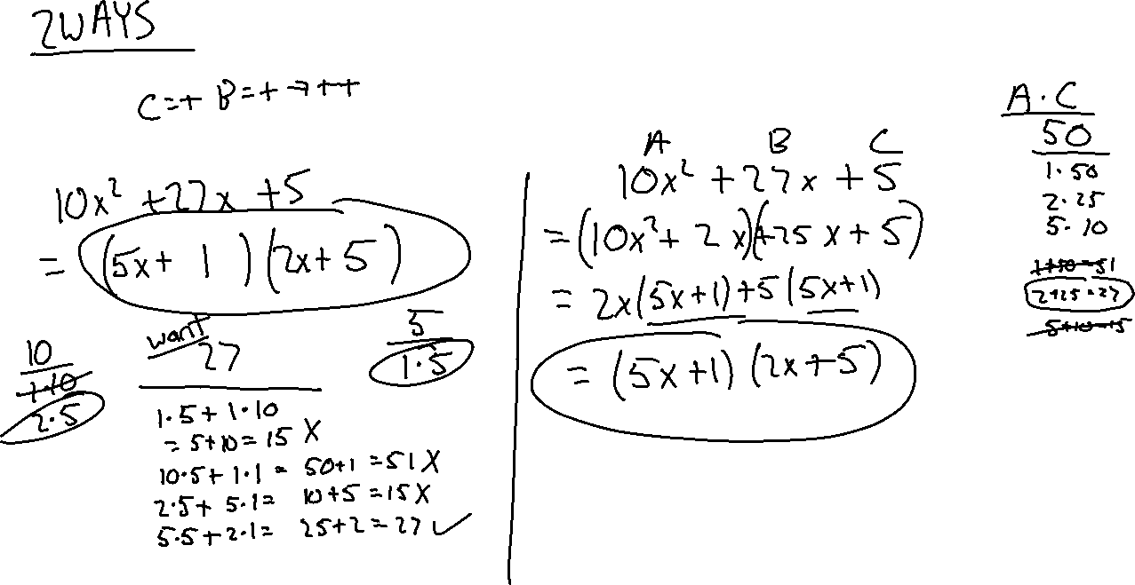
Factoring Trinomials ($A≠1)$
$$10x^{2}+27x+5$$

Slide 3

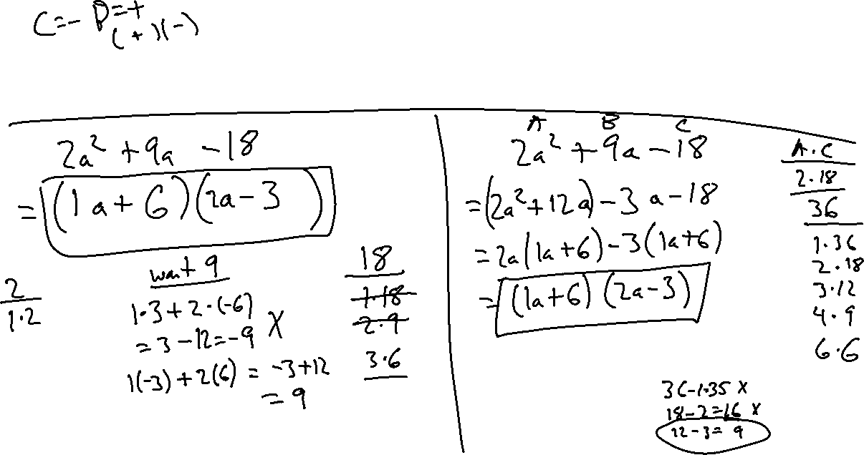
Factoring Trinomials ($A≠1)$
$$2a^{2}+9a−18$$

Slide 4

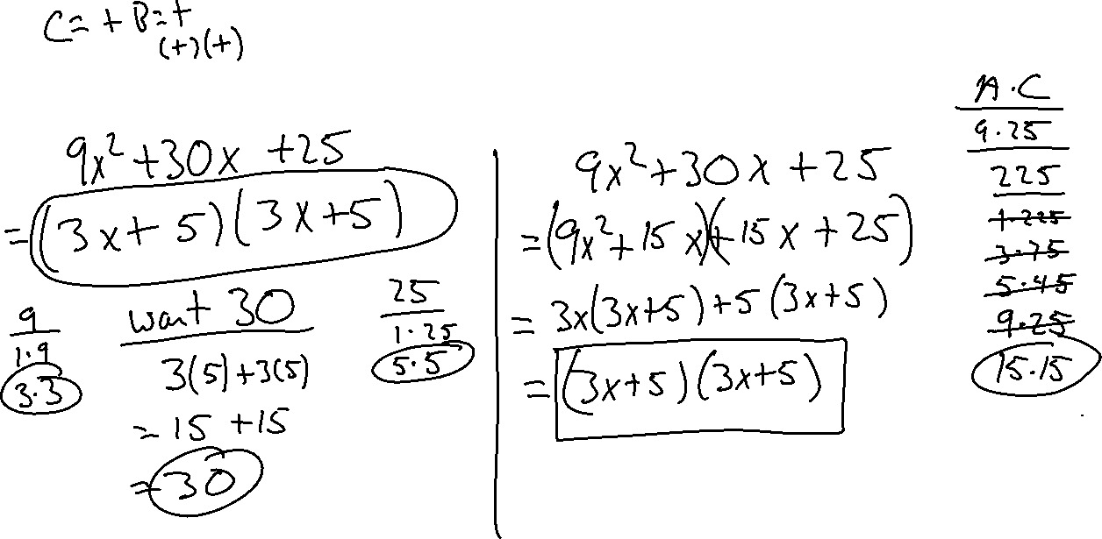
Factoring Trinomials ($A≠1)$
$$9x^{2}+30x+25$$

Slide 5

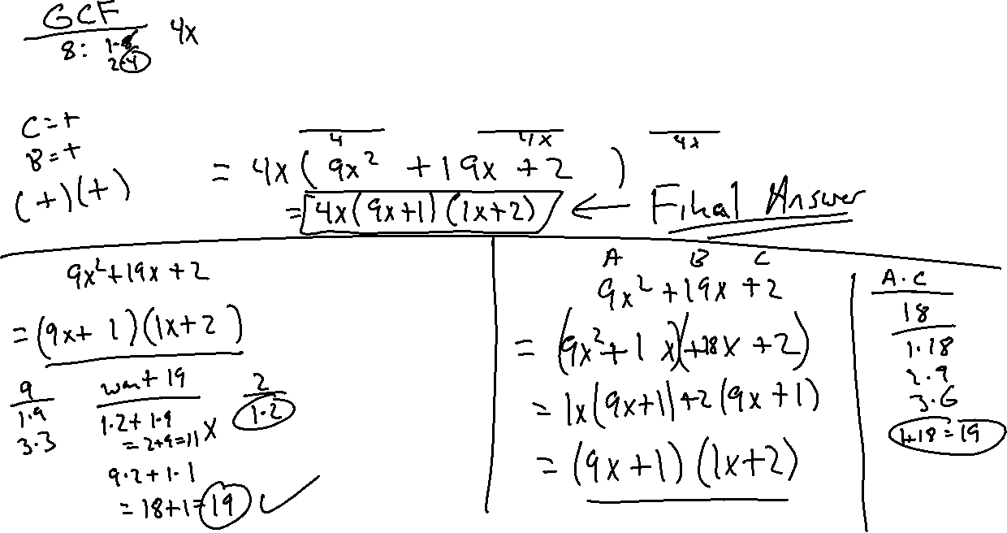
Factoring Trinomials ($A≠1)$
$$36x^{3}+76x^{2}+8x$$

Slide 6

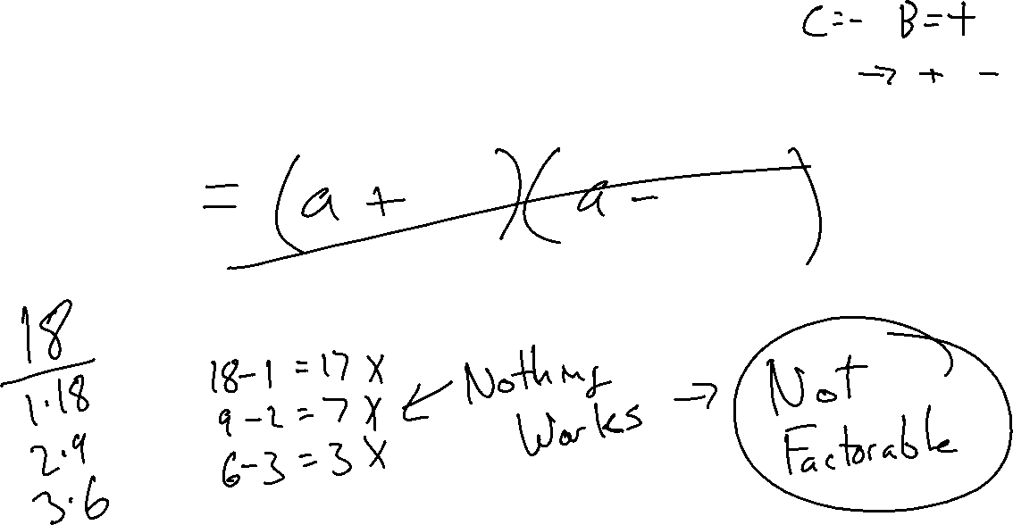
Factoring Trinomials
$$a^{2}+6a−18$$

Slide 7
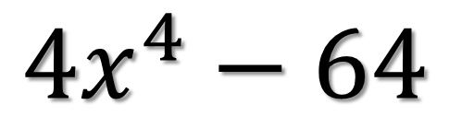
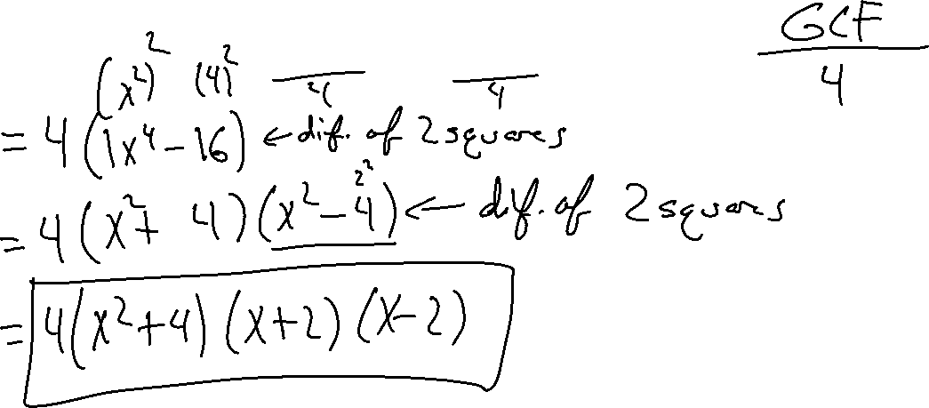
FACTORING COMPLETELY
$${4x}^{4}−64$$

Slide 8

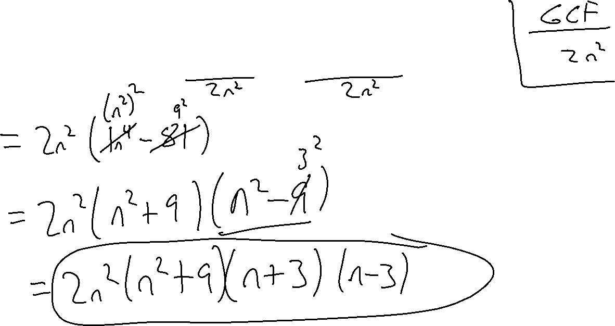
FACTORING COMPLETELY
$$2n^{6}−162n^{2}$$

