Slide 1
Section 4.7
Solving Polynomial Equations
Algebra II

Slide 2
POLYNOMIAL EQUATIONS
A ROOT of a Polynomial Equation is a value that satisfies the equation.
  Also called a Solution
Zero-Product Property
Write the equation with 0 as one side.
Factor the other side of the equation.
Solve the equation obtained by setting each factor equal to 0.

Slide 3
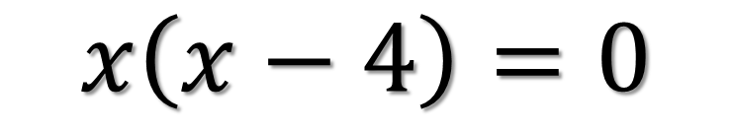
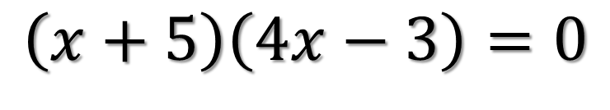
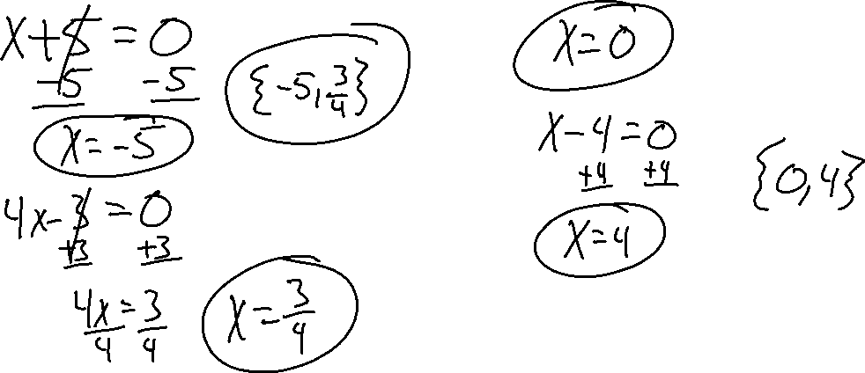
Solve
$$\left(x+5\right)\left(4x−3\right)=0$$
$$x\left(x−4\right)=0$$

Slide 4
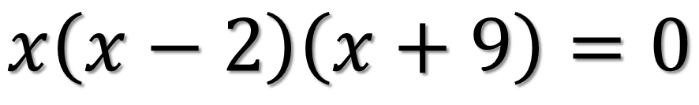
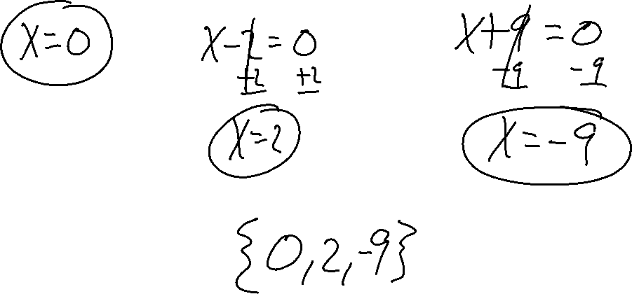
Solve
$$x\left(x−2\right)\left(x+9\right)=0$$

Slide 5
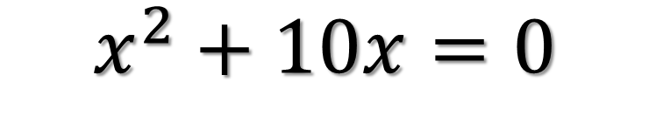
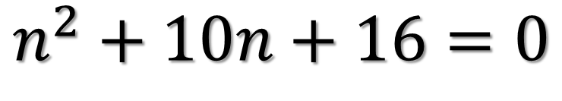
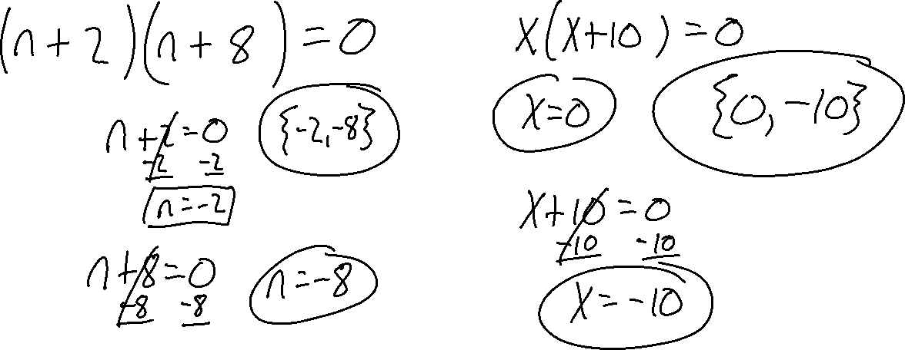
Solve
$$n^{2}+10n+16=0$$
$$x^{2}+10x=0$$

Slide 6
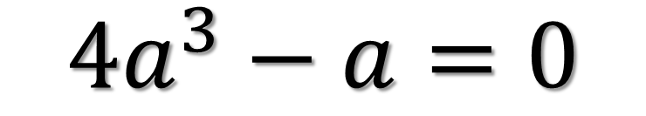
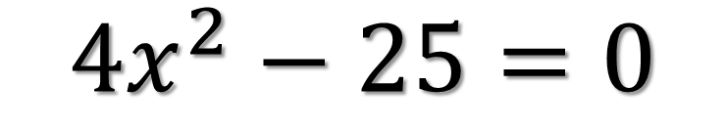
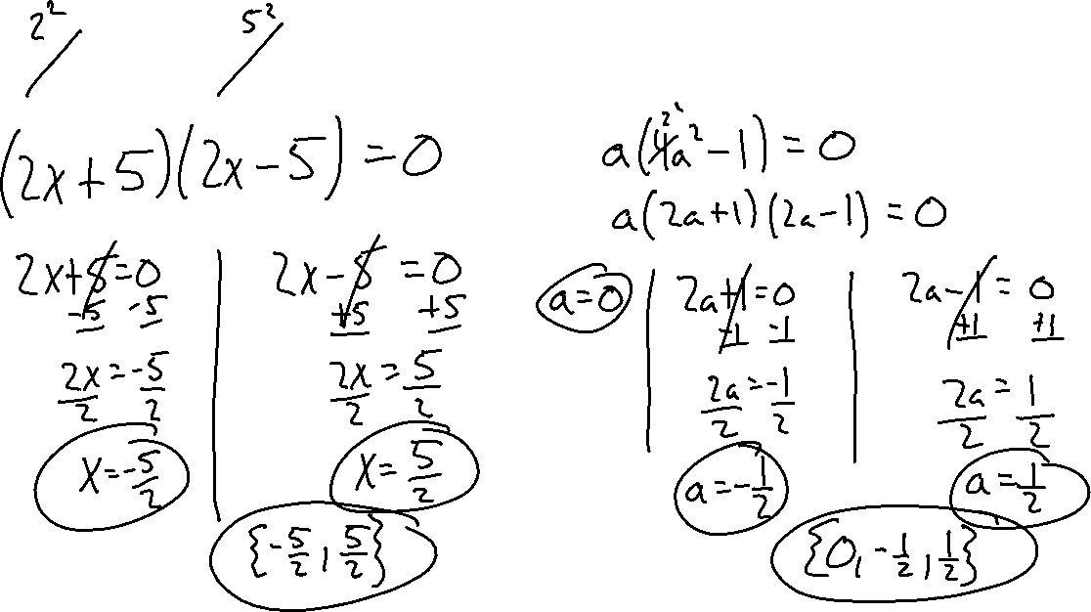
Solve
$${4x}^{2}−25=0$$
$${4a}^{3}−a=0$$

Slide 7
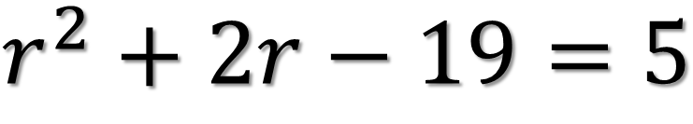
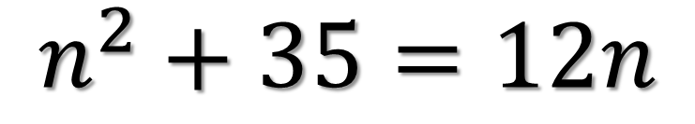
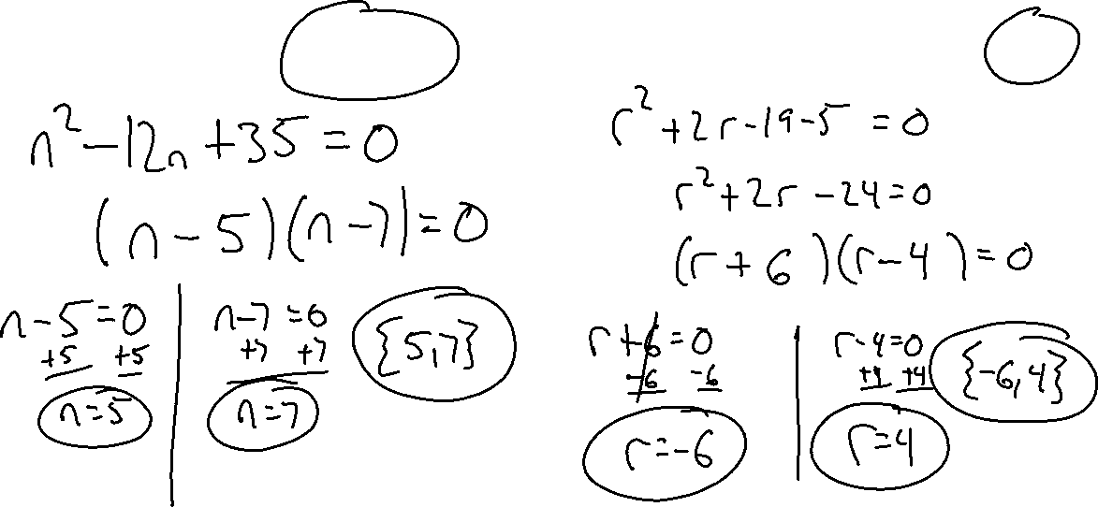
Solve
$$n^{2}+35=12n$$
$$r^{2}+2r−19=5$$

Slide 8
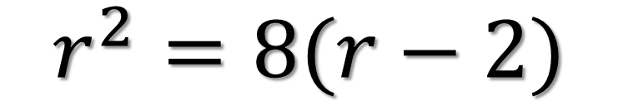
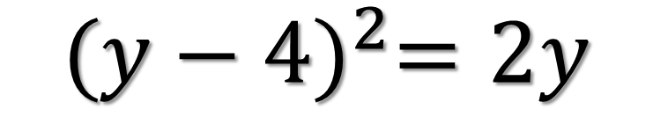
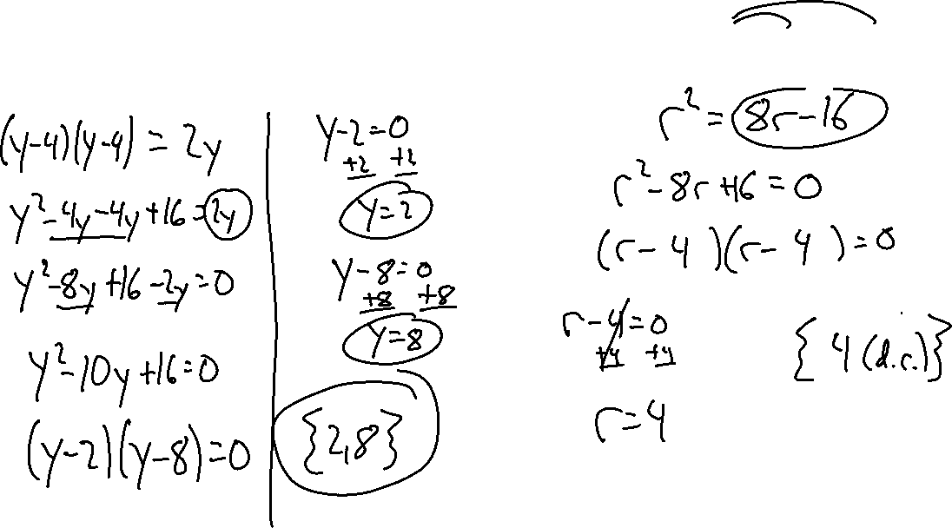
Solve
$${(y−4)}^{2}=2y$$
$$r^{2}=8(r−2)$$

