Slide 1
Section 5.1
Quotients of Monomials
Algebra II

Slide 2
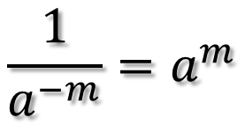





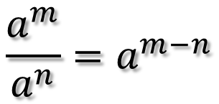
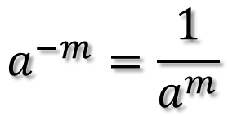
Laws of Exponents
Multiplying Rule
Division Rule
$$a^{m}∙a^{n}=a^{m+n}$$
$$\frac{a^{m}}{a^{n}}=a^{m−n}$$
Keep the base the same, add the exponents.
Example:
Keep the base the same, subtract the exponents.
Example:
$${2x}^{2}∙{4x}^{5}$$
$$\frac{x^{3}}{x^{1}}$$
Power Rule
Negative Exponent Rule
$${(a^{m})}^{n}=a^{mn}$$
$$a^{−m}=\frac{1}{a^{m}}$$
$$\frac{1}{a^{−m}}=a^{m}$$
Keep the base the same, multiply the exponents.
Example:
Negative on top, bring it down.
Negative on bottom, bring it up.
$${(x^{2})}^{4}$$

Slide 3
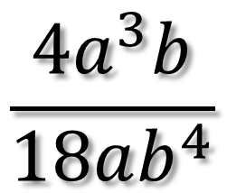
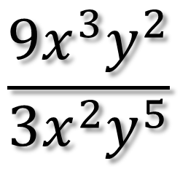
Simplify
$$\frac{{9x}^{3}y^{2}}{3x^{2}y^{5}}$$
$$\frac{{4a}^{3}b}{18ab^{4}}$$

Slide 4
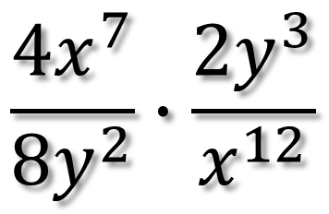
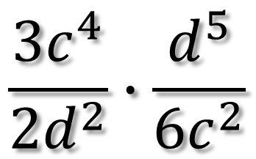
Simplify
$$\frac{{3c}^{4}}{{2d}^{2}}∙\frac{d^{5}}{{6c}^{2}}$$
$$\frac{{4x}^{7}}{{8y}^{2}}∙\frac{{2y}^{3}}{x^{12}}$$

Slide 5
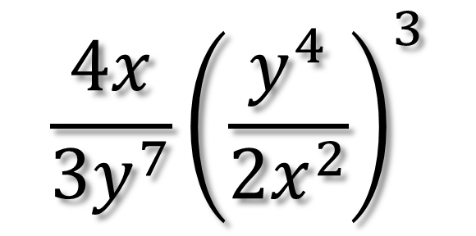
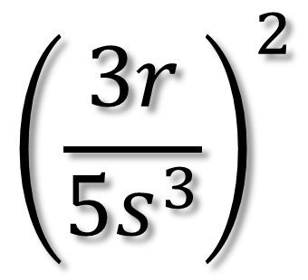
Simplify
$${\left(\frac{3r}{5s^{3}}\right)}^{2}$$
$$\frac{4x}{{3y}^{7}}{\left(\frac{y^{4}}{2x^{2}}\right)}^{3}$$

Slide 6
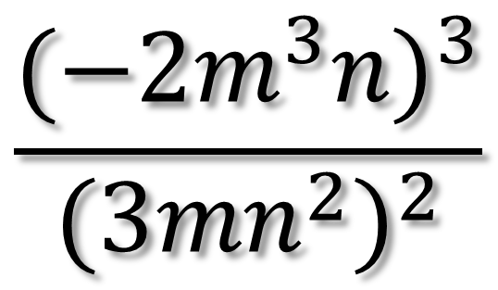
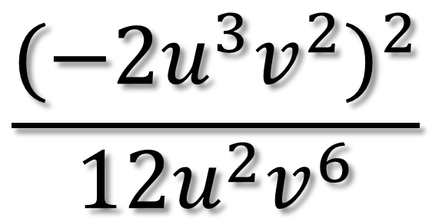
Simplify
$$\frac{{(−2u^{3}v^{2})}^{2}}{12u^{2}v^{6}}$$
$$\frac{{(−2m^{3}n)}^{3}}{{(3{mn}^{2})}^{2}}$$

