Slide 1
Section 5.2
Zero and Negative Exponents
Algebra II

Slide 2



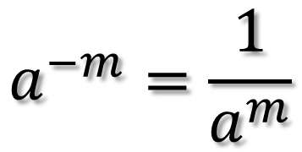
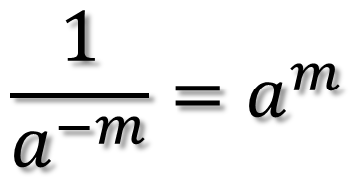
Laws of Exponents
Zero Rule
Negative Exponent Rule
$$a^{0}=1$$
$$a^{−m}=\frac{1}{a^{m}}$$
$$\frac{1}{a^{−m}}=a^{m}$$
Anything Raised to the Zero Power is Equal to 1.
Example:
Negative on top, bring it down.
Negative on bottom, bring it up.
$${(3x^{−2}yz^{2})}^{0}$$

Slide 3
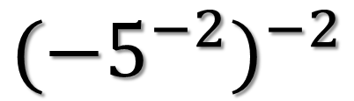
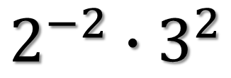
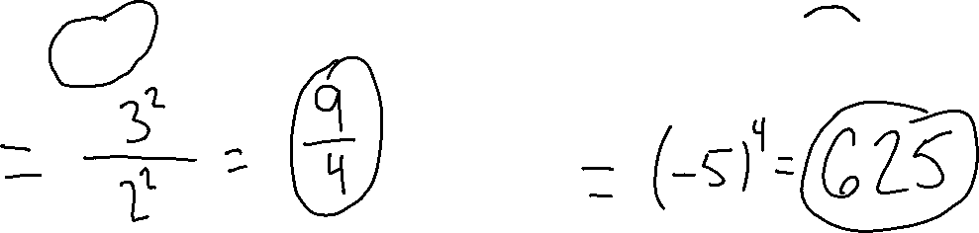
Simplify
$$2^{−2}∙3^{2}$$
$${({−5}^{−2})}^{−2}$$

Slide 4
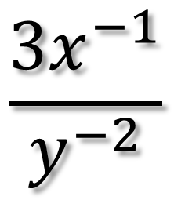
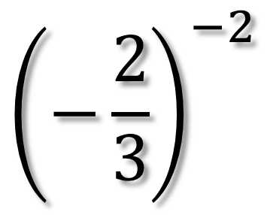
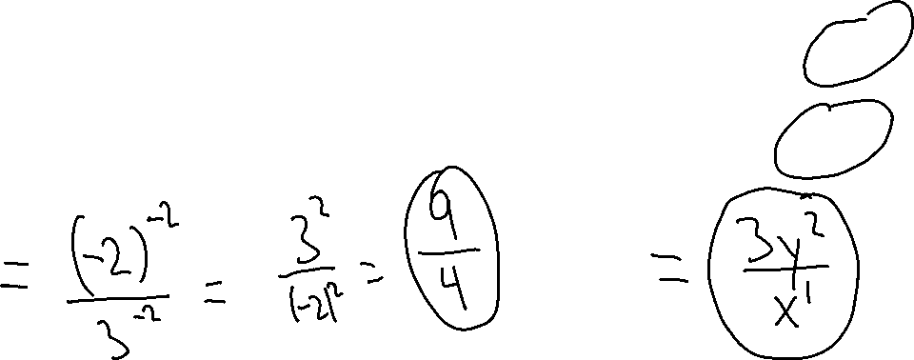
Simplify
$${\left(−\frac{2}{3}\right)}^{−2}$$
$$\frac{{3x}^{−1}}{y^{−2}}$$

Slide 5
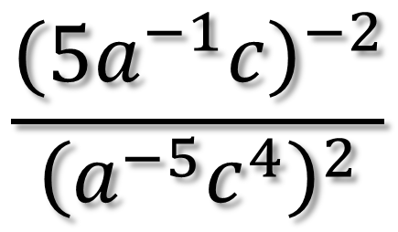
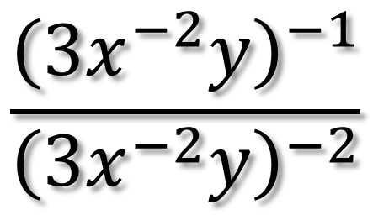
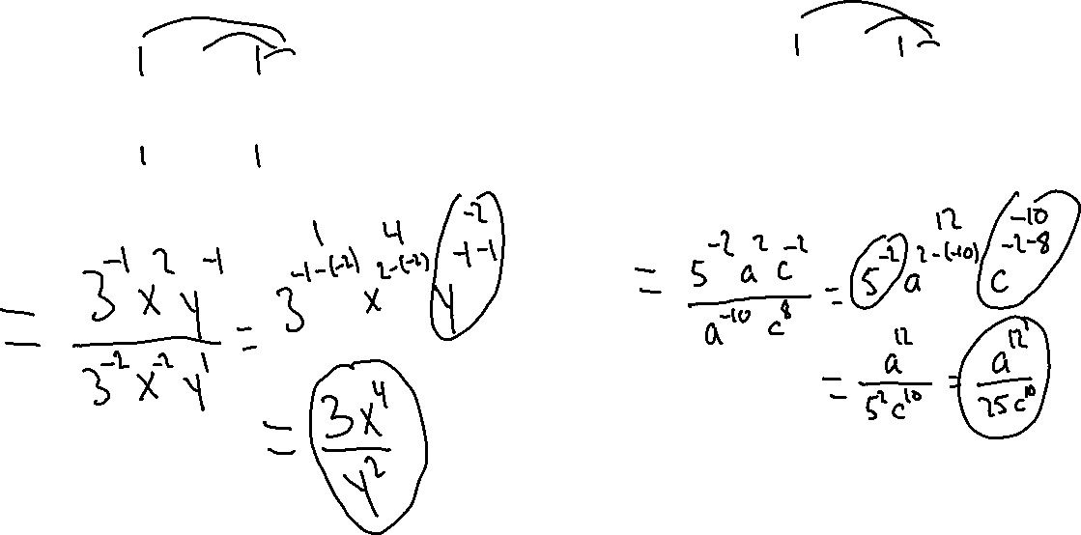
Simplify
$$\frac{{\left({3x}^{−2}y\right)}^{−1}}{{\left({3x}^{−2}y\right)}^{−2}}$$
$$\frac{{\left({5a}^{−1}c\right)}^{−2}}{{\left(a^{−5}c^{4}\right)}^{2}}$$

Slide 6
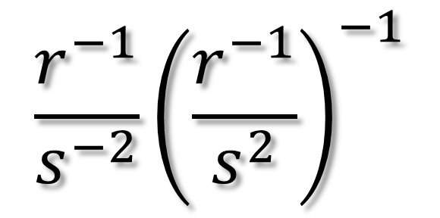
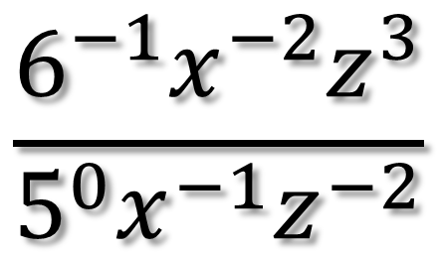
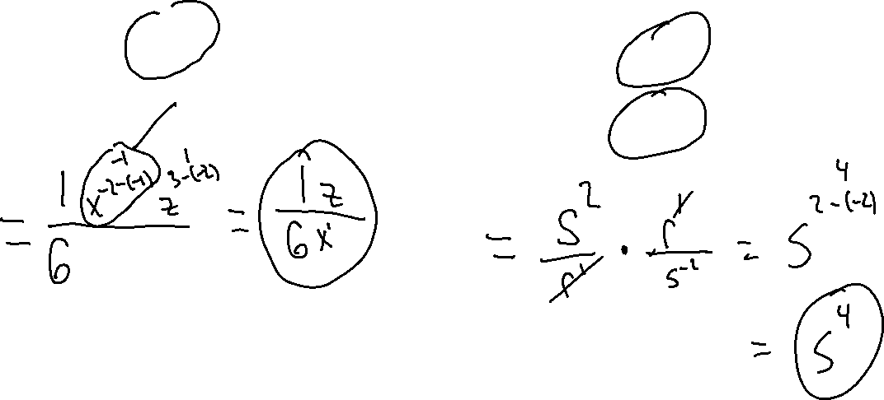
Simplify
$$\frac{6^{−1}x^{−2}z^{3}}{5^{0}x^{−1}z^{−2}}$$
$$\frac{r^{−1}}{s^{−2}}{\left(\frac{r^{−1}}{s^{2}}\right)}^{−1}$$

Slide 7
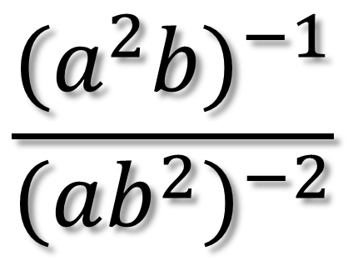
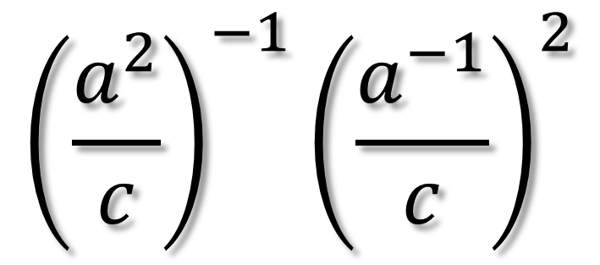
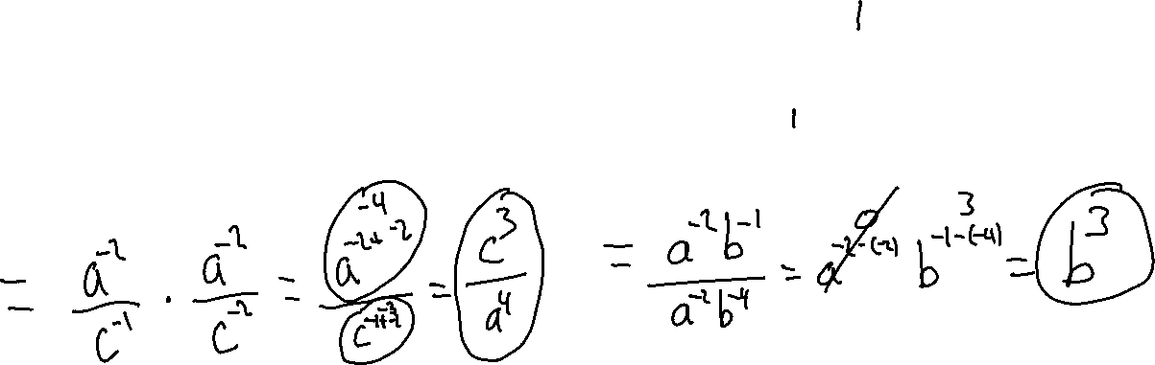
Simplify
$${\left(\frac{a^{2}}{c}\right)}^{−1}{\left(\frac{a^{−1}}{c}\right)}^{2}$$
$$\frac{{(a^{2}b)}^{−1}}{{(ab^{2})}^{−2}}$$

