Slide 1
Section 5.4
Rational Algebraic Expressions
Algebra II

Slide 2
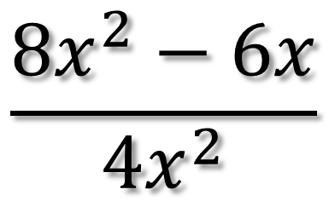
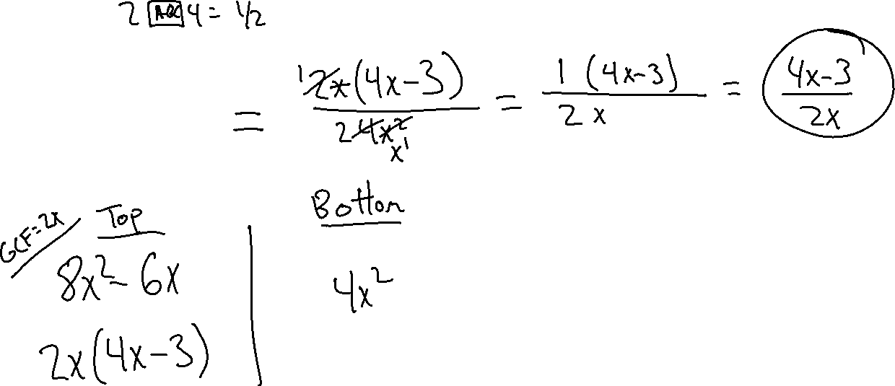
Simplify
$$\frac{{8x}^{2}−6x}{4x^{2}}$$

Slide 3
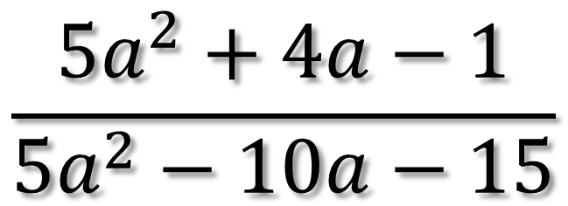
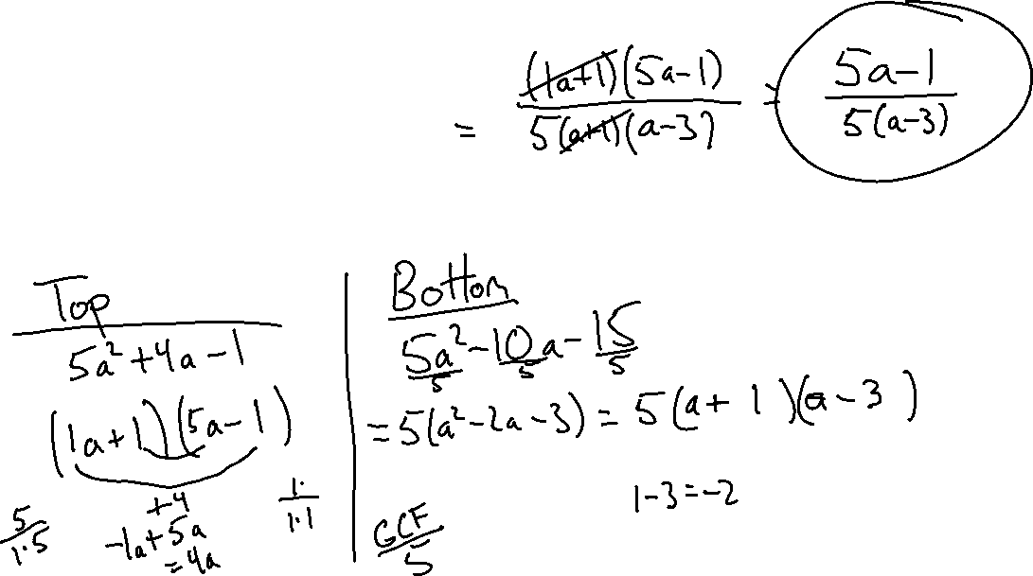
Simplify
$$\frac{{5a}^{2}+4a−1}{5a^{2}−10a−15}$$

Slide 4
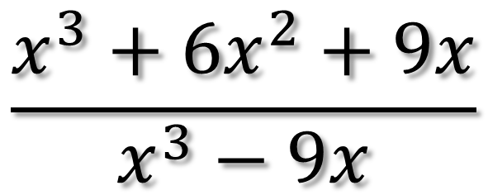
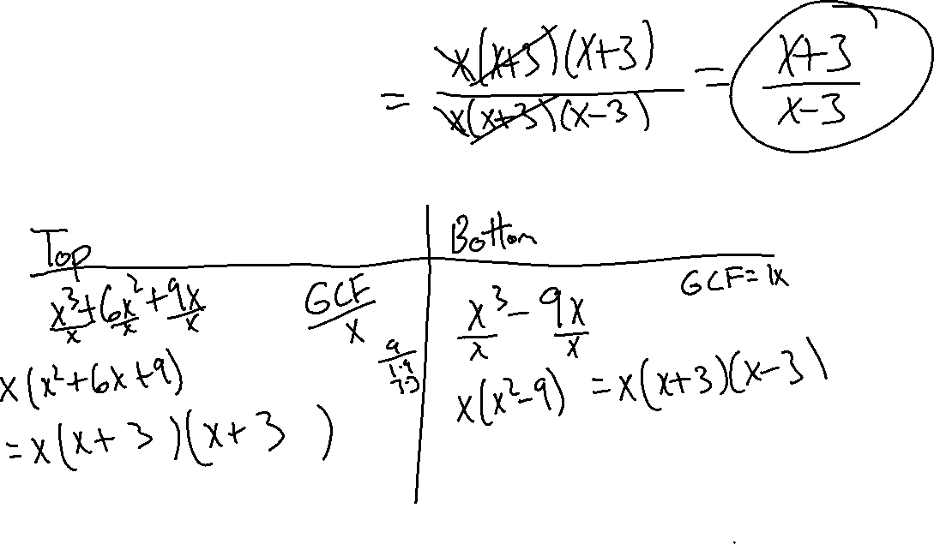
Simplify
$$\frac{x^{3}+6x^{2}+9x}{x^{3}−9x}$$

Slide 5
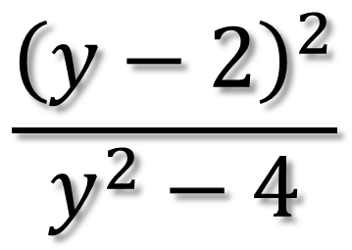
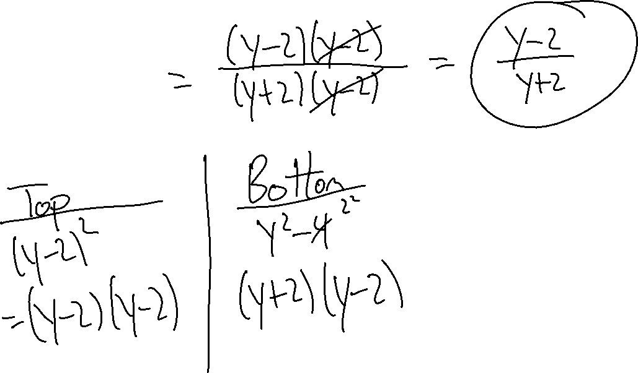
Simplify
$$\frac{{\left(y−2\right)}^{2}}{y^{2}−4}$$

Slide 6
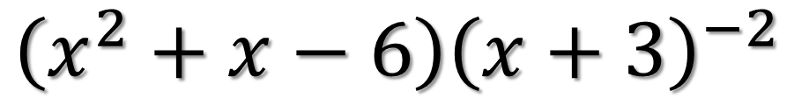
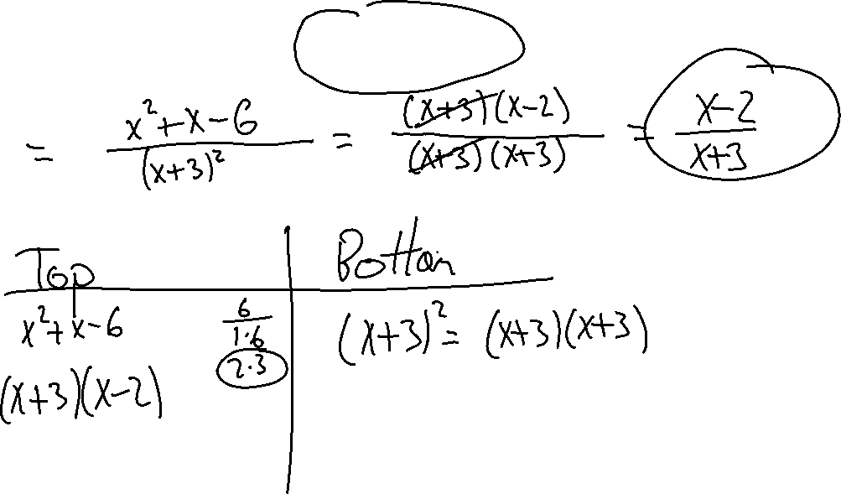
Simplify
$$\left(x^{2}+x−6\right){\left(x+3\right)}^{−2}$$

Slide 7
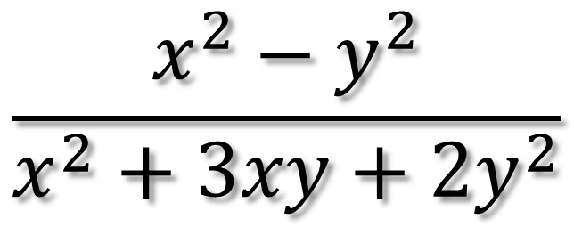
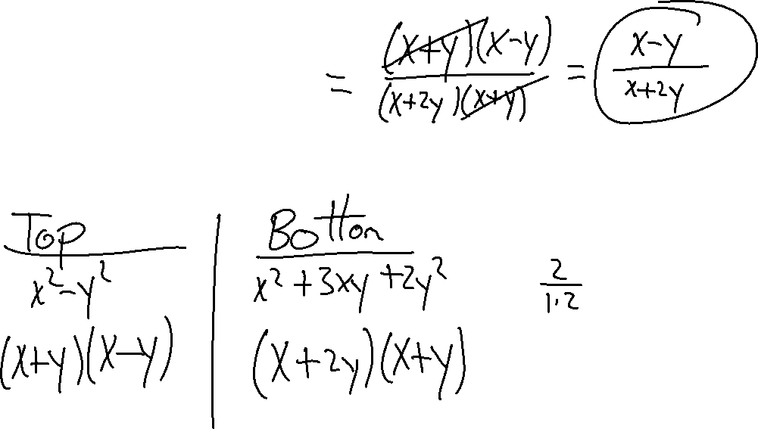
Simplify
$$\frac{x^{2}−y^{2}}{x^{2}+3xy+{2y}^{2}}$$

Slide 8
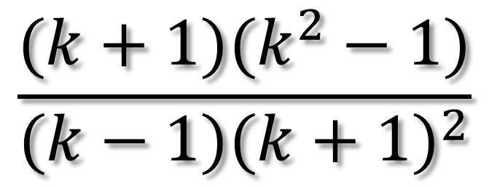
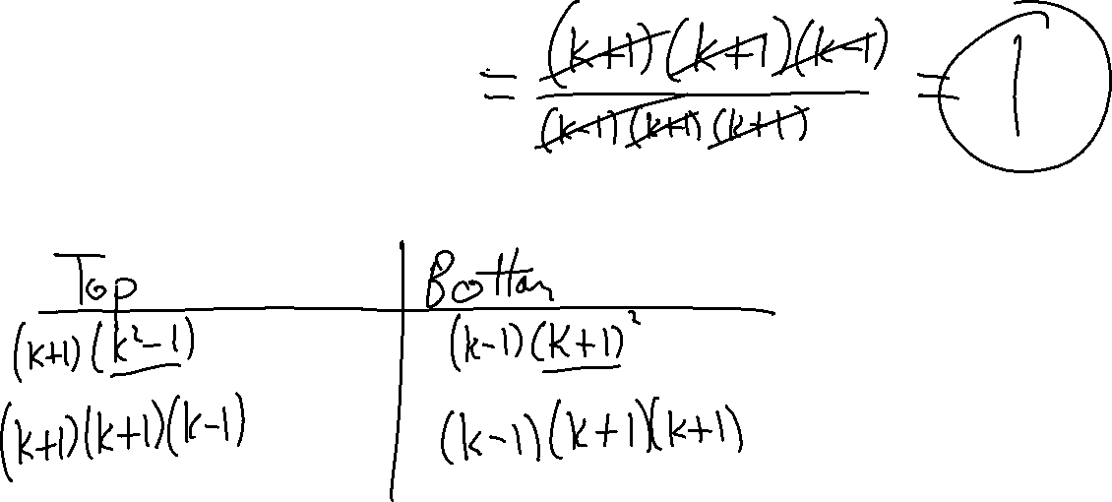
Simplify
$$\frac{(k+1)(k^{2}−1)}{(k−1){(k+1)}^{2}}$$

