Slide 1
Section 5.5 Products and Quotients of Rational Expressions
Algebra II

Slide 2
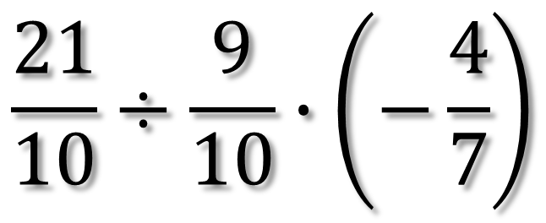
Simplify
$$\frac{21}{10}÷\frac{9}{10}∙\left(−\frac{4}{7}\right)$$

Slide 3
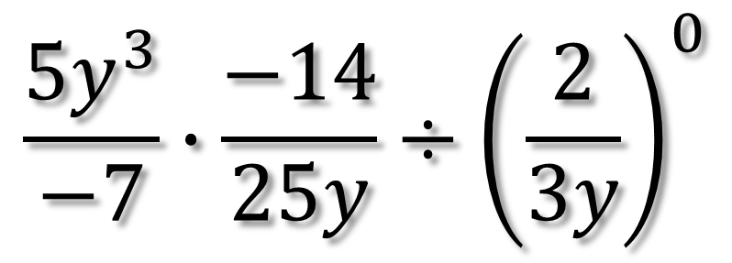
Simplify
$$\frac{{5y}^{3}}{−7}∙\frac{−14}{25y}÷{\left(\frac{2}{3y}\right)}^{0}$$

Slide 4
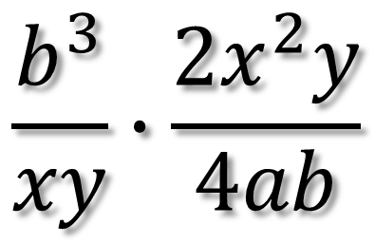
Simplify
$$\frac{b^{3}}{xy}∙\frac{2x^{2}y}{4ab}$$

Slide 5
Simplify
$$\frac{a^{3}−{6a}^{2}}{a^{2}+2a−3}∙\frac{a^{2}−2a+1}{a^{3}}$$

Slide 6
Simplify
$$\frac{1−x^{2}}{3x+4}÷\frac{x^{2}+x−2}{{9x}^{2}+24x+16}$$

Slide 7
Simplify
$$\frac{x^{2}−1}{x+2}÷\frac{x+1}{x−2}∙\frac{x^{2}−4}{x−1}$$

Slide 8
Simplify
$${\left(\frac{{2x}^{2}−x−1}{2x−1}\right)}^{−1}{\left(\frac{{4x}^{2}−1}{x^{2}−x}\right)}^{−1}$$

