Slide 1
Section 5.6
Sums and Differences of Rational Expressions
Algebra II

Slide 2
Rule for Adding and Subtraction Fractions
Find the Least Common Denominator (LCD) of the fractions. (The least common multiple (LCM) of the Denominators)
Express each fraction as an equivalent fraction with the LCD as the denominator.
Add or Subtract and then Simplify the result.

Slide 3
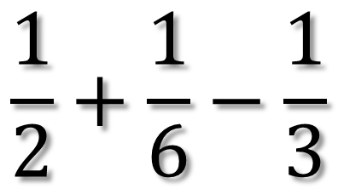
Simplify
$$\frac{1}{2}+\frac{1}{6}−\frac{1}{3}$$
Find the Least Common Denominator (LCD)
LCD is the Same as LCM
  Take All Variables and the Biggest Exponent

Slide 4
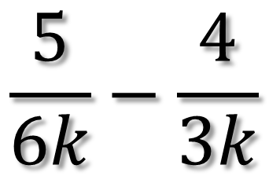
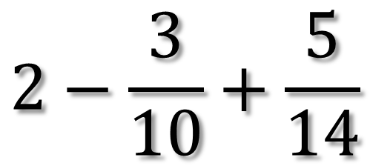
Simplify
$$2−\frac{3}{10}+\frac{5}{14}$$
$$\frac{5}{6k}−\frac{4}{3k}$$

Slide 5
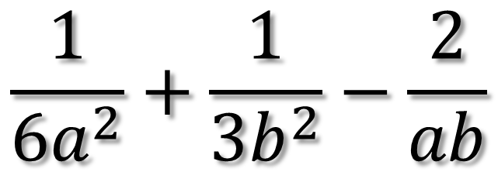
Simplify
$$\frac{1}{6a^{2}}+\frac{1}{3b^{2}}−\frac{2}{ab}$$

Slide 6
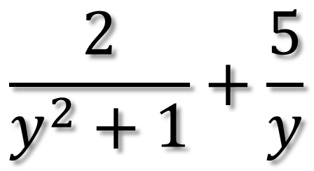
Simplify
$$\frac{2}{y^{2}+1}+\frac{5}{y}$$

Slide 7
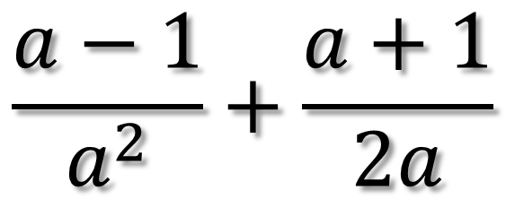
Simplify
$$\frac{a−1}{a^{2}}+\frac{a+1}{2a}$$

Slide 8
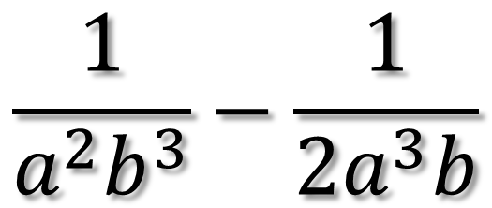
Simplify
$$\frac{1}{a^{2}b^{3}}−\frac{1}{2a^{3}b}$$

Slide 9
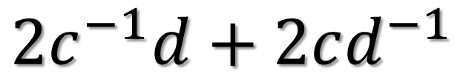
Simplify
$$2c^{−1}d+2cd^{−1}$$

Slide 10
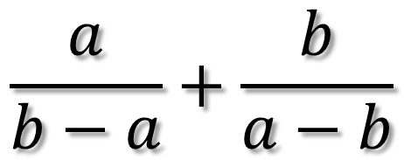
Simplify
$$\frac{a}{b−a}+\frac{b}{a−b}$$

Slide 11
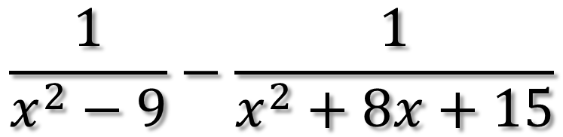
Simplify
$$\frac{1}{x^{2}−9}−\frac{1}{x^{2}+8x+15}$$

Slide 12
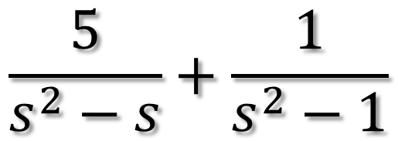
Simplify
$$\frac{5}{s^{2}−s}+\frac{1}{s^{2}−1}$$

Slide 13
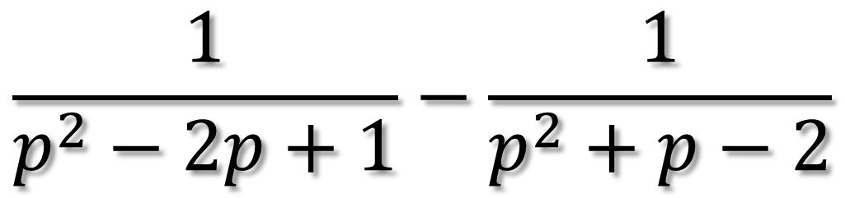
Simplify
$$\frac{1}{p^{2}−2p+1}−\frac{1}{p^{2}+p−2}$$

