Slide 1
Section 5.9
Fractional Equations
Algebra II

Slide 2
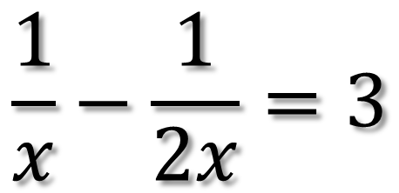
Simplify
$$\frac{1}{x}−\frac{1}{2x}=3$$

Slide 3
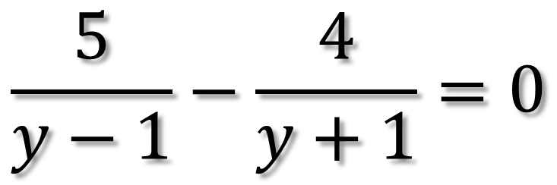
Simplify
$$\frac{5}{y−1}−\frac{4}{y+1}=0$$

Slide 4
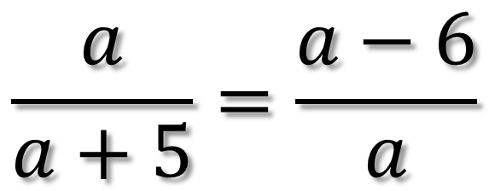
Simplify
$$\frac{a}{a+5}=\frac{a−6}{a}$$

Slide 5
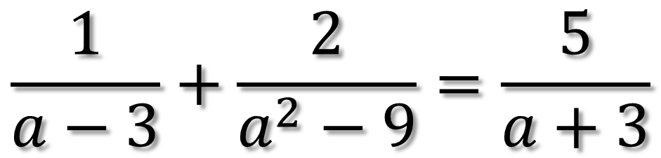
Simplify
$$\frac{1}{a−3}+\frac{2}{a^{2}−9}=\frac{5}{a+3}$$

Slide 6
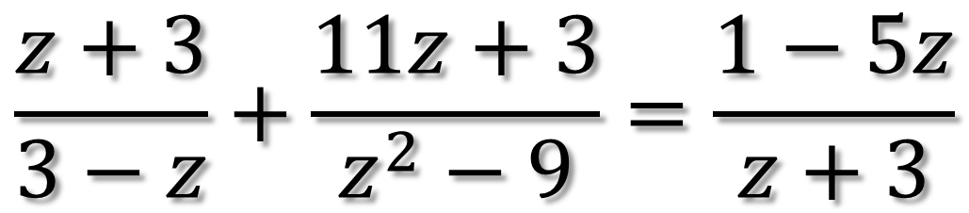
Simplify
$$\frac{z+3}{3−z}+\frac{11z+3}{z^{2}−9}=\frac{1−5z}{z+3}$$

Slide 7
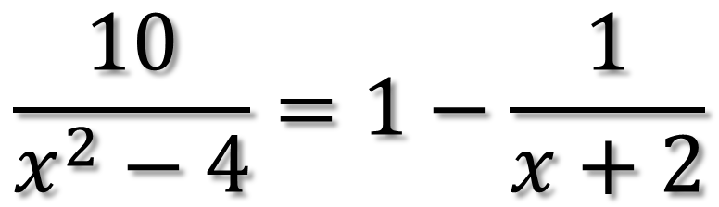
Simplify
$$\frac{10}{x^{2}−4}=1−\frac{1}{x+2}$$

Slide 8
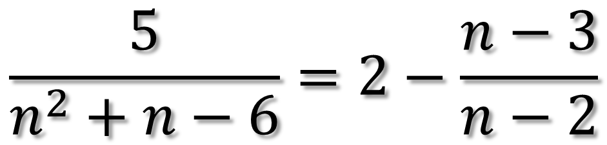
Simplify
$$\frac{5}{n^{2}+n−6}=2−\frac{n−3}{n−2}$$

