Slide 1
Section 6.1 Roots of Real Numbers
Algebra II

Slide 2
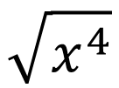
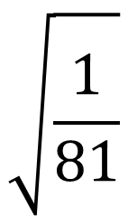
A SQUARE ROOT of a number $b$ is a solution to the equation $x^{2}=b$.
Every positive number $b$ has two square roots, denoted $\sqrt{b}$ and $−\sqrt{b}$.
Since the square of a real number is NEVER NEGATIVE, the equation $x^{2}=b$ has no real-number solution if $b<0$.
A Negative Number $b$ has NO REAL SQUARE ROOTS.
$$\sqrt{\frac{1}{81}}$$
$$\sqrt{81}$$
$$−\sqrt{81}$$
$$\sqrt{x^{4}}$$
$$\sqrt{−81}$$

Slide 3
Find the real roots of each equation. If there are none, say so.
$$x^{2}=16$$
$$x^{2}+25=0$$
$$4x^{2}−4=24$$

Slide 4
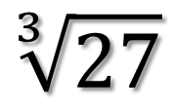
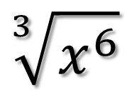
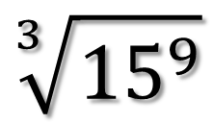
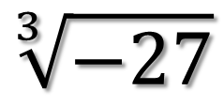
A CUBE ROOT of a number $b$ is a solution to the equation $x^{3}=b$.
Every number $b$ whether positive, negative, or zero has exactly one real cube root,$\sqrt[3]{b}$.
$$\sqrt[3]{27}$$
$$\sqrt[3]{−27}$$
$$\sqrt[3]{{15}^{9}}$$
$$\sqrt[3]{x^{6}}$$

Slide 5
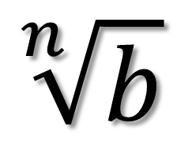
nth Roots
INDEX
$$\sqrt[n]{b}$$
BASE (RADICAND)
If there is no index, $n=2$, meaning it is a Square Root
If $n$ is EVEN, there are Two Real nth Roots of $b.$
If $b$ is negative, there is no real nth root of $b$.
If $n$ is ODD, there is exactly one real nth Roots of $b.$
$b$ can be positive, negative, or zero.

Slide 6
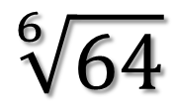
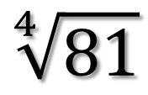
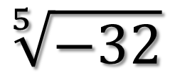
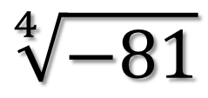
Simplify
$$\sqrt[4]{81}$$
$$\sqrt[6]{64}$$
$$\sqrt[5]{−32}$$
$$\sqrt[4]{−81}$$

Slide 7
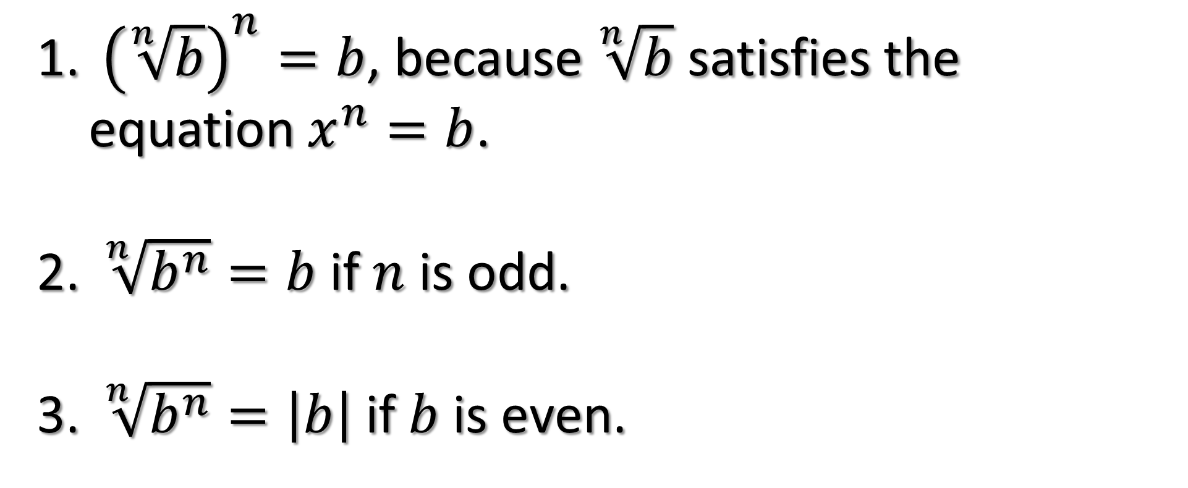
Properties of Radicals
${\left(\sqrt[n]{b}\right)}^{n}=b$, because $\sqrt[n]{b}$ satisfies the equation $x^{n}=b$.
$\sqrt[n]{b^{n}}=b$ if $n$ is odd.
$\sqrt[n]{b^{n}}=\left|b\right|$ if $b$ is even.

Slide 8
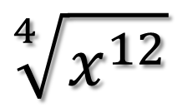
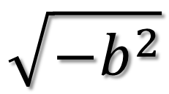
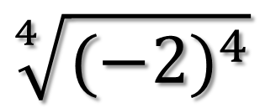
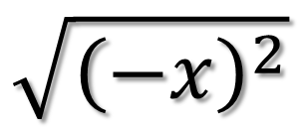
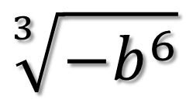
Simplify
$$\sqrt{−b^{2}}$$
$$\sqrt[4]{x^{12}}$$
$$\sqrt{{\left(−x\right)}^{2}}$$
$$\sqrt[3]{−b^{6}}$$
$$\sqrt[4]{{(−2)}^{4}}$$

