Slide 1
Section 6.2
Properties of Radicals
Algebra II

Slide 2
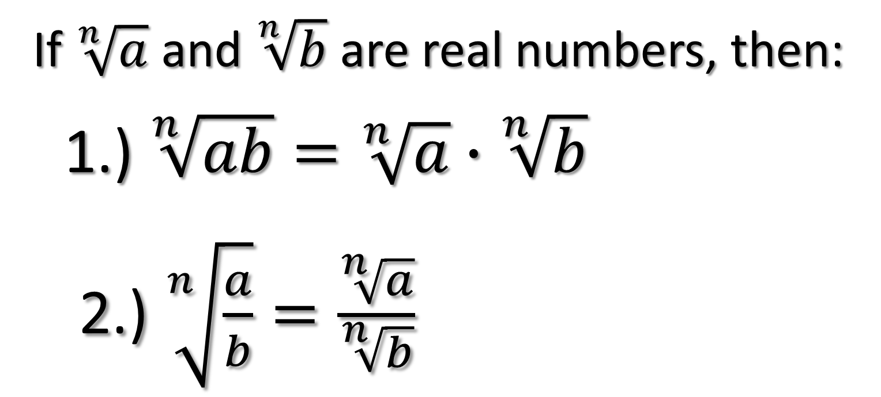
Product and Quotient Properties of Radicals
If $\sqrt[n]{a}$ and $\sqrt[n]{b}$ are real numbers, then:
  1.) $\sqrt[n]{ab}=\sqrt[n]{a}∙\sqrt[n]{b}$
  2.) $\sqrt[n]{\frac{a}{b}}=\frac{\sqrt[n]{a}}{\sqrt[n]{b}}$

Slide 3
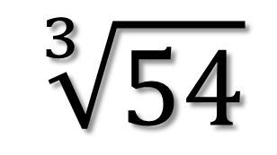
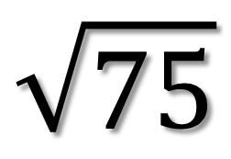
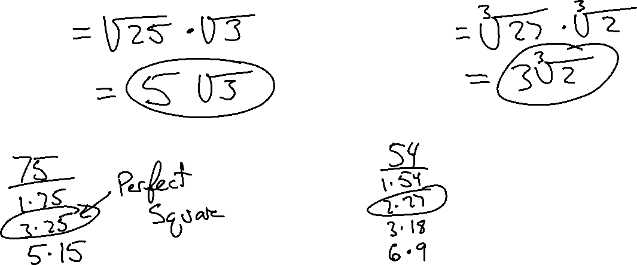
Simplify
$$\sqrt{75}$$
$$\sqrt[3]{54}$$

Slide 4
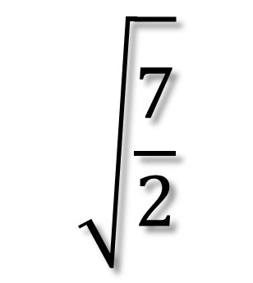
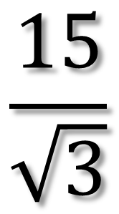
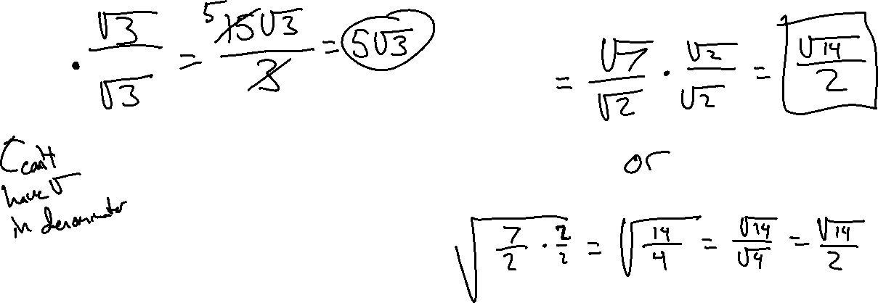
Rationalizing the Denominator
$$\frac{15}{\sqrt{3}}$$
$$\sqrt{\frac{7}{2}}$$

Slide 5
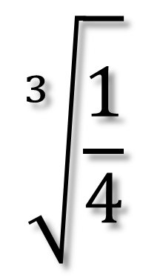
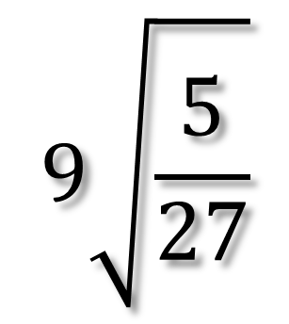
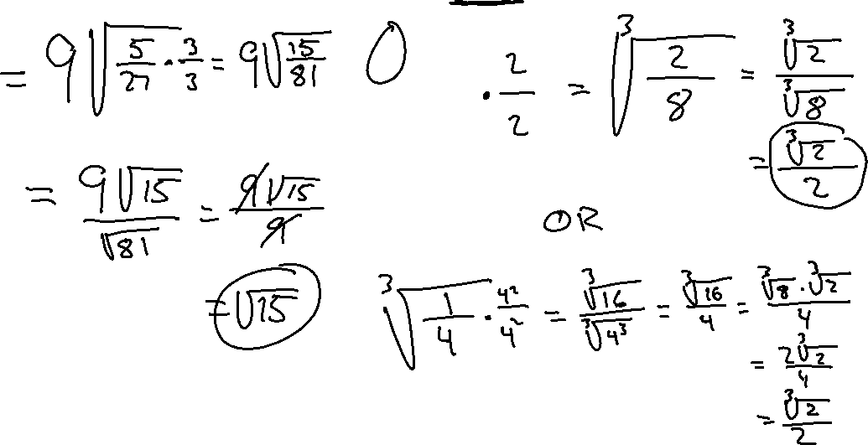
Rationalizing the Denominator
$$9\sqrt{\frac{5}{27}}$$
$$\sqrt[3]{\frac{1}{4}}$$

Slide 6
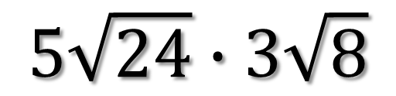
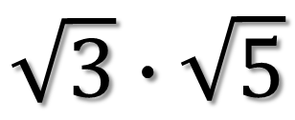
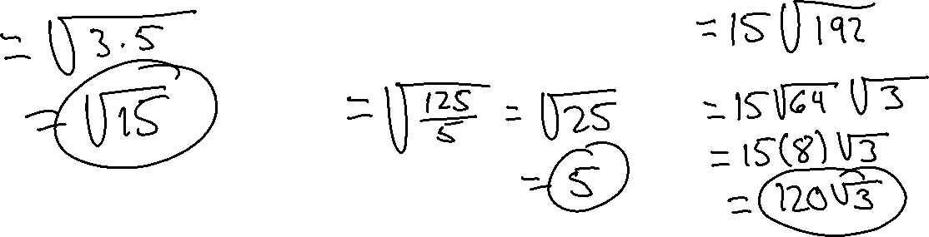
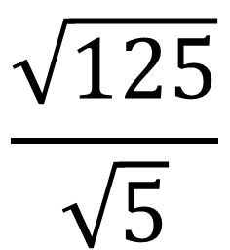
Simplify
$$\sqrt{3}∙\sqrt{5}$$
$$\frac{\sqrt{125}}{\sqrt{5}}$$
$$5\sqrt{24}∙3\sqrt{8}$$

Slide 7
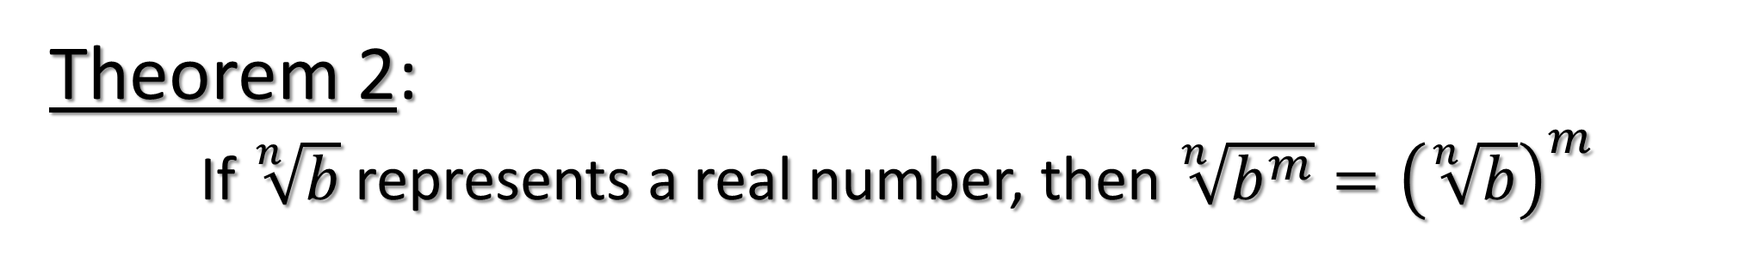
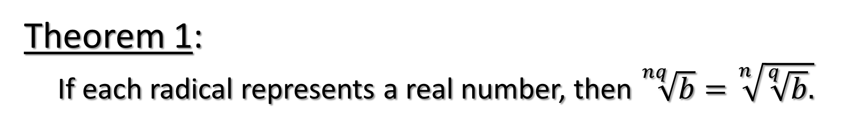
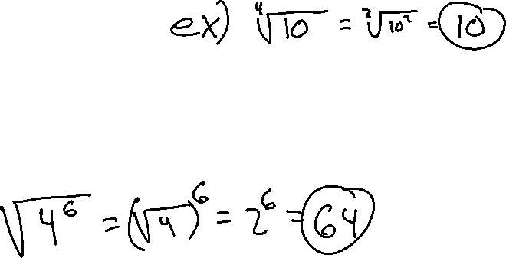
More Properties of Radicals
Theorem 1:
If each radical represents a real number, then $\sqrt[nq]{b}=\sqrt[n]{\sqrt[q]{b}.}$
Theorem 2:
If $\sqrt[n]{b}$represents a real number, then $\sqrt[n]{b^{m}}={\left(\sqrt[n]{b}\right)}^{m}$

Slide 8
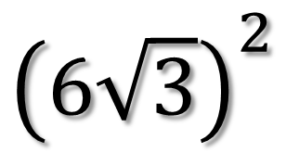
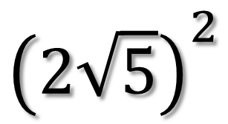
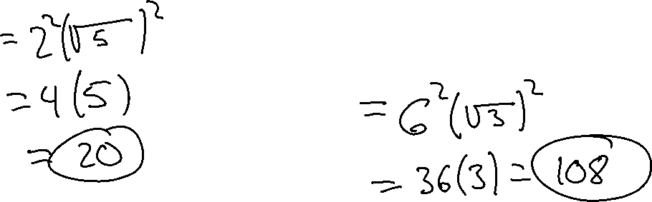
Simplify
$${\left(2\sqrt{5}\right)}^{2}$$
$${\left(6\sqrt{3}\right)}^{2}$$

Slide 9
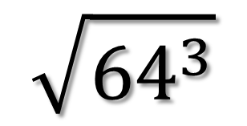
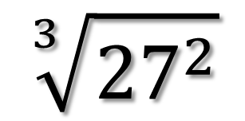
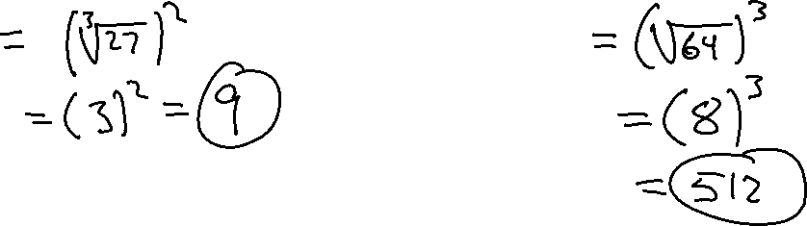
Simplify
$$\sqrt[3]{{27}^{2}}$$
$$\sqrt{{64}^{3}}$$

Slide 10
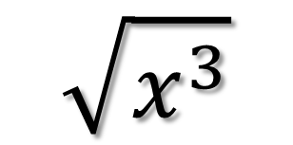
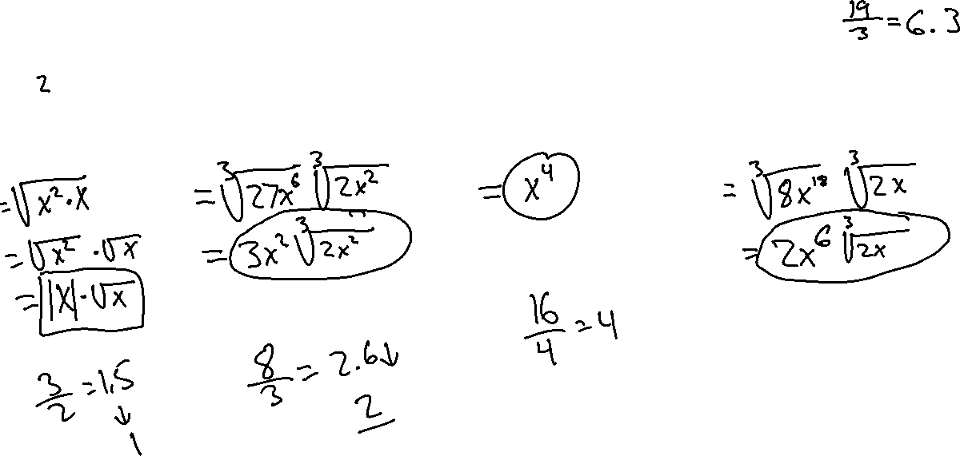
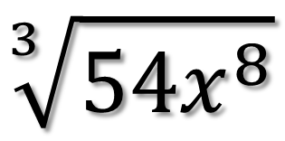
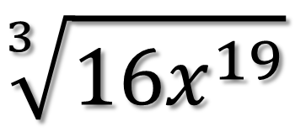
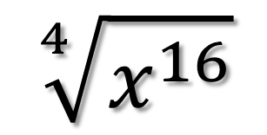
Simplify
$$\sqrt{x^{3}}$$
$$\sqrt[3]{{54x}^{8}}$$
$$\sqrt[4]{x^{16}}$$
$$\sqrt[3]{{16x}^{19}}$$

Slide 11
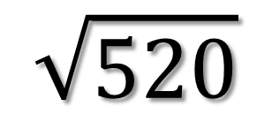
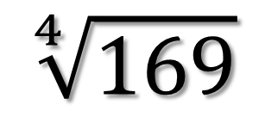
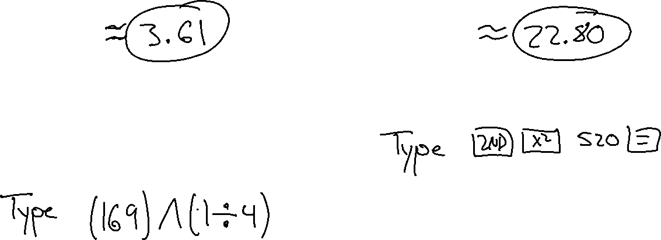
Give a Decimal Approximation to the nearest hundredth.
$$\sqrt[4]{169}$$
$$\sqrt{520}$$

