Slide 1
Section 6.3 Sums of Radicals
Algebra II

Slide 2
Sums of Radicals
Combining radicals is similar to combining like terms.
$$2x+4x=6x$$
$$2\sqrt{3}+4\sqrt{3}=6\sqrt{3}$$
If the radicals match, add the coefficients.
If the radicals don’t match, you must simplify.
If the radicals don’t match even when simplified, the answer is not possible.
You cannot combine $\sqrt{2}+\sqrt[3]{2}$ because they are not like radicals (they have different indices).

Slide 3
Simplify
$$\sqrt{72}+\sqrt{50}$$

Slide 4
Simplify
$$\sqrt{20}−\sqrt{45}$$

Slide 5
Simplify
$$\sqrt[3]{250}−\sqrt[3]{54}$$

Slide 6
Simplify
$$\sqrt{27}+\sqrt{12}−\sqrt{75}$$

Slide 7
Simplify
$$\sqrt{6}\left(\sqrt{3}−\sqrt{2}\right)$$

Slide 8
Simplify
$$2\sqrt{5}\left(3\sqrt{4}−\sqrt{8}\right)$$

Slide 9
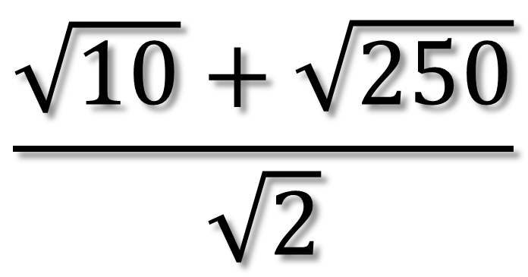
Simplify
$$\frac{\sqrt{10}+\sqrt{250}}{\sqrt{2}}$$

