Slide 1
Section 6.4
Binomials Containing Radicals
Algebra II

Slide 2
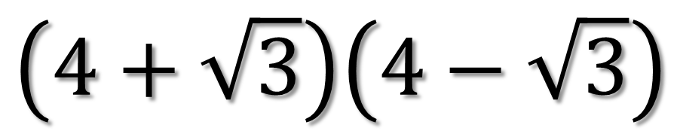
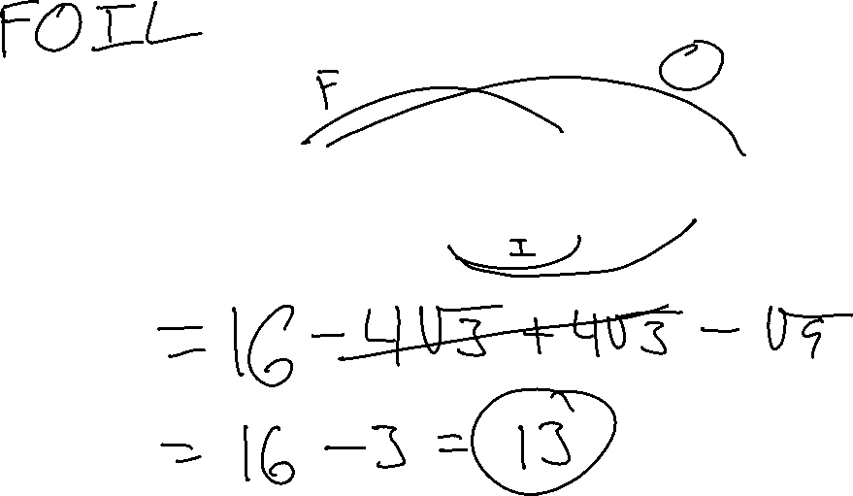
Simplify
$$\left(4+\sqrt{3}\right)\left(4−\sqrt{3}\right)$$

Slide 3
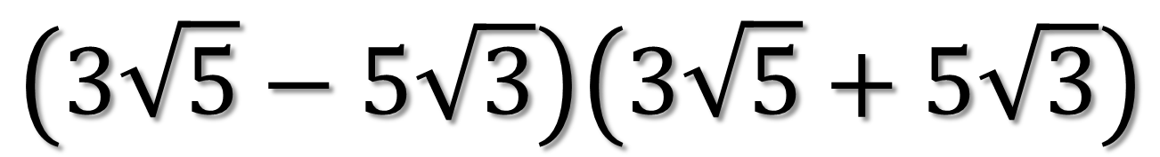
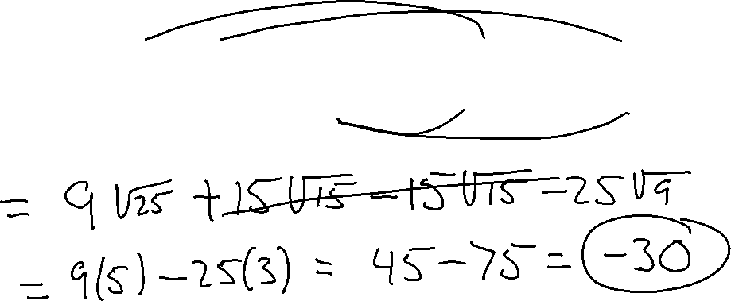
Simplify
$$\left(3\sqrt{5}−5\sqrt{3}\right)\left(3\sqrt{5}+5\sqrt{3}\right)$$

Slide 4
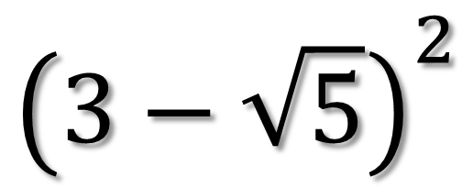
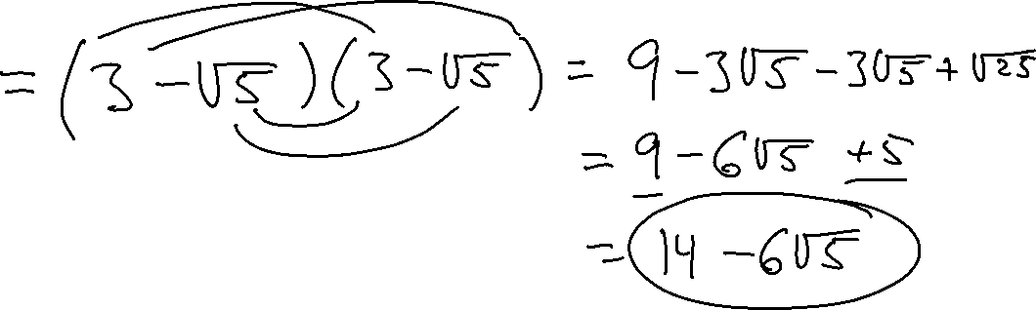
Simplify
$${\left(3−\sqrt{5}\right)}^{2}$$

Slide 5
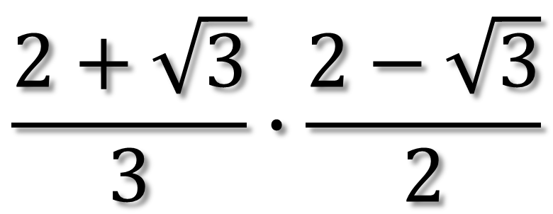
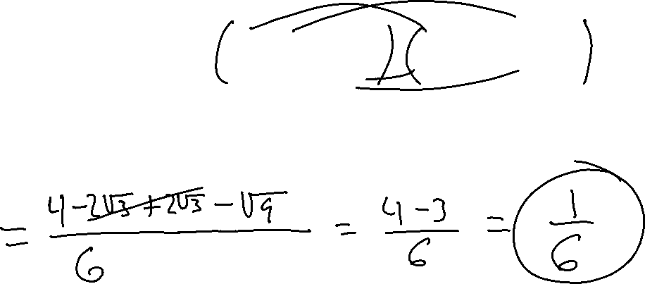
Simplify
$$\frac{2+\sqrt{3}}{3}∙\frac{2−\sqrt{3}}{2}$$

Slide 6
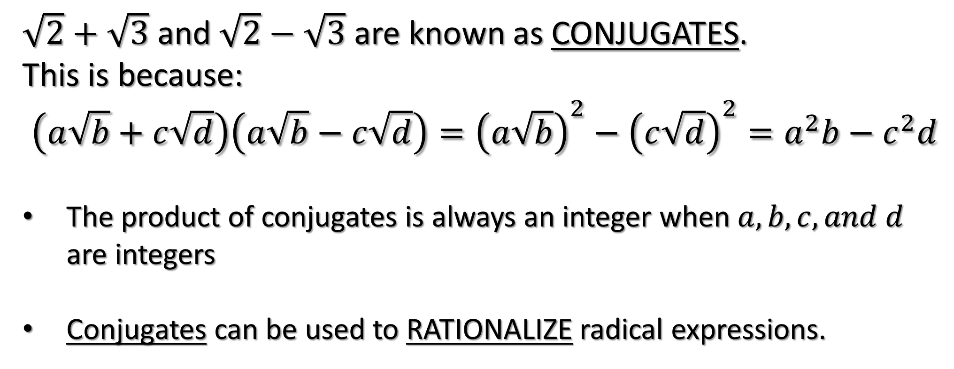

Conjugates
$\sqrt{2}+\sqrt{3}$ and $\sqrt{2}−\sqrt{3}$ are known as CONJUGATES.
This is because:
$$\left(a\sqrt{b}+c\sqrt{d}\right)\left(a\sqrt{b}−c\sqrt{d}\right)={\left(a\sqrt{b}\right)}^{2}−{\left(c\sqrt{d}\right)}^{2}=a^{2}b−c^{2}d$$
The product of conjugates is always an integer when $a, b, c, and d$ are integers
Conjugates can be used to RATIONALIZE radical expressions.

Slide 7
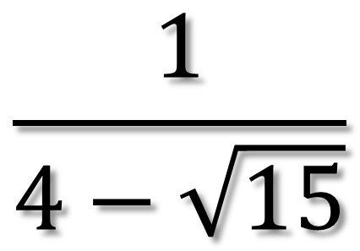
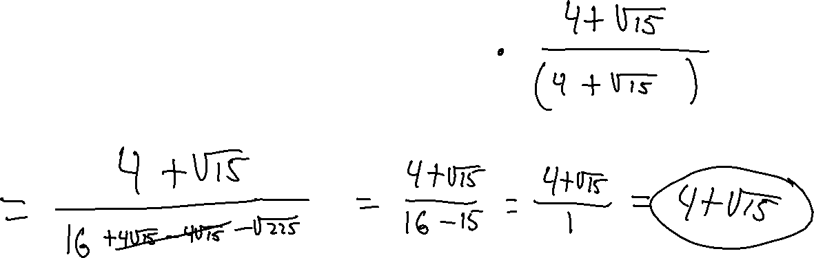
Simplify
$$\frac{1}{4−\sqrt{15}}$$

Slide 8
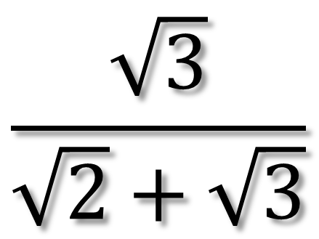


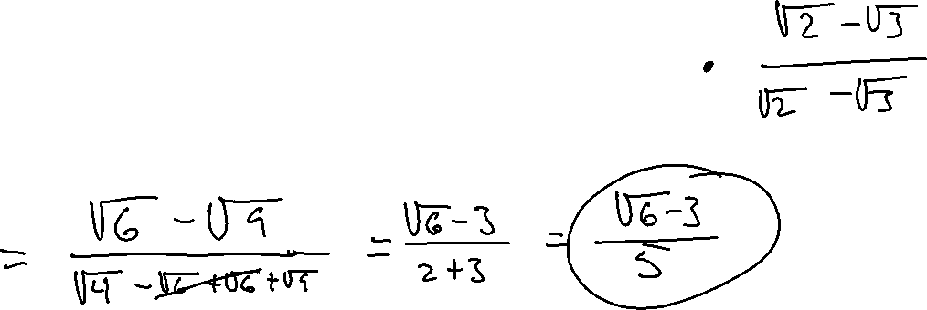
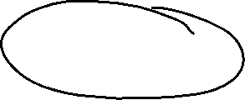
Simplify
$$\frac{\sqrt{3}}{\sqrt{2}+\sqrt{3}}$$

Slide 9
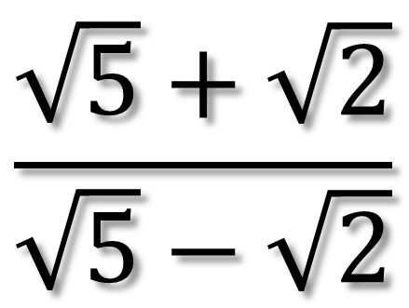
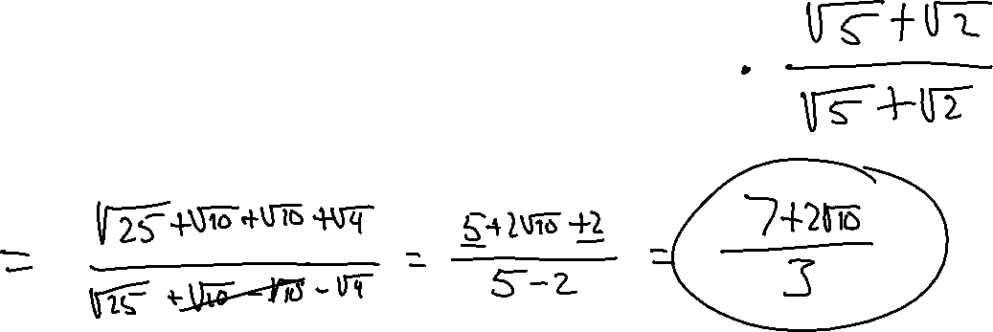
Simplify
$$\frac{\sqrt{5}+\sqrt{2}}{\sqrt{5}−\sqrt{2}}$$

Slide 10
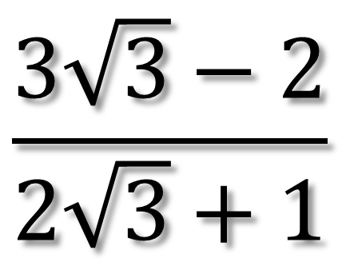
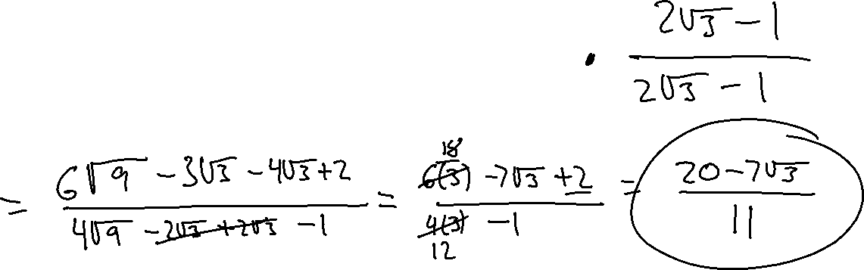
Simplify
$$\frac{3\sqrt{3}−2}{2\sqrt{3}+1}$$

