Slide 1
Section 6.5
Equations Containing Radicals
Algebra II

Slide 2
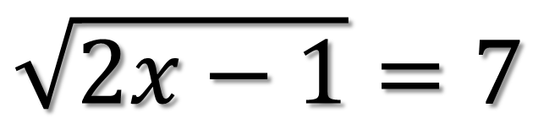
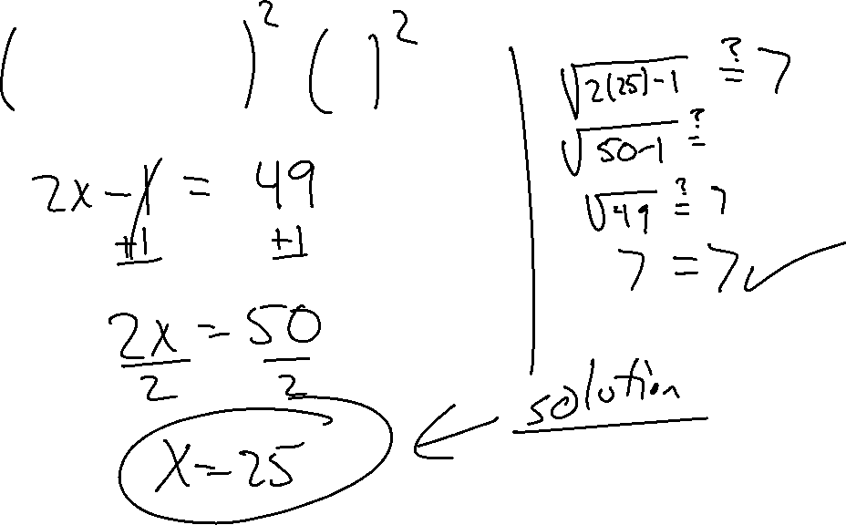
Solve for x
$$\sqrt{2x−1}=7$$

Slide 3
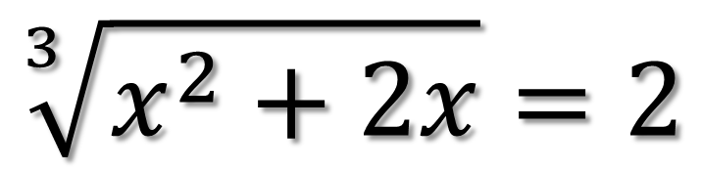
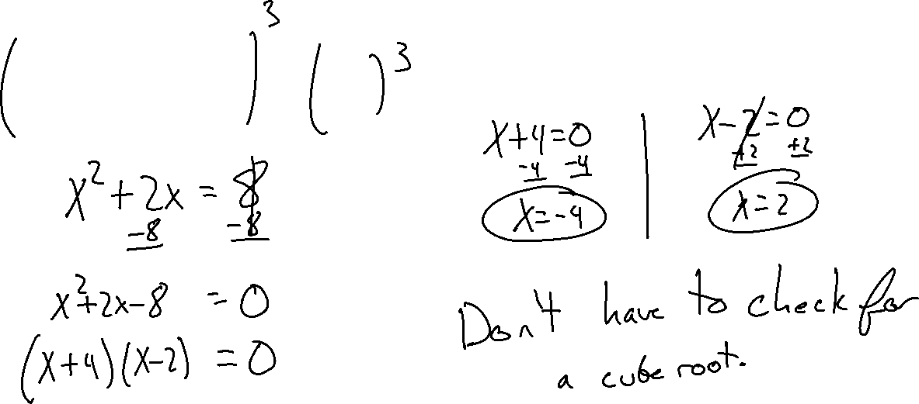
Solve for x
$$\sqrt[3]{x^{2}+2x}=2$$

Slide 4
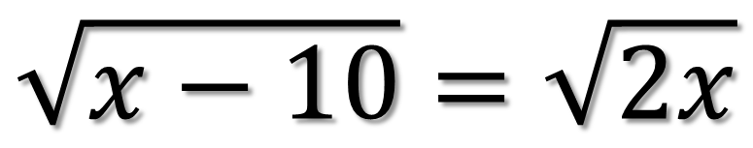
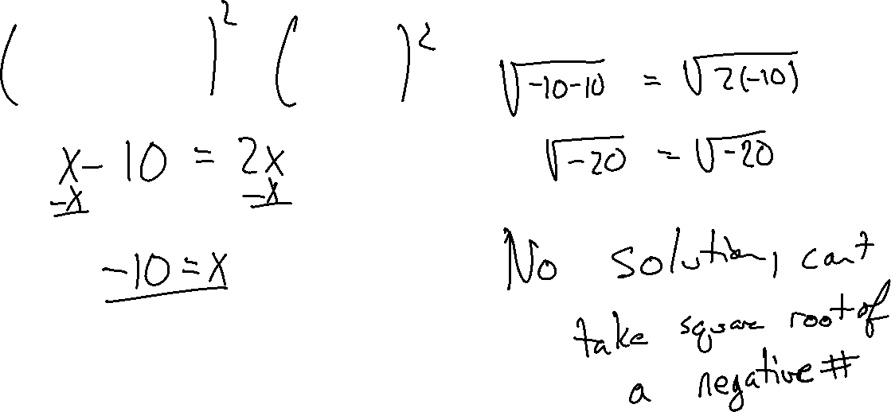
Solve for x
$$\sqrt{x−10}=\sqrt{2x}$$

Slide 5
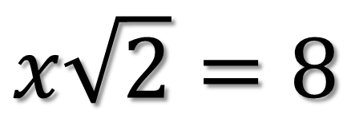
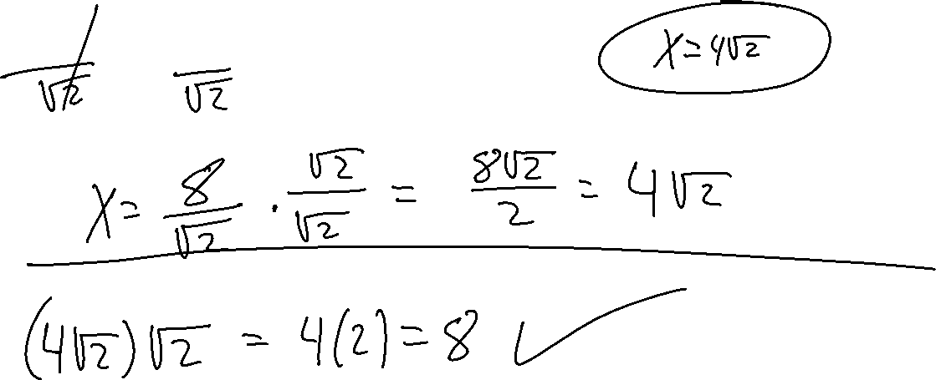
Solve for x
$$x\sqrt{2}=8$$

Slide 6
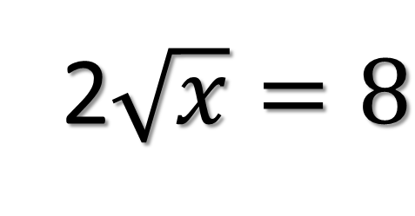
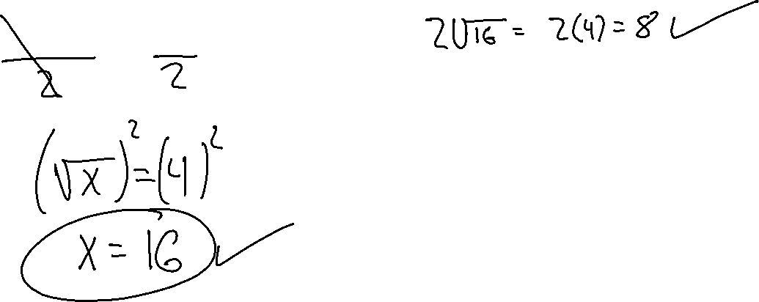
Solve for x
2$\sqrt{x}=8$

Slide 7
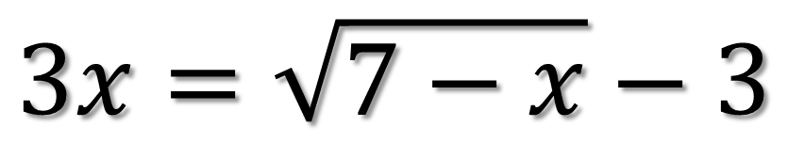
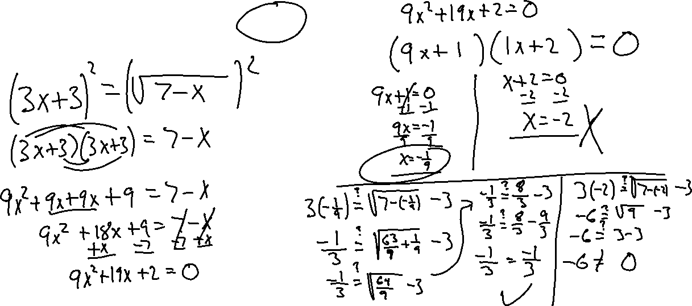
Solve for x
$$3x=\sqrt{7−x}−3$$

Slide 8
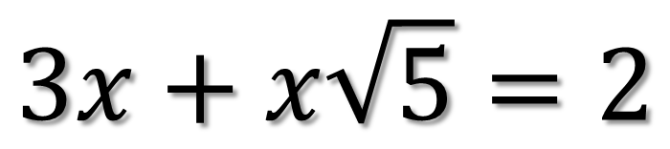
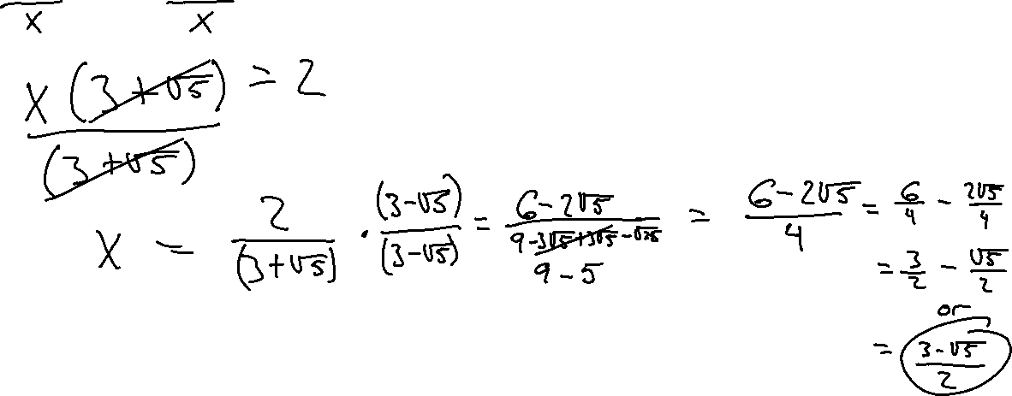
Solve for x
$$3x+x\sqrt{5}=2$$

Slide 9
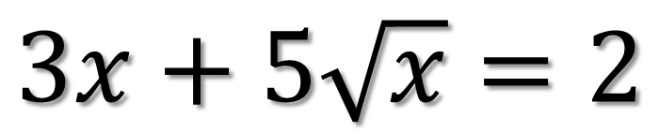
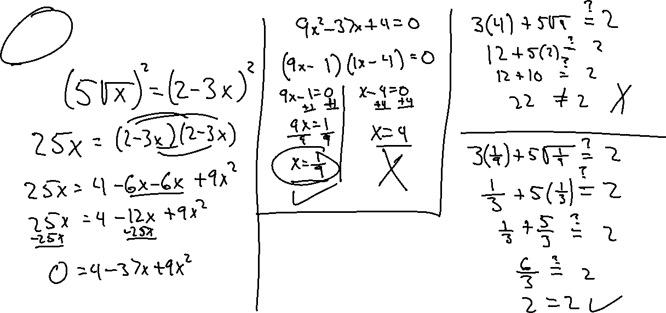
Solve for x
$$3x+5\sqrt{x}=2$$

Slide 10
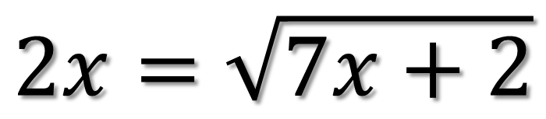


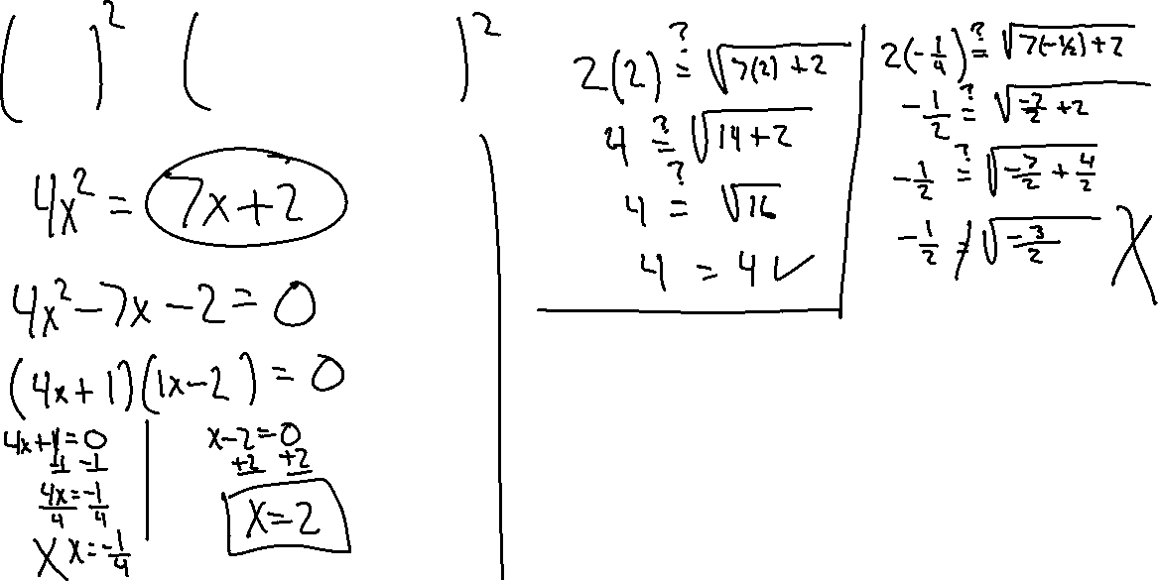
Solve for x
$$2x=\sqrt{7x+2}$$

