Slide 1

Section 6.7
The Imaginary Number $i$
Algebra II

Slide 2
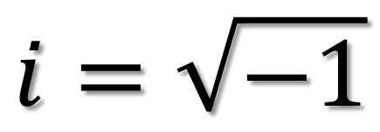

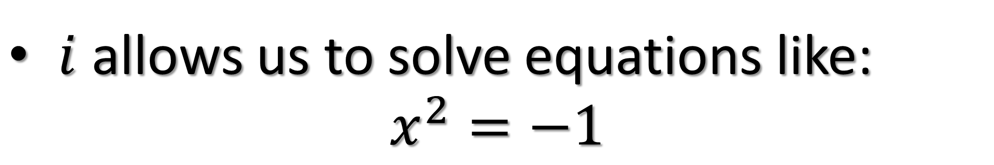
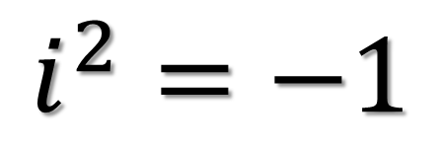
Definition of $i$
$$i=\sqrt{−1}$$
$$i^{2}=−1$$
$i$ allows us to solve equations like:
$$x^{2}=−1$$

Slide 3
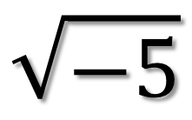
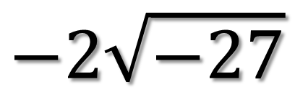
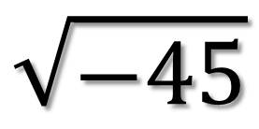
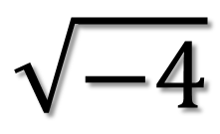
$$\sqrt{−r}=i\sqrt{r}$$
$$\sqrt{−5}$$
$$\sqrt{−4}$$
$$\sqrt{−45}$$
$$−2\sqrt{−27}$$

Slide 4
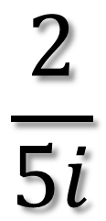
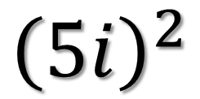
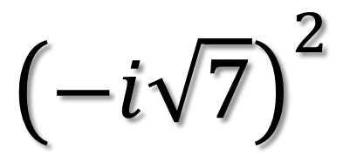
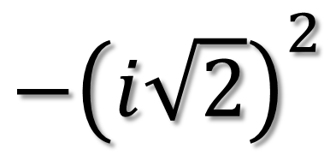
Simplify
$${\left(5i\right)}^{2}$$
$${−\left(i\sqrt{2}\right)}^{2}$$
$${\left(−i\sqrt{7}\right)}^{2}$$
$$\frac{2}{5i}$$

Slide 5
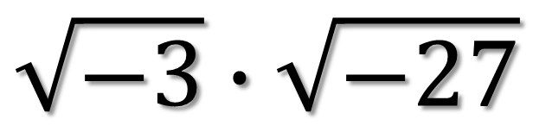
Simplify
$$\sqrt{−3}∙\sqrt{−27}$$

Slide 6
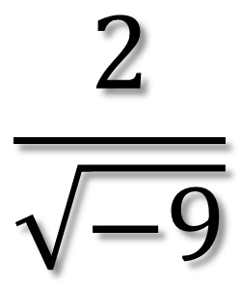
Simplify
$$\frac{2}{\sqrt{−9}}$$

Slide 7
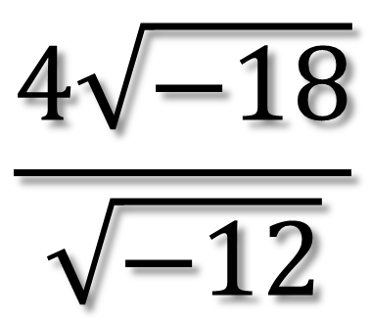
Simplify
$$\frac{4\sqrt{−18}}{\sqrt{−12}}$$

Slide 8
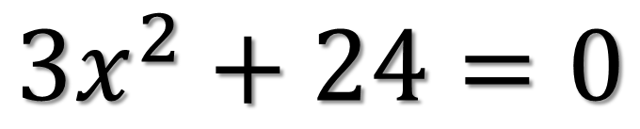
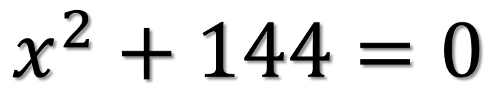
Simplify
$$x^{2}+144=0$$
$${3x}^{2}+24=0$$

Slide 9
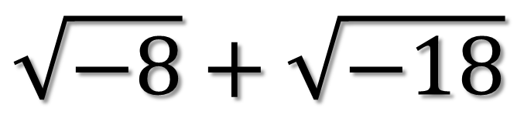
Simplify
$$\sqrt{−8}+\sqrt{−18}$$

