Slide 1
Section 6.8
The Complex Numbers
Algebra II

Slide 2
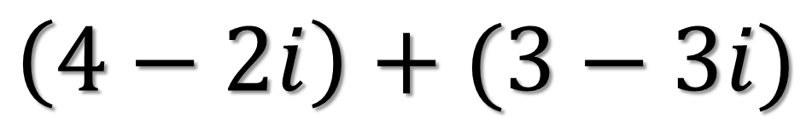



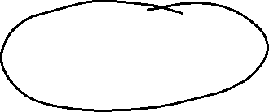
Simplify
$$\left(4−2i\right)+(3−3i)$$

Slide 3

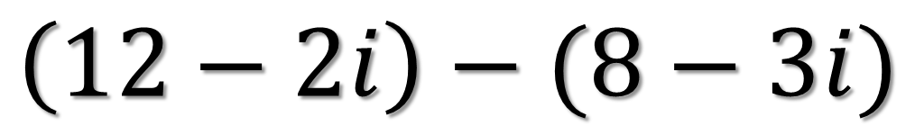
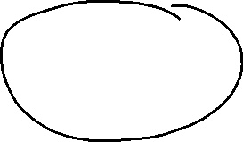






Simplify
$$\left(12−2i\right)−(8−3i)$$

Slide 4
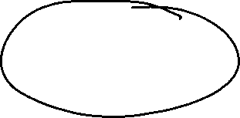
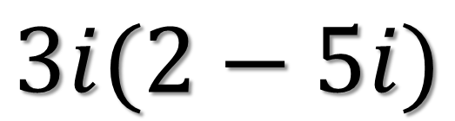







Simplify
$$3i(2−5i)$$

Slide 5

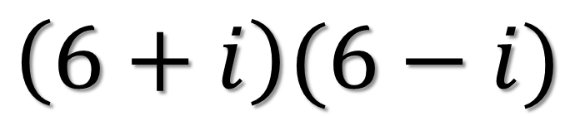











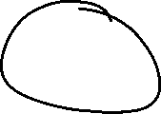
Simplify
$$\left(6+i\right)(6−i)$$

Slide 6





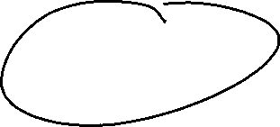


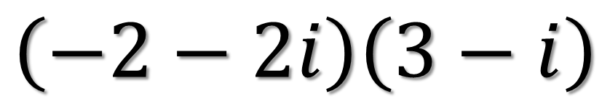

Simplify
$$\left(−2−2i\right)\left(3−i\right)$$

Slide 7




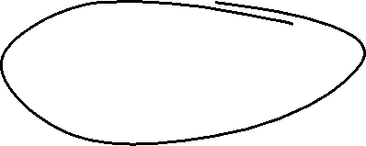



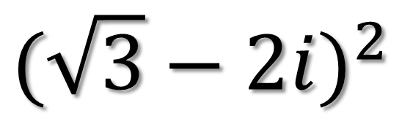






Simplify
$${(\sqrt{3}−2i)}^{2}$$

Slide 8














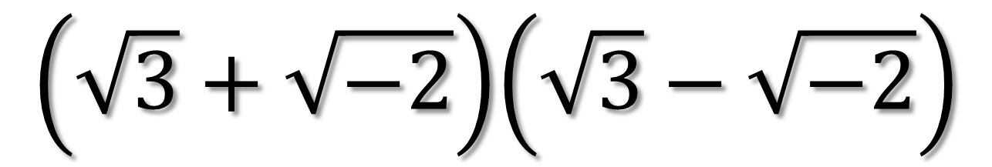
Simplify
$$\left(\sqrt{3}+\sqrt{−2}\right)\left(\sqrt{3}−\sqrt{−2}\right)$$

Slide 9



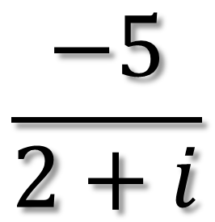


Simplify
$$\frac{−5}{2+i}$$

Slide 10

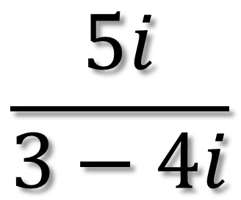

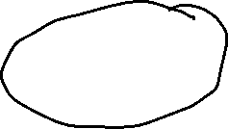


Simplify
$$\frac{5i}{3−4i}$$

Slide 11

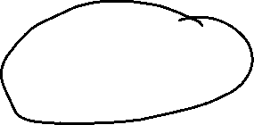

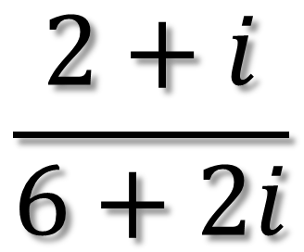



Simplify
$$\frac{2+i}{6+2i}$$

Slide 12

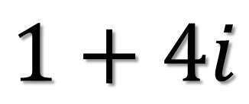
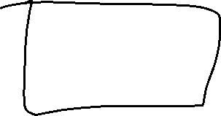
Find the Reciprocal
$$1+4i$$

Slide 13






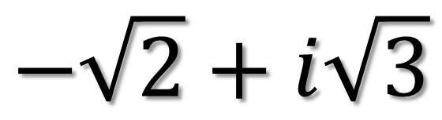






Find the Reciprocal
$$−\sqrt{2}+i\sqrt{3}$$

