Slide 1
Section 7.1
Completing the Square
Algebra II

Slide 2

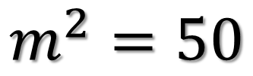
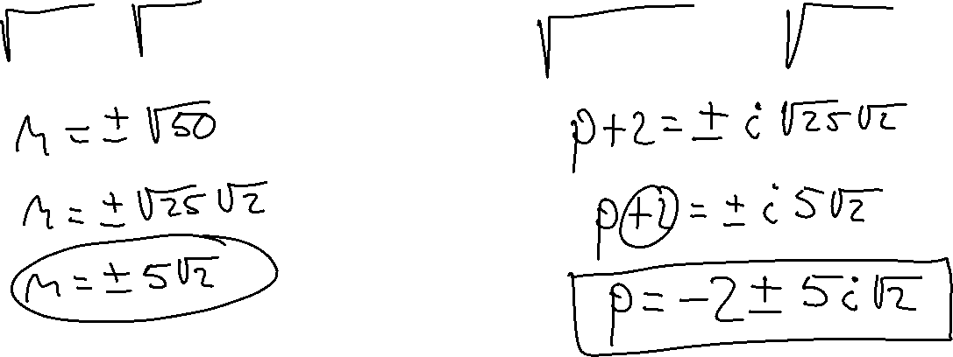
Solve
$$m^{2}=50$$
$${\left(p+2\right)}^{2}=−50$$

Slide 3
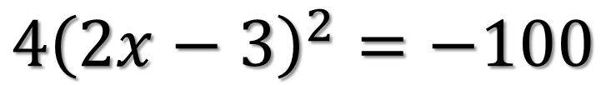

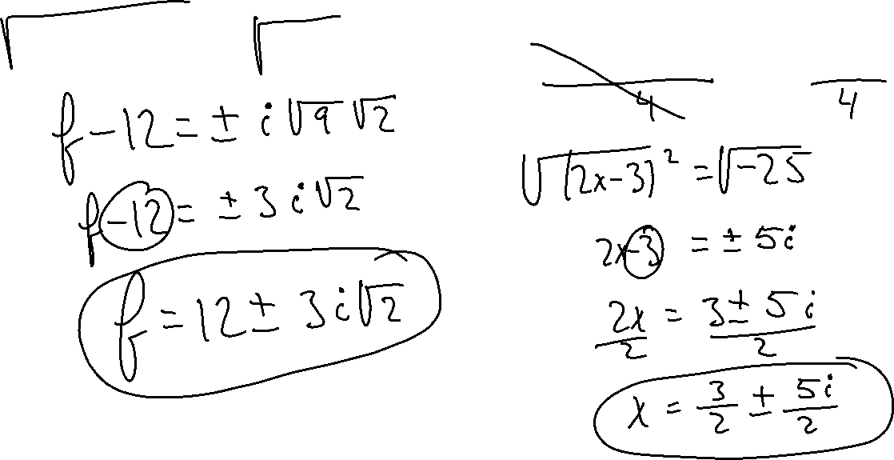
Solve
$${\left(f−12\right)}^{2}=−18$$
$${4\left(2x−3\right)}^{2}=−100$$

Slide 4
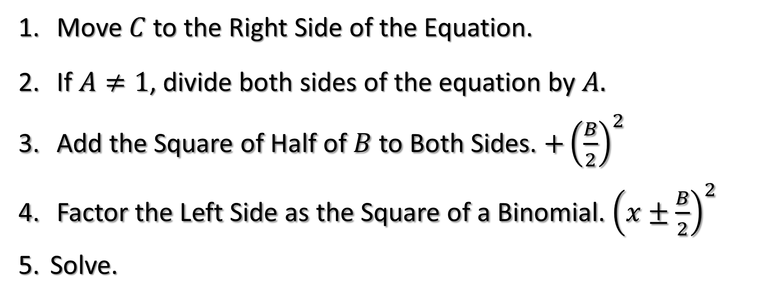
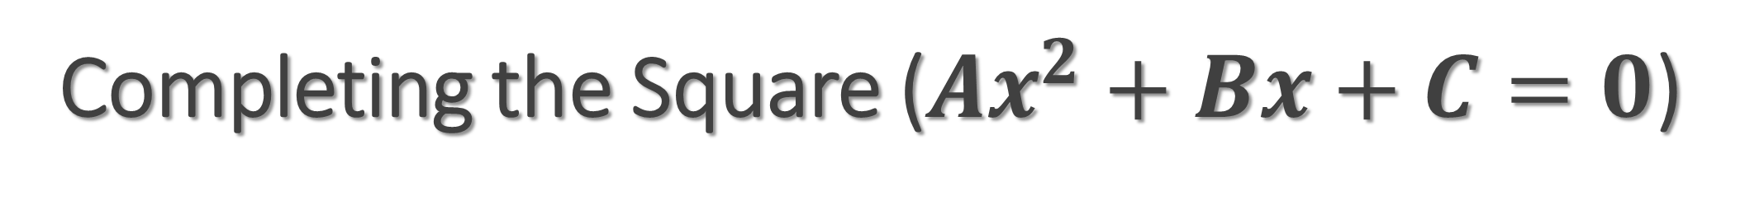
Completing the Square ($Ax^{2}+Bx+C=0$)
Move $C$ to the Right Side of the Equation.
If $A≠1$, divide both sides of the equation by $A.$
Add the Square of Half of $B$ to Both Sides. $+{\left(\frac{B}{2}\right)}^{2}$
Factor the Left Side as the Square of a Binomial. ${\left(x±\frac{B}{2}\right)}^{2}$
Solve.

Slide 5
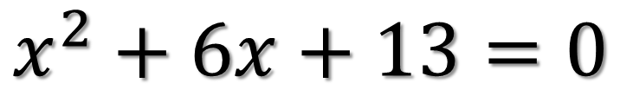
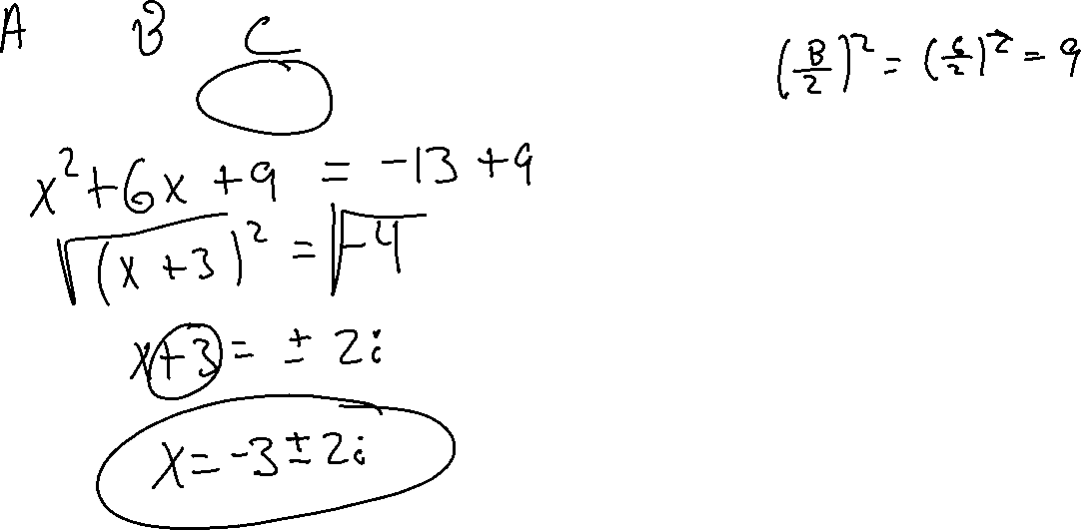
Solve
$$x^{2}+6x+13=0$$

Slide 6
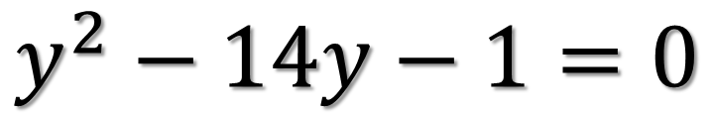
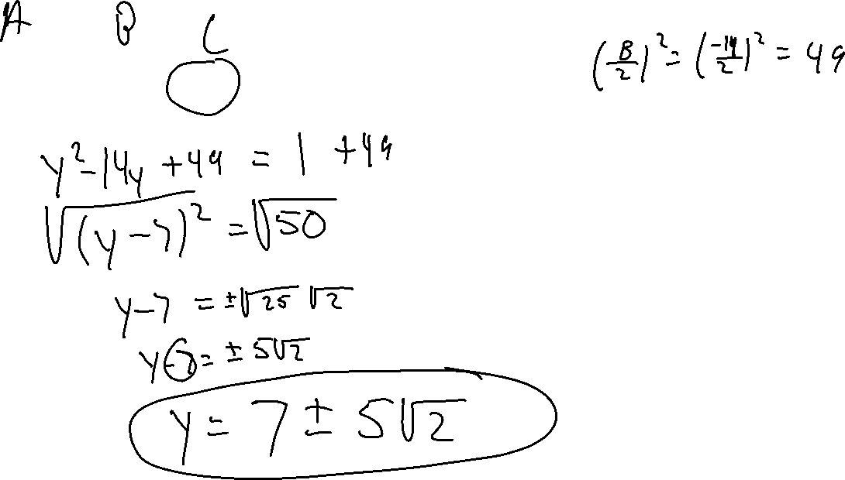
Solve
$$y^{2}−14y−1=0$$

Slide 7
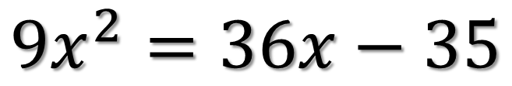
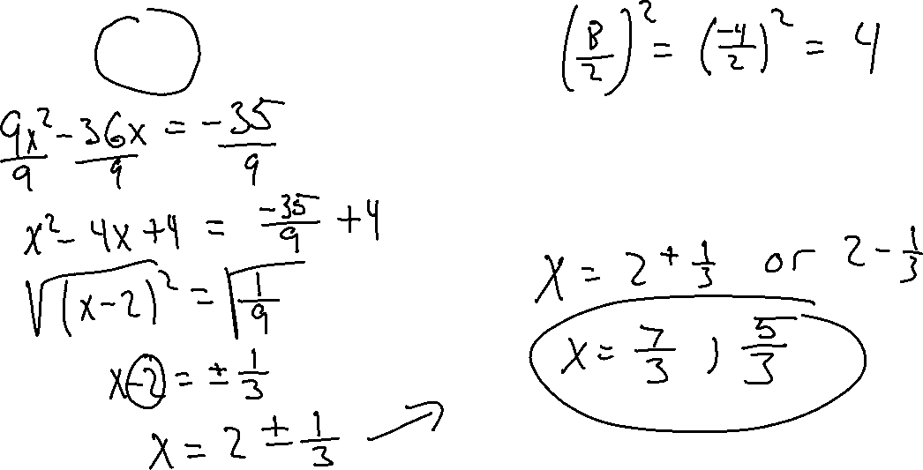
Solve
$${9x}^{2}=36x−35$$

Slide 8
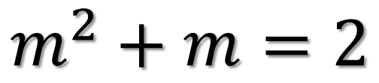
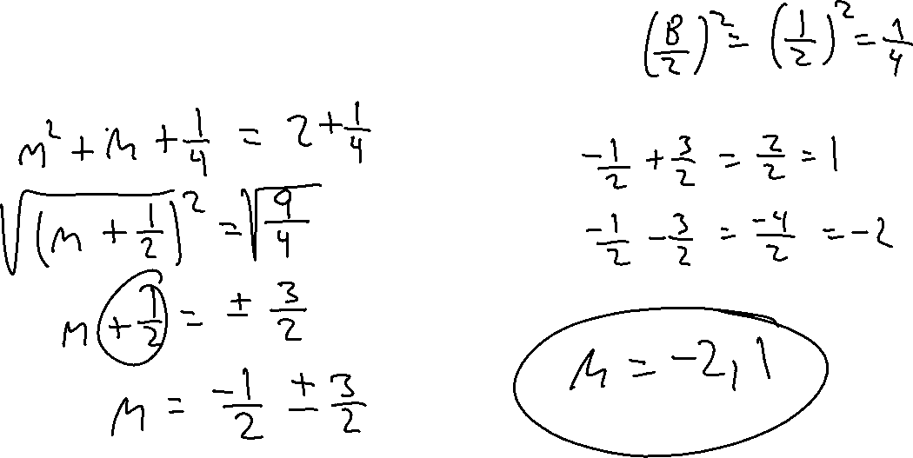
Solve
$$m^{2}+m=2$$

Slide 9
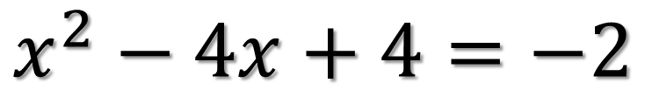
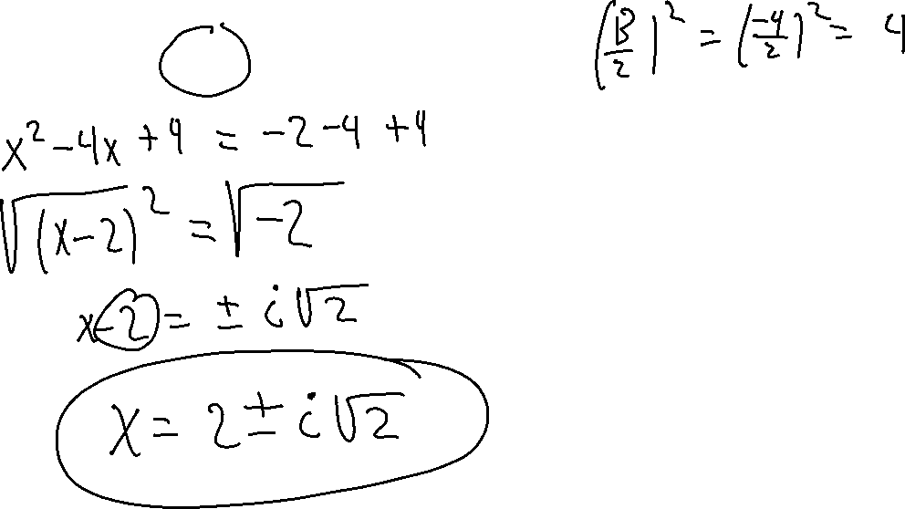
Solve
$$x^{2}−4x+4=−2$$

Slide 10
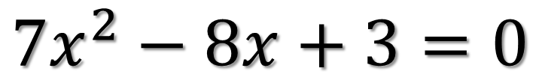
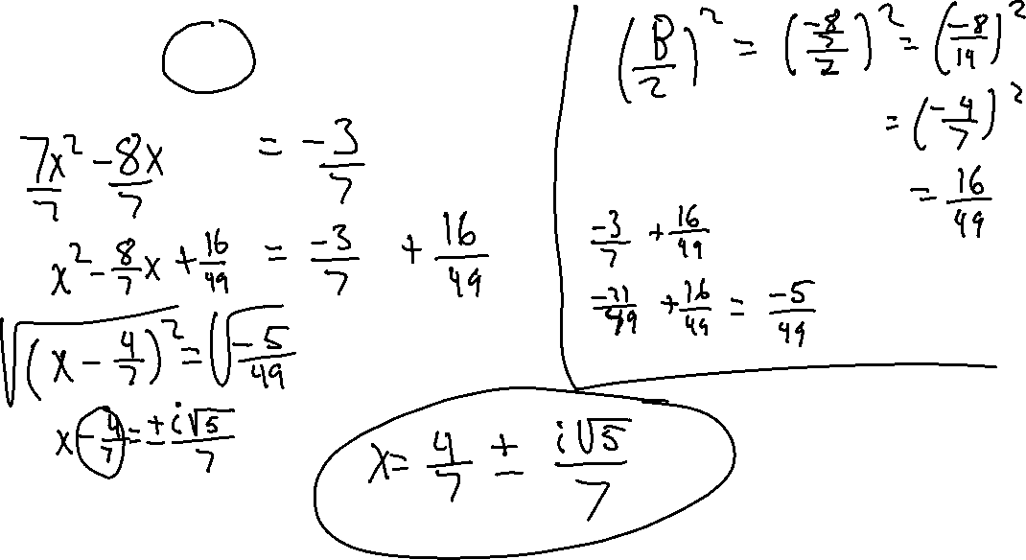
Solve
$$7x^{2}−8x+3=0$$

