Slide 1
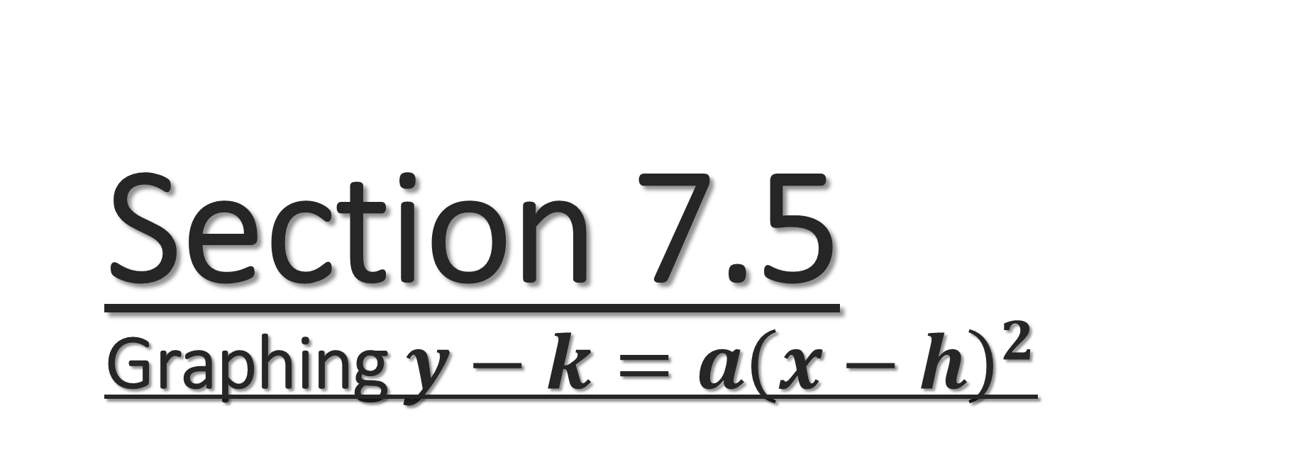
Section 7.5
Graphing $y−k=a{\left(x−h\right)}^{2}$
Algebra II

Slide 2
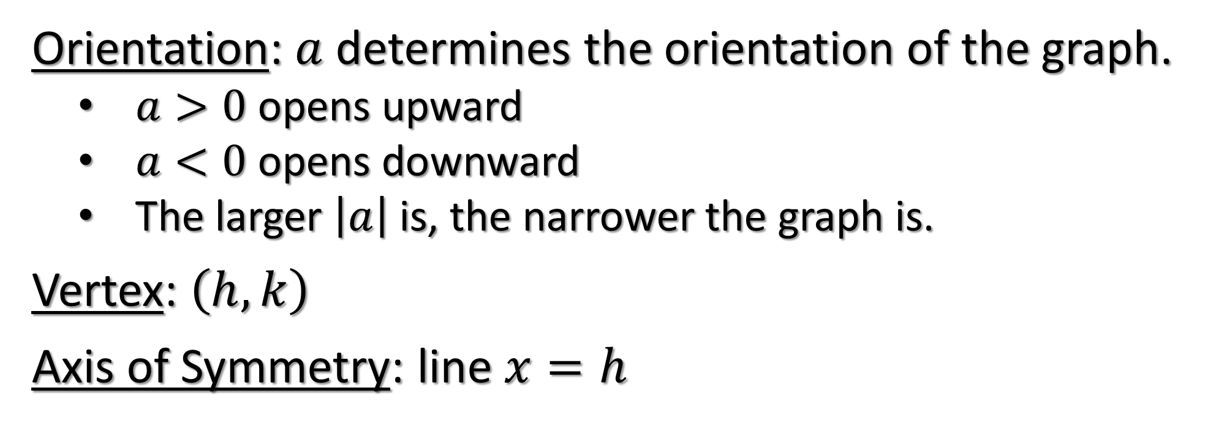
Graphing Parabolas
$$y−k=a{\left(x−h\right)}^{2}$$
Orientation: $a$ determines the orientation of the graph.
  $a>0$ opens upward
  $a<0$ opens downward
  The larger $\left|a\right|$ is, the narrower the graph is.
Vertex: $\left(h,k\right)$
Axis of Symmetry: line $x=h$

Slide 3
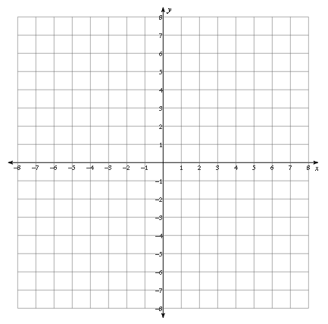
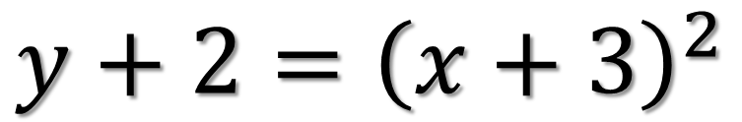
Graph
$$y+2={\left(x+3\right)}^{2}$$

Slide 4
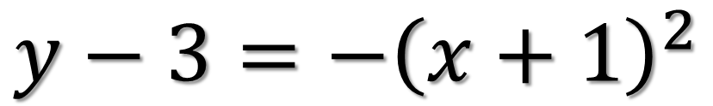
Graph
$$y−3={−\left(x+1\right)}^{2}$$

Slide 5
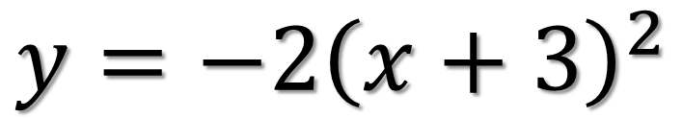
Graph
$$y={−2\left(x+3\right)}^{2}$$

Slide 6
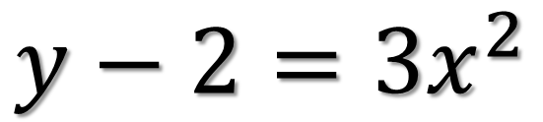
Graph
$$y−2={3x}^{2}$$

Slide 7
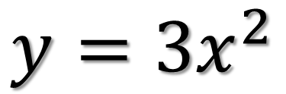
Graph
$$y={3x}^{2}$$

Slide 8
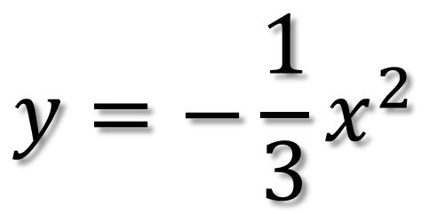
Graph
$$y={−\frac{1}{3}x}^{2}$$

Slide 9
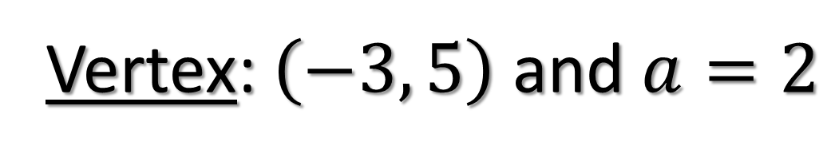
Find an equation $y−k=a{\left(x−h\right)}^{2}$ for each parabola.
Vertex: $\left(−3, 5\right)$ and $a=2$

Slide 10
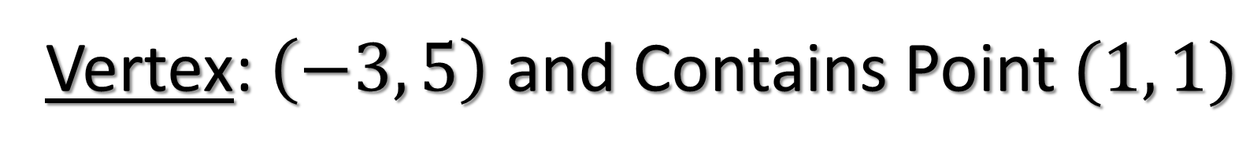
Find an equation $y−k=a{\left(x−h\right)}^{2}$ for each parabola.
Vertex: $\left(−3, 5\right)$ and Contains Point $(1, 1)$

Slide 11
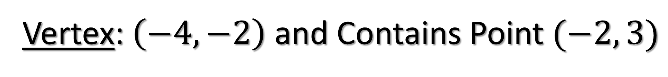
Find an equation $y−k=a{\left(x−h\right)}^{2}$ for each parabola.
Vertex: $\left(−4, −2\right)$ and Contains Point $(−2, 3)$

Slide 12

Find an equation $y−k=a{\left(x−h\right)}^{2}$ for each parabola.
Vertex: $\left(2, 6\right)$ and Contains $y−intercept$ of $1$

