Slide 1
Section 7.6 Quadratic Functions
Algebra II

Slide 2
Vertex Form
$$f\left(x\right)=a{\left(x−h\right)}^{2}+k, (a≠0)$$
Replace $f(x)$ with $y$.
Move $k$ to the other side of the equation.
Graph

Slide 3
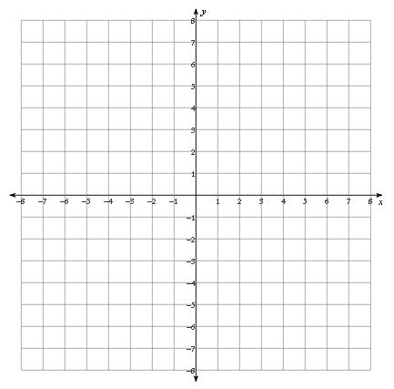
Graph
$$f\left(x\right)={2\left(x+1\right)}^{2}−6$$

Slide 4
Graph
$$f\left(x\right)={−\left(x+2\right)}^{2}+5$$

Slide 5
General/Standard Form
$$f\left(x\right)=Ax^{2}+Bx+C, (A≠0)$$
Calculate $h=\frac{−b}{2a}$
Calculate $k$ by evaluating $f(h)$.
Plot the Vertex.
Evaluate $f(x)$at two additional points and plot them.
Graph

Slide 6
Graph
$$f\left(x\right)={3x}^{2}−12x+7$$

Slide 7
Graph
$$f\left(x\right)={3+4x−x}^{2}$$

Slide 8
Minimum and Maximum Values
$$f\left(x\right)=Ax^{2}+Bx+C, (A≠0)$$
If $A<0, \left(A is Negative\right), k$ is a Maximum Value
If $A>0, \left(A is Positive\right), k$ is a Minimum Value

Slide 9
Find the vertex, axis of symmetry, max/min, domain, and range.
$$f\left(x\right)=x^{2}−8x+1$$

Slide 10
Find the vertex, axis of symmetry, max/min, domain, and range.
$$f\left(x\right)={−2x}^{2}+12x+21$$

Slide 11
Find the vertex, axis of symmetry, max/min, domain, and range.
$$f\left(x\right)={3x}^{2}+6x+7$$

