Slide 1
Section 7.7
Writing Quadratic Equations and Functions
Algebra II

Slide 2
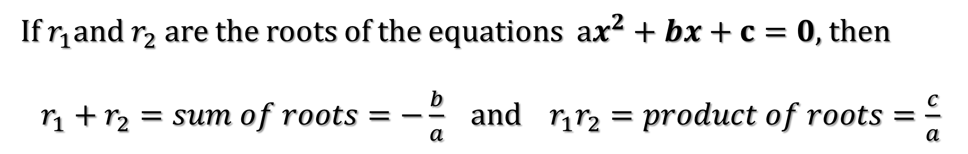
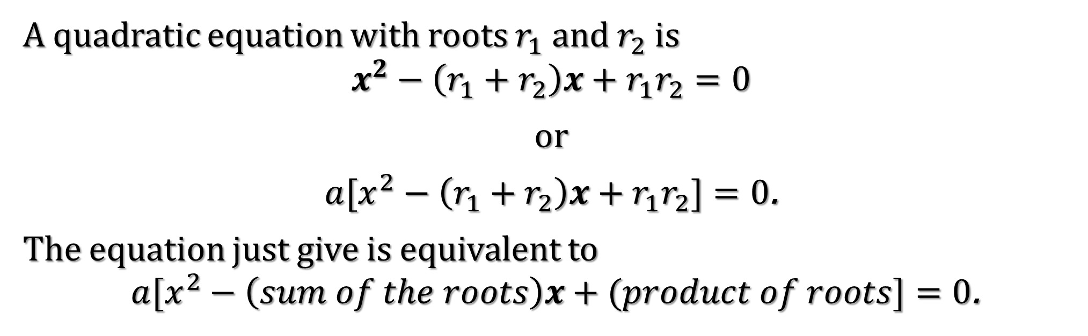
Theorems
A quadratic equation with roots $r_{1}$ and $r_{2}$ is
$x^{2}−\left(r_{1}+r_{2}\right)x+{r_{1}r}_{2}=0$
or
$a[x^{2}−\left(r_{1}+r_{2}\right)x+{r_{1}r}_{2}]=0$.
The equation just give is equivalent to
$a[x^{2}−\left(sum of the roots\right)x+(product of roots]=0$.
If $r_{1}$and $r_{2}$ are the roots of the equations $ax^{2}+bx+c=0$, then
$r_{1}+r_{2}=sum of roots=−\frac{b}{a}$ and $r_{1}r_{2}=product of roots=\frac{c}{a}$

Slide 3


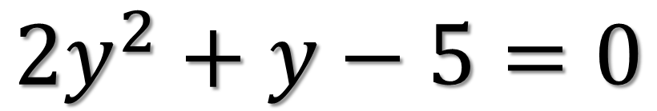




Find the roots of the given equation and check your answer by using the theorem about the sum and product of the roots.
$${2y}^{2}+y−5=0$$

Slide 4




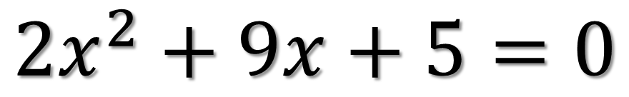




Find the roots of the given equation and check your answer by using the theorem about the sum and product of the roots.
$${2x}^{2}+9x+5=0$$

Slide 5

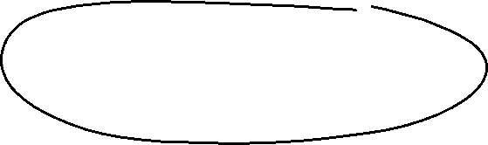




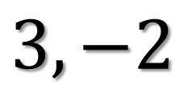







Find the quadratic equation with integral coefficients having the given roots.
$$3, −2$$

Slide 6


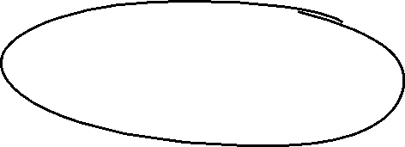




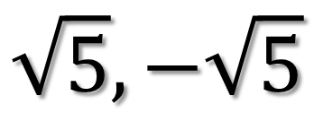




Find the quadratic equation with integral coefficients having the given roots.
$$\sqrt{5},−\sqrt{5}$$

Slide 7


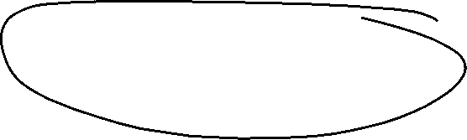




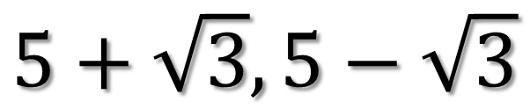
Find the quadratic equation with integral coefficients having the given roots.
$$5+\sqrt{3},5−\sqrt{3}$$

Slide 8
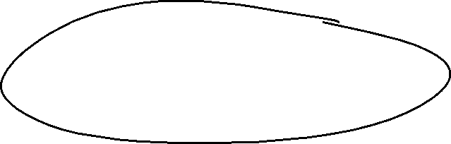




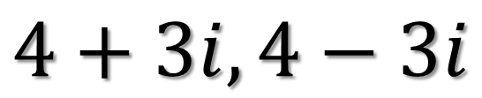

Find the quadratic equation with integral coefficients having the given roots.
$$4+3i, 4−3i$$

Slide 9

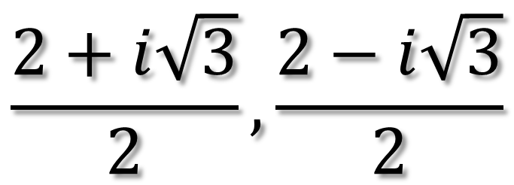





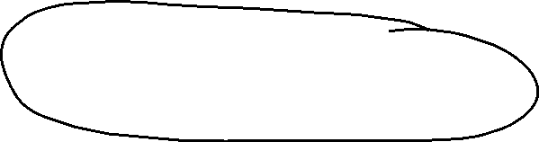
Find the quadratic equation with integral coefficients having the given roots.
$$\frac{2+i\sqrt{3}}{2},\frac{2−i\sqrt{3}}{2}$$

Slide 10












Find the quadratic function ${f\left(x\right)=ax}^{2}+bx+c$ such that the maximum value is $8$ and the graph of $f$ has $x−intercepts 3$ and $7$

Slide 11








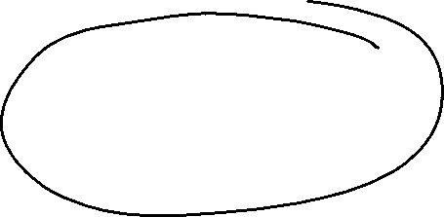
Find the quadratic function ${f\left(x\right)=ax}^{2}+bx+c$ such that the minimum value is $−1$ and the graph of $f$ has $x−intercepts 1$ and $3$

Slide 12





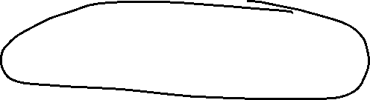


Find the quadratic function ${f\left(x\right)=ax}^{2}+bx+c$ such that the maximum value is $−5$ and the graph of $f$ has $x−intercepts −2$ and $3$

