Slide 1
Section 8.1
Direct Variation and Proportion
Algebra II

Slide 2
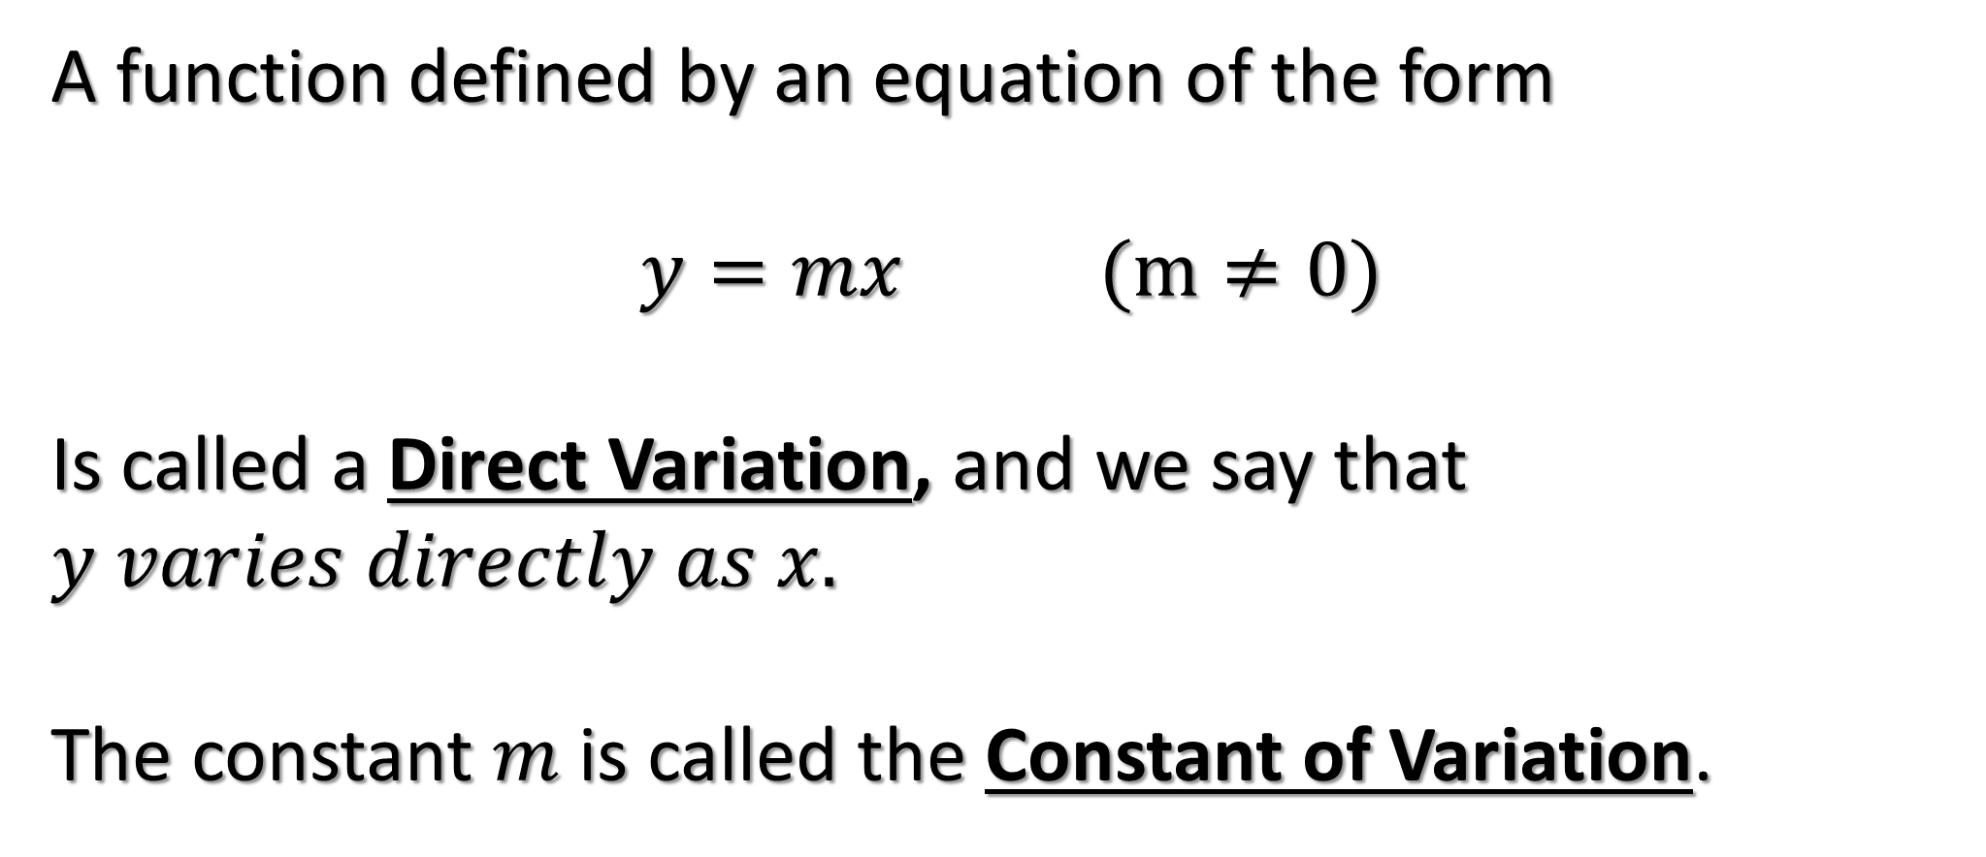
DIRECT VARIATION
A function defined by an equation of the form
$$y=mx (m≠0)$$
Is called a Direct Variation, and we say that $y varies directly as x.$
The constant $m$ is called the Constant of Variation.

Slide 3













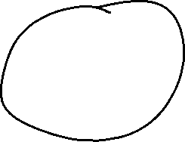


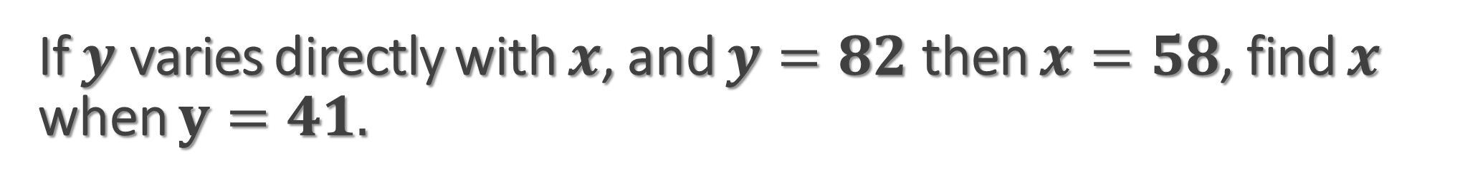
If $y$ varies directly with $x$, and $y=82$ then $x=58$, find $x$ when $y=41.$

Slide 4

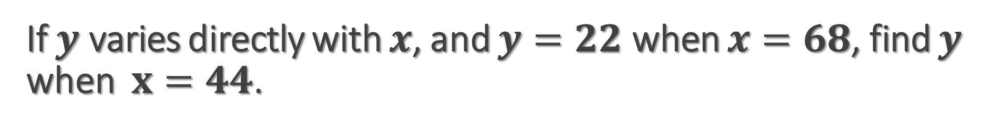





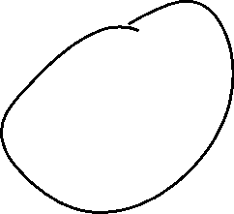



If $y$ varies directly with $x$, and $y=22$ when $x=68$, find $y$ when $x=44$.

Slide 5




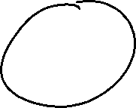
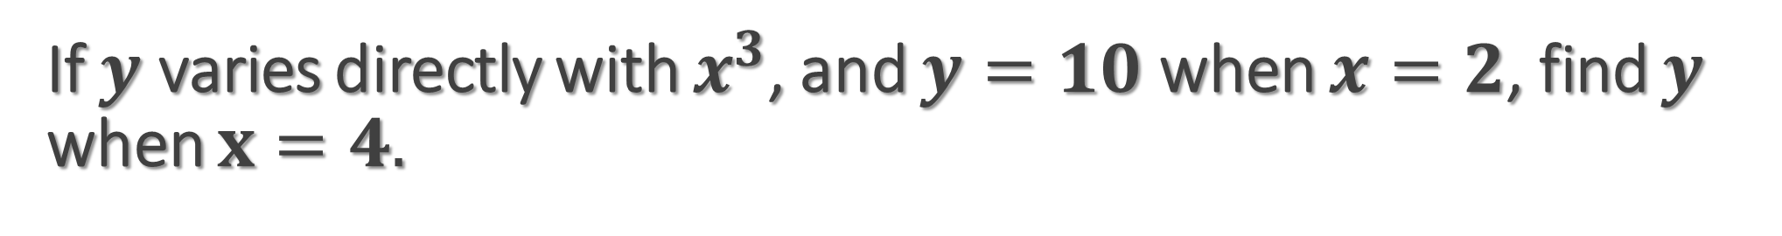
If $y$ varies directly with $x^{3}$, and $y=10$ when $x=2$, find $y$ when $x=4.$

Slide 6












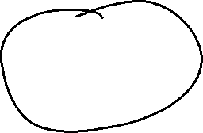
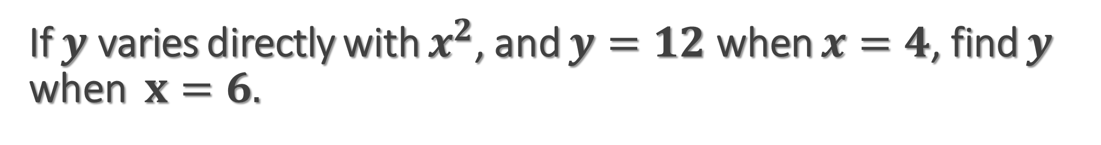
If $y$ varies directly with $x^{2}$, and $y=12$ when $x=4$, find $y$ when $x=6.$

Slide 7










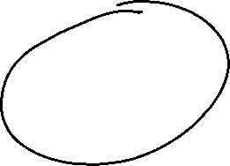


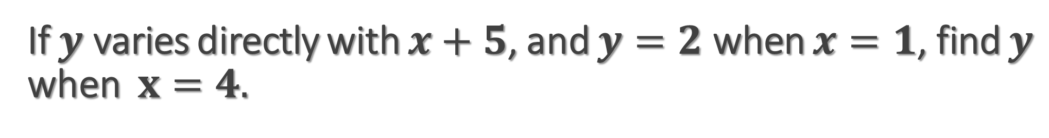


If $y$ varies directly with $x+5$, and $y=2$ when $x=1$, find $y$ when $x=4.$

Slide 8


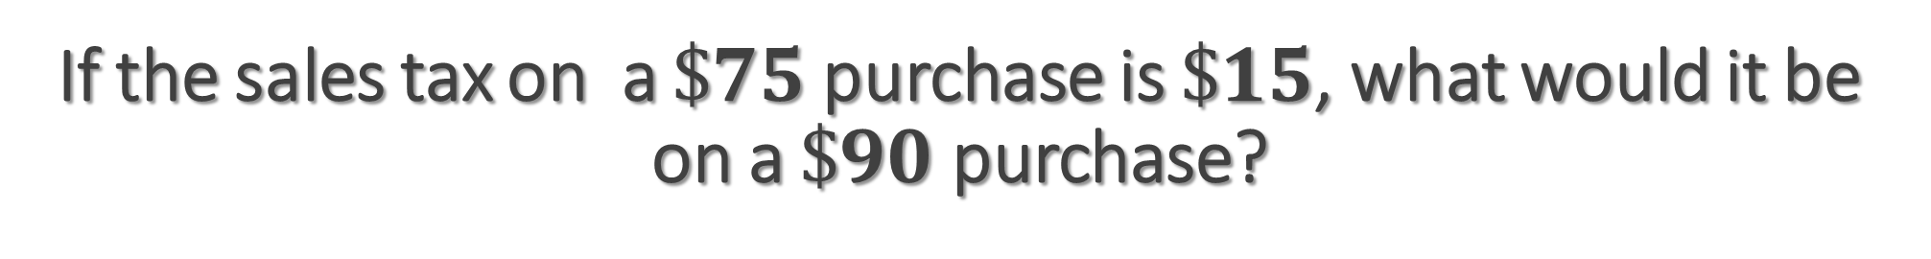





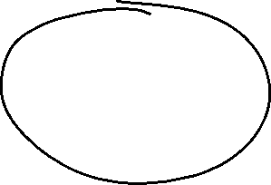





If the sales tax on a $\$75$purchase is $\$15$, what would it be on a $\$90$ purchase?

Slide 9


















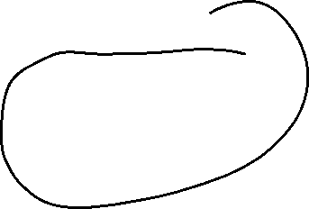
In a pre-election pole of 360 voters, 120 favored candidate Smith. How many of an anticipated 15,000 votes is Smith likely to get?

