Slide 1
Section 8.2
Inverse and Joint Variation
Algebra II

Slide 2
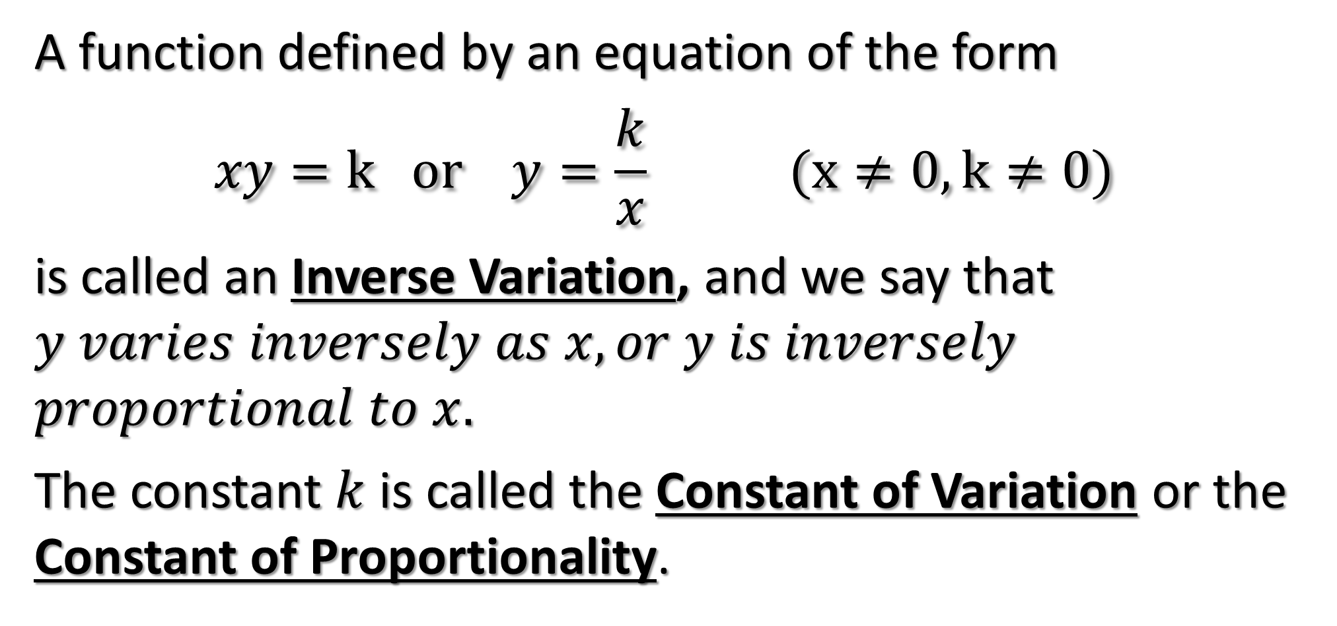
INVERSE VARIATION
A function defined by an equation of the form
$$xy=k or y=\frac{k}{x} (x≠0, k≠0)$$
is called an Inverse Variation, and we say that $y varies inversely as x, or y is inversely$
$proportional to x.$
The constant $k$ is called the Constant of Variation or the Constant of Proportionality.

Slide 3
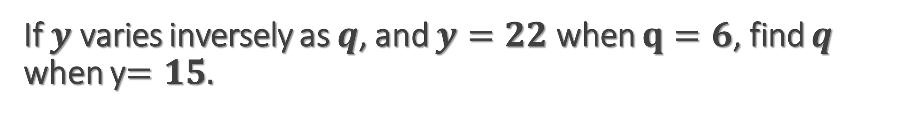
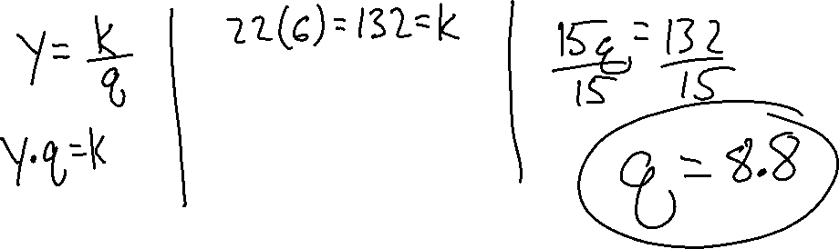
If $y$ varies inversely as $q$, and $y=22$ when $q=6$, find $q$ when y$=15.$

Slide 4
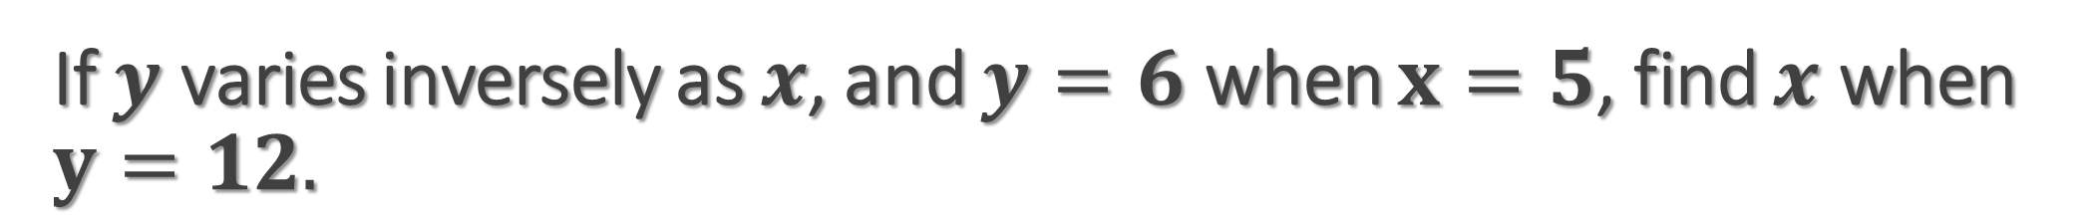
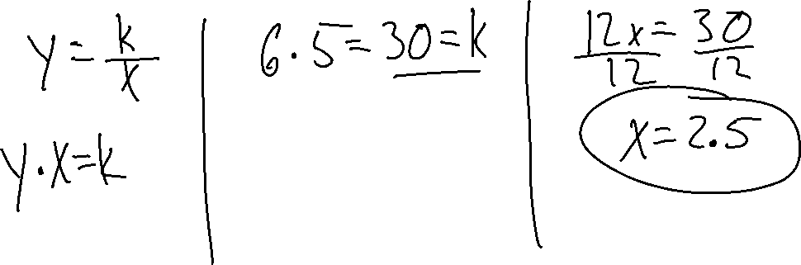
If $y$ varies inversely as $x$, and $y=6$ when $x=5$, find $x$ when $y=12.$

Slide 5
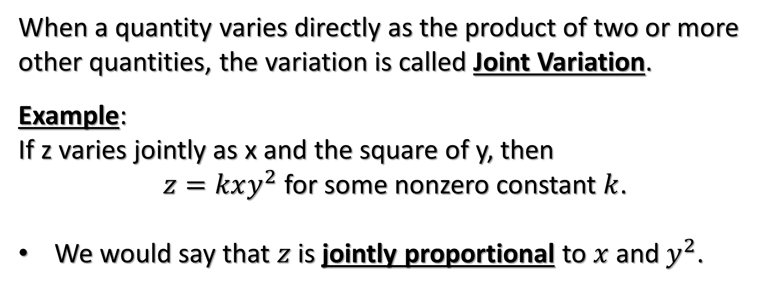
JOINT VARIATION
When a quantity varies directly as the product of two or more other quantities, the variation is called Joint Variation.
Example:
If z varies jointly as x and the square of y, then
$z=kxy^{2}$ for some nonzero constant $k$.
We would say that $z$ is jointly proportional to $x$ and $y^{2}$.

Slide 6
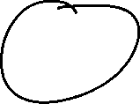
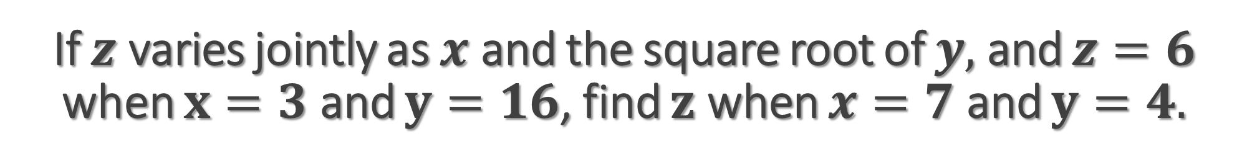


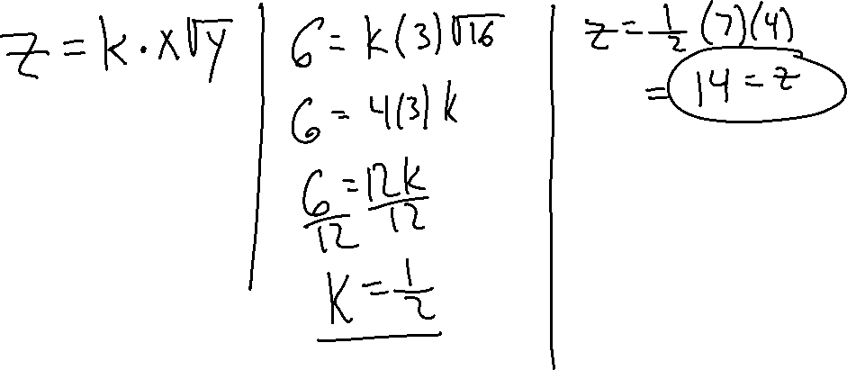
If $z$ varies jointly as $x$ and the square root of $y,$ and $z=6$ when $x=3$ and $y=16$, find $z$ when $x=7$ and $y=4.$

Slide 7
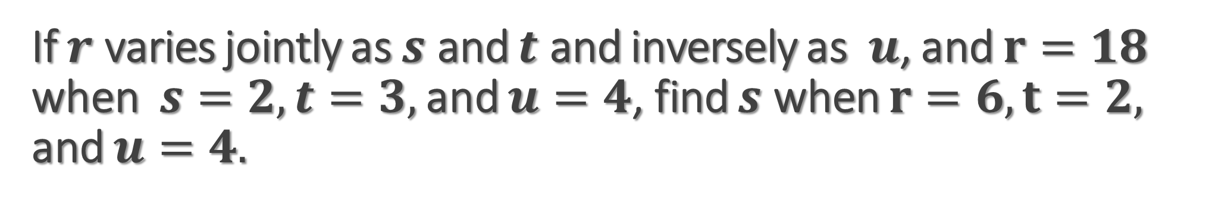
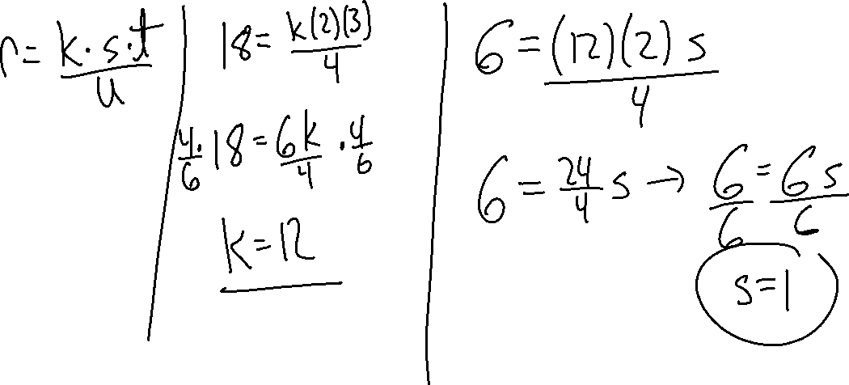
If $r$ varies jointly as $s$ and $t$ and inversely as $u$, and $r=18$ when $s=2, t=3,$ and $u=4$, find $s$ when $r=6, t=2,$ and $u=4.$

Slide 8
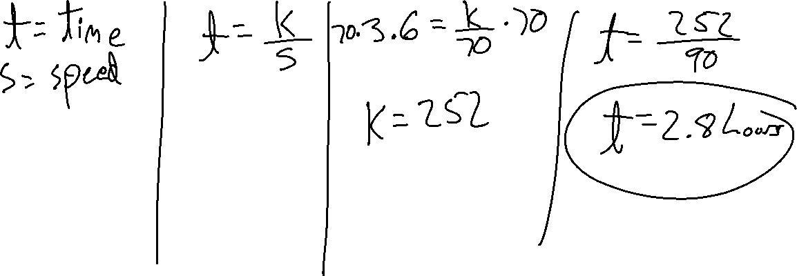
The time required to travel a given distance is inversely proportional to the speed of the travel. If the trip can be made in 3.6 hours at a speed of 70 km/h, how long will it take to make the same trip at 90 km/h?

Slide 9
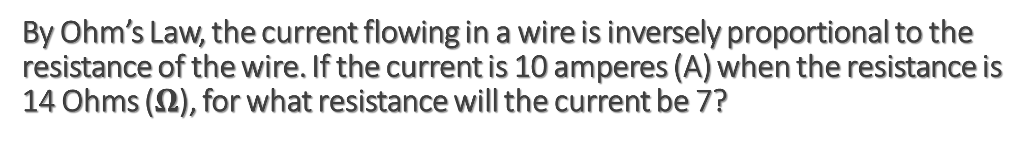
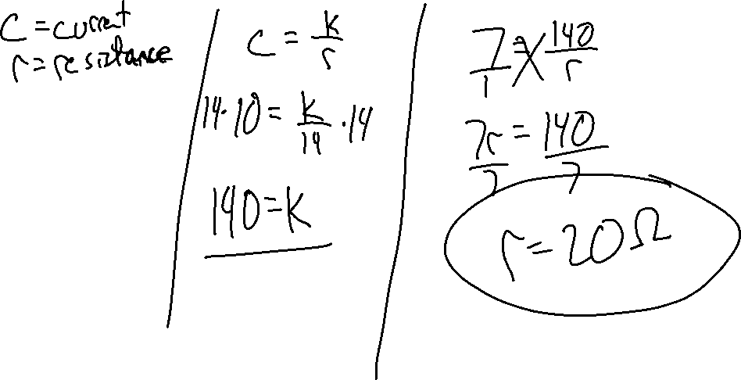
By Ohm’s Law, the current flowing in a wire is inversely proportional to the resistance of the wire. If the current is 10 amperes (A) when the resistance is 14 Ohms ($Ω$), for what resistance will the current be 7?

