Slide 1
One & Two Step Equations
Integrated Mathematics

Slide 2
Vocabulary
Equation: A statement that the values of two mathematical expressions are equal
Inverse Operations: Operations that undo one another

Slide 3
Property of Equality
You can add or subtract any number to BOTH sides of an equation and the equation will still hold true.

Slide 4
One-Step Equations with Addition/Subtraction
Ex.1) x + 2 = 6
Ex.2) a – 4 = 2

Slide 5
One-Step Equations with Addition/Subtraction
Ex.3) 19 = y + 7
Ex.4) z – 7 = 4

Slide 6
One-Step Equations with Addition/Subtraction
Try These:
1) x + 4 = 10
2) y - 2 = 12
3) 15 = 23 + r
4) -13 + z = 2

Slide 7
Property of Equality
You can multiply or divide BOTH sides of an equation by any number and the equation will still hold true.

Slide 8
One-Step Equations with Multiplication/Division
Ex.5) -2x = 8
Ex.6) 3y = 15

Slide 9
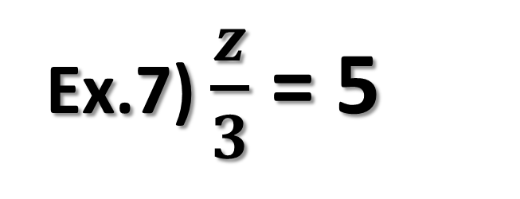
One-Step Equations with Multiplication/Division
Ex.7) $\frac{z}{3}$ = 5
Ex.8) $\frac{y}{4}$= 4

Slide 10
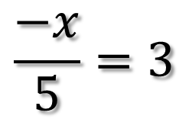
What Do We Do with Negative Fractions?
Recall that
$$\frac{−x}{5}=3$$
$$−\frac{x}{5}=\frac{−x}{5}=\frac{x}{−5}$$

Slide 11
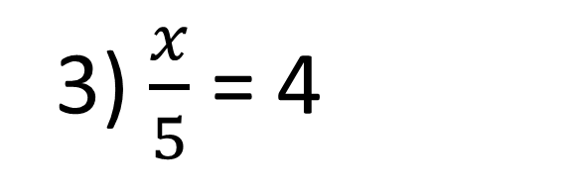
One-Step Equations with Multiplication/Division
Try These:
1) 25 = 5x
3) $\frac{x}{5}$= 4
2) -4x = -12
4) - $\frac{z}{2}$ = 24

Slide 12
Two-Step Equations
1) Separate the Equation
2) Should It Stay or Should It Go
Addition/Subtraction
3) Solve for Variable
Multiply or Divide

Slide 13
Two-Step Equations
Ex.9) 5x + 7 = 3
Ex.10) $\frac{t}{3}$ + 15 = 45

Slide 14
Two-Step Equations
Ex.11) 4 = -6y - 20

Slide 15
Two-Step Equations
Ex.12) 11z + 8 = 30

Slide 16
Two-Step Equations
Ex.13) 4 = -11 + $\frac{p}{−5}$

Slide 17
Two-Step Equations
Ex.14) 20 – $\frac{1}{7}$ c = -9

Slide 18
Two-Step Equations
Ex.15) $\frac{2x−3}{3}=5$

Slide 19
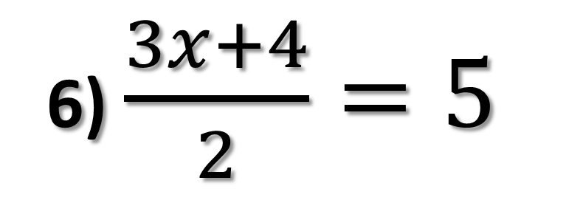
Two-Step Equations
Try These:
1) 11x + 2 = 35
4) -32 = 4t - 16
2) 8 = -22 + 2b
5) $\frac{4n}{5}$ – 7 = –4
6) $\frac{3x+4}{2}=5$
3) 2 = 5x – 8

