Slide 1
Chapter 12
Properties of Solutions

Slide 2
Solutions
Solutions are homogeneous mixtures of two or more pure substances.
In a solution, the solute is dispersed uniformly throughout the solvent.

Slide 3
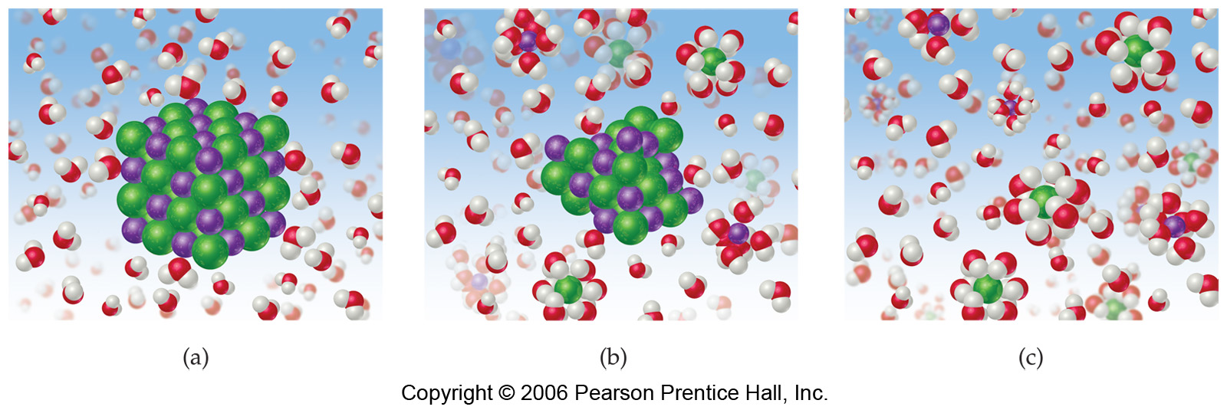
Solutions
The IMFs between solute and solvent particles must be strong enough to compete with those between solute particles and solvent particles.

Slide 4
How Does a Solution Form?
As a solution forms, the solvent pulls solute particles apart and surrounds, or solvates, them.

Slide 5
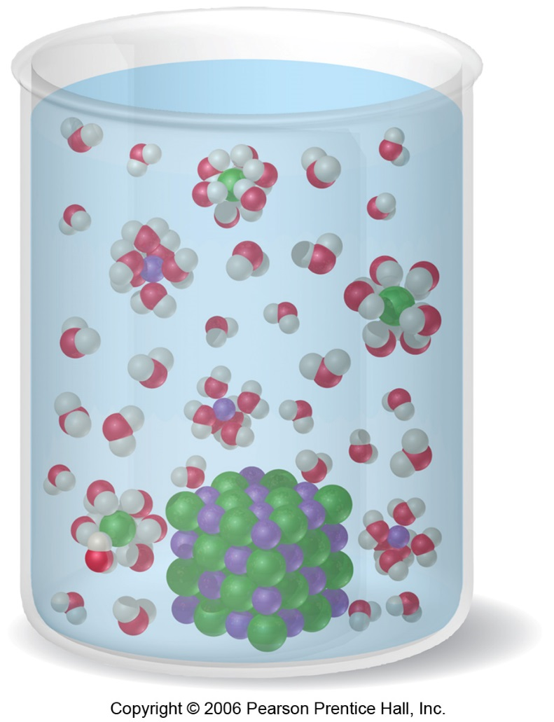
Types of Solutions
Saturated
  Solvent holds as much solute as is possible at that temperature.
  Dissolved solute is in dynamic equilibrium with solid solute particles.

Slide 6
Types of Solutions
Unsaturated
  Less than the maximum amount of solute for that temperature is dissolved

Slide 7
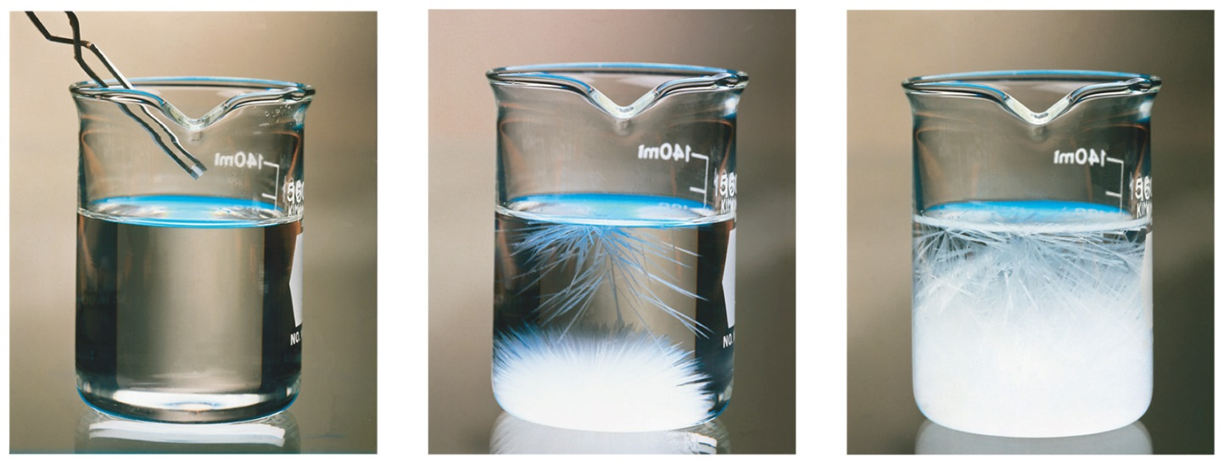
Types of Solutions
Supersaturated
  Solvent holds more solute than is normally possible at that temperature.

Slide 8
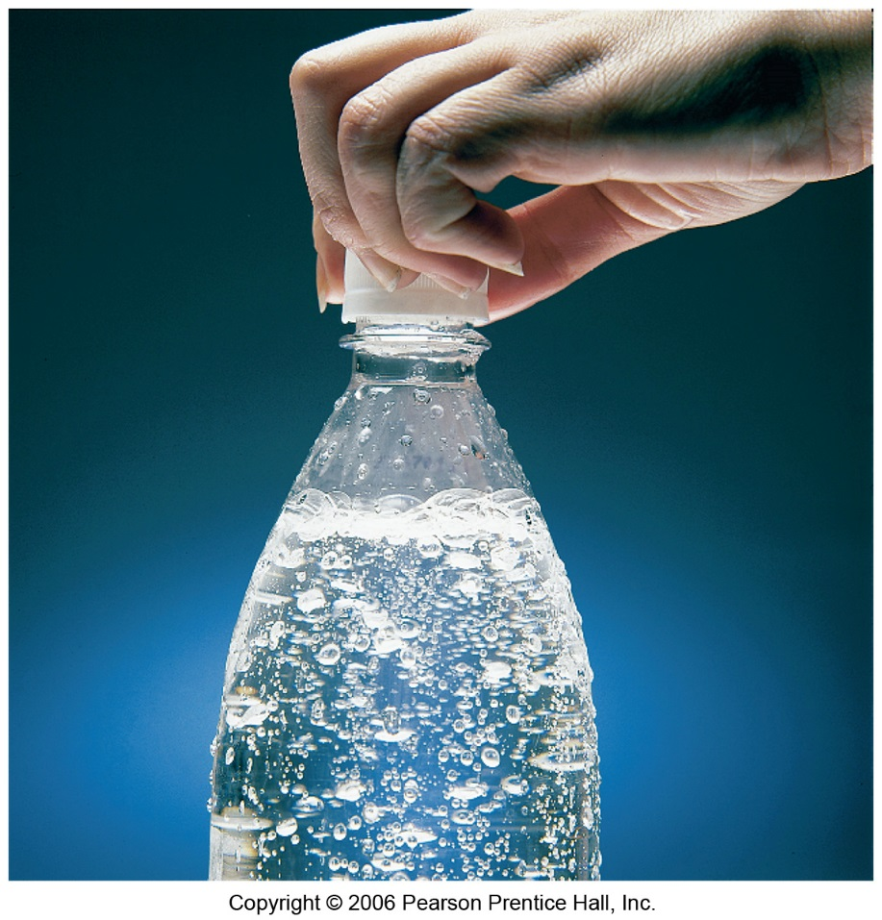
Henry’s Law
S_{g} = kP_{g}
S_{g} → solubility of the gas
k → Henry’s law constant for that gas in that solvent
P_{g} → partial pressure of the gas above the liquid.

Slide 9
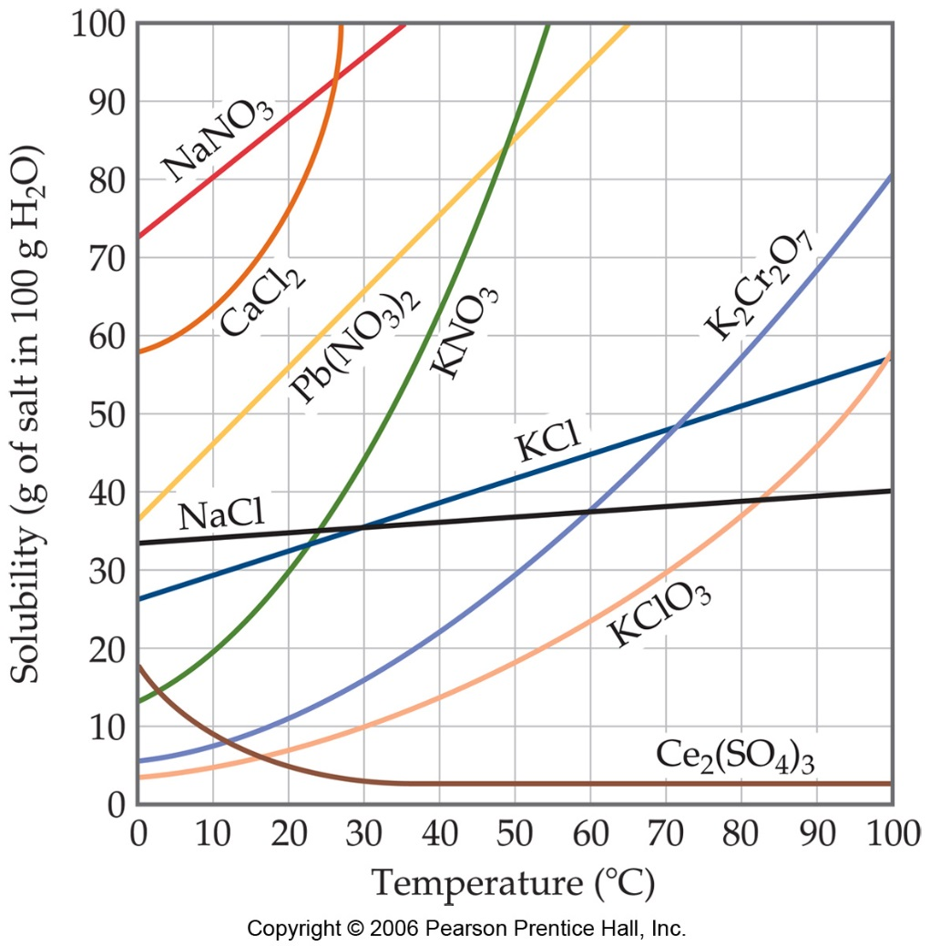
Temperature
Generally, the solubility of solid solutes in liquid solvents increases with increasing temperature.

Slide 10
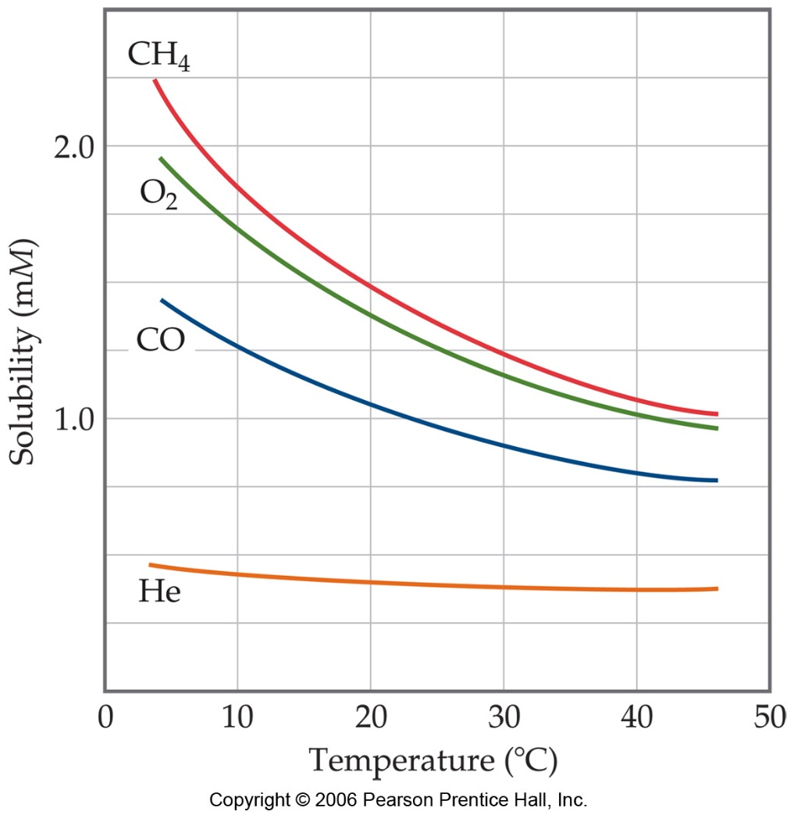
Temperature
The opposite is true of gases:
  Carbonated soft drinks are more “bubbly” if stored in the refrigerator.
  Warm lakes have less O₂ dissolved in them than cool lakes.

Slide 11
Ways of Expressing Concentrations of Solutions

Slide 12
Mass Percentage
mass of A in solution
total mass of solution
Mass % of A =
× 100

Slide 13
Parts per Million (ppm)
mass of A in solution
total mass of solution
ppm =
× 10⁶
Parts per Billion (ppb)
mass of A in solution
total mass of solution
ppb =
× 10⁹

Slide 14
Mole Fraction (X)
moles of A
total moles in solution
X_{A} =

Slide 15
Molarity (M)
mol of solute
L of solution
M =
Because volume is temperature dependent, molarity can change with temperature.

Slide 16
Molality (m)
mol of solute
kg of solvent
m =
Because both moles and mass do not change with temperature, molality (unlike molarity) is not temperature dependent.

Slide 17
Colligative Properties
Changes in colligative properties depend only on the number of solute particles present, not on the identity of the solute particles.
Among colligative properties are:
  Vapor pressure lowering
  Boiling point elevation
  Freezing point depression
  Osmotic pressure

Slide 18
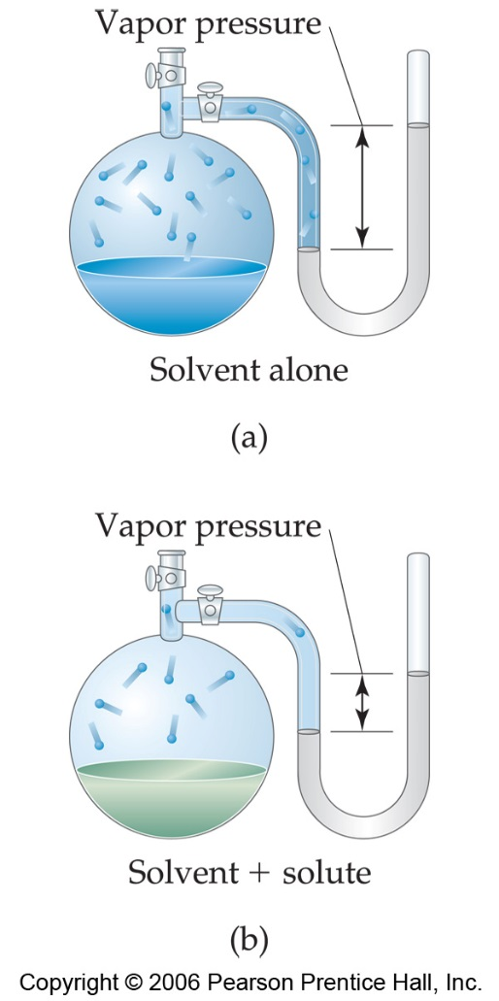
Vapor Pressure
Because of solute-solvent intermolecular attraction, higher concentrations of solutes make it harder for solvent to escape to the vapor phase.
  Thus, the vapor pressure of a solution is lower than that of the pure solvent.

Slide 19
Raoult’s Law
P_{A} = X_{A}P°_{A}
  X_{A} is the mole fraction of the SOLVENT
  P°_{A} is the normal vapor pressure of the solvent at that temperature

Slide 20
Example
Calculate the vapor pressure of a solution containing 22.5 g of lactose (C₁₂H₂₂O₁₁) and 200.0 g of water at 60 ᵒC. Assume that the vapor pressure of pure water at 60 ᵒC is 149 torr.
What if we tripled the amount of solute?
So…adding more solute will inc/dec VP??

Slide 21
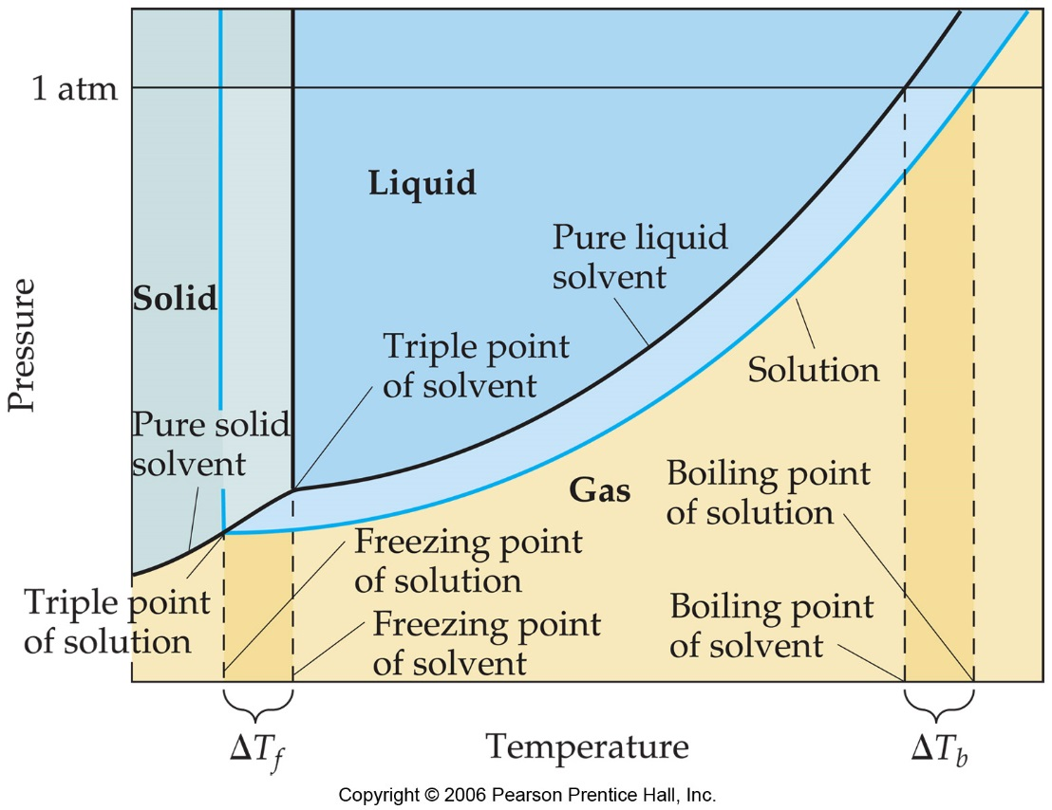
Boiling Point Elevation and Freezing Point Depression
Solute-solvent interactions also cause solutions to have higher boiling points and lower freezing points than the pure solvent.

Slide 22
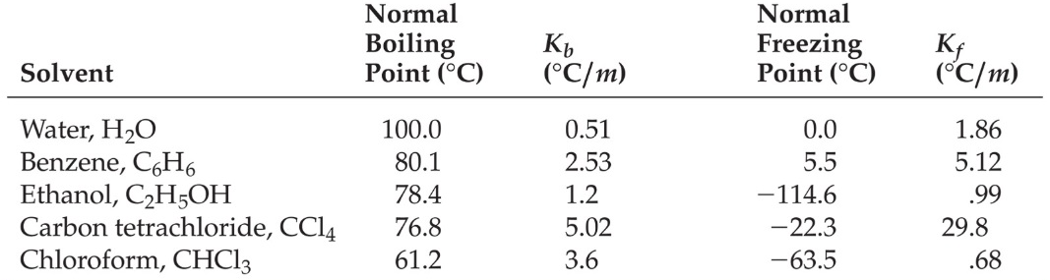
Boiling Point Elevation
ΔT_{b} = i K_{b}  m
i → the dissociation factor…think electrolytic behavior
K_{b} → molal boiling point elevation constant, a property of the solvent
m →molality of solution
ΔT_{b} is added to the normal boiling point of the solvent.

Slide 23
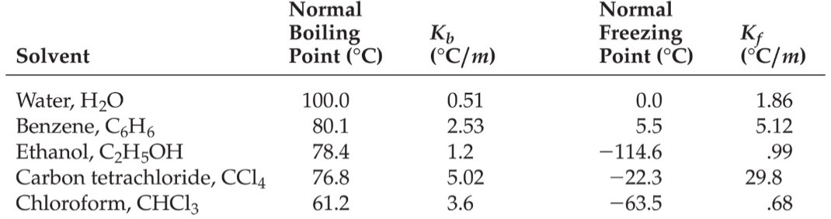
Freezing Point Depression
The change in freezing point can be found similarly:
ΔT_{f} = i K_{f}  m
Here K_{f} is the molal freezing point depression constant of the solvent.
ΔT_{f} is subtracted from the normal freezing point of the solvent.

Slide 24
Osmosis
Some substances form semipermeable membranes, allowing some smaller particles to pass through, but blocking other larger particles.
In biological systems, most semipermeable membranes allow water to pass through, but solutes are not free to do so.
In osmosis, there is net movement of solvent from the area of higher solvent concentration to the are of lower solvent concentration

Slide 25
Osmotic Pressure
The pressure required to stop osmosis, known as osmotic pressure, π, is
n
V
π = i( )RT = iMRT
M is the molarity
R is the ideal gas constant (0.08206 L-atm/mol-K)
T is temp in Kelvin

