Slide 1
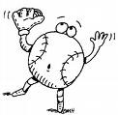
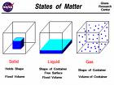
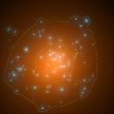
INTRO. TO MATTER
CHAPTER 2

Slide 2
MATTER
Is what the universe is made of.
Anything that occupies space (volume) & has weight (mass).
We use our senses to become familiar with matter.

Slide 3
CHEMISTRY
The study of the properties of matter and how matter changes.

Slide 4
Property
A characteristic that describes an object
Specific Properties- tells how matter is different.
Color, Odor, Size, Shape, Texture
Red apple/green apple

Slide 5
GENERAL PROPERTY
General Property- tells how all matter is alike.
Mass, Weight, Volume, & Density.

Slide 6

PROPERTIES OF MATTER
1. Physical Property
2. Chemical Property

Slide 7



PHYSICAL PROPERTIES
A characteristic of a substance that can be observed w/out changing the substance.
Ripping paper up, phase changes, texture, color.

Slide 8
Physical Property Examples
Color, odor, texture, hardness, phase changes, and ability to dissolve.

Slide 9
CHEMICAL PROPERTIES
A property that describes how a substance changes into a new substance
Chemical properties help identify gases & other substances

Slide 10
Chemical Properties:
Flammability- ability to burn, when H combines with O = burn
Rusting- O & water work on the metal to make Iron Oxide or Rust.

Slide 11
ELEMENT
An element is the simplest pure substance. It can’t be changed into a simpler substance by heating or chemical means.
Iron, Aluminum, Gold, Carbon

Slide 12
Identifying Elements
Can be identified by its specific physical and chemical properties.

Slide 13
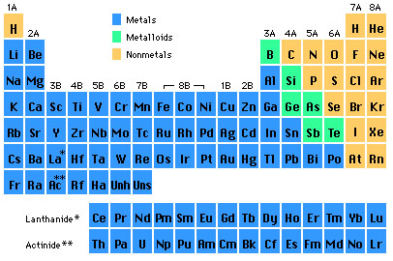
Periodic Table of Elements

Slide 14
Chemical Symbols
A shorthand way to represent elements (easy)
Consists of 1 or 2 letters from the elements name.
Oxygen= O, Carbon= C, Hydrogen= H

Slide 15
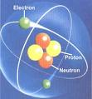
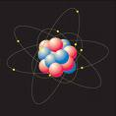
ATOMS
Smallest particle of an element that has all the properties of that element.
Atoms are able to combine with other atoms. Chemical bond holds atoms together.

Slide 16
COMPOUNDS
Pure substances made up of more than one element. 2 elements chemically combined.
Salt, Water, TNT
Can be broken down into simpler substances.

Slide 17

Compound Properties
Compounds have properties different from the properties of the elements in them.

Slide 18
COMPOUNDS
Water & Salt are pure substances, but they are not elements because they can be broken down into simpler substances.

Slide 19
Salt (NaCl) you put on french fries to add taste, but those elements alone act differently.
Sodium (Na) is a silvery metal that explodes in water, & Chlorine (Cl) is a yellowish gas that is poisonous.

Slide 20
MIXTURES
Matter that consists of two or more substances mixed together, but not chemically combined.
Each substance has its own identity

Slide 21
Same particles are present before & after mixing.
Can be separated easily (physically).
Examples: cereal, hoagie, granite

Slide 22
Classifying Mixtures
Mixtures are classified according to how well they are mixed.
3 Types of Mixtures: Heterogeneous, Homogeneous, & Solutions.

Slide 23
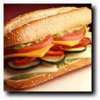
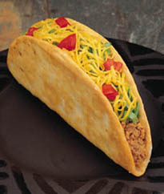
HETEROGENEOUS MIXTURE
Least Mixed
Parts of a mixture are easily seen & can be separated easily.
Tacos, hoagie, cereal

Slide 24

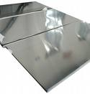
HOMOGENEOUS MIXTURES
Well mixed
Particles are very small & not easily recognizable.
Stainless steel, milk, tanning lotion

Slide 25

Solutions
Best mixed of all mixtures
A type of homogeneous mixture where one substance dissolves in another.
Ocean water, air, lemonade

Slide 26
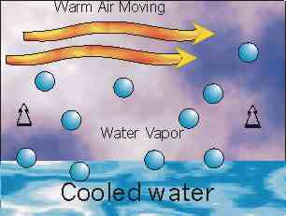

SEPARATING MIXTURES
Evaporation
Electrolysis
Filtering

Slide 27
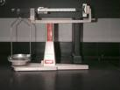

SECTION 2
MEASURING MATTER

Slide 28
WEIGHT VS MASS
Mass- the amount of matter in an object
WEIGHT-the measure of force attraction between 2 objects due to gravity

Slide 29
VOLUME
the amount of space an object takes up. Can be expressed in L, ml, or cm.
Volume = length X width X height
Can also submerge object.

Slide 30
DENSITY
Mass per unit volume. Stuff inside.
Compares different types of matter. Steel vs Wood
Density= Mass/Volume
Expressed g/ml or g/cm3

Slide 31
Example
If 100 g of steel has a volume of 5cm3, what’s the density?
D=M/V
D= 100g/5cm3
D= 20g/cm3

Slide 32

SECTION 3
CHANGES IN MATTER

Slide 33
PHYSICAL CHANGE
Any change that alters the form or appearance of matter, but does not make a different substance.
Can– can crush, flatten, chop it, BUT it is still a can!
Change state(solid to liquid, liquid to gas…)
Change in shape or form- bend, crush, chop, dissolve, break…

Slide 34
CHEMICAL CHANGE
A change in matter that produces a new substance with properties different from the original substance. (chemical reaction)
Combustion, Electrolysis, Oxidation, Rusting, Tarnishing.

Slide 35

Chemical Change Examples
Water is a combo of the elements hydrogen (H) & oxygen (O).
Made of 2 atoms of hydrogen & 1 atom of oxygen.

Slide 36
Salt is a combo of sodium (Na) & chlorine (Cl) that you put on frenchfries to add taste, but those elements alone act differently.
Sodium (Na) is a silvery metal that explodes in water, & Chlorine (Cl) is a yellowish gas that is poisonous.

Slide 37
Law of Conservation of Mass
Matter cannot be created nor destroyed in any physical or chemical change.
No mass is lost during a change.
Atoms are rearranged.

Slide 38
ENERGY & Matter
Ability to do work or cause change.
Every chemical or physical change in matter includes a change in energy.

Slide 39

TEMP & THERMAL ENERGY
Temp is average energy of motion of particles.
Thermal energy is TOTAL energy of all particles in object.
Not same, but temp is related to the amount of thermal energy an object has.

Slide 40
THERMAL ENERGY & CHANGES IN MATTER
When matter changes, the most common type of energy released or absorbed is thermal energy.
Ice melting- ice absorbs thermal energy from air & sun.

Slide 41

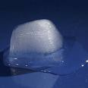

Types of Change
Endothermic Change- object absorbs energy, ice melting.
Exothermic Change- object releases energy, combustion.

Slide 42
SECTION 4
ENERGY & MATTER

Slide 43
FORMS OF ENERGY
Kinetic- energy in motion
Potential- stored energy
Chemical- energy stored in matter (chemical bonds).
Electromagnetic- energy in form of waves
Electrical- energy of electrically charged particles
Thermal- total energy motion

Slide 44
Transforming Energy
During a chemical change, chemical energy may be changed to other forms of energy.
Photosynthesis: Plant convert electromagnetic energy from the sun to chemical energy to make sugars (food).

