Slide 1
Helping Verbs
Level 2

Slide 2
Review: What Is A Verb?
A verb is a word that describes action or a state of being.
Some examples include:
Sneeze
Love
Run
Sleep

Slide 3
How Can Verbs Help Me???
The words is and are are helping verbs. Use them with other verbs that end in –ing to show that an action is still happening.
Use is to tell about one person or thing.
ex. The boat is moving. (there is only one boat, so use is; the verb to move is used with –ing at the end)
Use are for more than one person or thing.
ex. The dogs are barking. (there is more than one dog talked about, so use are; the verb to bark is used with –ing at the end)

Slide 4
What d’ya Mean There’re More???
We can also use helping verbs to "modify" the meaning of the main verb in some way. A modal helping verb expresses necessity or possibility, and changes the main verb in that sense. These are the modal verbs:
can, could
may, might
will, would,
shall, should
must
ought to
Notes:
http://www.englishclub.com/grammar/verbs-what_classification-helping.htm

Slide 5
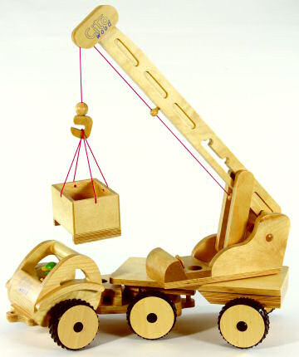
Find the Verbs & Helping Verbs
Everywhere, rescuers are working. Cranes and bulldozers are digging. A neighbor is removing the rubble. The workers are looking for survivers.
Helping Verbs
Are
Is
Verbs
Working
Digging
Removing
Looking

Slide 6
Choose the Correct Helping Verb
The rain is/are falling heavily in Oregon.
The rivers is/are rising rapidly.
Many volunteers is/are stacking sandbags.
The community center is/are preparing a shelter.
The people is/are buying emergency supplies.
The mayor is/are telling people to stay calm.

Slide 7
Rewrite the sentence. Change the underlined verbs to show the action is still happening.
Mr. Smith’s class studies disasters.
Mr. Smith’s class is studying disasters.
Pablo’s group goes to the library.
Jose reads magazine articles about hurricanes.
Joe and Mary learn about earthquakes.
They draw a map to show earthquake locations.
Rosa searches the Internet.
She records information about floods around the world.

Slide 8
Rewrite the sentence. Change the underlined verbs to show the action is still happening.
Mr. Smith’s class studies disasters.
Mr. Smith’s class is studying disasters.
Pablo’s group is going to the library.
Jose is reading magazine articles about hurricanes.
Joe and Mary are learning about earthquakes.
They are drawing a map to show earthquake locations.
Rosa is searching the Internet.
She is recording information about floods around the world.

