Slide 1
Man killed in shootout with Florida deputy
A Florida deputy sheriff was on administrative leave Monday while authorities in Ocala, Fla., investigated her fatal shooting of a man in a parked car.
The Marion County Sheriff's Office said in a release that its major crimes detectives unit had requested assistance from patrols to locate Joseph Napoli for questioning. On Monday afternoon the deputy, whose name hasn't been released, found Napoli's car on the side of a road.
The deputy parked behind Napoli's vehicle and, as she approached it, realized Napoli was armed, authorities said.
"The deputy stated that Napoli raised his gun and she discharged her weapon," the statement said. "It is believed that Napoli simultaneously discharged his as well. The deputy was uninjured but Napoli was pronounced dead on scene."
The sheriff's office said it was not immediately clear if the deputy shot Napoli or if he shot himself.
The Florida Department of Law Enforcement has taken over the investigation.

Slide 2
Why
The race of the officer and the victim were not immediately known.

Slide 3
Blacks Closing Gap on Whites in Life Expectancy
The life expectancy gap between blacks and whites is now the smallest in history, falling from seven years in 1990 to 3.4 years in 2014. According to 2014 data, African-Americans have a life expectancy of 75.6 years, while whites average 79 years, reports the New York Times. "The gap is now the narrowest it has been since the beginning of the 20th century, and that's really good news," says a demographer. An increase in opioid overdoses in white communities is partly responsible, but "there has been true progress for blacks," an epidemiologist at McGill University says. The homicide rate for blacks fell by 40% and the death rate from cancer dropped by 29% for blacks from 1995 to 2013. Those rates dropped 28% and 20%, respectively, among whites. Experts also cite a decline in black deaths from AIDS.
The suicide rate for black men has fallen by 8% from 1999 to 2014, according to the CDC, while infant mortality among blacks has fallen by about 20% since the late 1990s. The overall trend shows huge improvement since the 1900s, when life expectancy for blacks was 15 years less than for whites because of a slew of reasons, including limited access to medical care. "But we need to be very cautious," says a rep for the American Cancer Society. African-Americans still die of cancer, AIDS, heart disease, and homicide at higher rates than white people. In fact, "the excess in premature deaths among blacks is the equivalent of a jumbo jet crashing every day," reports the Times.

Slide 4
Muslim Student Labeled 'Isis' in Yearbook
(Newser) – A principal in Rancho Cucamonga, Calif., is calling it a "regrettable misprint." But the Muslim student misidentified as "Isis Phillips" in the Los Osos High School yearbook isn't buying it. "I am extremely saddened, disgusted, hurt, and embarrassed that the Los Osos High School yearbook was able to get away with this," Bayan Zehlif writes in a Facebook post. "Apparently I am 'Isis' in the yearbook. The school reached out to me and had the audacity to say that this was a typo. I beg to differ, let's be real." The school district superintendent tells the Los Angeles Times that there is another student named Isis at the school, and that both families have been contacted. An investigation is underway. "If they find that a student acted irresponsibly and intentionally, [the] administration will take appropriate actions," he says.
Zehlif and her family have spoken to the LA office of the Council on American-Islamic Relations, per NBC Los Angeles. In a statement, CAIR says it's concerned "about a possible bias motive," adding "no student should have to face the humiliation of being associated with a group as reprehensible as ISIS." On Friday, per the Times, the school handed out 287 of the yearbooks to seniors. No more yearbooks will be distributed until the error is corrected, and students who got a copy have been asked to return it. "We should have checked each name carefully in the book and we had no intention to create this misunderstanding," the yearbook staff tweeted. "It is our fault and this is absolutely inexcusable on our part." (This Sikh man's image was altered to look like a Paris terrorist.)

Slide 5
Cadets' Raised-Fist Photo Sparks Anger, Debate
(Newser) – Were cadets raising their fists to sisterhood, Beyonce, Black Lives Matter—or just taking pride in their pending graduation? A photo of 16 black female cadets raising their fists in traditional military dress at West Point was posted online in April, sparking debate and spurring the military academy to investigate, CBS News reports. Some say the cadets are clearly allying with Black Lives Matter and breaking an Army rule against political activities in uniform. The photo is "completely unprofessional," writes Iraq veteran and blogger John Burk in a post that's gotten some attention on Facebook. He adds that Black Lives Matter is "known for inflicting violent protest throughout various parts of the United States, calling for the deaths of police officers, and even going so far as to call for the deaths of white Americans."
But West Point graduate Mary Tobin says she talked to some of the cadets, who are upset by the controversy and see it differently: "That fist to them meant you and your sisters did what only a few people, male or female, have ever done in this country," she tells the New York Times. (Historically, the raised fist has been used by groups ranging from suffragists to labor unions to the Black Panthers, the Army Times notes.) Meanwhile, Black Lives Matter organizer Jonathan Pulphus says fist-raising by blacks is a way to acknowledge civil-rights advances and make "a space for themselves in institutions where they tend to not have a sense of belonging." Failure to realize this, he adds, would cost West Point black applicants. As for the cadets in the photo, they're still slated to graduate on May 21 from the mostly white, male military academy.

Slide 6
Hamilton Makes Broadway History With 16 Tony Nods
(Newser) – The megahit musical Hamilton has grabbed a record-breaking 16 Tony Award nominations, the biggest haul in Broadway history and another notch in the show's march into theatrical history. Lin-Manuel Miranda's hip-hop-flavored biography about the first US treasury secretary broke the 15-nominations record Tuesday held by The Producers and Billy Elliot. Hamilton was nominated in virtually every category it could compete in, from acting to scenic design. Next month, it will compete for Broadway's biggest crown—best new musical—with Bright Star, School of Rock, Shuffle Along, and Waitress.
The New York Times notes that those competitors probably realize they don't have much of a shot against Miranda's powerhouse production, but they know the nomination itself may help boost ticket sales for their own musicals. Deadline reports Hamilton has already brought in a never-before-seen $80 million in advance ticket sales since it began its official Great White Way run in August. Meanwhile, the best play category is composed of Eclipsed, The Father, The Humans, and King Charles III. The awards will be handed out June 12, with James Corden playing host from the Beacon Theatre in New York. (Hamilton also just won a Pulitzer.)

Slide 7
50 Cent Gives $100K to Charity After Teasing Autistic Teen
(Newser) – Curtis Jackson III needed to make amends for a "joke" he posted online, and he's just donated a huge chunk of money to an autism advocacy group, the Cincinnati Enquirer reports. Jackson—better known by his rapper name 50 Cent—landed in hot water when he posted a video to Instagram of himself making fun of Andrew Farrell, a 19-year-old with autism, Asperger's, and major hearing loss who works as a janitor at the Cincinnati/Northern Kentucky International Airport. In the video, 50 can be heard saying Farrell is "high as a mother-----," per TMZ.
"[I want] to turn this misunderstanding into an understanding," 50 said in a statement. "There are people [who] are ignored, mistreated, and neglected with disabilities that need our support. Today, I have made a donation of $100,000 to this worthy cause through Autism Speaks." Farrell and his family are said to be pleased, especially because they had only asked for a $10,000 donation to an autism cause. (50 Cent got into trouble with a bankruptcy judge for posting video of himself frolicking in cash.)

Slide 8
Sinn Fein Leader: N-Word Tweet Was Meant to Be 'Ironic'
(Newser) – Gerry Adams caught a viewing of Quentin Tarantino's Django Unchained on Sunday and was perhaps a little too enthusiastic in sharing his thoughts on it. The leader of Ireland's Sinn Fein party posted in a now-deleted tweet: "Watching Django Unchained - A Ballymurphy [N-word]!" Cue the backlash over what he now says was an "ironic" choice of words, the Guardian reports. Per the BBC, Adams has since apologized for the tweet—which CNN notes differed from his usual stream of dog, trampoline, and stuffed-animal tweets—but insists he was merely trying to compare the struggles of the 2012 movie's title character (a freed slave dealing with pre-Civil War racism) to Irish nationalists who were murdered in 1971's Ballymurphy Massacre in the Ballymurphy section of Belfast (nearly a dozen people were killed by British soldiers).
"Attempts to suggest that I am a racist are without credibility," Adams says in a statement on the Sinn Fein website. "I am opposed to racism and have been all my life," thought at a Monday press conference in Belfast he acknowledged that his use of the N-word was "inappropriate." The Guardian points out that Adams and other nationalists have often tried to paint their troubles as similar to those of blacks, both in the US and post-colonial states, and that Sinn Fein has participated in anti-racism campaigns in Ireland. A Northern Ireland pol, however, says it's "insulting to dismiss the suffering of the slaves in such a flippant manner," while another says the tweet showed a "staggering deficiency in judgment" on Adams' part. Meanwhile, a Belfast activist tweeted: "White, male millionaires don't have a right to use the 'n' word. #gerryadams."

Slide 9
Confederate Monument Coming Down in Kentucky
(Newser) – A Confederate monument will be removed from a spot near the University of Louisville campus where it has stood since 1895. The stone monument honoring Kentuckians who died for the Confederacy in the Civil War will be moved to another location, University President James Ramsey and Louisville Mayor Greg Fischer said during a surprise announcement Friday. The monument is capped with a statue of a Confederate soldier. "It's time for us to move this monument to a more appropriate place," Ramsey said while standing in front of the stone memorial, which sits next to the university's gleaming Speed Art museum that just completed a $60 million renovation.
Governments and universities across the country have re-evaluated displays of Confederate symbols following the racially motivated slayings last summer of nine black parishioners at the Emanuel AME church in Charleston, South Carolina. The tall, obelisk-style monument will be disassembled and cleaned while it is in storage awaiting a new location, which has not been determined. It was given to the city by the Kentucky Woman's Monument Association. Ricky Jones, a professor of Pan-African studies at the university, says he has been pushing for removal of the statue since he arrived at the university in the late 1990s. "I can't tell you how happy I am," Jones said after the announcement Friday. "I think this statue being on the campus is somewhat akin to flying the Confederate flag over the (university's) administration building."

Slide 10
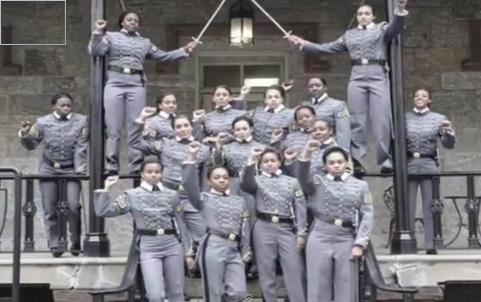

Slide 11
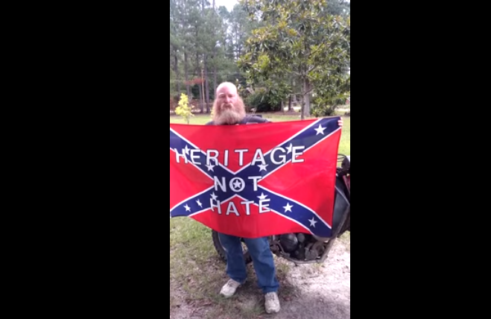

Slide 12
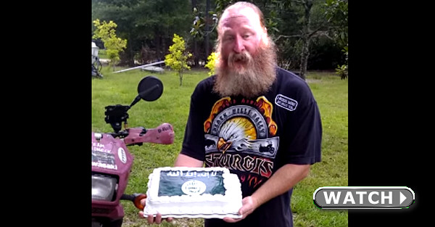

Slide 13
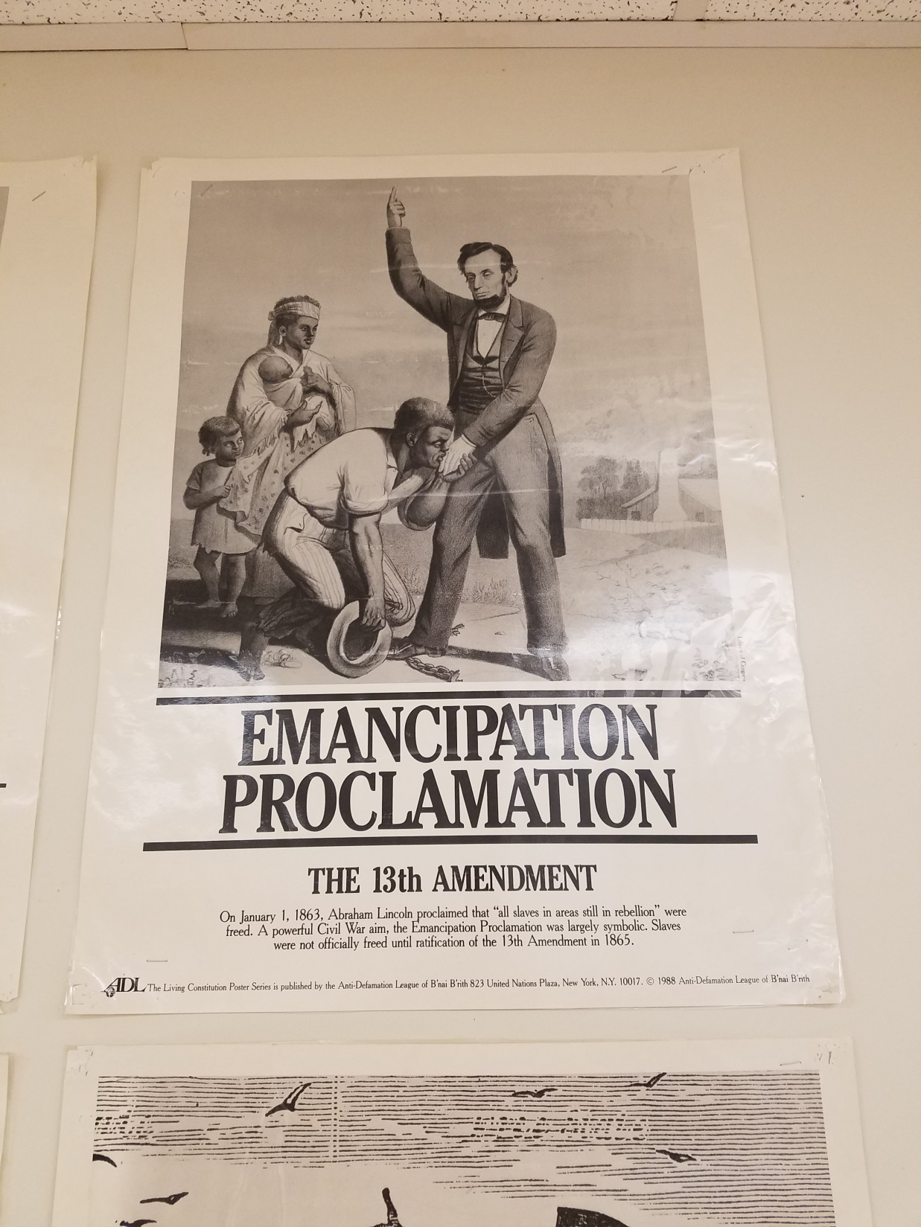

Slide 14
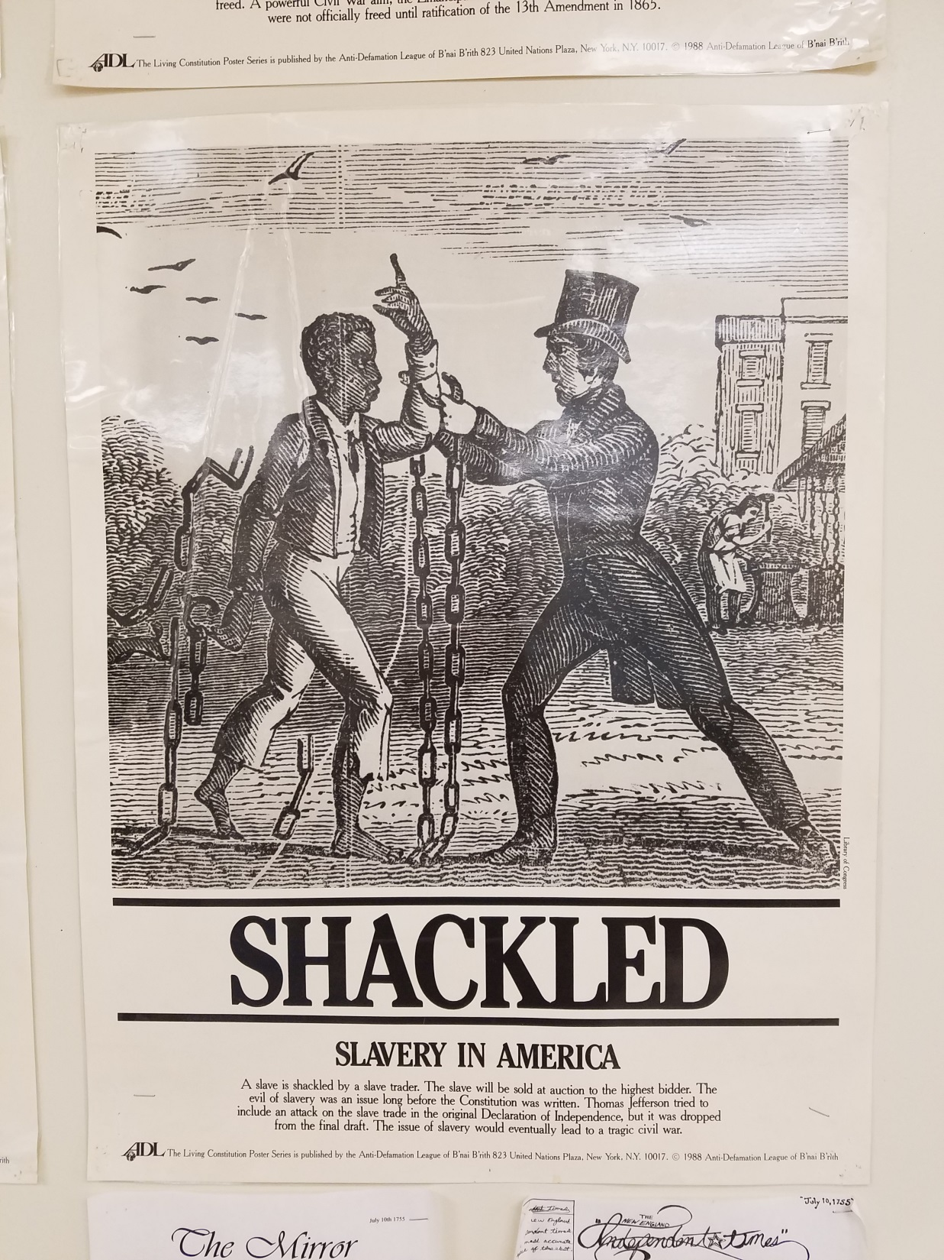

Slide 15
