Slide 1
Parenteral Medications
Karen Malt, MSN, RN

Slide 2
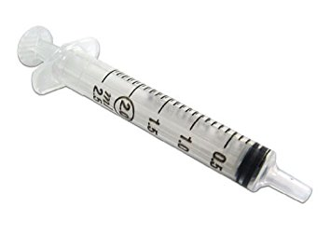
Parenteral Route- commonly used when referring to medication given by injection.
When the parenteral route is used the filtering effects of the liver does not occur. Therefore, more active drug will be in the circulation and the intended adverse effects may be more pronounced. (Older adults and children should be watched closely for adverse dug effects.)
The equipment needed to administer parenteral drugs consists of a syringe and a needle.
Parts of a syringe;
Plunger- withdraw and instill medication
Barrel- Holds the medication
Tip- Attaches to the needle
Syringes are calibrated in mL (milliliter), cc (cubic centimeter), U (units).

Slide 3
Insulin Pens – A hard plastic cylinder that looks much like a fountain (writing) pen.
The cylinder contains a pre-filled reservoir of insulin. The dose of insulin is dialed and displayed in a window at the end of the syringe.
When selecting the prescribed dose, each unit of insulin is accompanied by a clicking sound in the pen.
Critical Thinking: Why is this advantageous to the diabetic client?

Slide 4
Insulin Pens
The insulin pen automatically resets to zero following the injection.
The insulin in the pre-filled pens is table for 30 days.
A disposable needle is attached to the pen at during each use.
Review Advantages and Disadvantages in Timby page 796.

Slide 5
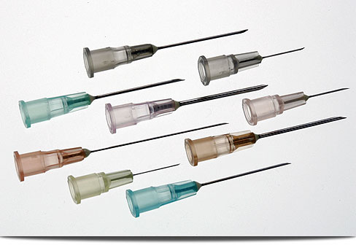
Needles
Needles are supplied in various lengths and gauges. The Shaft (the length of the needle) depends on the depth to which the medication will be administered. Needle lengths vary from ½ inch to 2 ½ inches. The tip of the shaft is beveled of slanted to puncture the skin easily. A Filter needle contains a membrane that acts as a barrier blocking the entrance of glass shards when withdrawing from an ampule. The gauge refers to the needles width. Most commonly 18 – 27 gauge needles are used. The smaller the number the larger the diameter needle

Slide 6
Factors to Consider when Selecting a Needle
The depth of the medication
The depth of the tissue
The volume of prescribed drug
The viscosity of the prescribed drug
The size of the client
Review Table 34-1 Common sizes of syringes and needles

Slide 7
Modified Safety Injection Equipment
Needle Stick Safety and Prevention Act 2000
Conventional syringes and needles are being redesigned to avoid needle stick injuries and reduce the risk of acquiring a blood-borne viral disease.
Hepatitis B (HBV)
Hepatitis C (HCV)
HIV/AIDS
Currently there are 3 various types of safety injection devices:
Those with plastic shields that cover the needles after its use
Those with needles that retract I the syringe
Gas pressured devices that inject medications without needles.

Slide 8
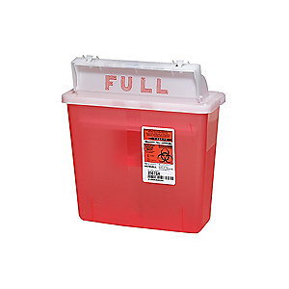
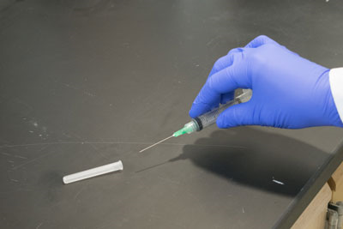
Techniques if Safety Devices Not is Use
Scoop Method – Threading the Needle within the cap without touching the cap itself.
Biohazard Container – The needle is left uncapped and placed immediately in the nearest sharps container.

Slide 9
Accidental Needle Stick
Report the injury to a supervisor immediately
Document the injury in writing
Identify the client if possible
Obtain HIV and HBV status results, if legal to do so
Obtain counseling for possible infection
Receive the most appropriate post exposure drug treatment prophylaxis
Be tested for antibodies at appropriate intervals
Monitor for symptoms and receive follow up
https://www.youtube.com/watch?v=F-dGbIuxI68

Slide 10
Drug Preparation
Withdrawing medication from an ampule or a vial or assembling a pre-filled syringe cartridge.
Ampule- A sealed glass drug container. This type of container must be broken to withdraw the medication. A filter needle must be used to withdraw the drug.
Vials- A glass or plastic container of parenteral medication with a self- sealing rubber stopper must be pierced with a needle or a needleless adapter to remove medication. The amount of drug in the vial may be single dose or have multiple doses. Sometimes these drugs are in powder form and must be reconstituted.
Reconstitution-
The type of diluent used
The amount of diluent to add
The dosage per volume after reconstitution
Directions for storing the drug
If the medication can be used for more than one dose, the preparer writes the date, time, and initials on the vial label.

Slide 11
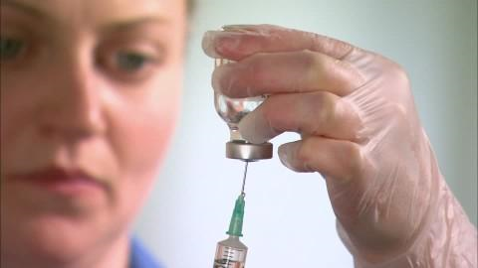
Practice Withdrawing Medication
Timby, page 799 and 800

Slide 12
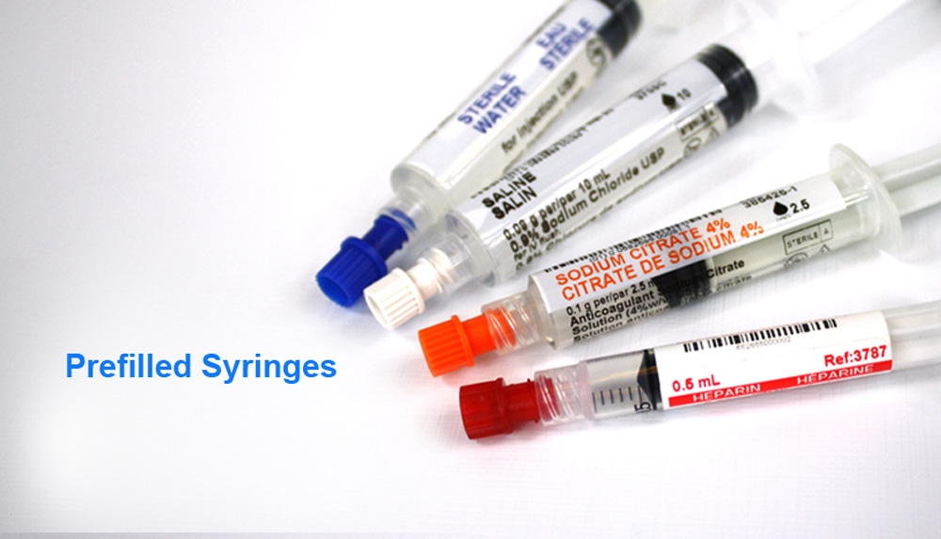
Pre-filled Cartridges
A sealed glass cylinder of parenteral medication.

Slide 13
Combining Medications in One Syringe
Sometimes it is necessary to combine more than one drug in a syringe.
Exact amounts must be withdrawn from each container precisely, because there is no way of removing one without the other once in the syringe.
Before mixing any drugs together the nurse must check for drug compatibility to ensure there will be no chemical interaction when combined. The chemical reaction will often create a precipitate (liquid that contains solid particles.)

Slide 14
Injection Routes
Four Injection Routes
Intradermal- between the layers of the skin
Subcutaneous – beneath the skin, but above the muscle
Intramuscular- injection in the muscle tissue
Intravenous- injection into the vein
See Figure 34-10 in the textbook

Slide 15
Intradermal Injections
Intradermal injections are used for diagnostic purposes.
Example : Tuberculin Test and Allergy Testing Small volumes are used such as 0.01 to 0.05 mL.
Injection Sites;
Inner aspect of the arm, back, posterior arm, upper chest.
Injection Equipment
Tuberculin syringe holds 1 mL of fluid and is calibrated in 0.01mL increments. A 25 – 27 gauge needle measuring ½ inch in length is commonly used.
Injection Technique – When giving an intradermal injection, the nurse instills the mediation shallowly at a 10 to 15 degree angle of entry.
See Diagram Timby page 802 Intradermal Injection sites

Slide 16
Critical Thinking
What actions would be necessary if a client displays signs and symptoms of an allergic reaction to an agent given intradermally?

Slide 17
Subcutaneous Injections
Subcutaneous injections are administered more deeply than an intradermal injection. Mediation is instilled between the skin and the muscle and absorbed fairly rapidly: Medications usually begin acting within 15-30 minutes of administration. The volume to be administered is usually up to 1mL. The subcutaneous route is commonly used for insulin and heparin.
Injection Sites:
See Figure 34-13 in Timby. The rate of absorption site from fastest to slowest;
Abdomen, outer back area of the upper arm, the outer areas of the thigh, “wallet” area of the buttocks. According to Morris (2014) exercising these areas after injection can increase blood flow and hasten drug absorption from those areas.

Slide 18
Insulin Injection Sites
The preferred site for giving a SC injection of Insulin is in the abdomen. Rotating within one injection site, preferably the abdomen, is preferable, rather than rotating to a different area with each injection. When the abdominal site is used, insulin is absorbed at a more consistent rate. Rotating sites prevents tissue injury. When rotating within one injection site, keep injections an inch or a finger width apart from previous site. Also, avoid a two inch central area around the umbilicus.
Injection Equipment-
Insulin Syringe or pre-filled cartridge. 25 gauge needle commonly used. Needle lengths can vary from 1/2 to 5/8 inches.
Injection Techniques-
Normal sized or obese client with 2 inch tissue fold inject at 90 degree angle.
Thin clients who have a one inch fold of tissue, insert the needle at a 45 degree angle.

Slide 19
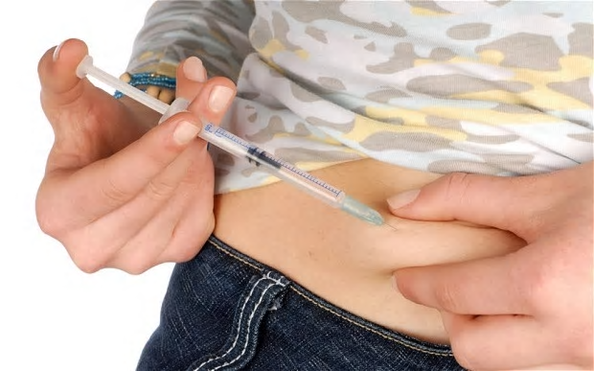
Insulin Injection (continued)
NOTE: When administering Insulin, the tissue is usually “bunched” between the thumb and fingers to avoid injecting into the muscle. Bunching is NOT necessary when using an insulin pen, because the needle that is used is only 5mm long and very unlikely to enter muscle.

Slide 20
Pharmacy Considerations
Subcutaneous medications (other than insulin) should NEVER be given using an Insulin Syringe. Insulin Syringes are calibrated for insulin only.

Slide 21
Administering Insulin
The most common route of administration of insulin is SC or IV injection.
Injectable Insulin is prescribed in units; a special syringe called an insulin syringe is used. The standard dosage strength of insulin is 100 units/mL.
Low Dose Insulin Syringe- Holds insulin doses of 30 – 50 units or less.
Standard Insulin Syringe – Holds up to 100 units of insulin.

Slide 22
Insulin Injections
Overtime, injection sites tend to undergo changes that interfere with absorption of the insulin.
This is known as:
Lipoatrophy- the breakdown of SC fat at the site of repeated injection sites.
Lipohypertrophy – Thickening of the SC fat at the site of repeated insulin injections.
Rotate sites at each injection.

Slide 23
Gerontologic Considerations
Older clients with diabetes often have visual problems, considering an insulin pen may be more appropriate for this client.
Older adults learning to self administer insulin, will often benefit from advanced training such as home health nurses etc.

Slide 24
Preparing Insulin from Vials
Insulin Types Vary in their onset, peak effect, and duration of action.
Nursing Consideration; Read Vials Carefully as Insulin Vials Look Similar!
Some Insulins contain an “additive” which delays its absorption. Therefore, when preparing other than rapid-acting, short-acting, or Lantus (Long-acting) insulin the nurse will rotate the vial between the palms to ensure redistributing the “additive.”

Slide 25
Mixing Insulin in One Syringe
Most types of insulin are mixed just prior to administration, due to insulins tending to bind together or unique characteristics of each off set those of the other.
When injected within 15 minutes of mixing, the insulin acts as though they had been injected separately.
Rapid Acting Insulin and short acting insulin, which are additive free are often combined with intermediate acting insulin.
Long Acting Insulin (Glargine) is NEVER mixed with any other type of insulin!
Some pharmaceutical companies provide combination insulins premixed in a single vial.
Novolin 70/30 – 70% intermediate acting, 30% short acting
Humulin 50/50 – Equal amounts of intermediate and short acting

Slide 26
Insulin Onset Peak Duration

Slide 27
Insulin Pumps
Some people with diabetes prefer the use of an insulin pump rather than a syringe, needle and or insulin pen.
An insulin pump is a small, programmable computerized device that contains 180 – 315 units of rapid acting insulin that can be refilled from vials. Insulin is released from the device through a catheter attached to a needle in the skin. The pump acts similar to a natural pancreas. It releases small amounts of insulin continuously and can release an additional amount after a meal.
https://www.bing.com/videos/search?q=youtube+insulin+pump+use&qpvt=youtube+insulin+pump+use&view=detail&mid=11281CE476C768E652E711281CE476C768E652E7&&FORM=VDRVRV

Slide 28
Administering Heparin
Heparin is an anticoagulant drug. That means, this drug prolongs the time it takes for blood to clot. Heparin is frequently administered SC as well as IV.
Heparin is supplied in multi-dose vials or pre-filled cartridges.
The dosages are very small volumes and may require a tuberculin syringe to ensure accuracy.
When administering Heparin to prevent local bruising.
Change the needle after filling with the dose of heparin (before injecting the client).
DO NOT clean with alcohol wipe prior to injection.
DO NOT aspirate with the plunger.
The needle is left in place for 5 seconds.
Press on injection site for any bleeding, but NEVER Rub!!!
Rotate injection sites.

Slide 29
Administering Heparin
The dose of unfractionated (standard heparin) may change depending on the route of administration.
The dose is determined after reporting lab results of the client’s Partial Thromboplastin Time (PTT).
Some client’s are prescribed one of several low molecular weight heparins such as Lovenox. Lovenox has the advantage of being prescribed in a consistent daily dose with no or fewer blood tests, less side effects, and can be self administered out of the hospital.
According to Timby, 2017, 30% of all hospitalized clients will receive heparin therapy. BE AWARE that vials of heparin come in various dosages:
20,000 units/mL
10,000 units/mL
5,000 units/mL

Slide 30
Intramuscular Injections
An IM injection is the administration of up to 3mL of medication into one muscle or muscle group. Because deep muscles have few nerve endings, irritating medications are commonly given IM.
Except for IV, Absorption from an IM injection happens rapidly.
NEVER administer an IM into a limb that is paralyzed, inactive, or affected by poor circulation.
Avoid the arm of a client with a mastectomy or a client with a shunt for dialysis.

Slide 31
Injection Sites (IM)
There are 5 IM Injection Sites named for the muscles into which the medications are injected:
Ventrogluteal
Vastus Lateralis
Rectus Femoris
Deltoid
Dorsogluteal

Slide 32
IM Injection Sites
Ventrogluteal Site – uses the gluteus medius and gluteus minimus in the hip for injection.
Major Disadvantage; there is only a small area for administering the injection.
This site has several advantages:
NO large nerves or blood vessels
Usually less fatty and cleaner because fecal contamination is rare here
Favored injection site for adults, but also acceptable for children.
https://www.youtube.com/watch?v=2YaB9crnPdU

Slide 33
IM Injection Sites (continued)
Vastus Lateralis
Uses the vastus lateralis muscle; one of the muscles in the quadriceps group of the outer thigh.
Large nerves and muscles usually absent which makes it a safer site.
Desirable for infants and small children, clients who are thin/debilitated.
https://www.youtube.com/watch?v=QrSJTjNJR6s

Slide 34
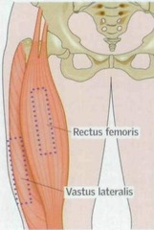
IM Sites
Rectus Femoris Site-
the anterior aspect of the thigh.
May be used for infants.
The nurse will place the injection in the
Middle third of the thigh, with the client sitting or supine.

Slide 35
IM Injection Sites (continued)
Deltoid Site- Lateral aspect of the upper arm is the least used site because it is a smaller muscle than others.
Used for children.
Risk of damaging the radial nerve and artery if the site is not well identified.
https://www.youtube.com/watch?v=uZOrP_NcjpU

Slide 36
IM Injection Site (continued)
Injecting medication into the gluteus maximus in the buttocks.
Least preferred site for an IM injection. Many educators are excluding this site for the following reasons.
Sciatic nerve damage
Superior Gluteal artery may be pierced
The depth of the gluteal muscle is usually greater than the length of the needle.
If the medication is placed in the SC tissue accidentally the client may experience unnecessary pain/discomfort.
Decreased rate of absorption may lead to overdose of client.
https://www.youtube.com/watch?v=BlWcyoU5Rk8

Slide 37
Critical Thinking
Mrs. Smith is a 93 year old client with dementia and receives a monthly B12 injection for pernicious anemia. The nurse caring for her may want to make certain considerations prior to giving this IM injection…. Identify those considerations…..

Slide 38
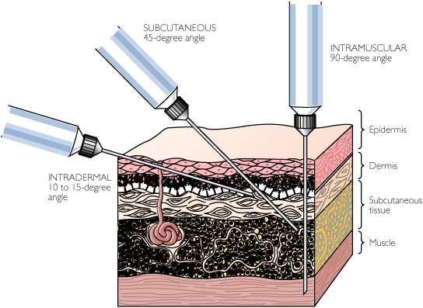
IM Injection Equipment
Usually 3 – 5 mL syringe.
22 gauge needle that is 1½ inch long.

Slide 39
Injection Techniques
When administering IM injections:
Use a 90 degree angle for piercing the skin.
Nurses use the Z-Track method (a technique for manipulating the tissue to seal a medication in the muscle) to administer IM injections for drugs that may be irritating to the upper layers of skin. Also, sometimes called the zigzag technique. The maneuver resembles the letter “Z”.
https://www.youtube.com/watch?v=IPp28ZGgobw

Slide 40
Reducing Injection Discomfort
Use the smallest gauge needle appropriate
Change the needle before administering a drug that is irritating to tissue.
Select a site that is free from irritation
Rotate injection sites
Numb the skin with an ice pack before the injection
Insert and withdraw the needle without hesitation
Instill the medications slowly and steadily
Use the Z-Track technique for IM injections
Apply pressure to the site during needle withdrawal
Massage the site after the injection
Have client do deep breathing, avoid watching needle going in, ambulate or move the extremity as much as possible

Slide 41
Consider This
For client’s who fear IM injections:
Use EMLA Cream (Eutectic Mixture of Local Anesthetic.) Reduces local discomfort by numbing the area. Apply the cream 1 – 2 hours before the injection.
EMLA is best suited for multiple administrations such as weekly injections for IM medications.

Slide 42
Practice Injections (See Timby, 20017 pages 813- 819)
Intradermal
Subcutaneous
Intramuscular

