Slide 1
Topical and Inhalant Medications
Karen Malt, MSN, RN

Slide 2
Topical Route
The administration of Medications to the skin or mucous membranes.
Topically applied drugs have a local or systemic effect. Many achieve a direct effect on the tissue applied.
Percutaneous Applications – Drugs rubbed into or placed in contact with the skin. A topical Preparation rubbed into the skin for administration of a medication (also called oils, lotions, creams).
Ointments
Patches
Pastes

Slide 3
Ointment Applications
Topical Medications come in various forms:
Cutaneous -
Ophthalmic -
Otic
Nasal
Sublingual
Buccal
Vaginal
Rectal

Slide 4
Transdermal Applications
Drugs that are applied to and absorbed through the skin.
Example: Patches and Pastes
Skin Patches – Drugs are bonded to an adhesive and applied to the skin. The drug stays in place for a number of hours and the drug is delivered over time through the skin.
Typically applied to the upper body, chest, upper arms, stomach.
The patch is marked with date, time, initials, and documentation is completed in the MAR.
Each time a patch is applied it is placed in a slightly different location.
Clipping the hair on the chest may be necessary to be sure of adherence.
When removing a patch, the patch should be closed with the adhesive patches together., preventing accidental exposure to others.

Slide 5
Applying Nitroglycerin Paste
Wash Hands/ Alcohol Rub
Check client Identify
Apply Clean Gloves
Squeeze the required amount of paste from the tube onto an application paper.
Fold the paper to spread the paste (This facilitates distributing the drug over a wide area for quick absorption).
Place the application paper on a clean, non-hairy area of the skin
Cover the paper with an transparent.
Remove the first patch before applying the new one.
Rotate the sites
Remove the application if the client becomes weak, flushed, hypotensive, or develops a severe headache.
NOTE; Nitroglycerin Paste has a shorter drug action than that supplied in a transdermal patch. Application of paste is more frequent.

Slide 6
Considerations
The onset of topical drug action may be faster in the elderly. Why?

Slide 7
Considerations
Where should a transdermal patch be placed on the body of someone who is cognitively impaired?

Slide 8
Considerations
Clients prescribed nitroglycerin in any form should NEVER be prescribed medications, or herbal remedies for erectile dysfunction. Why?

Slide 9
Considerations
Always use gloves when applying patches or pastes? Why?

Slide 10
Ophthalmic Applications
Applying drugs onto the mucous membrane of one or both eyes.
The mucous membrane of the eye is called the “CONJUNCTIVA”.
The conjunctiva lines the inner eye lids and the anterior surface of the sclera.
Supplied in two forms:
Liquid
Ointment
Have the client blink to distribute the drug, DO NOT RUB.
When administering the drop or ointment in the eye it is imperative NOT to touch the tip of the dropper or tube to any surface.

Slide 11
Stop, think, Respond….
Mrs. Smith is using Timolol eye drops one drop both eyes twice daily. The nurse accidentally touches the tip of the dropper with her finger when administering the drop to the client. What should the nurse do?

Slide 12
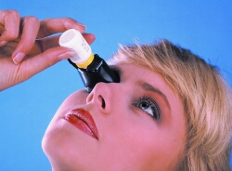
Considerations
Some clients are receiving more than one eye drop. It is possible that a client may use four different drops throughout the day. It is necessary to wait at least five minutes in between each drop to ensure absorption of each medication.
For people having difficulty self-administering, there are devices that are available to ensure accurate administration.
https://www.cc.nih.gov/ccc/patient_education/pepubs/eyedrops.pdf

Slide 13
Gerontologic Considerations
Many older adults are using more than one eye medication. The caps of the bottles may be different colors to help them distinguish between them. If they are not, the nurse may need to devise a plan to assist the client in distinguishing their eye medication.
To ensure even distribution of eye medication, have the client “blink” several times. This allows the medication to cover the entire surface of the eye.

Slide 14
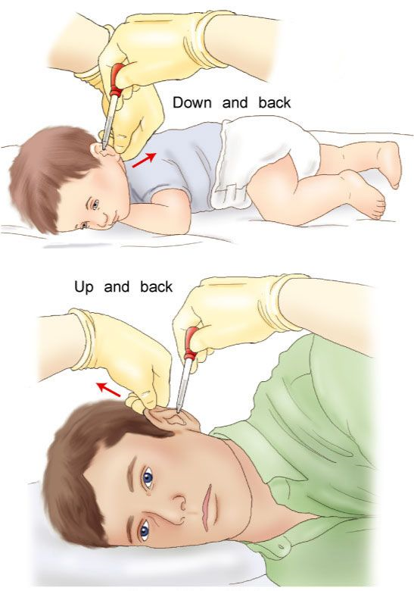
Otic Applications
An otic application is a drug instilled into the ear.
It can be administered to help moisten hardened cerumen that has built up in the ear or treat a local bacterial or fungal infection.
If drainage is present apply gloves, clean ear canal gently with a swab or face cloth.
Manipulate the ear to straighten the auditory canal.
Child- Pull ear down and back
Adult- Pull ear up and back

Slide 15
Otic Applications
Tilt the client’s head away from the ear in which the medication is to be instilled.
Compress the container and instill the prescribed number of drops on the side of the ear canal rather than directly into the tympanic membrane.
Press and release the “tragus” to facilitate moving the medication into the ear canal.
Place a small cotton ball loosely in the ear to absorb excess medication.
If a bilateral application is necessary, wait at least 5 minutes before instilling medication in the opposite ear. WHY??

Slide 16
Nasal Applications
Topical Nasal applications are dropped or sprayed in the nose. Proper instillation is important to prevent the drops from entering nearby structures such as the back of the throat. Most adults would prefer instilling their own nasal medications, but it may be necessary to assist older clients and children.
NOTE: Damage to the nasal passage from drug overuse can cause irritation of the nares and an inability to respond to the drug. A result of this is called “rebound effect” and it causes nasal membrane swelling from overuse.

Slide 17
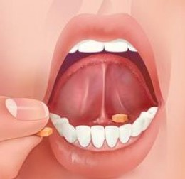
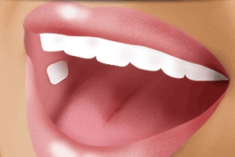
Sublingual and Buccal Applications
Sublingual – a drug placed under the tongue
Buccal – a drug placed against the mucous membrane of the cheek.
Instruct the client NOT to chew or swallow the medication. Eating and smoking are also contraindicated while the medication is dissolving.

Slide 18
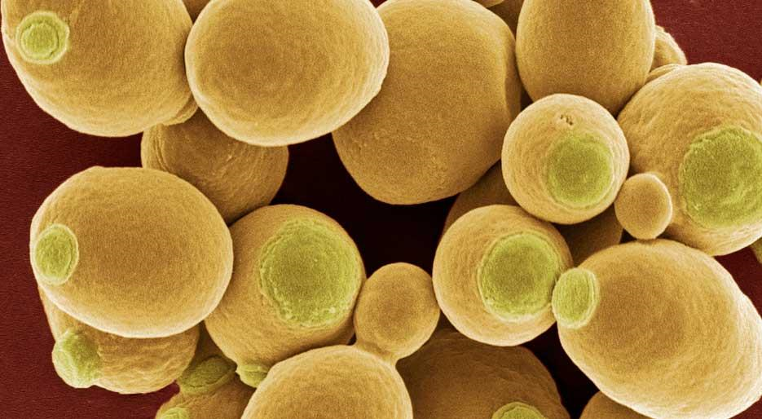
Vaginal Applications
Topical applications used to treat vaginal infections.
Vaginal infections are common and usually result in over colonization of yeast. This type of infection can occur from yeast being transferred from improper wiping after a bowel movement.
Symptoms of a vaginal yeast infection
Intense vaginal itching
White- cottage=cheese like discharge

Slide 19
Vaginal Application (continued)
Another common vaginal infection is caused by a protozoan called “Trichomonas Vaginalis.” Transmitted from an infected to an uninfected person during sexual contact. Treatment for this is Flagyl(Metronidazole).
Treatment for Vaginal Yeast Infections Include:
Monistat (miconazole)
Clotrimazole (Lotrimin)
Suppositories or creams are available.
Oral drugs like Diflucan are also available.
Client education for self-administration is essential.

Slide 20
Vaginal Application
Obtain the form of medication for this type of application based on client preference.
Instill the medication prior to bed. WHY?
Empty the bladder prior to instillation of the medication. WHY?
Place the vaginal drug in the applicator.
Lubricate the tip of the applicator.
Lie down, bend knees, spread the legs.
Separate the labia and insert the applicator into the vagina to the length recommended by the package directions.
Depress the plunger at proper distance within the vagina to insert the medication.
Remove applicator, place on clean tissue, apply sanitary pad if client prefers.
Remain recumbent for at least 30-60 minutes.
Dispose of applicator if disposable, wash with soap and water if not.
Notify MD if symptoms persist.

Slide 21
Rectal Applications
Drugs administered rectally are usually in the form of suppositories, but creams and ointments may also be prescribed.
The technique for using a rectal applicator is similar to using a vaginal applicator.
Gerontologic Consideration:
Elderly people may have difficulty reaching certain parts of the body. Rheumatoid Arthritis and morbid obesity may cause difficulty reaching various body parts.

Slide 22
Inhalant Route
Administers drugs to the lower airways.
Effective as the lungs provide an extensive area from which the circulatory system can quickly absorb the drug.
A quick way of administering inhalants is through an “Inhaler.”
Two types of Inhalers:
Dry Powder- Holds a reservoir of pulverized drug and a carrier substance. Depends on the client’s inspiratory effort.
Metered Dose- Delivers aerosol medication, which is a liquid drug forced through a narrow channel via a chemical propellant. Client education requires teaching the client to inhale and not swallow the drug. Inhaled drugs may leave an unpleasant taste in the mouth. Rinse the mouthpiece to remove drug residue.
See page 785 Timby for example of different types of inhalants medications

Slide 23
Inhalant Route (continued).
When a client is taking more than one inhaler it is important to determine the type of medication as some inhalers should be given before others.
Example: One drug may act to expand the bronchioles and would prove beneficial to be given before a medication that loosens secretions.
Monitor BP and Heart Rate as these drugs can cause tachycardia and hypertension. These side effects can cause further complications in those individuals with underlying cardiovascular disease.

Slide 24
Using an Inhaler
Insert the canister into the holder.
Shake the canister to distribute the drug in the pressurized chamber.
Remove the cap from the mouthpiece.
Tilt your head back slightly and exhale slowly through pursed lips.
Place the inhaler in your mouth and close your lips around the mouthpiece or place the inhaler 1 – 2 inches away.
Press down on the canister once to release the medication.
As the medication is being released, breathe in slowly through your mouth for approximately 3 -5 seconds.

Slide 25
Using an Inhaler
Hold your breath for 10 seconds to let the medication reach your lungs.
Exhale slowly through pursed lips.
Wait one full minute before doing another inhalation if more than one ordered.
Clean the inhaler (holder and mouthpiece) daily by rinsing it in warm water and weekly with mild soap and water. Allow the inhaler to air dry. Have another inhaler available to use while the first is drying.
https://www.bing.com/videos/search?q=how+to+use+an+inhaler+correctly&view=detail&mid=0F0E6607C626DA7EDAD10F0E6607C626DA7EDAD1&FORM=VIRE

Slide 26
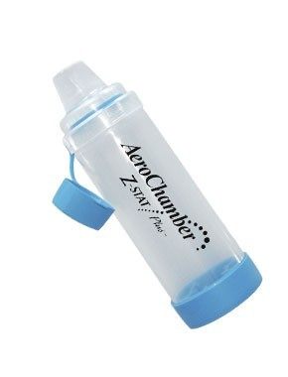
Inhalant Route
A “Spacer” is used for the client who is having difficulty coordinating their breathing with the use of an inhaler. This may result in reduced dosing.
Spacers provide a reservoir for the aerosol medication. As the client continues to take additional breaths, the additional medication that is held in the reservoir is inhaled and absorbed. The spacer prevents “drug loss.” Prolonging inhalation can also reduce side effects such as tachycardia and tremulousness.

Slide 27
Inhalant Route
A “Nebulizer” sometimes called a breathing machine is a device that converts liquid medication to an aerosol using compressed air. The aerosol is inhaled through a mouthpiece or a face mask over 10-20 minutes until the mist is no longer visible.
The components of the nebulizer are cleaned and allowed to air dry after each use.
https://www.bing.com/videos/search?q=how+to+use+a+nebulizer&docid=608051552782192501&mid=D368ABB62BF2E4F5C31FD368ABB62BF2E4F5C31F&view=detail&FORM=VIREHT

Slide 28
Critical Thinking
Before discharge from the hospital, a client who has had a heart attack says, “You nurses always put my nitroglycerin patches on my back. How can I do that when I have to do that myself?” How would you respond?

Slide 29
Critical Thinking
How might a nurse help a legally blind client identify two different containers of eye medication?

Slide 30
Critical Thinking
How can a nurse prevent eye drops from rolling down a client’s cheek?

Slide 31
Critical Thinking
What questions would be important to ask if a client’s symptoms persist after being treated for a vaginal infection with a regimen of self-administered medication?

