Slide 1
World War II
1939-1945

Slide 2
PDN
Enduring Understanding:
World War II was caused by a rise of dictators, the failure of the League of Nations, the failure of appeasement, and resentment of the Treaty of Versailles.
Essential Questions:
What types of early aggression did Germany take?
Why did Britain and France end their policy of appeasement?

Slide 3
Objectives
Identify the causes of World War II
Summarize the actions taken by aggressive regimes in Europe and Asia
Understand how German aggression led Europe into World War II

Slide 4
Causes of World War II
1. Resentment of the Treaty of Versailles
Germany thought it was too harsh
Could not pay reparations: Depression
2. Failure of Appeasement
Policy of granting concessions to an enemy with a goal of maintaining peace.
Hitler took advantage of lack of unity among the Allies.

Slide 5
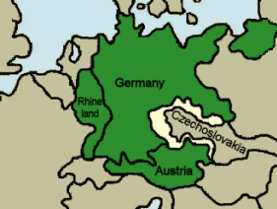
3. Germany brings Austria into the Reich and a portion of western Czechoslovakia.

Slide 6
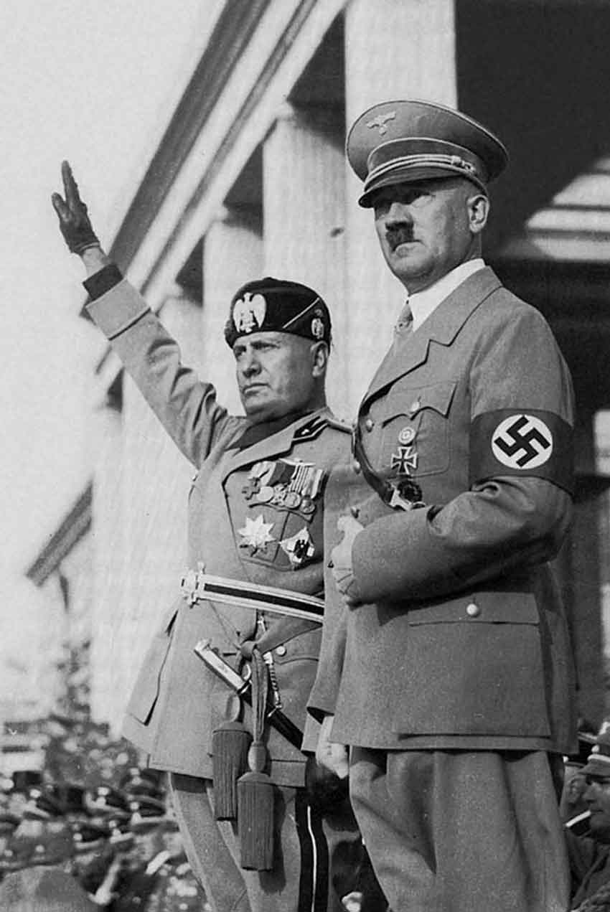
3. Failure of the League of Nations
Not all countries joined the league
The League had no power
The League had no army
Unable to act quickly
4. Rise of dictators &
totalitarian states
Hitler invades Poland on
September 1, 1939

