Slide 1
RUSSIAN REVOLUTION FEBRUARY/MARCH

Slide 2
PDN
Enduring Understanding:
Two revolutions in 1917 would topple the Russian government and lead to radical changes
Essential Questions:
What were the causes of the Russian Revolution in March 1917?
How did the Russian government collapse?

Slide 3
Objectives
Describe the government structure of Russia before and after World War I
Explain the causes of the March Revolution

Slide 4
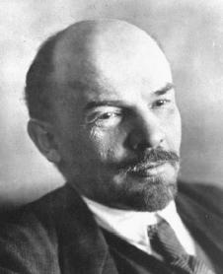
the Bolsheviks
small Marxist group
wanted to change life in Russia
leader = Vladimir Lenin
goal = overthrow czar
Notes:
Vladimir Lenin → wanted to establish a Communist social system, “in which there would be no economic classes & no private property

Slide 5
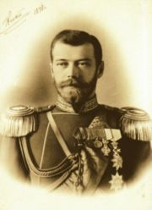
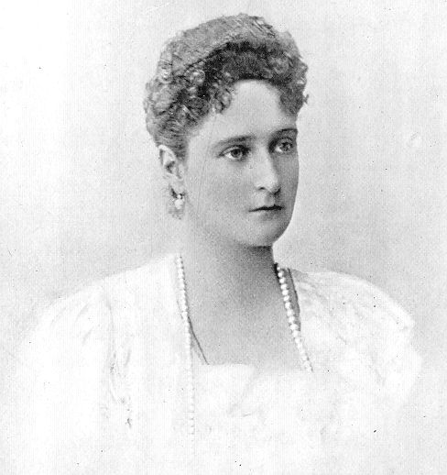
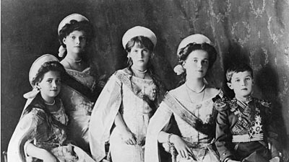
the Bolsheviks
if czar was overthrown, industrial workers could govern Russia

Slide 6
Russia & WWI
Czar Nicholas II hoped war would unite Russia & stop talk of revolution
patriotism increased rapidly
Notes:
@ start of war, Russia had 6M soldiers → people rushed from across country to join the army

Slide 7
Russia & WWI
Russia was not ready for war
Russia lacked:
factories/supplies
transportation system
modern equipment
competent military leaders
Notes:
Factories were unable to produce ammunition & other supplies quickly enough for the huge army
Transportation system was weak, making it hard to move troops & equipment to right places @ right times
Equipment (weapons, etc) was outdated
Military leaders = poor quality
→ “officers advanced on basis of personal connections” (nepotism)

Slide 8
Conditions Worsen
1915 → Nicholas II took command of Russian military
if Russia failed in WWI, so would Nicholas II
Notes:
Nicholas II wasn’t qualified to lead army
but he led it because if Russia failed in the war, he knew he would lose his country

Slide 9
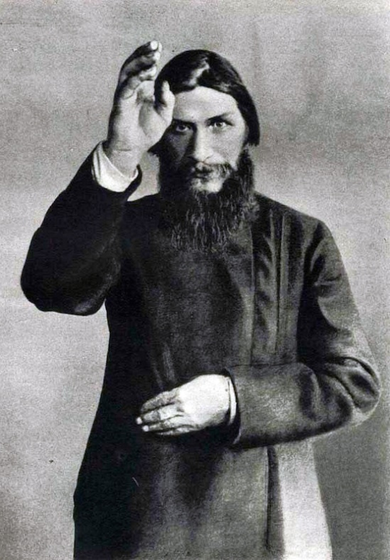
Conditions Worsen
food & other goods grew scarce
peasants grew desperate
Nicholas II went to war
left Czarina Alexandra in charge (unpopular)
Alexandra took advice from Grigory Rasputin (corrupt/immoral)
Notes:
Russian army had been doing badly before Nicholas II took over
an offensive was defeated → soldiers lost faith in leaders & army seemed doomed
Czarina was unpopular with the people of Russia
to make matters worse, she relied on Grigory Rasputin, a “self-proclaimed holy man” for advice.
Rasputin was seen as corrupt & immoral by many Russians, especially because most of the political appointments & military actions he gave advice on were disastrous

Slide 10
Revolution Begins
March 8, 1917 → Petrograd, Russia
unhappy citizens marched
police & soldiers were sympathetic
the Duma (Russia’s legislature) defied Nicholas II
March 15, 1917 → Nicholas II forced to abdicate
Notes:
Petrograd was the capital at the time
citizens marched in Petrograd
the police & soldier disobeyed orders to shoot the rioters
Nicholas II ordered Duma to disband, but they disobeyed
Nicholas II’s family was murdered by ??

