Slide 1
PDN
Enduring Understanding:
American trade, American propaganda, Zimmermann telegram, and Germany's policy of unrestricted submarine warfare were the reasons America entered the war.
Essential Questions:
1. What were the reasons the United States entered the war?
2. When was the armistice signed?

Slide 2
OBJECTIVES
Describe how World War I became a total war
Explain how U.S. entry into the war led to an Allied Victory

Slide 3
THE U.S. ENTERS THE WAR
1. Unrestricted Submarine Warfare
Germany’s policy of attacking any ship that tried to get through its U-boat blockade of Great Britain
Effective way to keep Britain low on supplies and other necessary items
German U-boats sink The Lusitania, a British passenger liner, killing 1,200 people
Made trade with any nation difficult

Slide 4
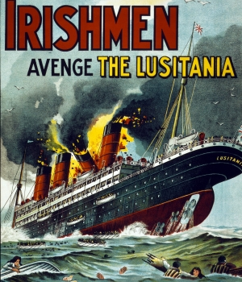
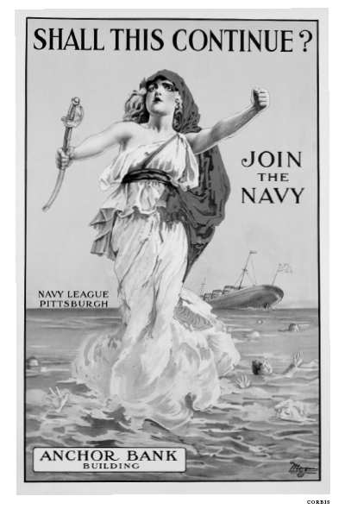

Slide 5
THE U.S. ENTERS THE WAR
2. The Zimmerman Telegram
Telegram sent from German Foreign Minister Arthur Zimmerman to Ambassador in Mexico City
Intercepted by the British
Promised Mexico that Germany would help recover land from the United States if they would join in war
Mexico was a bigger threat to the U.S. than Germany due to proximity

Slide 6
THE U.S. ENTERS THE WAR
3. American Propaganda
Information designed to influence people’s opinions published by the government
Portrayed Germans as bad, barbaric, dangerous, wicked, ape/gorilla, abuse of women, etc
Caused Americans to become enraged at the Germans and ready to go to war

Slide 7
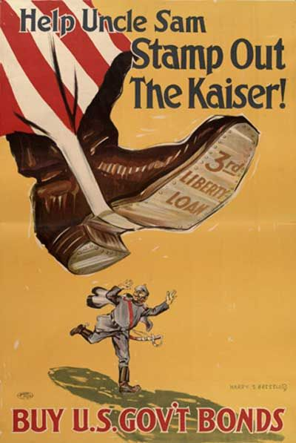
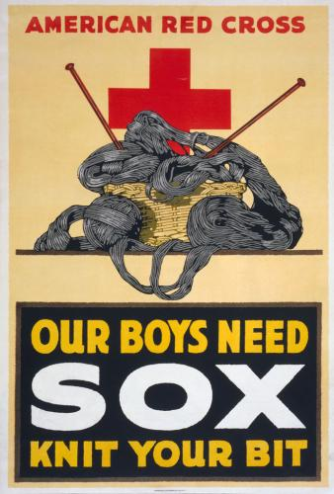

Slide 8
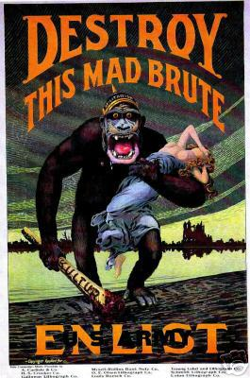
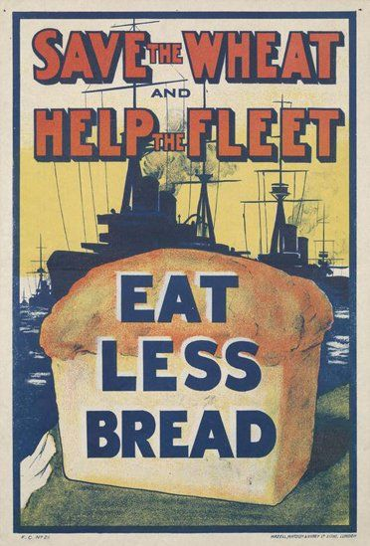

Slide 9
THE U.S. ENTERS THE WAR
4. American Trade
Traded with Great Britain and France during war
Britain’s blockade made the U.S. unable to trade with Germany
U.S. wanted to continue trading with Britain, but refused to trade with British because it blockaded Germany – technically taking an act of war with Britain

Slide 10
The End of the Fighting
April 1917 → United States entered war
Germany had to win before United States was able to fight

Slide 11
A New German Offensive
Germany refocused efforts at Western Front
no longer fighting with Russia in east
March 1918 → Germany led major assault
made progress: gained around 40 miles

Slide 12
A New German Offensive
June 1918 → American soldiers helped in Europe & gave Allies hope
800,000 German soldiers died

Slide 13
German Collapse
Second Battle of the Marne
Allies stopped Germans (had done so in 1914, as well)
Allies used tanks & aircraft to gain ground
many Germans simply gave up
they knew Germany was defeated

Slide 14
German Collapse
October 1918 → Allied forces broke through heavily defended Hindenburg Line
German leaders approached Allies for truce
November 11, 1918 → armistice agreed to
Veteran’s Day

